Slide 1
Association Rules Mining

Slide 2
Topics
Basic concepts of Association Rules
Rule strength measures
Basic Algorithms
  Apriori Algorithm
  FP-Growth Algorithm
  Other Approaches
  Interestingness Measures
  Sequential Pattern Mining
Summary
DoCSE, SVNIT

Slide 3
Association rule mining
Motivation: Finding inherent regularities in data
  What products were often purchased together?— Clothes and Milk !
  What are the subsequent purchases after buying a PC?
  What kinds of DNA are sensitive to new drug?
  Can we automatically recommend next web document?
Applications
  Basket data analysis, Cross-marketing, Rack arrangement, Sale campaign analysis
  DNA sequence analysis
  Web log (click stream) analysis
DoCSE, SVNIT

Slide 4
Association rule mining
Frequent pattern
  A pattern (a set of items, subsequences, substructures, etc.) that occurs frequently in a data set
First proposed by Agrawal et al. in 1993 in the context of frequent itemsets and association rule mining
An important data mining model studied extensively
DoCSE, SVNIT

Slide 5
Association rule mining
Given a set of transactions, find rules that will predict the occurrence of an item based on the occurrences of other items in the transaction
Initially used for Market Basket Analysis to find how items purchased by customers are related
Bread → Milk [Sup = 5%, Conf = 100%]
DoCSE, SVNIT

Slide 6
The model: Data
I = {i₁, i₂, …, i_{m}}: a set of items
Transaction t: a set of items, and t ⊆ I
Transaction Database T: a set of transactions T = {t₁, t₂, …, t_{n}}
DoCSE, SVNIT

Slide 7
Transaction data: Supermarket data
Market basket transactions:
  t1: {bread, cheese, milk}
  t2: {apple, biscuit, salt, yogurt}
  … …
  tn: {biscuit, bread, milk}
Concepts:
  An item: an item/article in a basket
  I: the set of all items sold in the store
  A transaction: items purchased in a basket; it may have TID (transaction ID)
  A transactional dataset: A set of transactions
DoCSE, SVNIT

Slide 8
Transaction data: a set of documents
Text document data set, each document is treated as a “bag” of keywords
doc1: Student, Teach, School
doc2: Student, School
doc3: Teach, School, City, Game
doc4: Baseball, Basketball
doc5: Basketball, Player, Spectator
doc6: Baseball, Coach, Game, Team
doc7: Basketball, Team, City, Game
Web page data set
  Session1: PageA.html, PageB.html, PageC.html
  Session2: PageC.html, PageD.html, PageE.html
  Session3: PageA.html, PageC.html, PageD.html
DoCSE, SVNIT

Slide 9
The model: Rules
A transaction t contains X, a set of items (itemset) in I, if X ⊆ t
An association rule is an implication of the form:
X → Y, where X, Y ⊂ I, and X ∩Y = ∅
An itemset is a set of items
  E.g., X = {milk, bread, cereal} is an itemset
A k-itemset is an itemset with k items
  E.g., {milk, bread} is a 2-itemset
  {milk, bread, cereal} is a 3-itemset
DoCSE, SVNIT

Slide 10
Rule Strength Measures
An association rule is a pattern that states when X occurs, Y occurs with certain probability
  Support
  Confidence
DoCSE, SVNIT

Slide 11
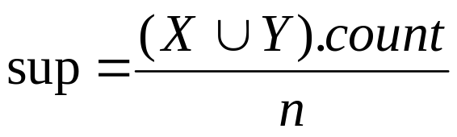
Support and Confidence
Support
  The rule holds with support sup in T (the transaction data set having n transactions) if sup% of transactions contain X ∪ Y
  sup = Pr(X ∪ Y)
    Relative Support
  The frequency count of an itemset X U Y, denoted by (XUY).count, in a data set T is the number of transactions
    Count/Absolute Support
DoCSE, SVNIT

Slide 12
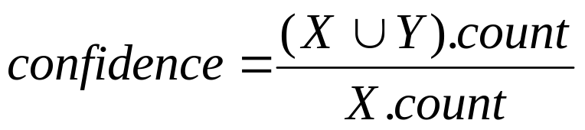
Rule strength measures
Confidence
  The rule holds in T with confidence conf if % of transactions that contain X also contain Y.
  conf = Pr(Y | X)
DoCSE, SVNIT

Slide 13
Goal and key features
Goal: Find all rules that satisfy the user-specified minimum support (minsup) and minimum confidence (minconf)
Key Features
  Completeness: find all rules
  Compute the support and confidence for each rule
  Prune rules that fail the minsup and minconf thresholds
  Mining with data on hard disk (not in memory)
DoCSE, SVNIT

Slide 14
An example
  t1: Bread, Biscuit, Milk
  t2: Bread, Cheese
  t3: Cheese, Boots
  t4: Bread, Biscuit, Cheese
  t5: Bread, Biscuit, Clothes, Cheese, Milk
  t6: Biscuit, Clothes, Milk
  t7: Biscuit, Milk, Clothes
Transaction data
Assume:
minsup = 30%
minconf = 80%
An example frequent itemset: {Biscuit, Clothes, Milk}
[sup = 3/7]
Association rules from the itemset:
Clothes → Milk, Biscuit [sup = 3/7, conf = 3/3]
… …
Clothes, Biscuit → Milk, [sup = 3/7, conf = 3/3]
DoCSE, SVNIT

Slide 15
Assumption
A simplistic view of shopping baskets transactions
  Some important information not considered e.g.
    The quantity of each item purchased
    The price paid
Assume all data are categorical
  Examples:
    Item Purchased or not ?
    ID numbers, eye color {brown, black, etc.}, zip codes
    Height in {tall, medium, short}
DoCSE, SVNIT

Slide 16
Many mining algorithms
A large number of them!!
Use of different strategies and data structures
Resulting sets of rules are all the same
Computational efficiencies and memory requirements may be different
DoCSE, SVNIT

Slide 17
The Apriori algorithm
The best known algorithm
Two steps:
  Find all itemsets that have minimum support (frequent itemsets, also called large itemsets)
  Use frequent itemsets to generate rules
E.g., a frequent itemset
{Biscuit, Clothes, Milk} [sup = 3/7]
and one rule from the frequent itemset
  Clothes → Milk, Biscuit [sup = 3/7, conf = 3/3]
DoCSE, SVNIT

Slide 18
Step 1: Mining all frequent itemsets
A frequent itemset is an itemset whose support is ≥ minsup
Key idea
  The apriori property (downward closure property)
    Any subsets of a frequent itemset are also frequent itemsets
ABC ABD ACD BCD
  If {juice, glass, nuts} is frequent, so is {juice, glass}
  i.e., every transaction having
  {juice, glass, nuts}
  also contains {juice, glass}
AB AC AD BC BD CD
A B C D
DoCSE, SVNIT

Slide 19
The Algorithm
Iterative algo. (also called level-wise search): Find all 1-item frequent itemsets; then all 2-item frequent itemsets, and so on
  In each iteration k, only consider itemsets that contain some k-1 frequent itemset
Find frequent itemsets of size 1: F₁
For k = 2
  C_{k} = candidates of size k: those itemsets of size k that could be frequent, given F_{k-1}
  F_{k} = those itemsets that are actually frequent, F_{k} ⊆ C_{k} (need to scan the database once)
DoCSE, SVNIT

Slide 20
The Apriori Algorithm—An Example
Database T
Tid | Items
10 | A, C, D
20 | B, C, E
30 | A, B, C, E
40 | B, E
Sup_{min} = 2
DoCSE, SVNIT

Slide 21
The Apriori Algorithm—An Example
Sup_{min} = 2
Database T
Tid | Items
10 | A, C, D
20 | B, C, E
30 | A, B, C, E
40 | B, E
C₁
Itemset | sup
{A} | 2
{B} | 3
{C} | 3
{D} | 1
{E} | 3
1st scan
DoCSE, SVNIT

Slide 22
The Apriori Algorithm—An Example
Sup_{min} = 2
Database TDB
C₁
Itemset | sup
{A} | 2
{B} | 3
{C} | 3
{D} | 1
{E} | 3
Tid | Items
10 | A, C, D
20 | B, C, E
30 | A, B, C, E
40 | B, E
L₁
Itemset | sup
{A} | 2
{B} | 3
{C} | 3
{E} | 3
1st scan
DoCSE, SVNIT

Slide 23
The Apriori Algorithm—An Example
Sup_{min} = 2
Itemset | sup
{A} | 2
{B} | 3
{C} | 3
{D} | 1
{E} | 3
Database TDB
Itemset | sup
{A} | 2
{B} | 3
{C} | 3
{E} | 3
L₁
Tid | Items
10 | A, C, D
20 | B, C, E
30 | A, B, C, E
40 | B, E
C₁
1st scan
Itemset
{A, B}
{A, C}
{A, E}
{B, C}
{B, E}
{C, E}
C₂
DoCSE, SVNIT

Slide 24
The Apriori Algorithm—An Example
Sup_{min} = 2
Itemset | sup
{A} | 2
{B} | 3
{C} | 3
{D} | 1
{E} | 3
Database TDB
Itemset | sup
{A} | 2
{B} | 3
{C} | 3
{E} | 3
L₁
Tid | Items
10 | A, C, D
20 | B, C, E
30 | A, B, C, E
40 | B, E
C₁
1st scan
Itemset | sup
{A, B} | 1
{A, C} | 2
{A, E} | 1
{B, C} | 2
{B, E} | 3
{C, E} | 2
Itemset
{A, B}
{A, C}
{A, E}
{B, C}
{B, E}
{C, E}
2nd scan
C₂
DoCSE, SVNIT

Slide 25
The Apriori Algorithm—An Example
Sup_{min} = 2
Itemset | sup
{A} | 2
{B} | 3
{C} | 3
{D} | 1
{E} | 3
Database TDB
Itemset | sup
{A} | 2
{B} | 3
{C} | 3
{E} | 3
L₁
Tid | Items
10 | A, C, D
20 | B, C, E
30 | A, B, C, E
40 | B, E
C₁
1st scan
C₂
Itemset | sup
{A, B} | 1
{A, C} | 2
{A, E} | 1
{B, C} | 2
{B, E} | 3
{C, E} | 2
C₂
Itemset
{A, B}
{A, C}
{A, E}
{B, C}
{B, E}
{C, E}
2nd scan
DoCSE, SVNIT

Slide 26
The Apriori Algorithm—An Example
Sup_{min} = 2
Itemset | sup
{A} | 2
{B} | 3
{C} | 3
{D} | 1
{E} | 3
Database TDB
Itemset | sup
{A} | 2
{B} | 3
{C} | 3
{E} | 3
L₁
Tid | Items
10 | A, C, D
20 | B, C, E
30 | A, B, C, E
40 | B, E
C₁
1st scan
C₂
Itemset | sup
{A, B} | 1
{A, C} | 2
{A, E} | 1
{B, C} | 2
{B, E} | 3
{C, E} | 2
C₂
L₂
Itemset
{A, B}
{A, C}
{A, E}
{B, C}
{B, E}
{C, E}
Itemset | sup
{A, C} | 2
{B, C} | 2
{B, E} | 3
{C, E} | 2
2nd scan
DoCSE, SVNIT

Slide 27
The Apriori Algorithm—An Example
Sup_{min} = 2
Itemset | sup
{A} | 2
{B} | 3
{C} | 3
{D} | 1
{E} | 3
Database TDB
Itemset | sup
{A} | 2
{B} | 3
{C} | 3
{E} | 3
L₁
Tid | Items
10 | A, C, D
20 | B, C, E
30 | A, B, C, E
40 | B, E
C₁
1st scan
C₂
Itemset | sup
{A, B} | 1
{A, C} | 2
{A, E} | 1
{B, C} | 2
{B, E} | 3
{C, E} | 2
C₂
L₂
Itemset | sup
{A, C} | 2
{B, C} | 2
{B, E} | 3
{C, E} | 2
Itemset
{A, B}
{A, C}
{A, E}
{B, C}
{B, E}
{C, E}
2nd scan
Itemset
{B, C, E}
C₃
DoCSE, SVNIT

Slide 28
The Apriori Algorithm—An Example
Sup_{min} = 2
Itemset | sup
{A} | 2
{B} | 3
{C} | 3
{D} | 1
{E} | 3
Database TDB
Itemset | sup
{A} | 2
{B} | 3
{C} | 3
{E} | 3
L₁
Tid | Items
10 | A, C, D
20 | B, C, E
30 | A, B, C, E
40 | B, E
C₁
1st scan
C₂
Itemset | sup
{A, B} | 1
{A, C} | 2
{A, E} | 1
{B, C} | 2
{B, E} | 3
{C, E} | 2
C₂
L₂
Itemset
{A, B}
{A, C}
{A, E}
{B, C}
{B, E}
{C, E}
Itemset | sup
{A, C} | 2
{B, C} | 2
{B, E} | 3
{C, E} | 2
2nd scan
C₃
Itemset
{B, C, E}
Itemset | sup
{B, C, E} | 2
3rd scan
L₃
DoCSE, SVNIT

Slide 29
The Apriori Algorithm
C_{k}: Candidate itemset of size k
F_{k} : frequent itemset of size k
Algorithm Apriori(T)
C₁ ← init-pass(T);
F₁ ← {f | f ∈ C1, f.count/n ≥ minsup}; // n: no. of transactions in T
for (k = 2; F_{k-1} ≠ ∅; k++) do
C_{k} ← candidate-gen(F_{k-1});
for each transaction t ∈ T do
for each candidate c ∈ C_{k} do
if c is contained in t then
c.count++;
end
end
F_{k} ← {c ∈ C_{k} | c.count/n ≥ minsup}
end
return F ← U_{k} F_{k};
DoCSE, SVNIT

Slide 30
Apriori candidate generation
Function takes F_{k-1} and returns a superset (called the candidates) of the set of all frequent k-itemsets
It has two steps
  join step: Generate all possible candidate itemsets C_{k} of length k
  prune step: Remove those candidates in C_{k} that cannot be frequent
DoCSE, SVNIT

Slide 31
Implementation of Apriori
Example of Candidate-generation
  L₃={abc, abd, acd, ace, bcd}
  Self-joining: L₃*L₃
    abcd from abc and abd
    acde from acd and ace
  Pruning:
    acde is removed because ade is not in L₃
  C₄ = {abcd}
DoCSE, SVNIT

Slide 32
Assignment example
1. 2-Itemset={{A, C}, {B, C}, {B, E}, {C, E}}
3-itemset ?
2. 2-Itemset={{I1,I2}, {I1,I3}, {I1,I5}, {I2,I3}, {I2,I4}, {I2,I5}}}
3-itemset ?
DoCSE, SVNIT

Slide 33
Candidate-gen function
Function candidate-gen(F_{k-1})
C_{k} ← ∅;
forall f₁, f₂ ∈ F_{k-1}
with f₁ = {i₁, … , i_{k-2}, i_{k-1}}
and f₂ = {i₁, … , i_{k-2}, i’_{k-1}}
and i_{k-1} < i’_{k-1} do
c ← {i₁, …, i_{k-1}, i’_{k-1}}; // join f₁ and f₂
C_{k} ← C_{k} ∪ {c};
for each (k-1)-subset s of c do
if (s ∉ F_{k-1}) then
delete c from C_{k}; // prune
end
end
return C_{k};
DoCSE, SVNIT

Slide 34
Step 2: Generating rules from frequent itemsets
Frequent itemsets ≠ association rules
For each frequent itemset X,
For each proper nonempty subset A of X,
  Let B = X - A
  A → B is an association rule if
    Confidence(A → B) ≥ minconf,
    support(A → B) = support(A∪B) = support(X)
    confidence(A → B) = support(A ∪ B) / support(A)
DoCSE, SVNIT

Slide 35
Generating Rules: an example
Suppose {2,3,4} is frequent, with sup=50%
  Proper nonempty subsets: {2,3}, {2,4}, {3,4}, {2}, {3}, {4}, with sup=50%, 50%, 75%, 75%, 75%, 75% respectively
  These generate these association rules:
    2,3 → 4 confidence=100%
    2,4 → 3 confidence=100%
    3,4 → 2 confidence=67%
    2 → 3,4 confidence=67%
    3 → 2,4 confidence=67%
    4 → 2,3 confidence=67%
    All rules have support = 50%
DoCSE, SVNIT

Slide 36
Generating Rules: summary
To recap, in order to obtain A → B, we need to have support(A ∪ B) and support(A)
All the required information for confidence computation has already been recorded in itemset generation
  No need to see the data T any more
This step is not as time-consuming as frequent itemsets generation
DoCSE, SVNIT
Notes:
Han and Kamber 2001

Slide 37
Assignment Exercise: 1
A database has five transactions.
Let min sup = 60% and min con f = 80%.
TID items bought
T100 {M, O, N, K, E, Y}
T200 {D, O, N, K, E, Y}
T300 {M, A, K, E}
T400 {M, U, C, K, Y}
T500 {C, O, O, K, I ,E}
Find all frequent itemsets using Apriori.
DoCSE, SVNIT

Slide 38
Apriori Algorithm
Seems to be very expensive
Breadth-first (Level-wise) search
If, K = the size of the largest itemset then makes at most K passes over data
Very simple and fast
  Under some conditions, all rules can be found in linear time
Scale up to large data sets
DoCSE, SVNIT

Slide 39
Apriori Algorithm
Major computational challenges
  Multiple scans of transaction database
  Huge number of candidates
    The number of frequent itemsets to be generated is senstive to the minsup threshold
    When minsup is low, there exist potentially an exponential number of frequent itemsets
    Example:
      10⁴ frequent 1-itemsets, generate more than 10⁷ candidate 2-itemsets
      To discover a frequent pattern of size 100, such as {a₁, …,a₁₀₀}
        Generated candidates 2¹⁰⁰ – 1 = (Approx.) 10³⁰
  Tedious workload of support counting for candidates
DoCSE, SVNIT

Slide 40
Apriori Algorithm
Improving Apriori: general ideas
  Reduce passes of transaction database scans
  Shrink number of candidates
  Facilitate support counting of candidates
DoCSE, SVNIT

Slide 41
Mining Frequent Patterns without Candidate Generation ???
DoCSE, SVNIT

Slide 42
Pattern-Growth Approach: Mining Frequent Patterns Without Candidate Generation
The FPGrowth Approach given by J. Han, J. Pei, and Y. Yin, SIGMOD’ 00
  Depth-first search
  Avoid explicit candidate generation
DoCSE, SVNIT

Slide 43
FPGrowth Approach
Compress a large database into a compact, Frequent-Pattern tree (FP-tree) structure
  Highly condensed, but complete for frequent pattern mining
  Avoid costly database scans
An efficient, FP-tree-based frequent pattern mining method
  A divide-and-conquer methodology: decompose mining tasks into smaller ones calls conditional databases
  Avoid candidate generation: sub-database mining only!
DoCSE, SVNIT

Slide 44
Example
TID Items bought
100 {f, a, c, d, g, i, m, p}
200 {a, b, c, f, l, m, o}
300 {b, f, h, j, o, w}
400 {b, c, k, s, p}
500 {a, f, c, e, l, p, m, n}
min_support = 3
DoCSE, SVNIT

Slide 45
Step 1: Scan DB once, find frequent 1-itemset
(single item pattern)
TID Items bought
100 {f, a, c, d, g, i, m, p}
200 {a, b, c, f, l, m, o}
300 {b, f, h, j, o, w}
400 {b, c, k, s, p}
500 {a, f, c, e, l, p, m, n}
min_support = 3
Header Table
Item frequency
f 4
c 4
a 3
b 3
m 3
p 3
DoCSE, SVNIT

Slide 46
Step 2: Sort frequent items in frequency descending order, f-list
TID Items bought (ordered) frequent items
100 {f, a, c, d, g, i, m, p} {f, c, a, m, p}
200 {a, b, c, f, l, m, o} {f, c, a, b, m}
300 {b, f, h, j, o, w} {f, b}
400 {b, c, k, s, p} {c, b, p}
500 {a, f, c, e, l, p, m, n} {f, c, a, m, p}
min_support = 3
Header Table
Item frequency
f 4
c 4
a 3
b 3
m 3
p 3
F-list = f-c-a-b-m-p
DoCSE, SVNIT

Slide 47
Step 3: Scan DB again, construct FP-tree
TID Items bought (ordered) frequent items
100 {f, a, c, d, g, i, m, p} {f, c, a, m, p}
200 {a, b, c, f, l, m, o} {f, c, a, b, m}
300 {b, f, h, j, o, w} {f, b}
400 {b, c, k, s, p} {c, b, p}
500 {a, f, c, e, l, p, m, n} {f, c, a, m, p}
min_support = 3
{}
Header Table
Item frequency head
f 4
c 4
a 3
b 3
m 3
p 3
To facilitate the tree traversal, an item header table is built with a chain of node-links
f:1
c:1
a:1
m:1
F-list = f-c-a-b-m-p
p:1
DoCSE, SVNIT

Slide 48
Step 3: Cont…
TID Items bought (ordered) frequent items
100 {f, a, c, d, g, i, m, p} {f, c, a, m, p}
200 {a, b, c, f, l, m, o} {f, c, a, b, m}
300 {b, f, h, j, o, w} {f, b}
400 {b, c, k, s, p} {c, b, p}
500 {a, f, c, e, l, p, m, n} {f, c, a, m, p}
min_support = 3
{}
Header Table
Item frequency head
f 4
c 4
a 3
b 3
m 3
p 3
To facilitate the tree traversal, an item header table is built with a chain of node-links
f:2
c:2
a:2
m:1
b:1
F-list = f-c-a-b-m-p
p:1
m:1
DoCSE, SVNIT

Slide 49
Step 3: Cont…
TID Items bought (ordered) frequent items
100 {f, a, c, d, g, i, m, p} {f, c, a, m, p}
200 {a, b, c, f, l, m, o} {f, c, a, b, m}
300 {b, f, h, j, o, w} {f, b}
400 {b, c, k, s, p} {c, b, p}
500 {a, f, c, e, l, p, m, n} {f, c, a, m, p}
min_support = 3
{}
Header Table
Item frequency head
f 4
c 4
a 3
b 3
m 3
p 3
To facilitate the tree traversal, an item header table is built with a chain of node-links
f:4
c:1
c:3
b:1
b:1
a:3
p:1
m:2
b:1
F-list = f-c-a-b-m-p
p:2
m:1
DoCSE, SVNIT

Slide 50
FPGrowth Example
Tid | Items
10 | A, C, D
20 | B, C, E
30 | A, B, C, E
40 | B, E
MinSup=2
DoCSE, SVNIT

Slide 51
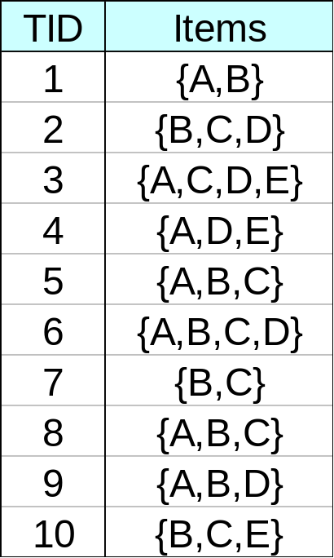
FPGrowth Assignment-2
Prepare the FP-Tree
DoCSE, SVNIT

Slide 52
Step 4: Mining of FP-Tree:
Partition Patterns and Databases
Frequent patterns can be partitioned into subsets according to f-list
  F-list = f-c-a-b-m-p
  Patterns containing p
  Patterns having m but no p
  …
  Patterns having c but no a nor b, m, p
  Pattern f
Completeness and non-redundency
DoCSE, SVNIT

Slide 53
Find Patterns Having P From P-conditional Database
Starting at the frequent item header table in the FP-tree
Traverse the FP-tree by following the link of each frequent item p
Accumulate all of transformed prefix paths of item p to form p’s conditional pattern base
{}
Header Table
Item frequency head
f 4
c 4
a 3
b 3
m 3
p 3
Conditional pattern bases
item cond. pattern base
c f:3
a fc:3
b fca:1, f:1, c:1
m fca:2, fcab:1
p fcam:2, cb:1
f:4
c:1
c:3
b:1
b:1
a:3
p:1
m:2
b:1
p:2
m:1
DoCSE, SVNIT

Slide 54
From Conditional Pattern-bases to
Conditional FP-trees
For each pattern-base
  Accumulate the count for each item in the base
  Construct the FP-tree for the frequent items of the pattern base
    having support count greater than the min support
m-conditional pattern base:
  fca:2, fcab:1
{}
Header Table
Item frequency head
f 4
c 4
a 3
b 3
m 3
p 3
f:4
c:1
All frequent patterns relate to m
m,
fm, cm, am,
fcm, fam, cam,
fcam
{}
c:3
b:1
b:1


f:3
a:3
p:1
c:3
m:2
b:1
p:2
m:1
a:3
m-conditional FP-tree
Conditional FP-Tree: Including items having support count greater than the min support
DoCSE, SVNIT

Slide 55
Recursion: Mining Each Conditional FP-tree
{}
{}
Cond. pattern base of “am”: (fc:3)
f:3
c:3
f:3
am-conditional FP-tree
c:3
{}
Cond. pattern base of “cm”: (f:3)
a:3
f:3
m-conditional FP-tree
cm-conditional FP-tree
{}
Cond. pattern base of “cam”: (f:3)
f:3
cam-conditional FP-tree
DoCSE, SVNIT

Slide 56
A Special Case: Single Prefix Path in FP-tree
Suppose a (conditional) FP-tree T has a shared single prefix-path P
Mining can be decomposed into two parts
  Reduction of the single prefix path into one node
  Concatenation of the mining results of the two parts
{}
a₁:n₁
a₂:n₂
a₃:n₃
{}
r₁
b₁:m₁
C₁:k₁
a₁:n₁
+

r₁
=
b₁:m₁
C₁:k₁
a₂:n₂
C₂:k₂
C₃:k₃
a₃:n₃
C₂:k₂
C₃:k₃
DoCSE, SVNIT

Slide 57
The FP-Growth Mining Method
Idea: Frequent pattern growth
  Recursively grow frequent patterns by pattern and database partition
Method
  For each frequent item, construct its conditional pattern-base, and then its conditional FP-tree
  Repeat the process on each newly created conditional FP-tree
  Until the resulting FP-tree is empty, or it contains only one path—single path will generate all the combinations of its sub-paths, each of which is a frequent pattern
DoCSE, SVNIT

Slide 58
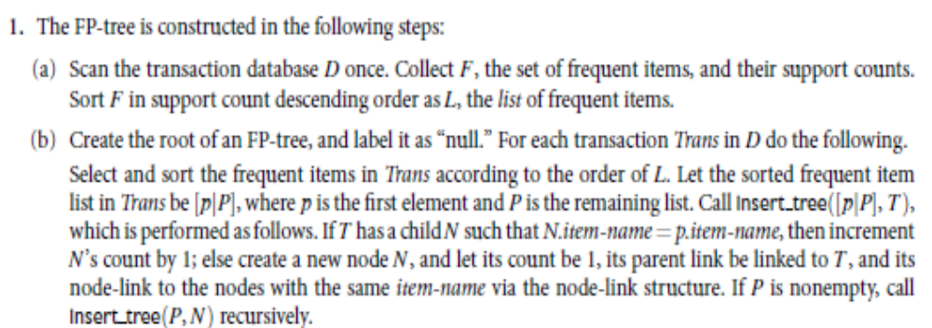
FP-Growth Algorithm
DoCSE, SVNIT

Slide 59

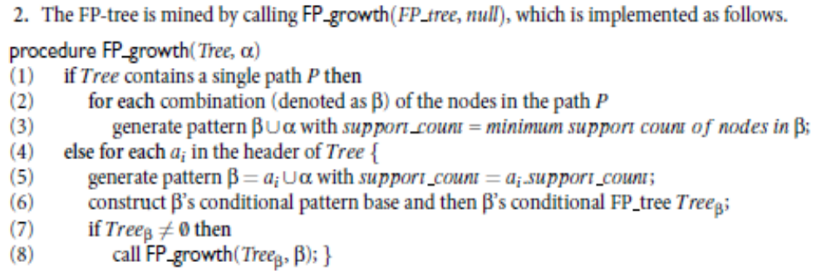
FP-Growth Algorithm Cont…
DoCSE, SVNIT

Slide 60
Benefits of the FP-tree Structure
Completeness
  Preserve complete information for frequent pattern mining
  Never break a long pattern of any transaction
Compactness
  Reduce irrelevant info—infrequent items are gone
  Items in frequency descending order: the more frequently occurring, the more likely to be shared
  Never be larger than the original database
DoCSE, SVNIT

Slide 61

FP-Growth vs. Apriori: Scalability With the Support Threshold
Data set T25I20D10K
25-Avg. no. of items per transaction
20-Avg. support of each item in dataset
10K-Total no. of transactions
DoCSE, SVNIT

Slide 62
FP-Growth Approach
Divide-and-conquer
  Decompose both the mining task and DB according to the frequent patterns obtained so far
  Lead to focused search of smaller databases
Performance is Faster than Apriori
  Use compact data structure
  No candidate generation, no candidate test
  Eliminate repeated database scans
  Basic operation is counting and FP-Tree building
Problem:
  When the database is large, sometimes unrealistic to construct a main memory based FP-Tree
DoCSE, SVNIT

Slide 63
Data Format
Apriori and FP-Growth
  { TID: itemset }
    TID: Transaction ID
    Itemset: set of items bought in transaction TID
  Horizontal Data Format
Alternative way
  { Item: TID_set }
    Item: item name
    TID_set: set of transaction identifiers containing the item
  Vertical Data Format
DoCSE, SVNIT

Slide 64
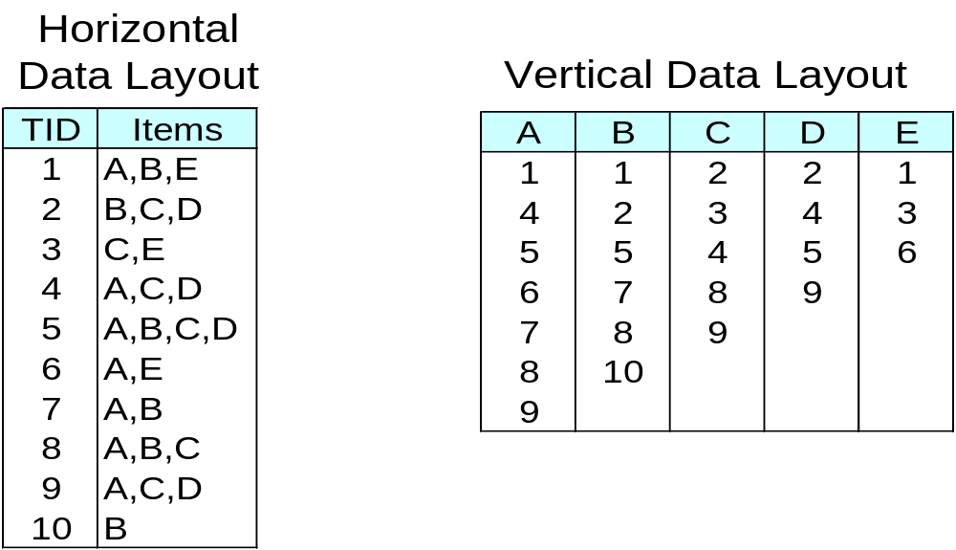
Data Format
TID-list
DoCSE, SVNIT

Slide 65
Mining by Exploring Vertical Data Format
ECLAT (Equivalence CLASS Transformation)
Developed by Zaki
DoCSE, SVNIT

Slide 66
ECLAT Algorithm
Deriving frequent patterns based on vertical intersections
  t(X) = t(Y): X and Y always happen together
  t(X) ⊂ t(Y): transaction having X always has Y
To count itemset AB
  Intersect TID-list of itemA with TID-list of itemB
DoCSE, SVNIT

Slide 67
ECLAT Algorithm
Transform the horizontally formatted data to the vertical format by scanning the data set once
Support count of an itemset
  The length of the TID_set of the itemset
DoCSE, SVNIT

Slide 68
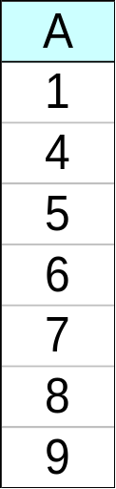
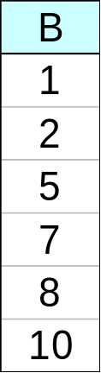
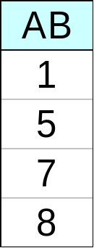
ECLAT Algorithm
Determine support of any k-itemset by intersecting tid-lists of two of its (k-1) subsets.
3 traversal approaches:
  top-down, bottom-up and hybrid
∧
→
DoCSE, SVNIT

Slide 69
ECLAT Algorithm
Starting with k=1, the Frequent k-itemsets can be used to construct the candidate (k+1) itemsets based on the Apriori property
  Done by intersection of the TID_sets of the frequent k-itemsets to compute the TID_sets of the corresponding (k+1) itemsets
This process repeats, with k incremented by 1 each time, until no frequent itemsets or no candidate itemsets can be found
DoCSE, SVNIT

Slide 70
ECLAT Algorithm Summary
Intersection is more efficient
Pipelined counting for frequent itemsets
Advantage
  Less number of database scan
  Very fast support counting
  No need to scan the database to find the support of (k+1) itemsets ( for k>=1 )
    Because the TID_set of each k-itemset carries the complete information required for counting each support
DoCSE, SVNIT

Slide 71
ECLAT Algorithm
Disadvantage
  Intermediate tid-lists may become too large for memory
  Long computation time for intersecting the long set
Performance improvement Idea
  Using diffset to accelerate mining [CHARM Algorithm]
    Only keep track of differences of tids
    t(X) = {T₁, T₂, T₃}, t(XY) = {T₁, T₃}
    Diffset (XY, X) = {T₂}
DoCSE, SVNIT

Slide 72
Problem of Frequent Item sets
A long pattern contains a combinatorial number of sub-patterns
  e.g., {a₁, …, a₁₀₀} contains
  = (₁₀₀¹) + (₁₀₀²) + … + (₁¹₀⁰₀⁰)
  = 2¹⁰⁰ – 1
  = 1.27*10³⁰ sub-patterns!
Solution
Mine closed patterns and max-patterns instead
DoCSE, SVNIT

Slide 73
Closed Patterns
An itemset X is closed if X is frequent and there exists no super-pattern Y כ X, with the same support as X
It is a lossless compression of freq. patterns
  Reducing the # of patterns and rules
DoCSE, SVNIT

Slide 74
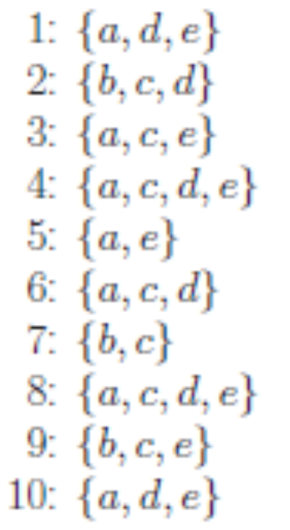
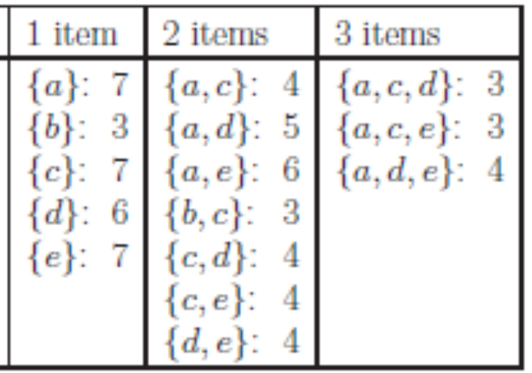
Closed Patterns - Example
Transaction Database
Frequent Item Set
{b} is a subset of {b,c} both have a support of 3
{d,e} is a subset of {a,d,e} both have a support of 4
All frequent item sets are Closed except {b} and {d, e}
DoCSE, SVNIT

Slide 75
Max-Patterns
An itemset X is a max-pattern (maximal) if X is frequent and there exists no frequent super-pattern Y כ X
DoCSE, SVNIT

Slide 76
Max-Patterns - Example
Transaction Database
Frequent Item Set
The maximal item sets are {b,c} {a,c,d} {a,c,e} {a,d,e}
Every frequent itemset is a subset of at least one of these sets
DoCSE, SVNIT

Slide 77
Closed Patterns and Max-Patterns
Exercise:
DB = {<a₁, …, a₁₀₀>, < a₁, …, a₅₀>}
  Min_sup = 1.
What is the set of closed itemset?
  <a₁, …, a₁₀₀>: 1
  < a₁, …, a₅₀>: 2
What is the set of max-pattern?
  <a₁, …, a₁₀₀>: 1
DoCSE, SVNIT

Slide 78
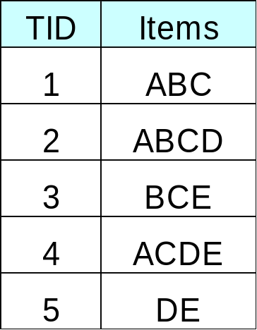
Mine the Closed and Max-Patterns
Minimum support = 2
DoCSE, SVNIT

