Slide 1
Strong Association Rule
An association rule is strong if it satisfies both a minimum support threshold (min_sup) and a minimum confidence threshold (min_conf)

Slide 2
Strong Association Rules Could Be Misleading …
Example:
10,000 transactions
6,000 transactions included computer games
7,500 transactions included videos
4,000 transactions included both
buys (X , ”Game”) 🡺 buys (X , ”Video”)
Support?? Confidence??

Slide 3
Strong Association Rules Could Be Misleading …
buys (X , ”Game”) 🡺 buys (X , ”Video”)
Support (Game & Video) =
4,000 / 10,000 =40%
Confidence (Game => Video) =
4,000 / 6,000 = 66%
Suppose it pass our minimum support and confidence (30% , 60%, respectively)

Slide 4
… Strong Association Rules Could Be Misleading
Does buying game really imply buying video as well??
Misleading…
Because, Purchasing videos is 75%
Which is quite greater than 66%

Slide 5
Misleading “Strong” Association Rule
The truth is : “Computer games and videos are negatively associated”
i.e. the purchase of one of these items actually decreases the likelihood of purchasing the other
How to get this conclusion??

Slide 6
Correlation

Slide 7
Correlation
10,000 transactions
6,000 transactions included computer games (G)
7,500 transactions included videos (V)
4,000 transactions included both (G,V)
P(S＾B) = 4000/10000 = 0.40
P(S) × P(B) = 0.60 × 0.75 = 0.45
P(S＾B) = P(S) × P(B) => Statistical independence
P(S＾B) > P(S) × P(B) => Positively correlated
P(S＾B) < P(S) × P(B) => Negatively correlated

Slide 8
Correlation Measures for Association Rules
Lift
Cosine
All_confidence
χ²

Slide 9
Lift
Simple correlation measure
Considers
The occurrence of itemset A is independent of the occurrence of itemset B if P(AUB) = P(A)P(B)
Otherwise, itemset A and B are dependent and correlated as events
i.e. both the antecedent and consequents of the rules are considered here
Lift(A,B) = P(AUB) / P(A)P(B)

Slide 10
Lift
Lift(A,B) = P(AUB) / P(A)P(B)
If the value = 1
Then A and B are independent and there is no correlation between them
If the value > 1
Then A and B are positively correlated
The occurrence of one implies the occurrence of the other
If the value < 1
The occurrence of A is negatively correlated with the occurrence of B

Slide 11
Lift
w.r.t. Association Rules,
If the lift is 1, imply that the probability of occurrence of the antecedent and that of the consequent are independent of each other. When two events are independent of each other, no rule can be drawn involving those two events.
If the lift is > 1, then it will inform the degree to which those two occurrences are dependent on one another, and makes those rules potentially useful for predicting the consequent in future data sets.
The value of lift is that it considers both the confidence of the rule and the overall data set.

Slide 12
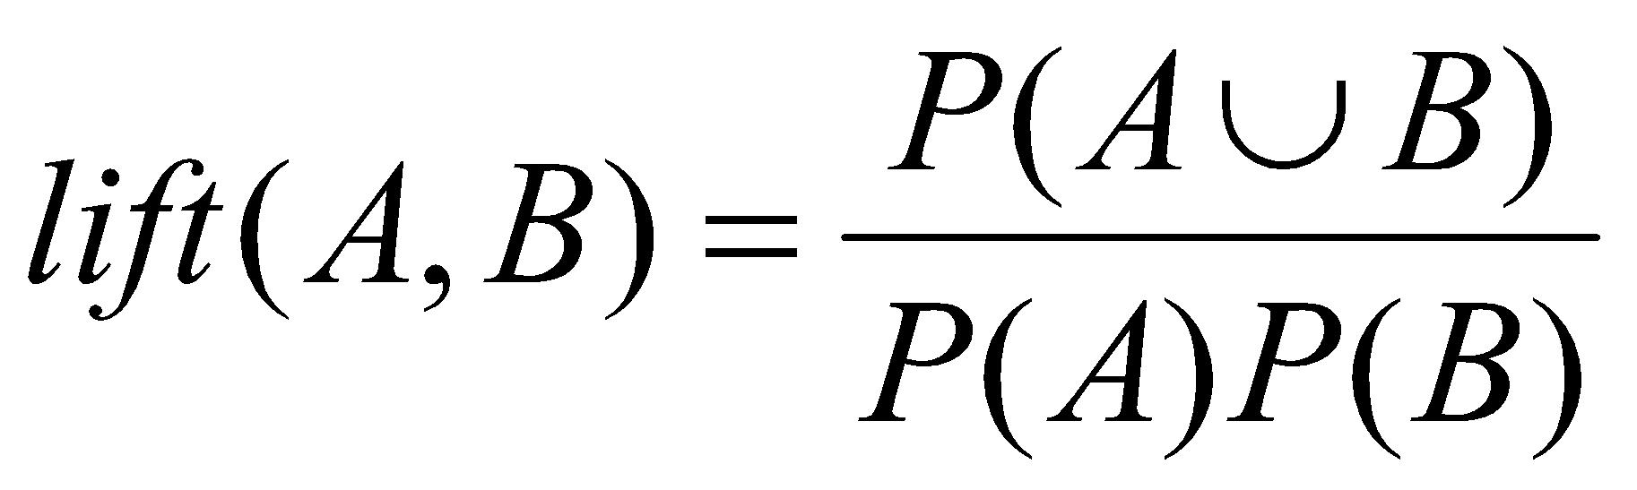
Lift
Example:
10,000 transactions
6,000 transactions included computer games
7,500 transactions included videos
4,000 transactions included both
lift({game},{video})=??
= 0.40/(0.60 * 0.75)
= 0.89 < 1 –vely correlated
So buying a computer game actually reduces the chance of buying a video!
A useful rule must have lift > 1

Slide 13
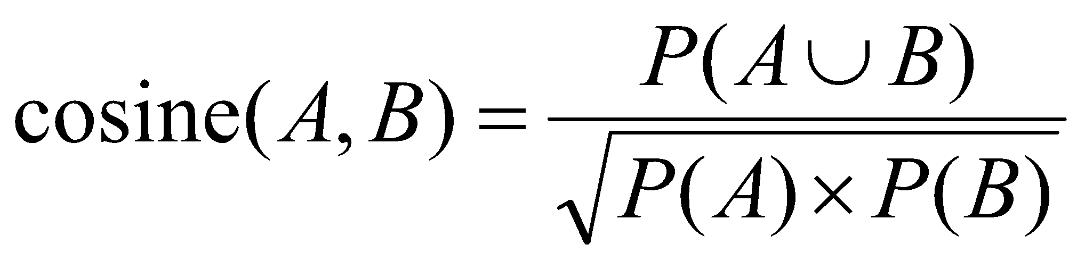
Cosine Measure
Harmonized lift measure
Two formulae are similar except that the for cosine, the square root is taken on the product of the probabilities of A and B
cosine({game},{video})=??

Slide 14
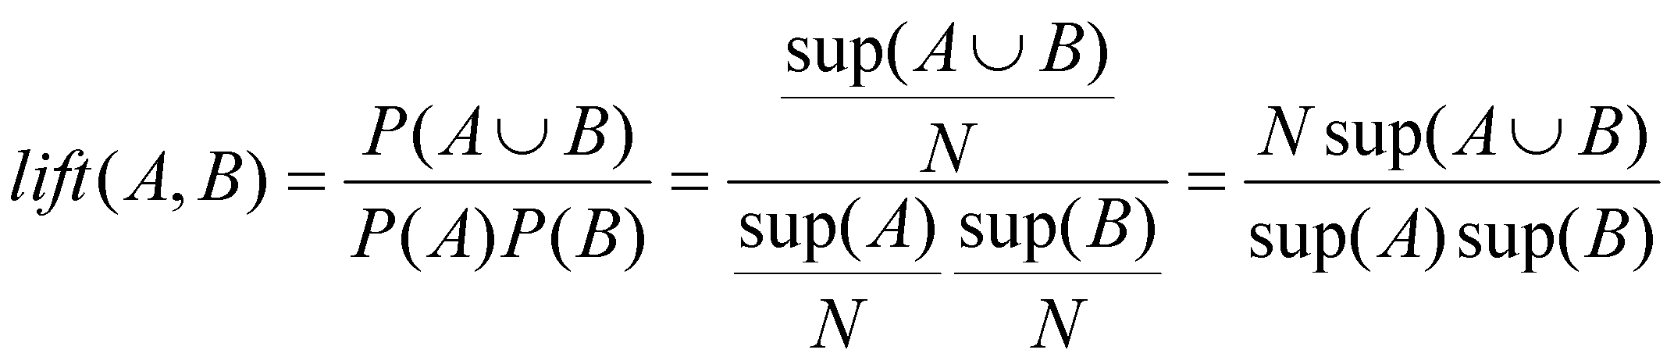
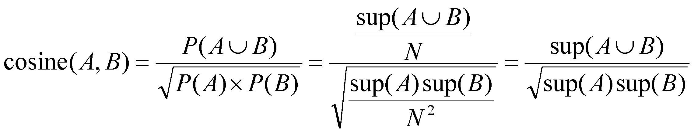
Cosine vs. Lift
Cosine value is only
influenced by the supports of A, B and AUB,
and NOT by the total number of transactions (N)

Slide 15
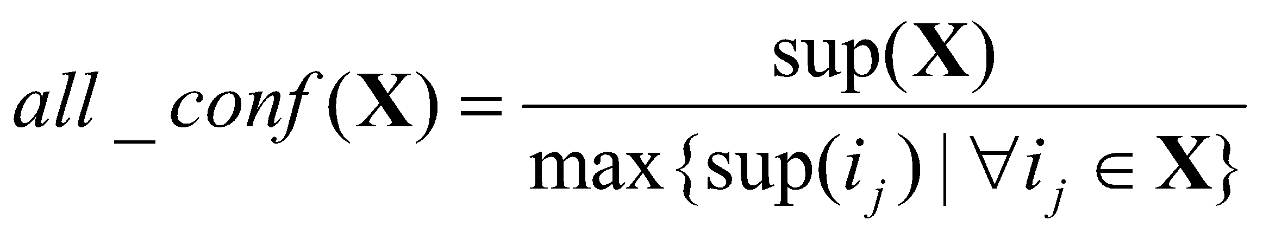
All_confidence
Variation of the confidence
All rules which can be generated from itemset X have at least a confidence of all-confidence(X)
Denominator is the maximum count of transactions that contain any subset of X
all_conf({game, video})=??

Slide 16
All_confidence
All-confidence possesses the downward-closed closure property
It is the smallest confidence of any rule for the set of items, X
That is, all rules produced from this item set would have a confidence greater than or equal to its all-confidence value

Slide 17
Misleading “Strong” Association Rule
Under the normal situation,
60% of customers buy the game
75% of customers buy the video
Therefore, it should have 60% * 75% = 45% of people buy both
That equals to 4,500 which is more than 4,000 (the actual value)

Slide 18
χ² Test
Test whether A and B are independent
If χ²
0: A and B are independent
>1 then
if observed value < expected value
Negatively Correlated

Slide 19
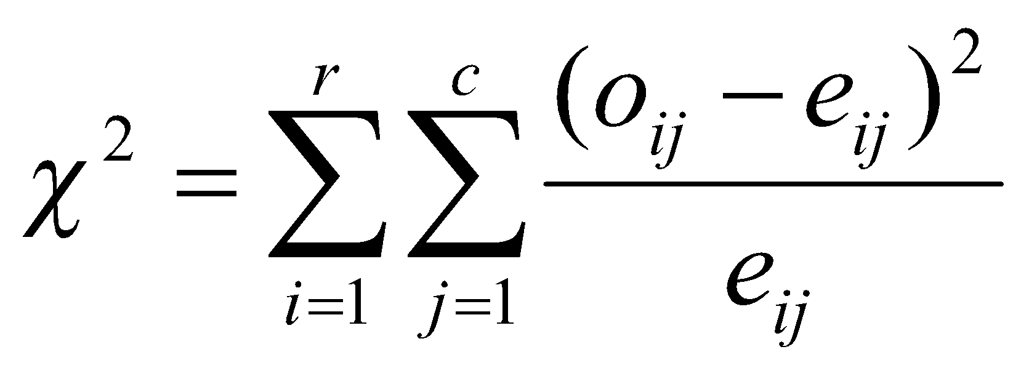
Pearson χ² Statistic
Two attributes A and B
A has r possible values
B has c possible values
Event (A=a_{i},B=b_{j})
Observed frequency: o_{ij}
Expected frequency: e_{ij}=count(A=a_{i})*count(B=b_{j})/N

Slide 20
Observed Frequencies (Contingency Table)
Example: 10,000 transactions
6,000 transactions included computer games
7,500 transactions included videos
4,000 transactions included both
game
!game
total
video
4000
??
7500
!video
??
??
??
total
6000
??
10000

Slide 21
Observed Frequencies (Contingency Table)
game
!game
total
video
4000
3500
7500
!video
2000
500
2500
total
6000
4000
10000

Slide 22
Expected Frequencies
game
!game
total
video
??
??
7500
!video
??
??
2500
total
6000
4000
10000
Expected frequency: e_{ij}=count(A=a_{i})*count(B=b_{j})/N

Slide 23
Observed (Expected) Frequencies (Contingency Table)
game
!game
total
video
4000
(4500)
3500
7500
!video
2000
500
2500
total
6000
4000
10000
Expected Frequency=(Count(game)*Count(video))/N
=(6000*7500)/10000=4500

Slide 24
Observed (Expected) Frequencies (Contingency Table)
game
!game
total
video
4000
(4500)
3500
(3000)
7500
!video
2000
(1500)
500
(1000)
2500
total
6000
4000
10000
Expected Frequency=(Count(!game)*Count(video))/N
=(4000*7500)/10000=3000

Slide 25
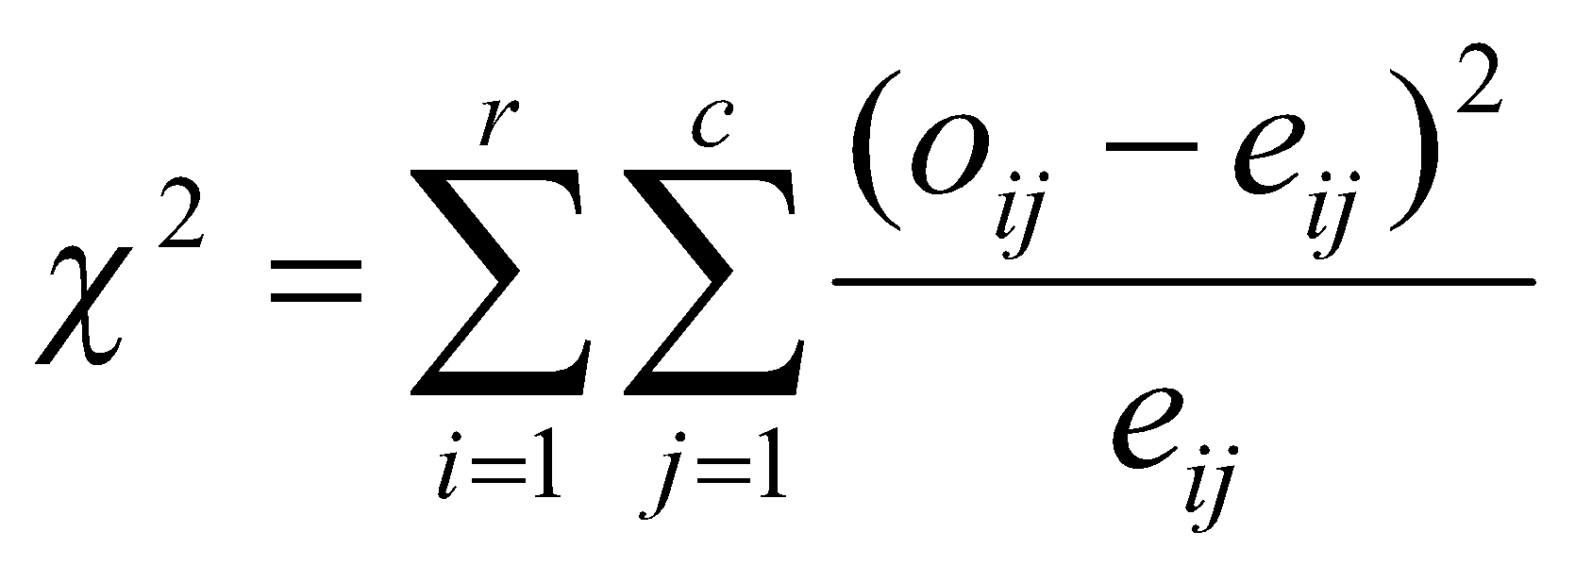

Interpretation of χ²
χ² is greater than 1
And the observed value of the slot (game, video) = 4000 which is less than the expected value 4500
Buying game and buying video are Negatively correlated

Slide 26
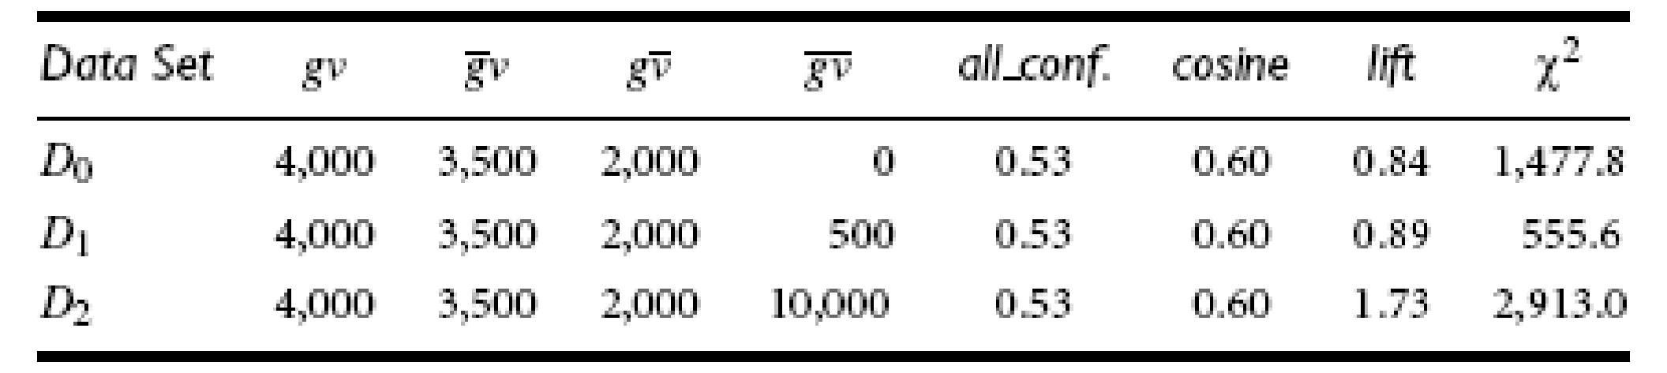
Comparison
Let D1 be the original game (g) and video (v) data set
Added two more data sets
D0 has zero null-transactions
D2 has 10,000 null-transactions (instead of only 500 as in D1)
gv, g’v, and gv’ remain the same in D0, D1, and D2

Slide 27
Comparison
lift and χ² change from rather negative to rather positive correlations, whereas all confidence and cosine have the nice null-invariant property, and their values remain the same in all cases
Because lift and χ² strongly influenced by g’v’ (Null Transactions)

Slide 28
Comparison
Unfortunately, one cannot precisely assert that a set of items are positively or negatively correlated when the value of all confidence or cosine is around 0.5
Strictly based on whether the value is greater than 0.5,
One can claim that g and v are positively correlated in D1
But, they are negatively correlated by the lift and χ² analysis
Therefore, a good strategy is to perform the all confidence or cosine analysis first, and when the result shows that they are weakly positively/negatively correlated, other analyses can be performed to assist in obtaining a more complete picture

