Slide 1

Project Title – Data analysis on SuperStore dataset
Sourabh Ojha

Slide 2

PROBLEM STATEMENT
Which state have maximum sale?
Which State have maximum Profit?
Which product is selling the most (category and sub category)?
Which category gives max profit?
Which product is purchased most?

Slide 3
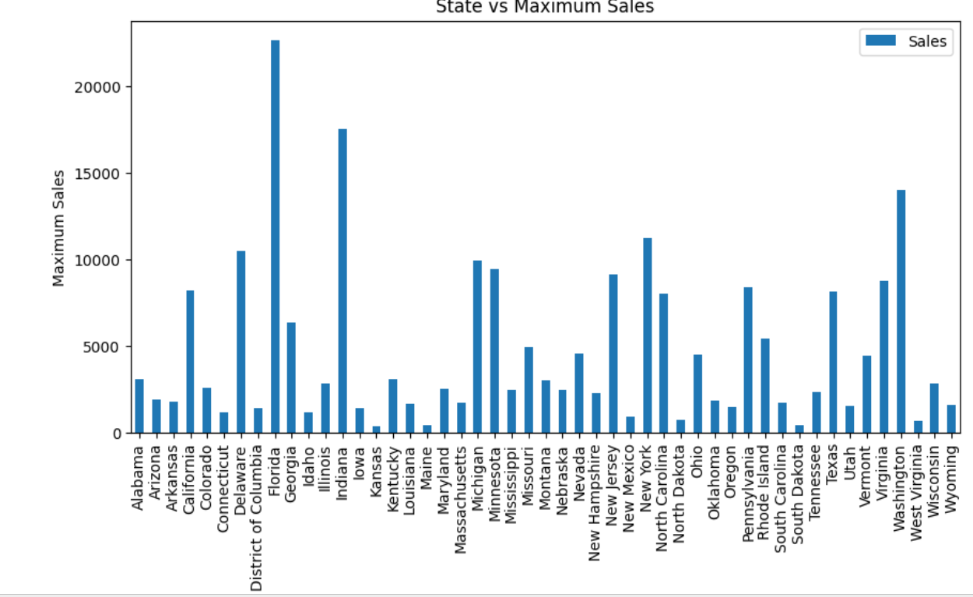
Which state have maximum sale?

Slide 4
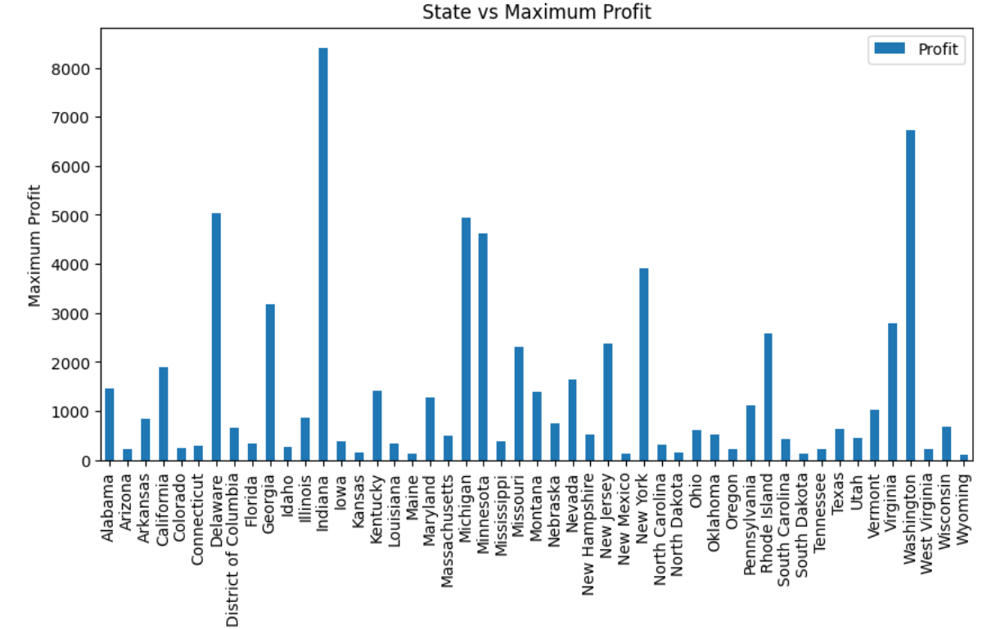
Which State have maximum Profit?

Slide 5
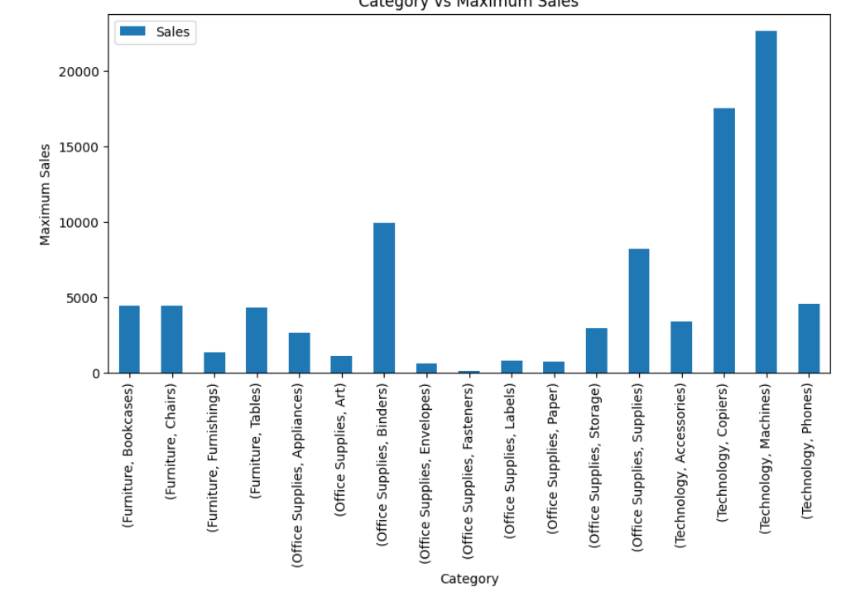
Which product is selling the most (category and sub category)?

Slide 6
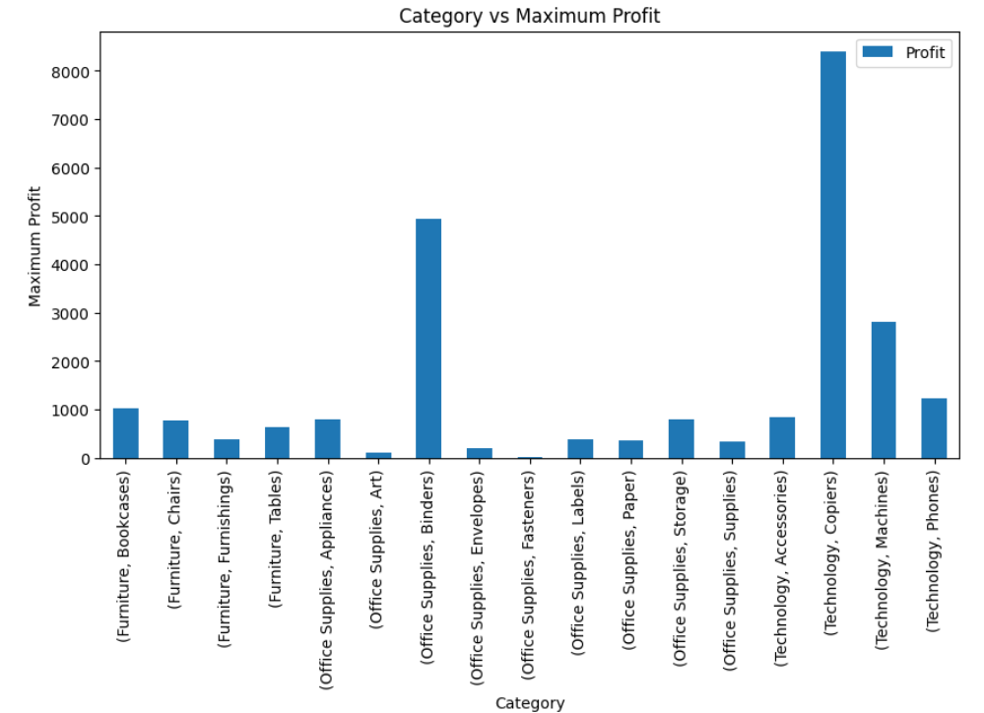
Which category gives max profit?

Slide 7
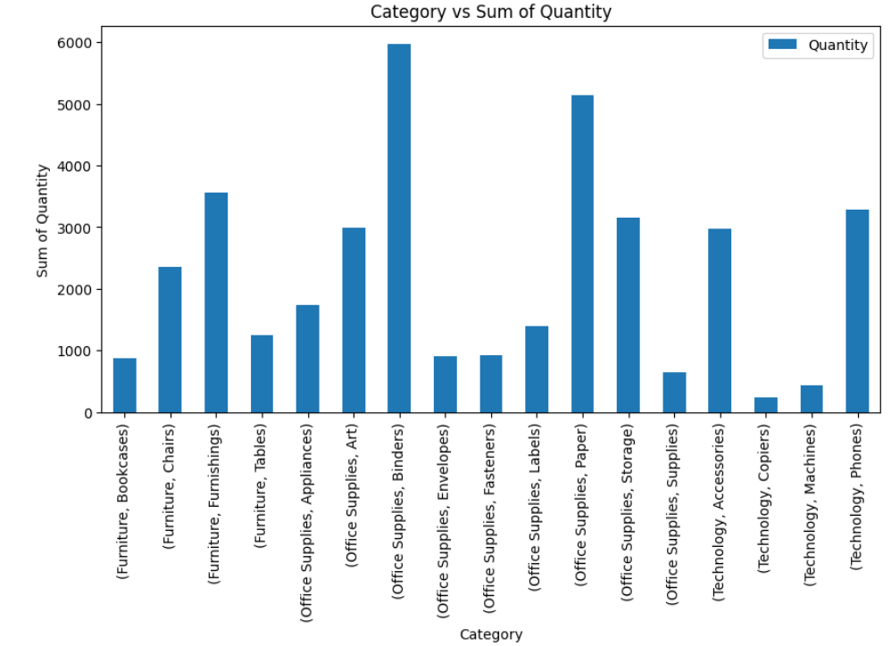
Which product is purchased most?

Slide 8

WHO ARE THE END USERS?
Stackholder
Financial Analysts and Accountants
Product Manager
Sales and Marketing Teams

Slide 9

Technology Used
Python libraries(pandas , matplotlib , seaborn )
Jupyter notebook

Slide 10
RESULTS
we have maximum sale of State Florida :-22638.480
We have maximum profit state Indiana :- 8399.9760
The most selled product is Technology,Machines :- 22638.480
We have maximum profit product is Technology,Copiers:- 8399.9760
The most selled product is Office supplies,Blinders:- 5971
Demo Link

Slide 11
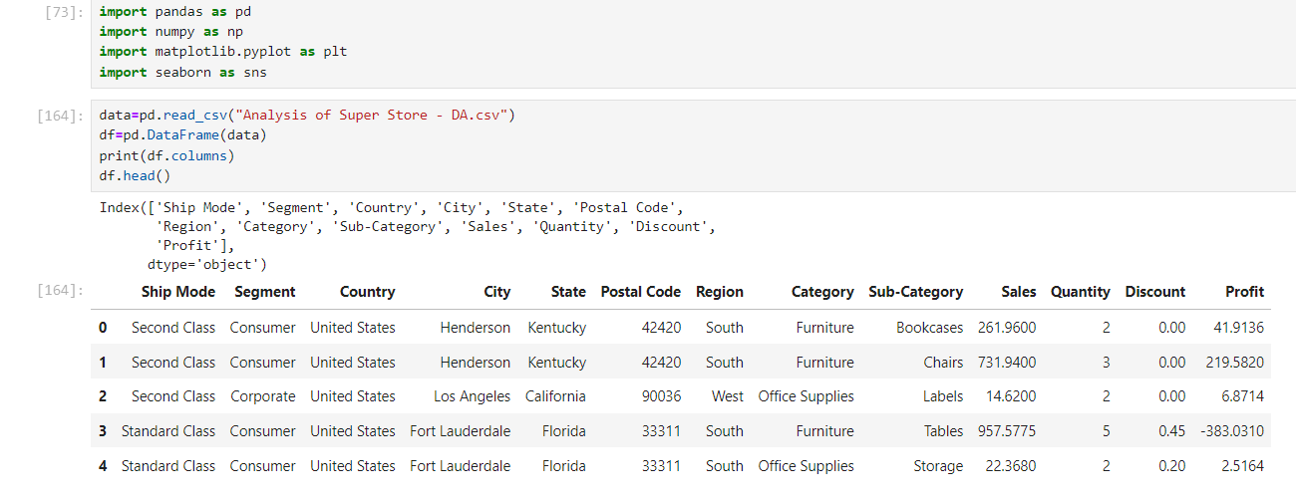
RESULTS
[Add screen shots of your code ]
Demo Link

Slide 12
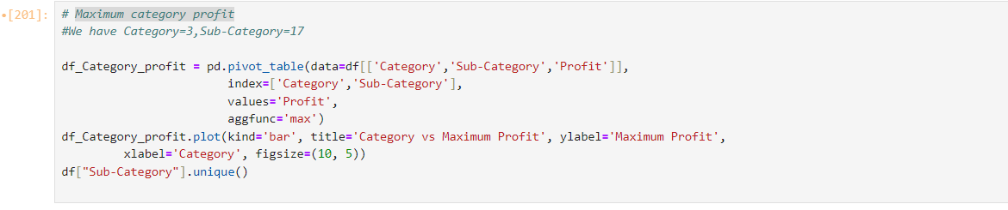
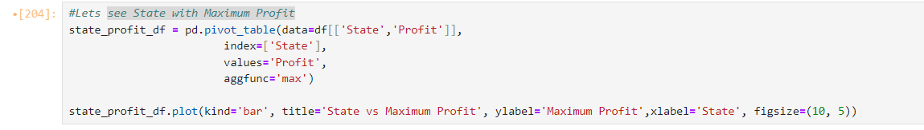
RESULTS
[Add screen shots of your code ]

Slide 13
Thank you
Any Question please ask
.
.

