Slide 1
IR PROJECT
NEWS DOCUMENT RETRIEVAL
GROUP-29
TEAM MEMBERS
G.VENKAT SOURABH - S20200010068
K Bharath Kumar Raju - S20200010100

Slide 2
Project Statement: To build a news document retrieval for tech news
Project Description:
➢The main goal of an IR project is to develop a model for retrieving the information from the repositories of documents.
➢A model of information retrieval predicts and explains what a user will find in relevance to the given query.
2
Can be seen from outer space
3

Slide 3
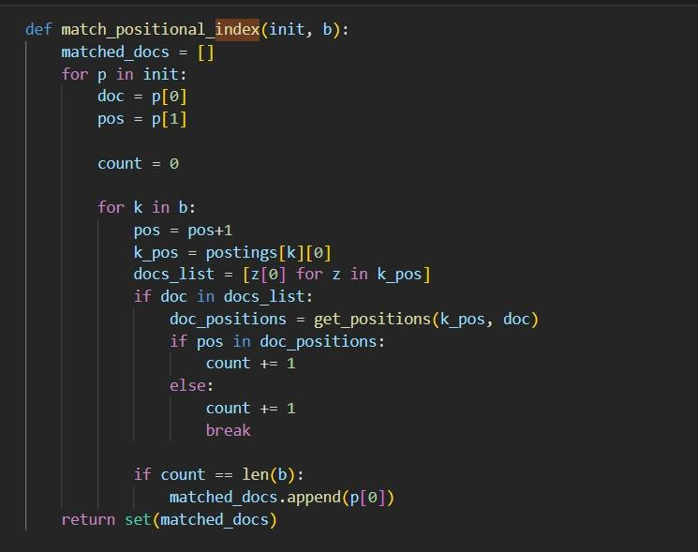
INDEXING :
WE have done the indexing by the with the help of dataset

Slide 4
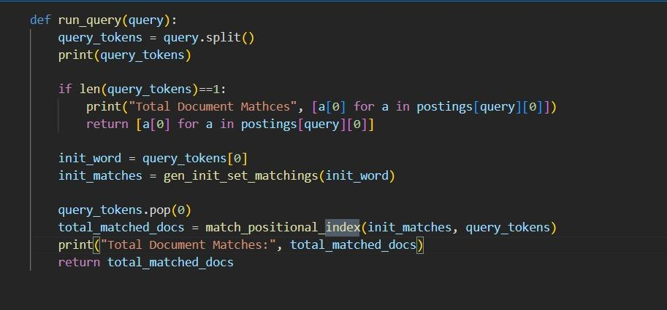

Slide 5

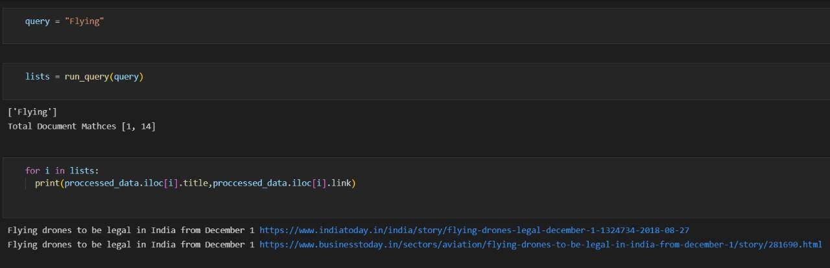

Slide 6
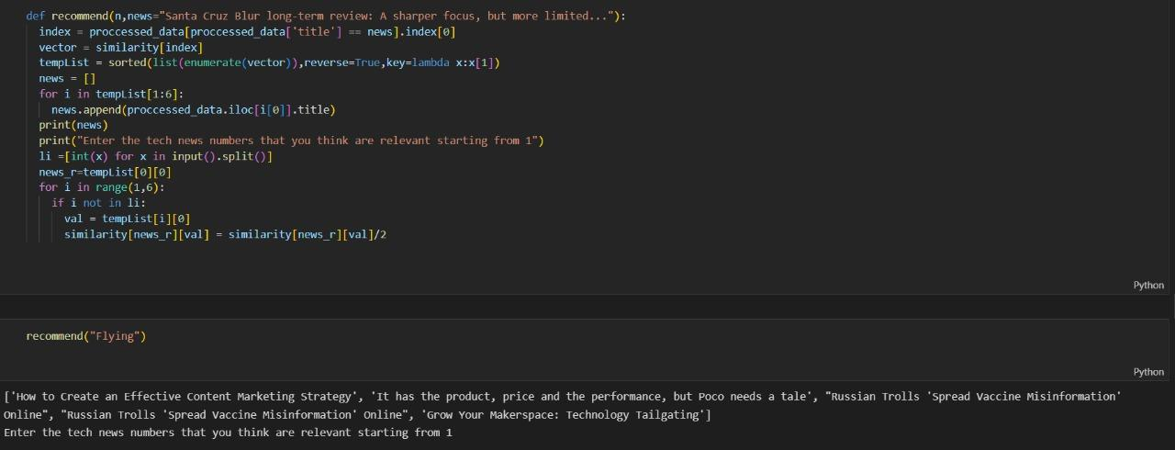
Capturing Feedback

Slide 7
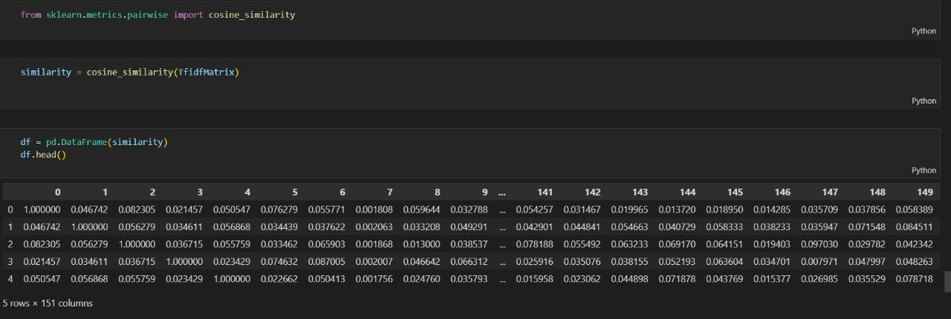
COSINE SIMILARITY :

Slide 8
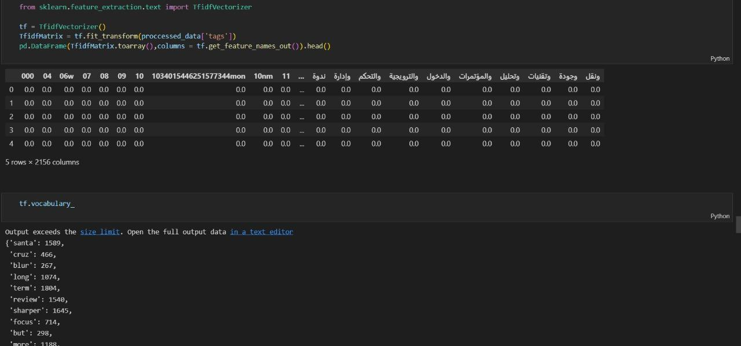
TF IDF :

Slide 9
THANK YOU

