Slide 1
Test Automation with CTA Framework
Igor Gershovich
Connected Testing, Inc.
www.connectedtesting.com
igershovich@connectedtesting.com

Slide 2
Connected Test Automation Framework
CTA Framework addresses the most common problem with test automation: Automation Engineers do not have domain knowledge and the End Users (Subject Matter Experts/Test Engineers) usually do not have automation expertise.

Slide 3
Connected Test Automation Framework
CTA Framework is a test automation component-based architecture leveraging Mercury BPT technology
CTA Framework allows clear delineation of the responsibilities and skill sets between End Users and Test Automation developers
  Automation developers define architecture and create components
  End Users create automated test cases using automated components as building blocks

Slide 4
CTA Framework Benefits
Automation projects get completed about 3-times faster
SME/Test Engineers do not need to know how to use QuickTest Pro (QTP).
Automation developers do not need detailed application knowledge.
Lower maintenance costs.

Slide 5
Test Automation Process
Automation Architecture Design
Automation
Engineer
Create Function Libraries
Create Object Repositories
Create Business Components
Drag Components to create tests in QC
Configure Input/Output parameters
Subject Matter Expert
or
Test Engineer
Debug tests in QC Test Plan module
Add tests to test set in Test Lab module

Slide 6
CTA Framework highlights
Fast component development (2-4 Pages/Windows per day)
Fast test case development (4+ test cases per day)
Creating Automated test cases is similar to manual test case development.
Uses very flexible Encapsulated Keyword/Data-Driven approach to create dynamic test cases.

Slide 7
CTA Framework highlights
CTA Framework utilizes only industry standard HP/Mercury technologies:
  Quality Center (QC)
  QuickTest Pro (QTP)
  Business Process Testing (BPT) technology
Allows to test Web Applications on Locked Computers, via Minimized Remote Desktop windows and on dual monitor computers.

Slide 8
CTA Framework highlights
Applicable to all areas of automated testing, like regression, smoke, acceptance, etc.
This Framework has been successfully implemented for several industries: Financial, Transportation, Aerospace.

Slide 9
Recent Success
Estimate using Traditional automation: 1 year
Estimate with CTA Framework: 6 months
Project was completed in 4 months by 1 person, 2 month ahead of schedule.
This was the first project for the automation developer utilizing the CTA Framework.
170 components were developed (1 component per Web page).
109 Regression Test cases were automated.

Slide 10
Typical Project Schedule for Web Applications
Task | Description | ETA, days
Initial | Getting familiar with the project | 5
Automation Architecture | Environment, Libraries, Data, etc. | 10
Business Component design | Assumption: 60 WebPages. Automating 3 pages per day | 20
Knowledge Transfer to End Users | Training, Documentation, etc. | 10
Create Automated Test Cases | Assumption: 200 test cases, Automating 5 test cases per day | 40
Total duration, days |  | 85

Slide 11
Test Automation Architecture

Slide 12
Test Automation elements
Integrated Development Environment:
  HP/Mercury Quality Center
  BPT Module for Quality Center
  QTP or WinRunner
External Function Libraries
Object Repositories
Business Components
Test Scripts

Slide 13
External Function Libraries
Environment Library
Navigation Library
Common Library
Project Specific Library

Slide 14
External Function Libraries
Environment Library
  This is a Library which allows the user to control the test environment in which a component is going to be run (QA, staging or production).
  Allows users to control and set login credentials
  Users can manually adjust this file prior to running a test.

Slide 15
External Function Libraries
Navigation Library
  A set of custom functions and procedures which address web site navigation.

Slide 16
External Function Libraries
Common Library:
  Contains Global Constants and Variables.
  Provides additional VBScript functions/methods for enhanced interaction with the various application objects i.e. WebEdit, WebFile, WebCheckBox, WebList, Link, WebButton, Image, WebRadioGroup, WebTable, WebElement, WinButton, Page and Browser.
  Contains General purpose functions to close applications or browsers, initialize components, replace text, etc.

Slide 17
External Function Libraries
Project Specific Library
  Contains project specific functions/methods

Slide 18
Test Automation Architecture
Object Repository
  The Object Repositories are stored in the BPT Resources sub-folder Object Repositories.
  Object Repositories are designed to be server independent.

Slide 19
Business Components
Component is a reusable module to perform tasks on logically independed application parts (Page or Window).
Components use Input/Output parameters for data input/verification and navigation within Page or Window.
Input/Output parameters also are used to pass data between components.
Components can use iterations if permitted.

Slide 20
Login component steps (example for Web Application)
Component initialization
Close all browsers except QC
Load environment variables like URL, login credentials, DB connection strings, etc.
Invoke an application
Login
Verification that login is successful
Component cleanup

Slide 21
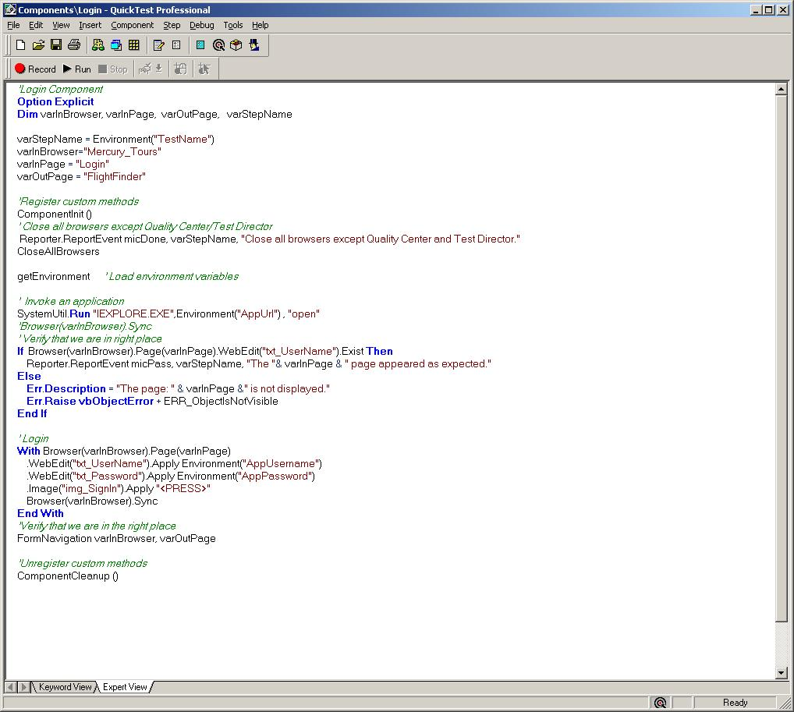
Example of Login component

Slide 22
Functional component steps (example for Web Application)
Component initialization
Verify that Expected page is displayed
Side or Top menu navigation
Web Page internal flow
Component cleanup

Slide 23
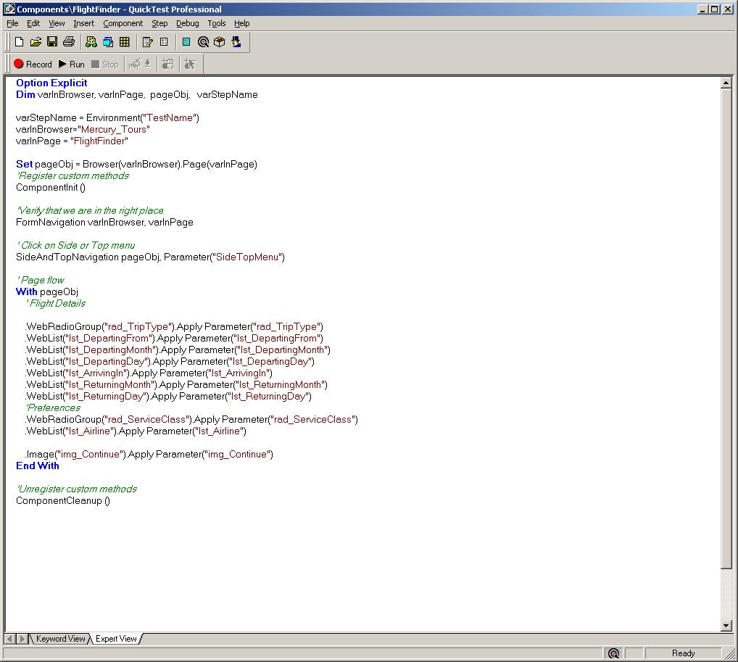
Example of Functional Component

Slide 24
New Test creation

Slide 25
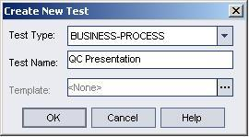
Create a New Test
In Quality Center Test Plan folder Right Click on Subject folder or an existing folder to create a new folder or test.
Under Test Type select BUSINESS-PROCESS from the drop down list.
Enter a name for the test.

Slide 26
Select Components for test
Click on Test Script tab
Click on Select Component menu item
  The component pane will be displayed.
  Drag and drop components in logical order.

Slide 27
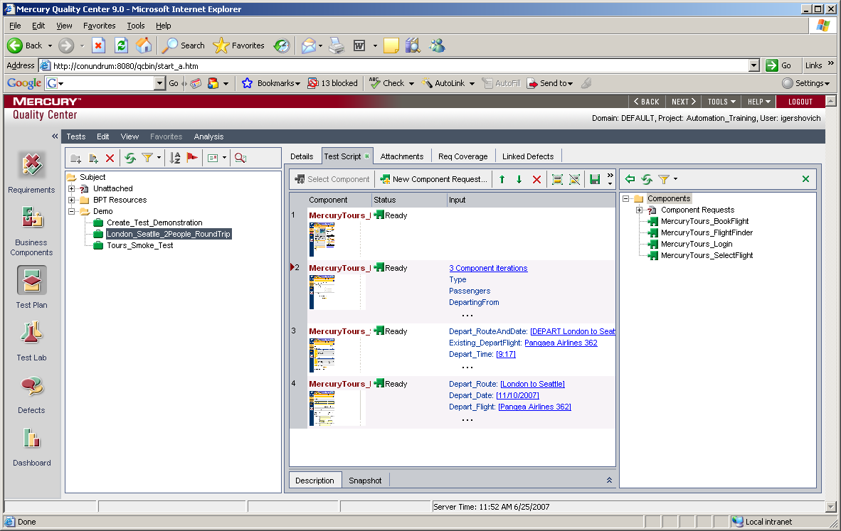
Select components (Snapshot)

Slide 28
Adding parameter data
  To add parameters (data) to the test, click on the component input link in the input column
  Users control interaction with the application objects via various input constraints.
  A spreadsheet type parameter list will be presented representing various objects in the application.
  Note the parameter field description at the bottom of the page indicating what type of object is being worked with. Buttons will be indicated with button, Lists with list and table with cell.

Slide 29
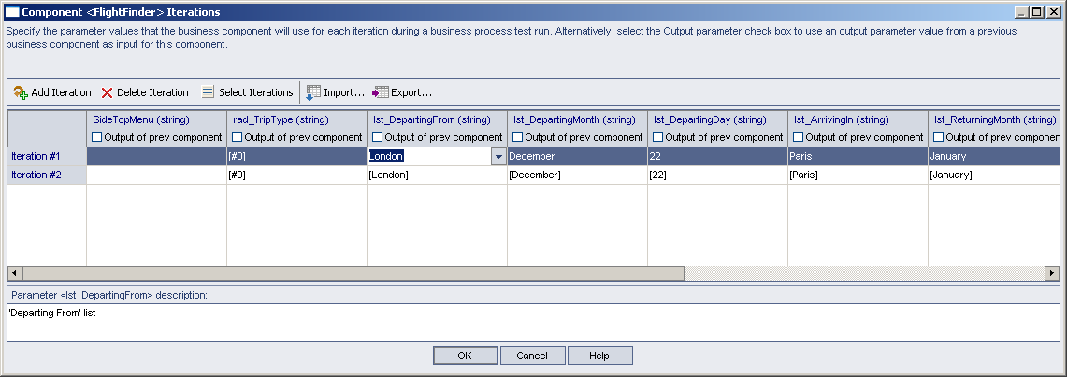
Adding Parameter data (snapshot)

Slide 30
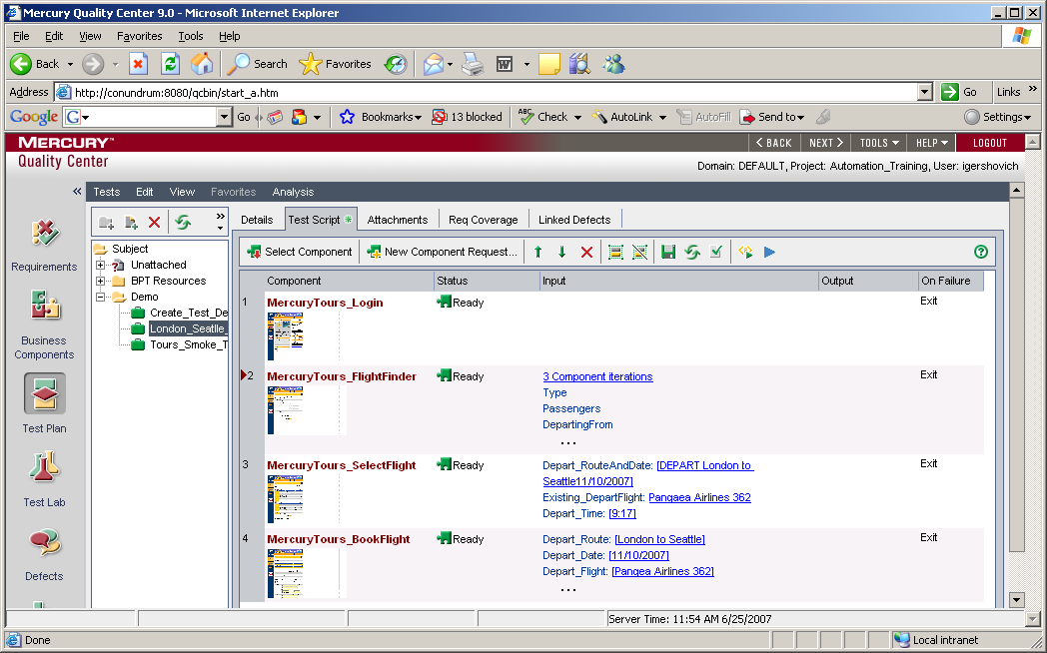
Create new test (continue)
Change Component’s “On Failure” settings from Continue to Exit when the test is completed and ready for use.

Slide 31
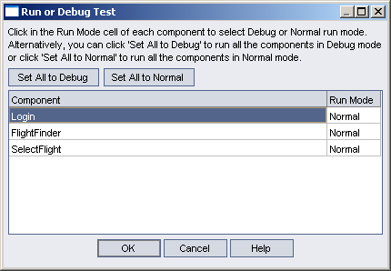
Test Your Script
  Click on the blue triangular command button to test created script.
  On the Run or Debug Test window click on the “Set all to Normal” command button to select a run mode of “Normal”, Click “OK”

Slide 32
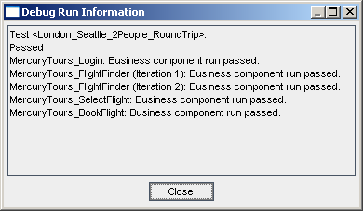
Test Results
If all components passed, test can be included into the Test Lab.

Slide 33
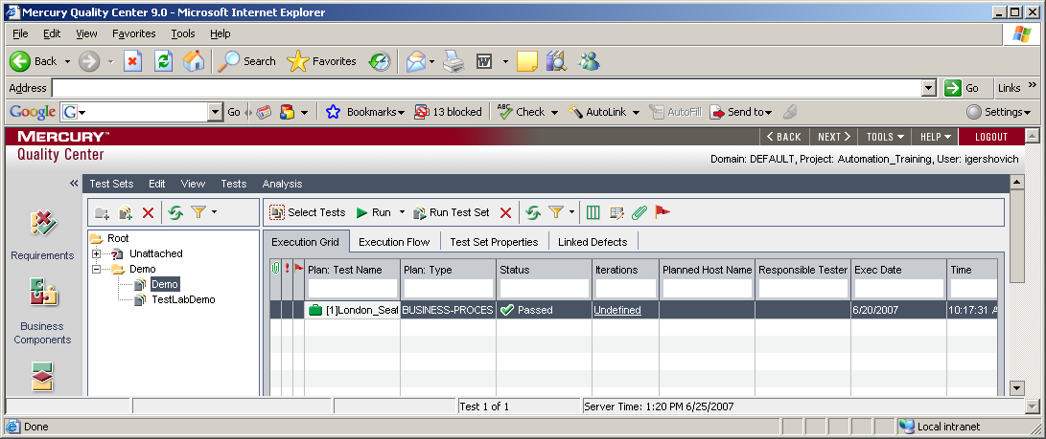
Test Lab
Click on the Test Lab folder to navigate to the Test Lab.
Click on the “Select Tests” command button to display a list of available tests.
Drag and drop tests onto the grid from the available list of tests in the test lab.

Slide 34
Parameter Input Constraints (Example)

Slide 35
Input Constraints for Edit (Text Box) object
Value | Action | Example
 | No action
<SKIP> | No action | <SKIP>
<CLEAR> | Clear edit field | <CLEAR>
text | Enter text | Hello
[text] | Verify text | [Hello]
<TODAY1> | Enter current date mm/dd/yyyy (02/27/2007) | <TODAY1>
[<TODAY1>] | Check current date mm/dd/yyyy | [<TODAY1>]
<TODAY1>+X | Enter dynamic date in a future | <TODAY1>+10
<TODAY1>-X | Enter dynamic date in a past | <TODAY1>-365
[<TODAY1>+X] | Check dynamic date in a future | [<TODAY1>+10]
[<TODAY1>-X] | Check dynamic date in a past | [<TODAY1>-365]

Slide 36
Input Constraints for Edit (Text Box) object - continue
Value | Action | Example
<TODAY2> | Enter current date dd-mmm-yyyy (27-Feb-2007) | <TODAY2>
[<TODAY2>] | Check current date dd-mmm-yyyy | [<TODAY2>]
<TODAY2>+X | Enter dynamic date in a future | <TODAY2>+10
<TODAY2>-X | Enter dynamic date in a past | <TODAY2>-365
[<TODAY2>+X] | Check dynamic date in a future | [<TODAY2>+10]
[<TODAY2>-X] | Check dynamic date in a past | [<TODAY2>-365]
<TODAY3> | Enter current date mmm dd yyyy (May 31 2007) | <TODAY3>
[<TODAY3>] | Check current date mmm dd yyyy | [<TODAY3>]
<TODAY3>+X | Enter dynamic date in a future | <TODAY3>+10
<TODAY3>-X | Enter dynamic date in a past | <TODAY3>-365
[<TODAY3>+X] | Check dynamic date in a future | [<TODAY3>+10]
[<TODAY3>-X] | Check dynamic date in a past | [<TODAY3>-365]

Slide 37
Input Constraints for Edit (Text Box) object - continue
Value | Action | Example
text<SSN>text | Replace <SSN> with unique 9 digits in XXX-XX-XXXX format | abc_<SSN>
text<UNIQUE1>text | Replace <UNIQUE1> with unique 9 digits in XXXXXXXXX format | Test<UNIQUE1>
text<RNDDIG_n>text | Replace <RNDDIG_n> with random n digits | <RNDDIG_5>_test
text<RNDALPHA_n>text | Replace <RNDALPHA_n> with random n uppercase characters | Test_<RNDALPHA_11>
[<REGEX>Pattern] | Verify that Pattern matches text | [<REGEX>TestCase.*]

Slide 38
Igor Gershovich
E-Mail: igershovich@connectedtesting.com
Phone: 720-933-9395
Website: www.connectedtesting.com

