Slide 1
Business Process Testing

Slide 2
Testing Team Challenges
Manage Test Duplication
Manage Test Maintenance
Assure Testing Accuracy
Assure appropriate testing by Business Priority
Notes:
The challenges facing the testing team that uses traditional tools may seem familiar.
How can you reduce the large amount of duplicated effort involved when tests are created in flat files like Word or Excel documents?
How can you reduce the amount of time and resources currently spent just maintaining existing tests?
How do you assure that the testing you’re doing is actually consistent, complete and accurate over the course of the many test cycles that need to be run during an application’s lifetime?
And with all this focus on shuffling flat files around, how can you, with confidence, assure that you are appropriately testing the business processes prioritized by the business?

Slide 3
Component Based Testing
Moving from Serial to Component Design
Create Order Test
Step 1: Login
Open application
Enter user name
Enter password
Click “Submit”
Step 2: Create an order
…
…
Step 3: View the newly created order
…
…
Step 4: Logout
…
…
Login
Create Order
View
Order
Logout

Slide 4
Design tests around business processes
Create an Order
Delete an Order
Update an Order
Login
Login
Login
Create Order
Search Order
Search Order
View
Order
Delete Order
Update Order
Logout
View
Order
View
Order
Logout
Logout

Slide 5
Reality of Testing
Create an Order
Delete an Order
Update an Order
Login
Login
Login
Create Order
Search Order
Search Order
View
Order
Delete Order
Update Order
Logout
View
Order
View
Order
Logout
Logout
Notes:
As you analyze your business processes… you may discover blocks of steps (like Login) that are executed in multiple places. This is your opportunity to create business components for reuse!

Slide 6
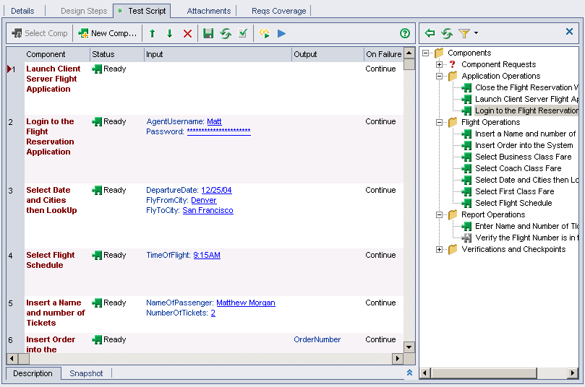
Reduce test maintenance
Create
Opportunity
Test 1
Test 4
Test 2
Test 3
Notes:
The componentization that Business Process Testing enables also significantly reduces test maintenance time.
In this example, let’s assume the business has changed the rules and now the steps it takes to create an opportunity have changed. This means that all the tests using the “Create Opportunity” activity in their scenario must be updated. If you’ve used Business Process Testing as your framework, then instead of having to go and edit every single test case that creates an opportunity, all you need to do is update the “Create Opportunity” component. All tests that use that component are automatically updated for you.
This approach greatly reduces test maintenance time and effort. With Business Process Testing, the changes are synchronized automatically for you. It’s a much more efficient approach.

Slide 7
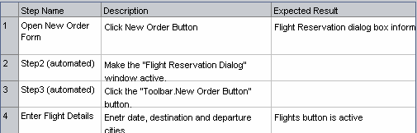
Reduce test maintenance
Create
Opportunity
Test 1
Test 4
a
Create purchase order
Update the component
Test 2
Test 3
Notes:
The componentization that Business Process Testing enables also significantly reduces test maintenance time.
In this example, let’s assume the business has changed the rules and now the steps it takes to create an opportunity have changed. This means that all the tests using the “Create Opportunity” activity in their scenario must be updated. If you’ve used Business Process Testing as your framework, then instead of having to go and edit every single test case that creates an opportunity, all you need to do is update the “Create Opportunity” component. All tests that use that component are automatically updated for you.
This approach greatly reduces test maintenance time and effort. With Business Process Testing, the changes are synchronized automatically for you. It’s a much more efficient approach.

Slide 8
Reduce test maintenance
a
a
Updated
Updated
Create
Opportunity
Test 1
Test 4
a
a
Updated
Updated
a
Create purchase order
Update the component
Test 2
Test 3
Notes:
The componentization that Business Process Testing enables also significantly reduces test maintenance time.
In this example, let’s assume the business has changed the rules and now the steps it takes to create an opportunity have changed. This means that all the tests using the “Create Opportunity” activity in their scenario must be updated. If you’ve used Business Process Testing as your framework, then instead of having to go and edit every single test case that creates an opportunity, all you need to do is update the “Create Opportunity” component. All tests that use that component are automatically updated for you.
This approach greatly reduces test maintenance time and effort. With Business Process Testing, the changes are synchronized automatically for you. It’s a much more efficient approach.

Slide 9
Create and Reuse
“Login”
business component
Changes made at the component level.
Business components well documented
Easy for new testers to compose tests or take ownership of existing components
Major reduction in maintenance
Higher quality test cases
Integration with Automation and Sprinter
test steps
data source
parameterization
iterations
automation
Notes:
The business components live in a kind of “library” and can be pulled off the shelf and dropped into a business process test. No work required to document steps, data or expected results. And if Login changes, you simply modify the Login business component, and any business process tests utilizing that component are automatically updated. Imagine how many times Login might be used across all of your test cases… the time saved can be extremely high and the result is a better maintained test suite. You can also tie requirements to business components, as well as business process tests, and utilize the “data configuration” feature, which allows you to tie requirements to the tests using different subsets of data. This means one data table and one test can satisfy multiple test cases – yet another way to minimize maintenance.

Slide 10
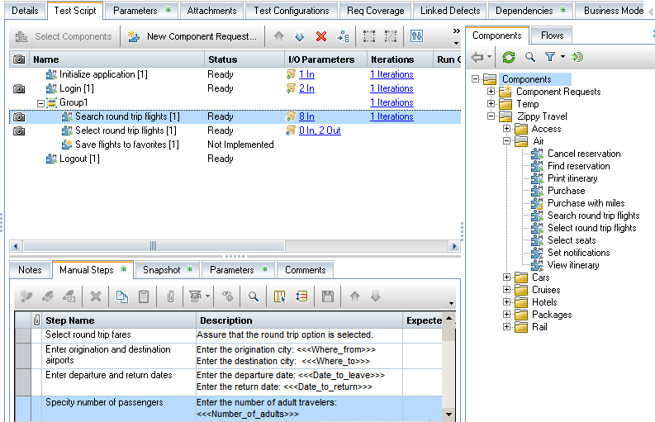
Business Process Testing
link directly to requirements
Use flows of activities & data
Tests designed via the browser
Notes:
Business Process Testing is integrated into ALM and is designed to help overcome those challenges
It provides a framework for creating a library of reusable testing components that can be assembled into flows via drag-and-drop
Testing team can spend more time increasing application quality by decreasing the time needed for test creation and maintenance
BPT centralizes test maintenance so application changes are automatically propagated throughout all the dependent tests

Slide 11
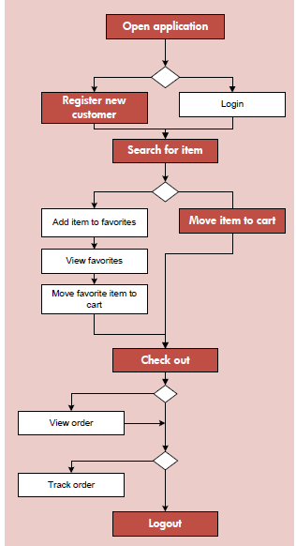
Test coverage by component criteria
One business process scenario
One BPT run
Open App
Open App
Register
Three requirements covered
Register
Search
When the customer orders checks on line, they are sent a confirmation email.
Search
Add to cart
✓
Add to cart
Check out
When the customer orders checks on line, the order is sent to the procurement system.
Check out
✗
Verify email sent
Verify email sent
When the customer orders checks on line, a charge is posted to their primary account.
Verify order sent
✓
Verify charge posted
Notes:
By default, ALM determines test coverage status for a requirement based on the overall pass/fail status of the test. This means that if one out of 20 components in a BPT fails, the overall test status is failed.
With BPT 11, you have the option now to fine tune how requirement coverage is assigned. When you link a BPT to a requirement, you select which component or components you want to be the indicators for test coverage. In the example here, when I link the test to the 1st requirement, only the “Verify email sent” component determines the status. The same test is run once, but it can now cover multiple requirements based and accurately reflect the test coverage status for each one separately.
This new feature lets testers be more accurate when they establish test coverage for business process requirements. And this reduces the amount of time that test managers and project leads spend trying to get an clear picture of which requirements have been covered by passing tests.

Slide 12
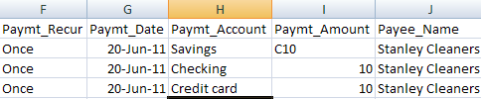
Test configurations
Order checks on line
Two requirements covered
Configuration #1
✓
Open App
When the customer orders checks on line, they can pay by credit card charge or checking or savings accounts debit.
Open App
Register
Register
Search
Search
Add to cart
Configuration #2
✗
Add to cart
When the customer orders checks on line, they can use Firefox 3.6 o 4 or IE 7 or 8.
Check out
Check out
Verify email sent
Verify email sent
Verify order sent
Verify charge posted
Notes:
By default, ALM determines test coverage status for a requirement based on the overall pass/fail status of the test. This means that if one out of 20 components in a BPT fails, the overall test status is failed.
With BPT 11, you have the option now to fine tune how requirement coverage is assigned. When you link a BPT to a requirement, you select which component or components you want to be the indicators for test coverage. In the example here, when I link the test to the 1st requirement, only the “Verify email sent” component determines the status. The same test is run once, but it can now cover multiple requirements based and accurately reflect the test coverage status for each one separately.
This new feature lets testers be more accurate when they establish test coverage for business process requirements. And this reduces the amount of time that test managers and project leads spend trying to get an clear picture of which requirements have been covered by passing tests.

