Slide 1

Introduction to BPT framework

Slide 2
Introduction to BPT framework
Business Process Testing is a framework for QA organizations to build and reuse structured testing components in both manual and automated testing.
BPT is ideal to build frameworks to maximize reuse of testing components mitigate risks by aligning business requirements with end-to-end test scenarios.

Slide 3
Benefits of BPT
Business process tests can be created in a script-free environment by subject matter experts who best understand the business processes that need to be tested, without the need for a programming background.
Business Process Testing enables structured testing of an application by combining test automation and automatically generated, easy-to-understand, plain-language test documentation.

Slide 4
Benefits of BPT Continued
When creating manual tests, Business Process Testing dramatically reduces the need for repeating steps and facilitates text reusability.
Business Process Testing supports a keyword-driven approach for constructing automated scripts.

Slide 5
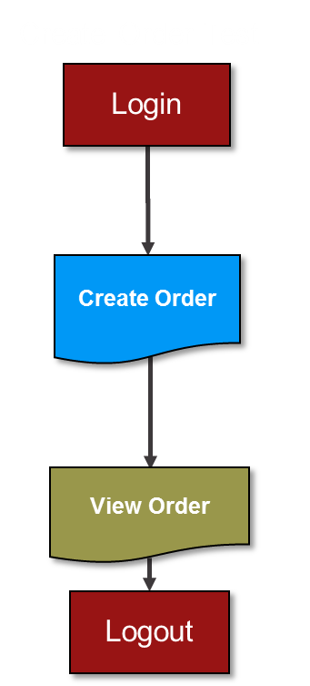
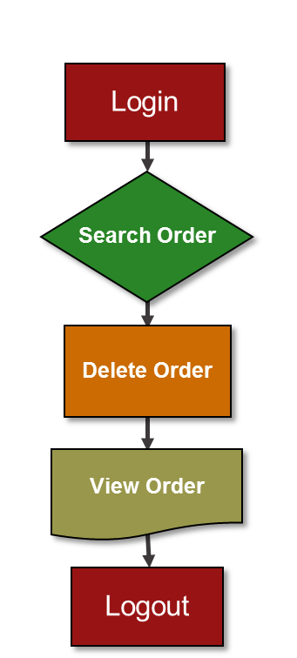
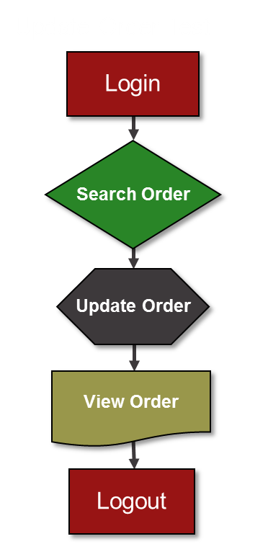

Traditional Functional Testing Process
Create Order Test
Delete Order Test
Update Order Test

Slide 6
When Using BPT
Login
Create Order
View Order
Search Order
Delete Order
Update Order
Logout
CREATE ORDER
DELETE ORDER
UPDATE ORDER
Test Data
Reduce Test Creation Time by 50%

Slide 7
Question ? Feedback ! Comments !!
Discussion

