Slide 1
Creating a Flow
Presented by: Gustavo Segura
gustavo@ideliver-inc.com
Elaborated by: Douglas G.
douglas@ideliver-inc.com

Slide 2
Agenda
Business Process Test and Flow
How to use flows in BPT test
Demo
Exercise

Slide 3
Business Process Test and Flow
A flow is a type of test that comprises a logical set of business components
Flows share the same functionality as business process tests
Flows cannot contain other flows.

Slide 4
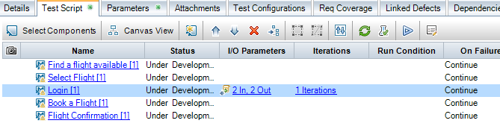
Validate Tests
Test Plan Module -> Test Script Tab
Click “Validate Button” or press “F8”
1
2

Slide 5
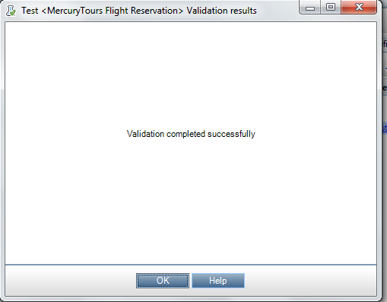
Validation Tests(Cont.)
If errors are not found, a message will be displayed

Slide 6
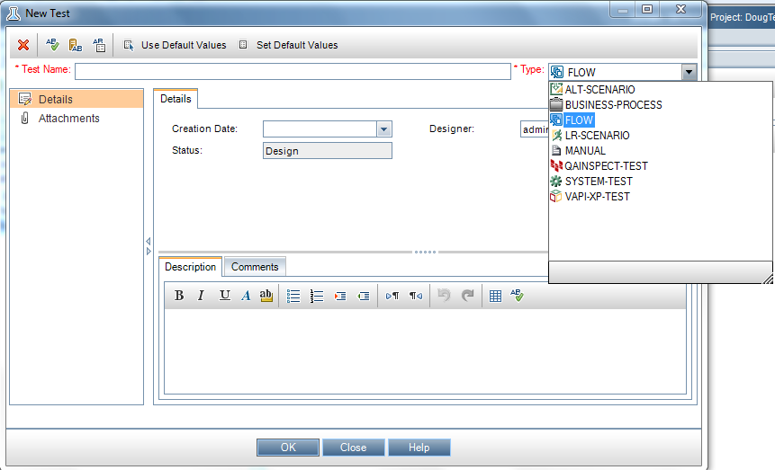
Create a flow test
Test Plan -> New Test -> Type: select Flow

Slide 7

Demo

Slide 8

Exercise

