Slide 1
UNIFIED FUNCTIONAL TESTING
Name - Sourabh Chakroborty
Email ID – Sourabhc@ideliver-inc.com

Slide 2
OVERVIEW :
OBJECT REPOSITORY
CHECKPOINT/OUTPUT VALUE
DATA TABLE

Slide 3
INTRODUCTION ON UFT
It performs functional and regression testing.
First it is known by Astra Quick Test & it is developed by Mercury interactive.
First release in 2001 version 5.5
Then it name change to QTP(Quick Test Professional).
In 2006 Mercury interactive it acquired by HP.
In 2012 QTP become UFT.
Latest version is 12.50.
QTP file script extension is .mst .

Slide 4
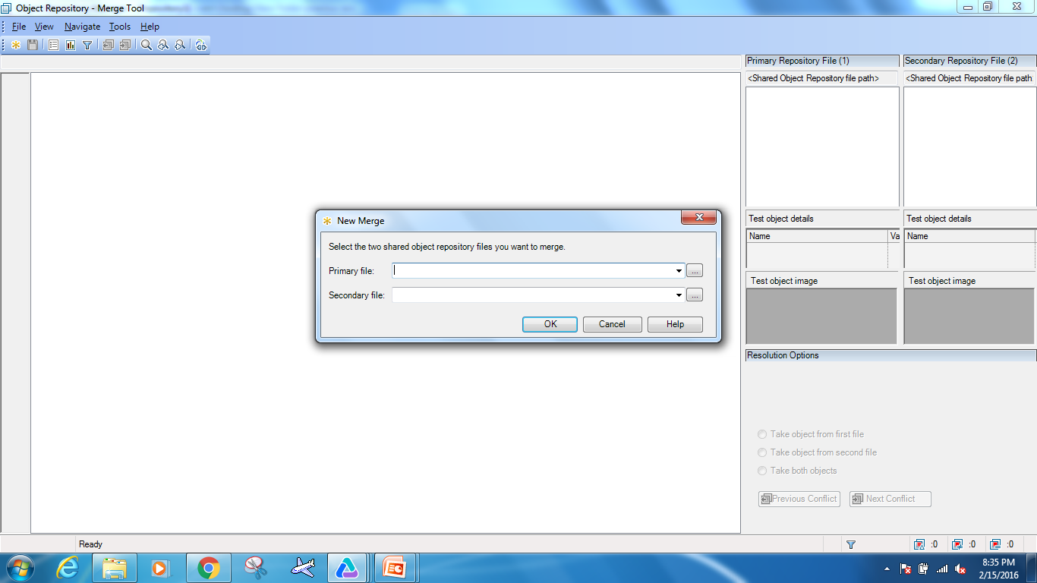
OBJECT REPOSITORY
Object Repository is a collection of object and properties with which QTP will be able to recognize the objects and act on it.
Types of Object Repository → Local object repository→ Shared object repository
Local OR extension .bdb
Shared OR extension .tsr
Convert local to shared OR
Merge two shared OR
Edit shared OR

Slide 5
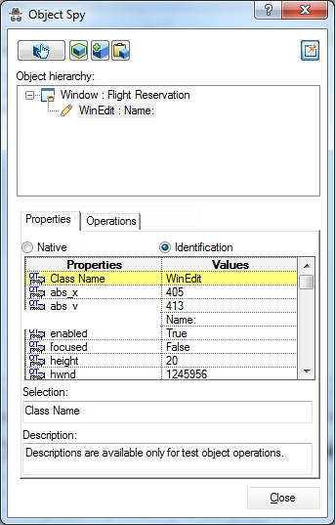

OBJECT SPY
Object Spy is a way within QTP to add objects to the Object Repository.
Object Spy gives the complete hierarchy of the object we have selected.

Slide 6
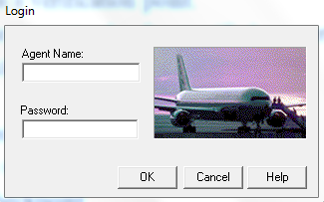
CHECKPOINT
Check point is a verification point.
It compare the current value of specified property to expected value.
Types of checkpoint
→Standard Checkpoints
→Bitmap Checkpoint
→Text Checkpoint
→Text Area Checkpoint

Slide 7
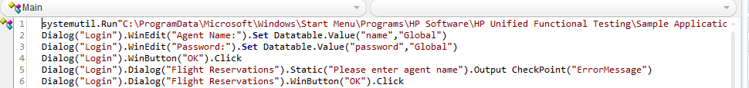
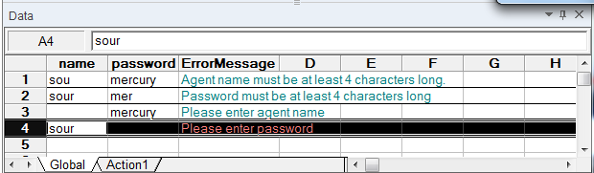
OUTPUT VALUE
An output value , is a step in which a object property value is captured at a specific point in your test and stored in the datatable.
Types of output value
→Standard output value
→Text output value
→Text Area output value

Slide 8
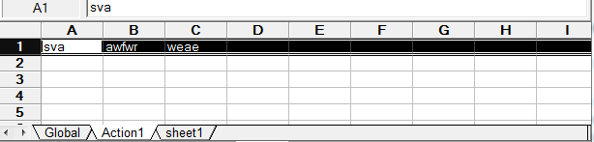
DATATABLE
A DataTable is similar to Microsoft Excel.
Helps testers to get and set data from datatable for the script.
Types of datatable
Design time
Run time
datatable.AddSheet"sheet1"

Slide 9
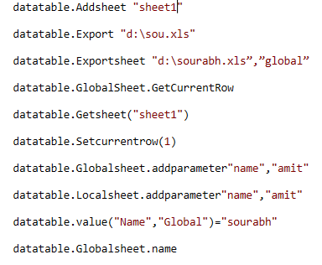
DATATABLE METHODS AND PROPERTIES
AddSheet Method
Export Method
ExportSheet Method
GetCurrentRow method
GetSheet Method
SetCurrentRow Method
GlobalSheet Property
LocalSheet Property
Value Property
Name Property

Slide 10
THANK YOU

