Slide 1

PROJECT 1
Swiggy_Instamart DATA

Slide 2
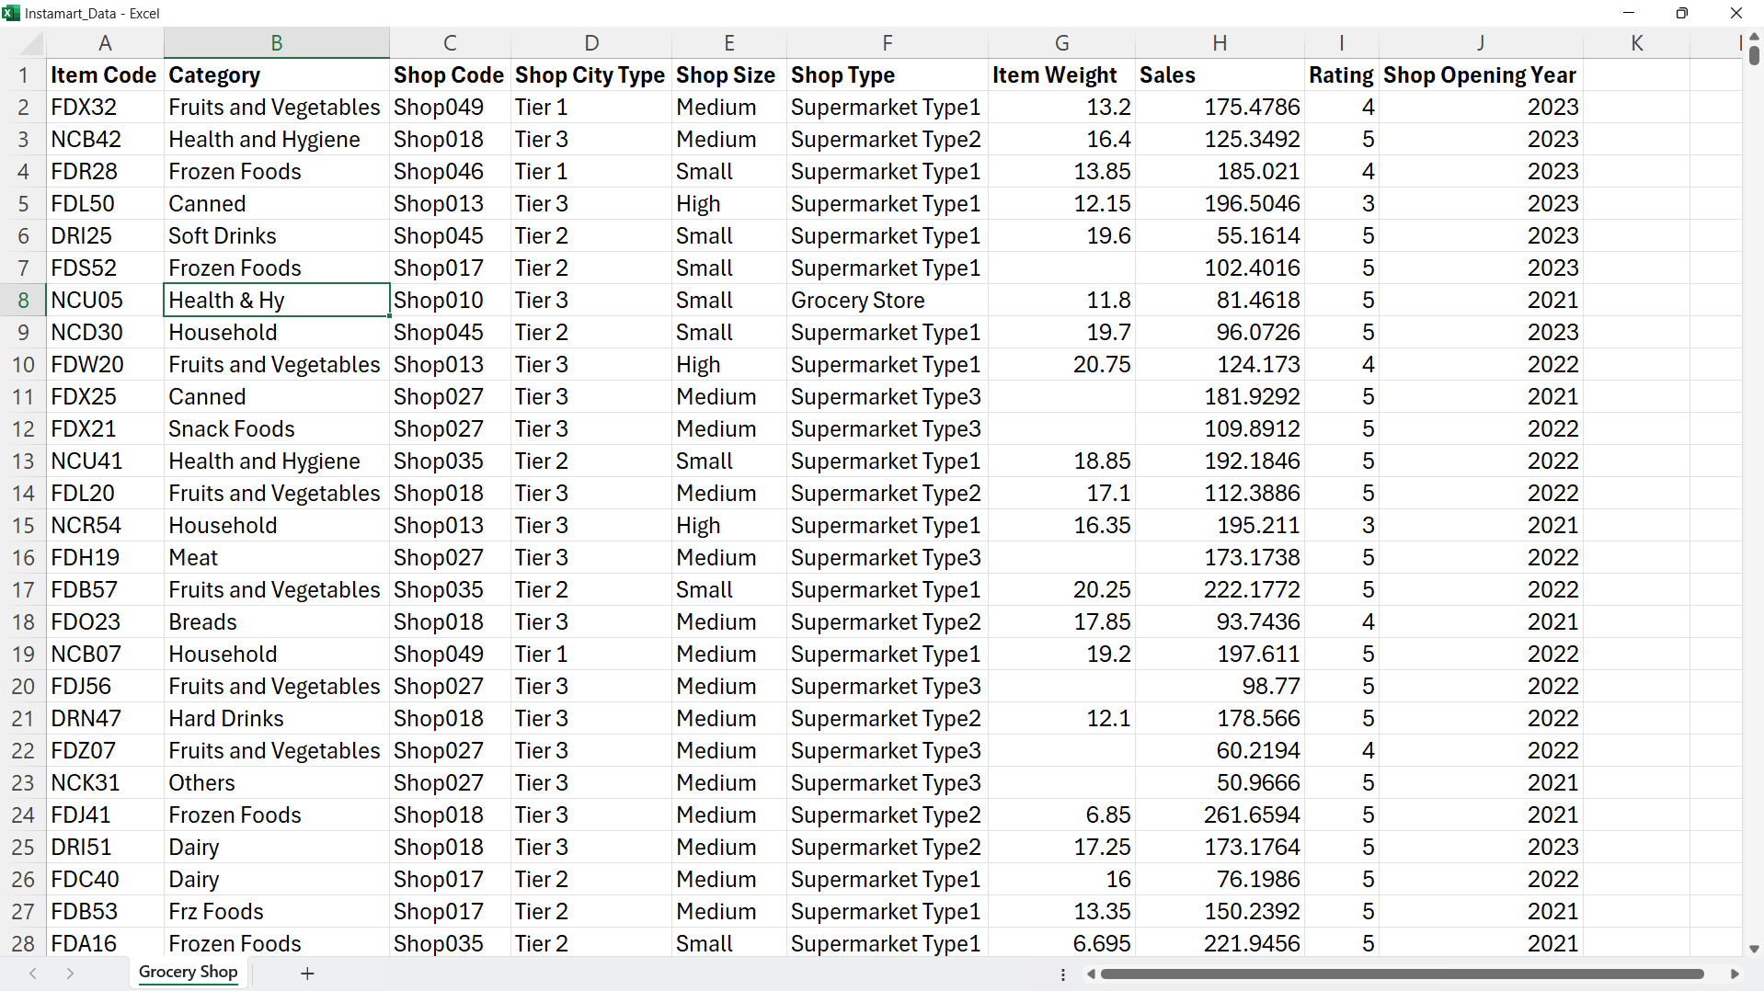
DATA

Slide 3
Show kpi’s
Total Sales: The overall revenue generated from all items sold.
Average Sales: The average revenue per sale.
Number of Items: The total count of different items sold.
Average Rating: The average customer rating for items sold.

Slide 4
Charts
Total Sales by Shop and Category
Total Order by City Type – Donut Chart
Shops opening year wise – Line Chart
Total Sales, Avg Sales, Order Count, Avg Rating …Show in Donut chart (Each Shop Size)
Total Sales by City Type in Column Chart
Shop Total Sales, Avg Sales, Order Count, Avg Rating …Show in Table (Each shop Type)
Total Sales by Category wise in Bar Chart

Slide 5
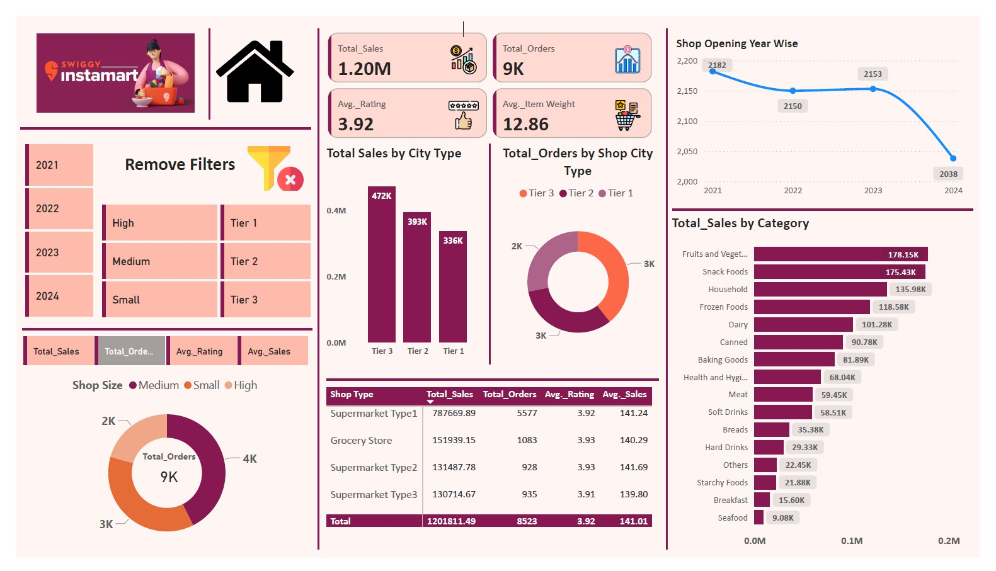

Slide 6




OUTPUT
Total Sales: The overall revenue generated from all items sold: 1.20 Million
Average Sales: The average item weight: 12.86
Number of Items: The total count of different items sold: 9K
Average Rating: The average customer rating for items sold: 3.92

