Slide 1
KRISHNA ENGINEERING, Ghaziabad, UP
Department of Information Technology
Project Presentation (IV Sem), Session 2022-23
Address Book
Project Guide: Ms. Neha Chandela
 | Saurabh Singh 2101611530048

Slide 2
Contents
Introduction
Flowchart
Hardware & Software Requirement
Code
Screenshots
References

Slide 3
Introduction
The Address Book application allows users to store and manage contact information
It utilizes database connectivity to ensure data persistence
Intuitive and user-friendly design
Efficiently organize and manage contact information including the person’s First name, Last name, phone number and many other information

Slide 4
Flowchart
Start
The main Window
Updating Window
Editing the record window
End

Slide 5
Hardware & Software Requirement:
Operating System:
Windows 7,10 or 11
Mac OS X 10.11 or higher, 64-bit
Linux: RHEL 6/7, 64-bit
Hardware Requirements:
x86 64-bit CPU (Intel / AMD architecture)
4 GB RAM
5 GB free disk space

Slide 6
Code
(1)
from tkinter import *
import sqlite3
import messagebox
main_window = Tk()
main_window.title("Address Book")
main_window.iconbitmap("Saurabh.ico")
main_window.geometry("750x380+100+200")
main_window.resizable(False,False)
main_window.configure(background='black')
def check():
flag = 0
global f_name,l_name,phone_num,address,state,city,zcode
if f_name.get() !="" and f_name.get()!=" ":
flag+=1
if l_name.get() !="" and l_name.get()!=" ":
flag+=1
if phone_num.get() !="" and phone_num.get()!=" ":
flag+=1
(2)
if address.get() !="" and address.get()!=" ":
flag+=1
if state.get() !="" and state.get()!=" ":
flag+=1
if city.get() !="" and city.get()!=" ":
flag+=1
if zcode.get() !="" and zcode.get()!=" ":
flag+=1
if flag==7:
try:
int(phone_num.get())
int(zcode.get())
Add()
except:
messagebox.showerror("Error","Please enter valid phone number or zipcode")
else:
messagebox.showerror("Error","Please enter complete Details.")

Slide 7
Code
(3)
def Add():
conn = sqlite3.connect('address_book.db')
c = conn.cursor()
c.execute("INSERT INTO addresses VALUES (:f_name, :l_name, :phone_num, :address, :state, :city, :zcode)",
{
"f_name": f_name.get(),
"l_name": l_name.get(),
"phone_num":phone_num.get(),
"address": address.get(),
"state": state.get(),
"city": city.get(),
"zcode": zcode.get()
})
conn.commit()
conn.close()
f_name.delete(0,END)
l_name.delete(0,END)
(4)
phone_num.delete(0,END)
address.delete(0,END)
state.delete(0,END)
city.delete(0,END)
zcode.delete(0,END)
def Querry():
#for clearing the widgets in the frame
for widget in frame_name.winfo_children():
widget.destroy()
#create a database or connect
conn = sqlite3.connect('address_book.db')
#create a cursor
c = conn.cursor()
#query the database
c.execute("SELECT *,oid FROM addresses")
records = c.fetchall()
print_record=''

Slide 8
Code
(5) if records == [ ]:
error = Label(frame_name,text="Records Empty",font=('Times New Roman',17,'bold'),bg="#FFE5B4")
error.grid(row=0,column=0,rowspan=2)
return
else:
naming = Label(frame_name,text="OID \t\t\tName",font=('Times New Roman',17,'bold'),bg="#FFE5B4")
naming.grid(row=0,column=0,padx=0,pady=0)
for record in records:
print_record+=(str(record[7])+"\t\t"+str(record[0])+" "+str(record[1])+"\n")
show = Label(frame_name,text=print_record,width=30,bd=5,font=('Times New Roman',17,'bold'),bg="#FFE5B4",fg="Maroon")
show.grid(row=1,column=0)
conn.commit()
conn.close()
(6) def oid_check():
conn = sqlite3.connect('address_book.db')
c = conn.cursor()
c.execute("SELECT oid FROM addresses")
records = c.fetchall()
flag=0
if del_box.get()=="" or del_box.get()==" ":
messagebox.showerror("Error","Please Enter a vaid OID")
else:
for record in records:
if int(del_box.get()) in record:
flag=1
if flag==1:
edit()
else:
messagebox.showerror("Error","Please Enter a vaid OID")
conn.commit()
conn.close()

Slide 9
Code
(7) def Updation():
global updation_window, frame_name, del_box, frame_update, empty_frame
updation_window=Tk()
updation_window.configure(background='black')
updation_window.iconbitmap("Saurabh.ico")
updation_window.title("Updating Record")
updation_window.geometry("630x500")
updation_window.resizable(False,False)
frame_update = LabelFrame(updation_window,padx=5,pady=5,width=300,height=300,bg="#FFE5B4")
frame_name = LabelFrame(updation_window,padx=5,pady=5,width=620,height=300,bg="#FFE5B4")
frame_name.grid(row=1,column=0,padx=5,pady=5)
Select_id = Label(frame_update,text="Enter OID",font=('Times New Roman',17,'bold'),bg="#FFE5B4",fg="maroon")
del_box = Entry(frame_update,bd=5,width=30,font=('Times New Roman',17,'bold'))
show_record = Button(frame_update,text="Show Records",command=Querry,font=('Times New Roman',17,'bold'),bg="#FFE5B4",bd=5,fg="maroon")
update_record = Button(frame_update,text="Update Record",command=oid_check,font=('Times New Roman',17,'bold'),bg="#FFE5B4",bd=5,fg="maroon")
remove_record = Button(frame_update,text="Remove Record",command=Remove,font=('Times New Roman',17,'bold'),bg="#FFE5B4",bd=5,fg="maroon")
Select_id.grid(row=1,column=0,padx=5,pady=5)
del_box.grid(row=1,column=1,padx=5,pady=5)
show_record.grid(row=0,columnspan=2,ipadx=180,pady=5,padx=5)

Slide 10
Code
(8) update_record.grid(row=2,column=0,ipadx=10,padx=10,pady=5)
remove_record.grid(row=2,column=1,padx=5,pady=5)
frame_update.grid(row=0,column=0,padx=5,pady=5)
updation_window.mainloop()
def Remove()
conn = sqlite3.connect('address_book.db')
c = conn.cursor()
c.execute("SELECT * from addresses")
if del_box.get()=="":
Label(empty_frame,text="Please Enter an OID",font=('Times New Roman',17,'bold')).grid(row=3,columnspan=2,padx=5)
else:
c.execute("DELETE from addresses WHERE oid="+del_box.get())
#commit changes
conn.commit()
#close the connection
conn.close()
(9) def update():
#create a database or connect
conn = sqlite3.connect('address_book.db')
#create a cursor
c = conn.cursor()
#query the database
record_id = del_box.get()
c.execute("""UPDATE addresses SET first_name = :first,last_name = :last,address = :address,phone_num = :phone_num,city = :city,state = :state,zipcode = :zipcode
WHERE oid = :oid""",
{'first' : f_name_editor.get(),
'last' : l_name_editor.get(),
'phone_num' : phone_num_editor.get(),
'address' : address_editor.get(),
'city' : city_editor.get(),
'state' : state_editor.get(),
'zipcode' : zcode_editor.get(),
'oid' : record_id,}}

Slide 11
Code
(10)
conn.commit()
conn.close()
edit_window.destroy()
def create():
conn = sqlite3.connect('address_book.db')
c = conn.cursor()
c.execute("""CREATE TABLE addresses (
first_name text,
last_name text,
phone_num integer,
address text,
city text,
state text,
zipcode integer
)""")
conn.commit()
conn.close()
(11)def edit():
global edit_window,Record_Box,l_name_editor,f_name_editor,address_editor,state_editor,city_editor,zcode_editor,phone_num_editor
conn = sqlite3.connect('address_book.db')
c = conn.cursor()
record_id = del_box.get()
if del_box.get()=="":
Label(updation_window,text="Please Enter an OID",font=('Times New Roman',17,'bold')).grid(row=3,columnspan=2,pady=(20,0),ipadx=100)
else:
edit_window = Tk()
edit_window.title("Edit the record")
edit_window.configure(background='black')
edit_window.resizable(False,False)
c.execute("SELECT * FROM addresses WHERE oid = "+record_id)
records = c.fetchall()

Slide 12
Code
(12)
frame_entry = LabelFrame(edit_window,padx=5,pady=5,bg="#FFE5B4",bd=4)
f_name_editor = Entry(frame_entry,width=30,font=('Times New Roman',17,'bold'),bd=5)
l_name_editor = Entry(frame_entry,width=30,font=('Times New Roman',17,'bold'),bd=5)
phone_num_editor = Entry(frame_entry,width=30,font=('Times New Roman',17,'bold'),bd=5)
address_editor = Entry(frame_entry,width=30,font=('Times New Roman',17,'bold'),bd=5)
state_editor = Entry(frame_entry,width=30,font=('Times New Roman',17,'bold'),bd=5)
city_editor = Entry(frame_entry,width=30,font=('Times New Roman',17,'bold'),bd=5)
zcode_editor = Entry(frame_entry,width=30,font=('Times New Roman',17,'bold'),bd=5)
f_name_editor.grid(row=0,column=1,padx=5,pady=5)
l_name_editor.grid(row=1,column=1,padx=5,pady=5)
address_editor.grid(row=2,column=1,padx=5,pady=5)
phone_num_editor.grid(row=3,column=1,padx=5,pady=5)
state_editor.grid(row=4,column=1,padx=5,pady=5)
city_editor.grid(row=5,column=1,padx=5,pady=5)
zcode_editor.grid(row=6,column=1,padx=5,pady=5)
(13)
for record in records:
f_name_editor.insert(0, record[0])
l_name_editor.insert(0, record[1])
phone_num_editor.insert(0, record[2])
address_editor.insert(0, record[3])
city_editor.insert(0, record[4])
state_editor.insert(0, record[5])
zcode_editor.insert(0, record[6])
frame_entry.grid(row=0,column=1,padx=5,pady=5)

Slide 13
Code
(14)
frame_label = LabelFrame(edit_window,padx=5,pady=5,bg="#FFE5B4",bd=4,fg="blue")
f_name_l = Label(frame_label,text="First Name",font=('Times New Roman',17,'bold'),fg="maroon",bg="#FFE5B4")
l_name_l = Label(frame_label,text="Last Name",font=('Times New Roman',17,'bold'),fg="maroon",bg="#FFE5B4")
phone_num_l = Label(frame_label,text="Phone Number",font=('Times New Roman',17,'bold'),fg="maroon",bg="#FFE5B4")
address_l = Label(frame_label,text="Address",font=('Times New Roman',17,'bold'),fg="maroon",bg="#FFE5B4")
state_l = Label(frame_label,text="State",font=('Times New Roman',17,'bold'),fg="maroon",bg="#FFE5B4")
city_l = Label(frame_label,text="City",font=('Times New Roman',17,'bold'),fg="maroon",bg="#FFE5B4")
zcode_l = Label(frame_label,text="Zip Code",font=('Times New Roman',17,'bold'),fg="maroon",bg="#FFE5B4")
f_name_l.grid(row=0,column=0,padx=5,pady=8)
l_name_l.grid(row=1,column=0,padx=5,pady=8)
phone_num_l.grid(row=2,column=0,padx=5,pady=8)
address_l.grid(row=3,column=0,padx=5,pady=8)
state_l.grid(row=4,column=0,padx=5,pady=8)
city_l.grid(row=5,column=0,padx=5,pady=8)
zcode_l.grid(row=6,column=0,padx=5,pady=8)
frame_label.grid(row=0,column=0,padx=5,pady=5)

Slide 14
Code
(15) frame_btn = LabelFrame(edit_window,padx=5,pady=5,bg="#FFE5B4",bd=5)
save_btn = Button(frame_btn,text="Save edited Record",command=update,font=('Times New Roman',17,'bold'),fg="maroon",bg="#FFE5B4")
save_btn.grid(row=0,column=0,padx=80,columnspan=2)
frame_btn.grid(row=1,column=0,columnspan=2,ipadx=106)
edit_window.mainloop()
frame_entry = LabelFrame(main_window,padx=5,pady=5,bg="#FFE5B4",bd=4)
f_name = Entry(frame_entry,width=30,font=('Times New Roman',17,'bold'),bd=5)
l_name = Entry(frame_entry,width=30,font=('Times New Roman',17,'bold'),bd=5)
phone_num = Entry(frame_entry,width=30,font=('Times New Roman',17,'bold'),bd=5)
address = Entry(frame_entry,width=30,font=('Times New Roman',17,'bold'),bd=5)
state = Entry(frame_entry,width=30,font=('Times New Roman',17,'bold'),bd=5)
city = Entry(frame_entry,width=30,font=('Times New Roman',17,'bold'),bd=5)
zcode = Entry(frame_entry,width=30,font=('Times New Roman',17,'bold'),bd=5)
f_name.grid(row=0,column=1,padx=10,pady=2)
l_name.grid(row=1,column=1,padx=10,pady=2)
address.grid(row=2,column=1,padx=10,pady=2)
phone_num.grid(row=3,column=1,padx=10,pady=2)
state.grid(row=4,column=1,padx=10,pady=2)
city.grid(row=5,column=1,padx=10,pady=2)

Slide 15
Code
(16)zcode.grid(row=6,column=1,padx=10,pady=2)
frame_entry.grid(row=0,column=1,padx=5,pady=5)
frame_label = LabelFrame(main_window,padx=5,pady=5,bg="#FFE5B4",bd=4,fg="blue")
f_name_l = Label(frame_label,text="First Name",font=('Times New Roman',17,'bold'),bg="#FFE5B4",fg="maroon")
l_name_l = Label(frame_label,text="Last Name",font=('Times New Roman',17,'bold'),bg="#FFE5B4",fg="maroon")
address_l = Label(frame_label,text="Address",font=('Times New Roman',17,'bold'),bg="#FFE5B4",fg="maroon")
phone_num_l = Label(frame_label,text="Phone Number",font=('Times New Roman',17,'bold'),bg="#FFE5B4",fg="maroon")
state_l = Label(frame_label,text="State",font=('Times New Roman',17,'bold'),bg="#FFE5B4",fg="maroon")
city_l = Label(frame_label,text="City",font=('Times New Roman',17,'bold'),bg="#FFE5B4",fg="maroon")
zcode_l = Label(frame_label,text="Zip Code",font=('Times New Roman',17,'bold'),bg="#FFE5B4",fg="maroon")
f_name_l.grid(row=0,column=0,padx=50,pady=5)
l_name_l.grid(row=1,column=0,padx=50,pady=5)
address_l.grid(row=2,column=0,padx=50,pady=5)
phone_num_l.grid(row=3,column=0,padx=50,pady=5)
state_l.grid(row=4,column=0,padx=50,pady=5)
city_l.grid(row=5,column=0,padx=50,pady=5)
zcode_l.grid(row=6,column=0,padx=50,pady=5)
frame_label.grid(row=0,column=0,padx=5,pady=5,ipadx=20)
frame_btn = LabelFrame(main_window,padx=5,pady=5,bg="#FFE5B4",bd=5)

Slide 16
Code
(17)
submit = Button(frame_btn,text="Add record to Database",command=check,font=('Times New Roman',17,'bold'),bg="#FFE5B4",fg="maroon",bd=5)
querry = Button(frame_btn,text="Add/Edit/Show",command=Updation,font=('Times New Roman',17,'bold'),bg="#FFE5B4",fg="maroon",bd=5)
submit.grid(row=7,column=0,ipadx=26,padx=5)
querry.grid(row=7,column=1,ipadx=96,padx=10)
frame_btn.grid(row=1,column=0,columnspan=2)
main_window.mainloop()

Slide 17
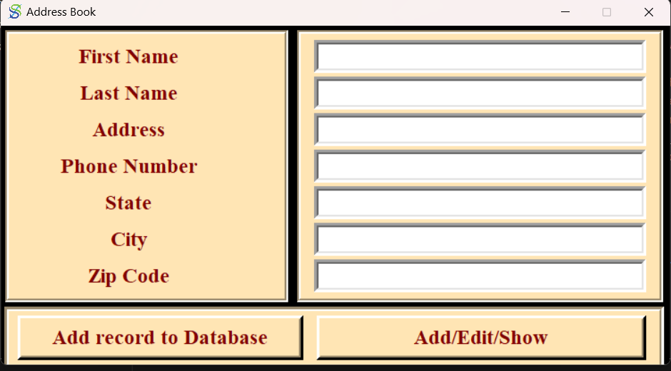
Screenshots
The Main Window

Slide 18
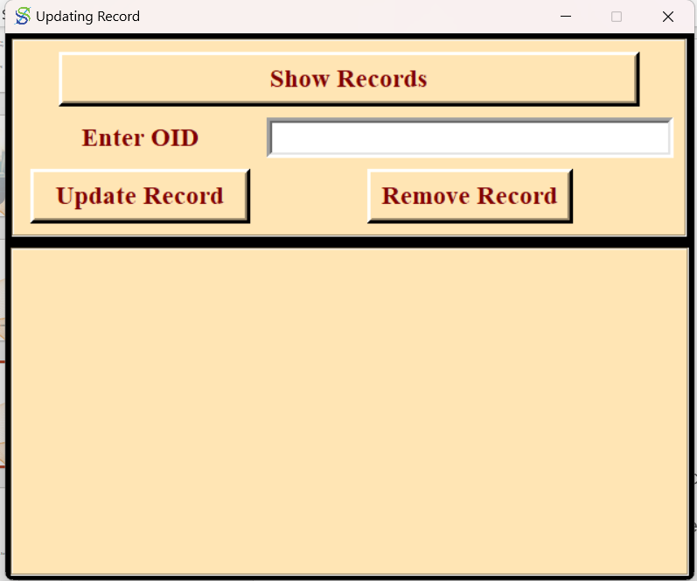
Screenshots
The Update Window

Slide 19
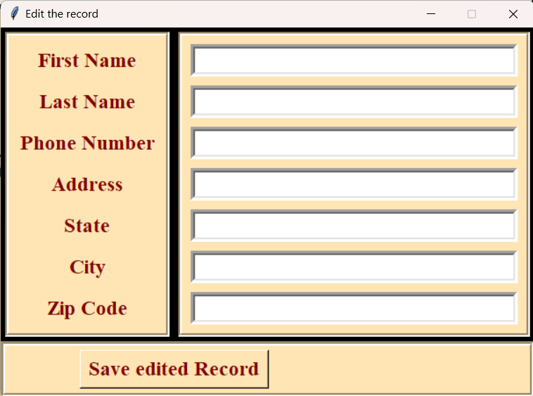
Screenshots
Edit the record window

Slide 20
References
Codemy.com
Geek for Geeks
Think Python

Slide 21
Thank You !

