Slide 1




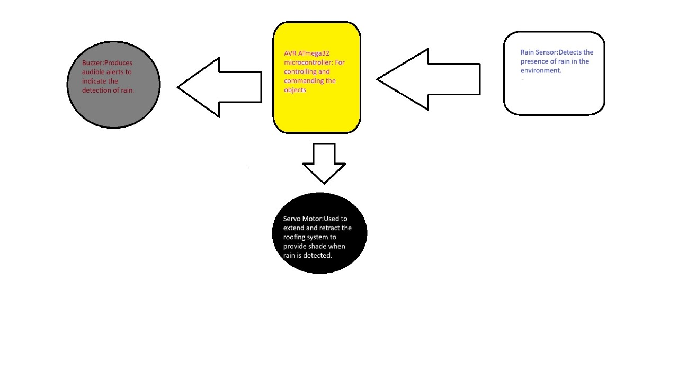

Department of C.S.E and C.S.E. (AI)
Auto-Roofing
Student Names:~Sourabh ~Amaresh ~Sarvesh ~Aniket ~Amey
Team No:7
Problem statement
Methodology
Block Diagram
A civil contractor is responsible for ensuring the safety and comfort of residents in a residential building. One particular area of concern is providing protection from rain in open areas such as balconies, terraces, or courtyards. Manually operating roofing systems can be cumbersome, especially for physically challenged and aged individuals. Therefore, an automatic solution is desired to enhance convenience and protection
Research and select the ATMEGA32 microcontroller based on its compatibility with the project requirements, including input/output pins, processing power, and available peripherals.
Ensure the microcontroller supports push button inputs and control of external devices such as a servo motor and buzzer
Reading input from push buttons and rain sensor.
Controlling the servo motor for extending and retracting the roof.
Activating the buzzer to sound an alarm when rain is detected..
.
Objectives
Rain Detection:
Implement a rain sensor to detect the presence of rain accurately.
Servo Motor Control:
Integrate a servo motor to control the movement of the roofing system.
Program the servo motor to extend the roof to provide shade when rain is detected and retract it when the rain stops.
Buzzer Activation:
Connect a buzzer to the system to provide an audible alert when rain is detected.
Design the system logic to activate the buzzer simultaneously with the extension of the roof.
Components Used
AVR ATmega32 microcontroller: For controlling and commanding the objects
Servo Motor:Used to extend and retract the roofing system to provide shade when rain is detected.
Rain Sensor:Detects the presence of rain in the environment.
Buzzer:Produces audible alerts to indicate the detection of rain.
Conclusions
The automatic roofing system presented in this project represents a significant advancement in providing rain protection for residential buildings, particularly for physically challenged and aged individuals. By leveraging the capabilities of the ATMEGA32 microcontroller and a range of components including servo motor, rain sensor and buzzer, the system achieves seamless automation and effective rain detection.
Microcontroller: Programming and Interfacing Project Worklet -2023-24

