Slide 1

1. UI Automation testing 2. CREATE AND AUTOMATE A REST API
STACK ROUTE
SDET – CAPSTONE PROJECT
Group No.: 05
STACK ROUTE
Under the Mentorship of
Ms. Swati Ma’am
Project Team Members
1. Sourabh G Patil
2. Rohit Gupta

Slide 2
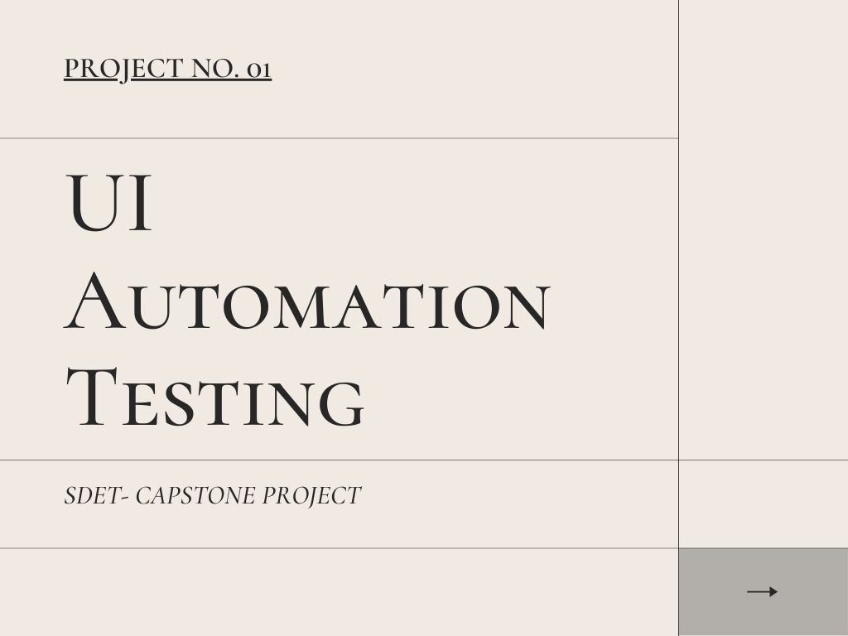

Slide 3
contents OF THE UI AUTOMATION
INTRODUCTION
TECHNOLOGY USED
TEST SCENARIOS
OUTPUT

Slide 4
INTRODUCTION
Automate the UI for the website - http://automationpractice.com/index.php
Write test scripts for two pages using POM
Each page must have five test scenarios which must be approved by the mentor
The project must include TestNG for all test cases
Automation test must be browser independent.
Jain college of engineering and research

Slide 5
TECHNOLOGY USED
Selenium
Selenium is an open-source tool that automates web browsers.
Java
Java programming language is used to write Selenium test scripts.
Cucumber
Cucumber is a tool based on Behavior Driven Development (BDD) framework which is used to write acceptance tests for the web application.
TestNG
TestNG is an open-source test automation framework for Java. TestNG makes automated tests more structured, readable, maintainable, and user-friendly.
Page Object Model (POM)
Page Object Model, also known as POM, is a design pattern in Selenium that creates an object repository for storing all web elements of a webpage.
Jain college of engineering and research

Slide 6
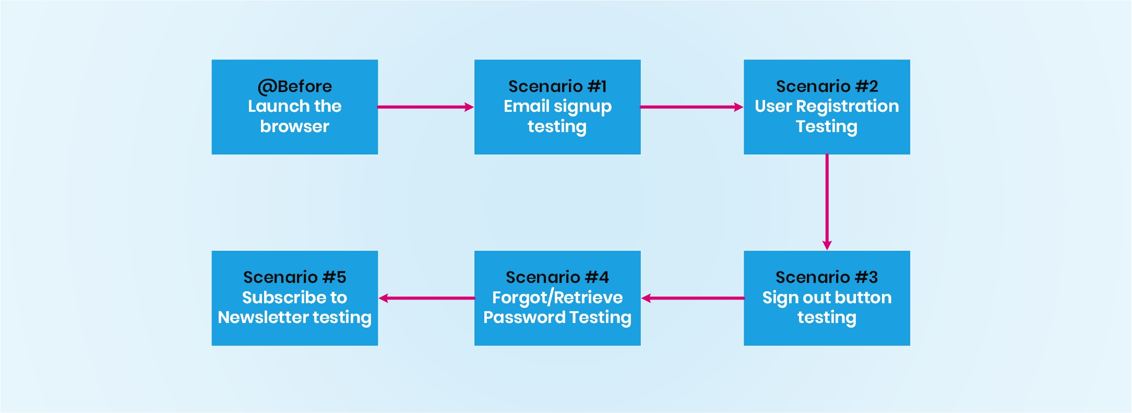
SCENARIOS FOR SIGN UP PAGE FEATURE
Jain college of engineering and research

Slide 7
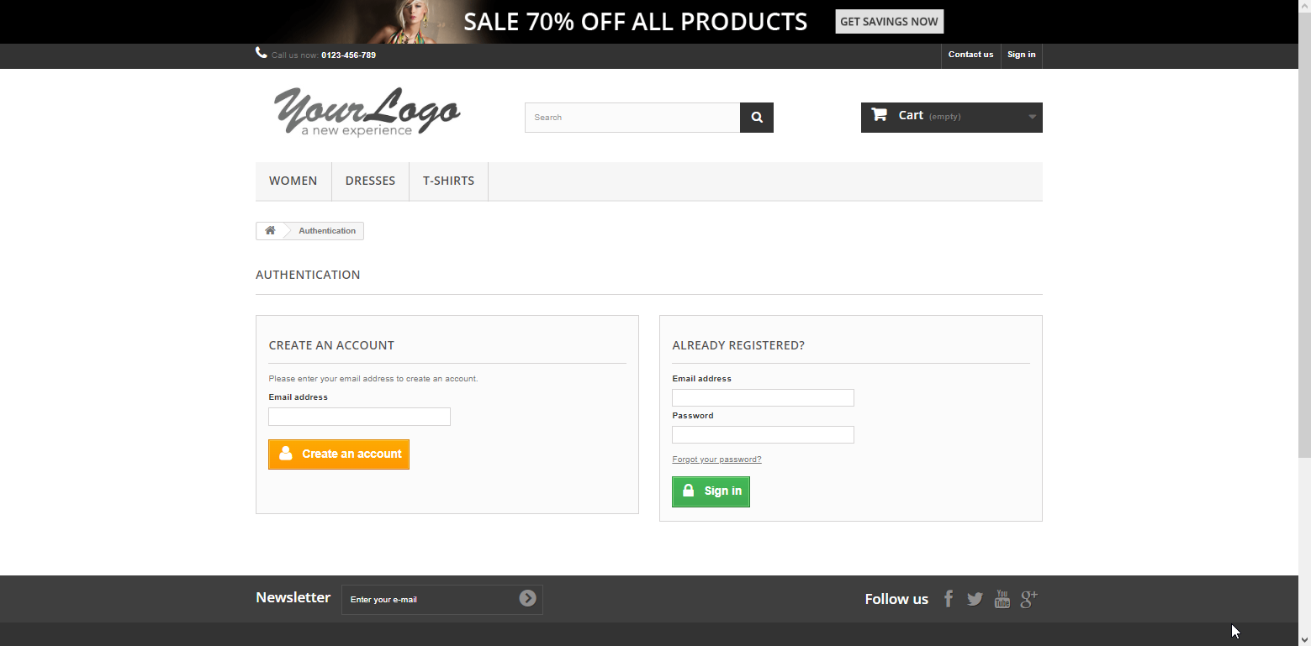
THE SIGNUP PAGE
Jain college of engineering and research

Slide 8
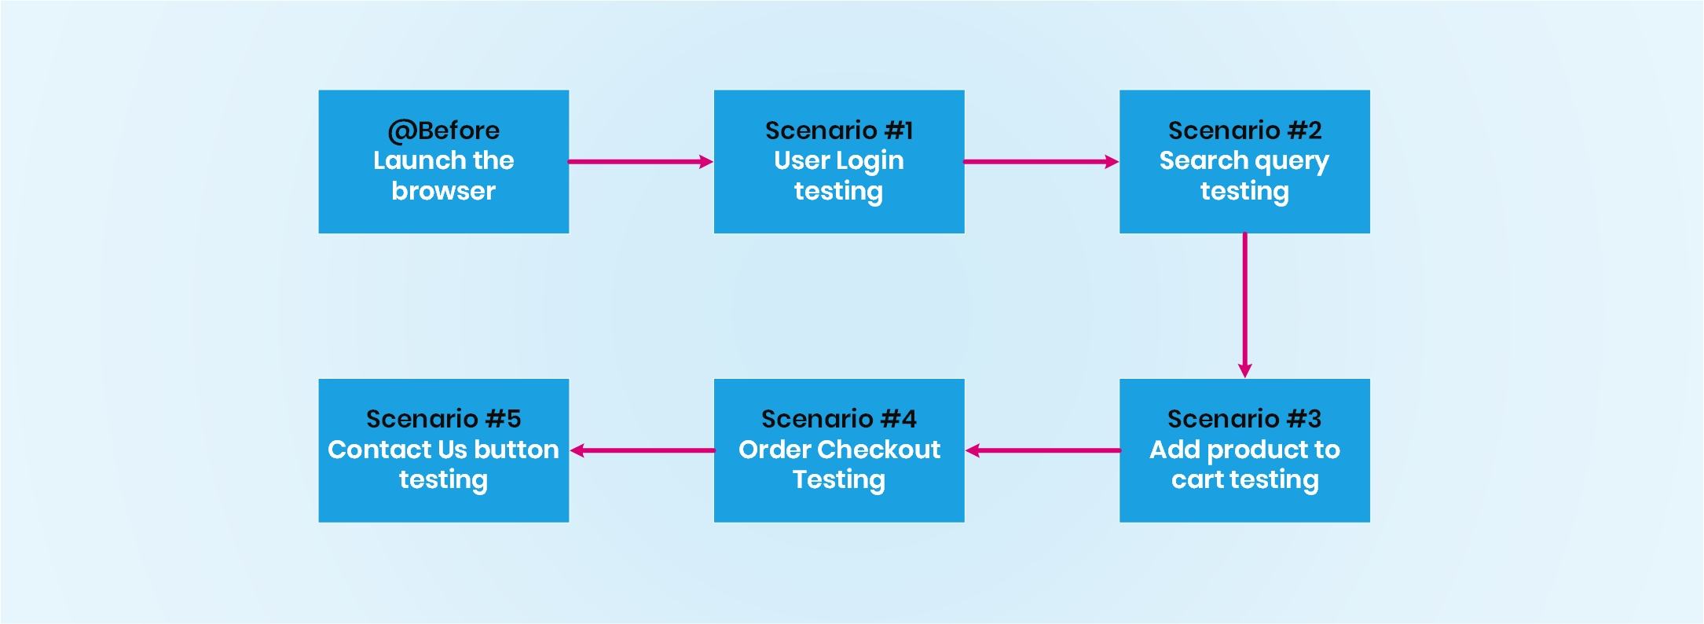
SCENARIOS FOR HOMEPAGE FEATURE
Jain college of engineering and research

Slide 9

THE HOMEPAGE
Jain college of engineering and research

Slide 10
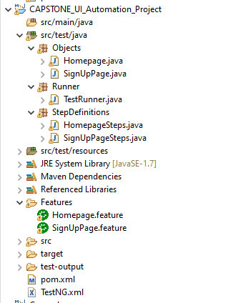
Project structure
Jain college of engineering and research

Slide 11
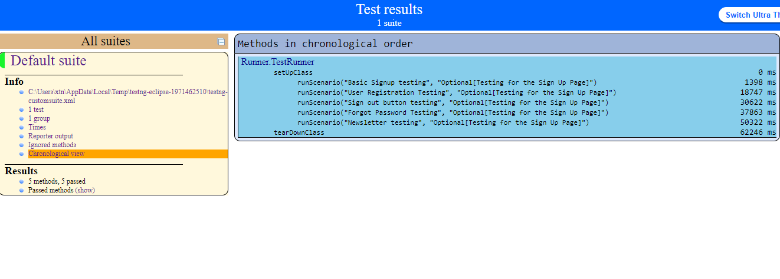
Testng report for Signup Page
Jain college of engineering and research

Slide 12
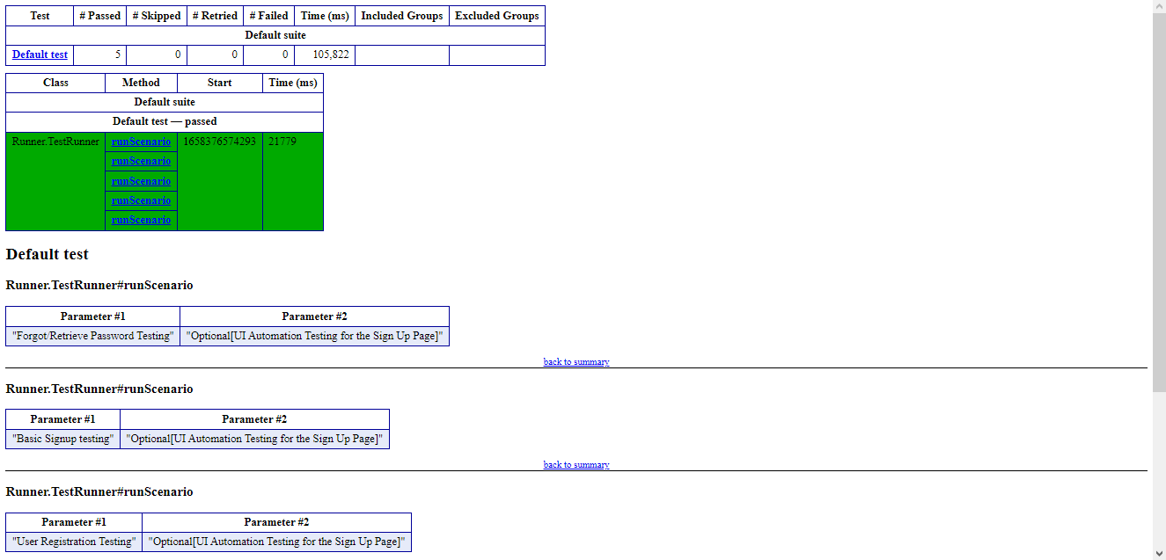
Testng emailable report for SIGNUP PAGE
Jain college of engineering and research

Slide 13
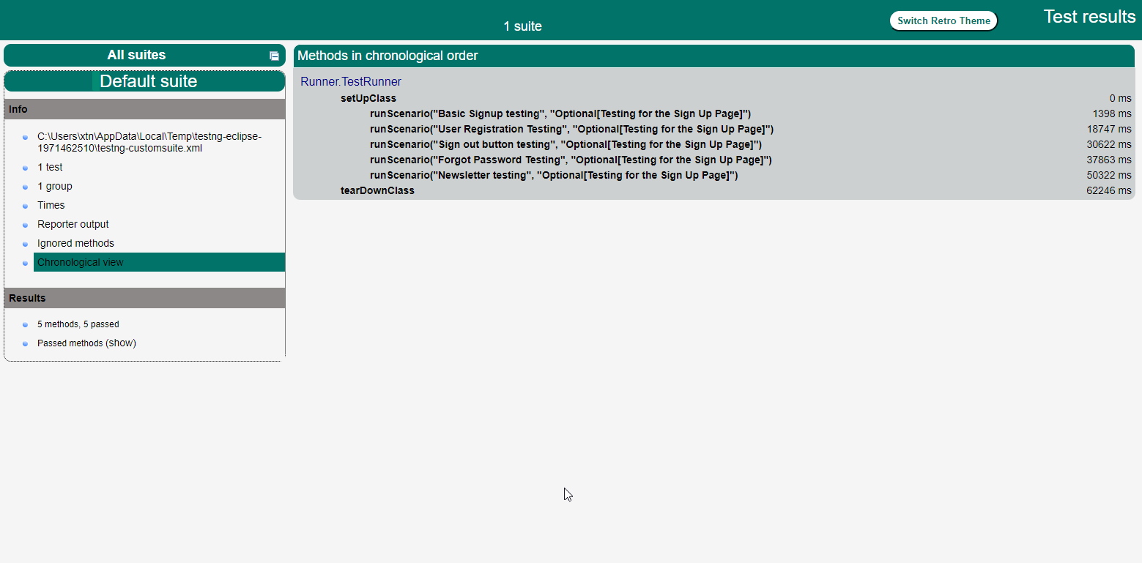
Testng report for homepage
Jain college of engineering and research

Slide 14
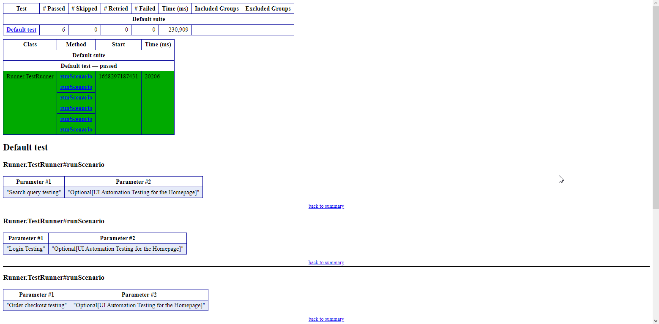
Testng emailable report for homepage
Jain college of engineering and research

Slide 15
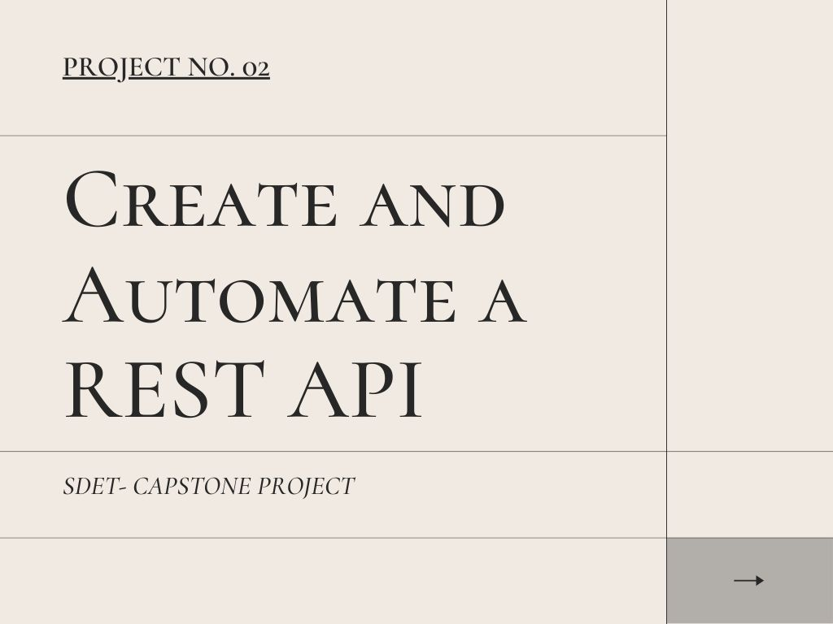

Slide 16
contentS OF THE API AUTOMATION
INTRODUCTION
OBJECTIVES
TECHNOLOGY USED
STEPS FOLLOWED
OUTPUT

Slide 17
INTRODUCTION
TopJobs Inc. is a company that wants to create an online job recruitment application that can be used by both employers and job seekers.
OBJECTIVES
Create a RESTful API using HTTP methods for CRUD(Create, Retrieve, Update and Delete) operations in Spring Boot along with the MySQL database.
This API should allow the employers to post the job openings and the applicants to apply for these jobs.
Automate this API by using TestNG.
Jain college of engineering and research

Slide 18
Technologies used
Apache Maven
Maven is chiefly used for Java-based projects, helping to download dependencies, which refers to the libraries or JAR files. The tool helps get the right JAR files for each project as there may be different versions of separate packages.
Spring Boot
Spring Boot is an open-source Java-based framework to build enterprise spring applications.
REST API
A REST API (also known as RESTful API) is an application programming interface (API or web API) that conforms to the constraints of REST architectural style and allows for interaction with RESTful web services.
MySQL
MySQL is a relational database management system that is used to store and manage the data of the API.
Postman
Postman is an API that is used to build, test, and modify REST APIs. We use Postman to execute the GET, POST, PUT and DELETE Request methods.
Jain college of engineering and research

Slide 19
STEPS FOLLOWED
Create the Spring Boot with Spring Initializr.
Create a MySQL database and define the Database Configurations.
Create Entity Model Class.
Create Service Class.
Create REST Controller class.
Build and Run the project.
Testing using Postman.
Write the test methods and run them using TestNG.
Jain college of engineering and research

Slide 20
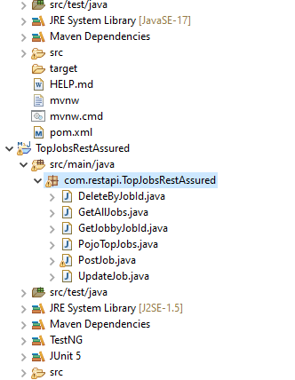
Project structure
Jain college of engineering and research

Slide 21
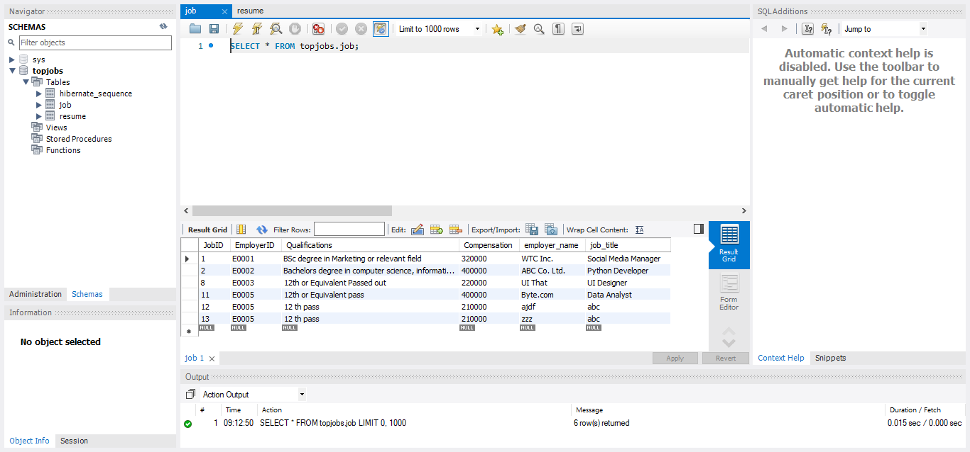
Fields in database
Jain college of engineering and research

Slide 22
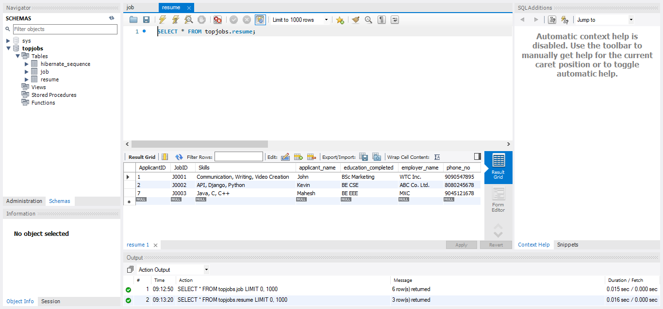
Fields in database
Jain college of engineering and research

Slide 23
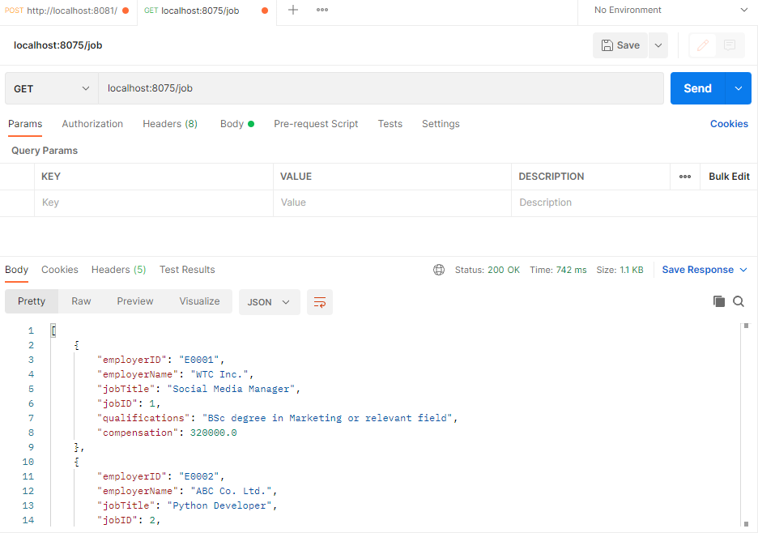
Testing in postman
Jain college of engineering and research

Slide 24
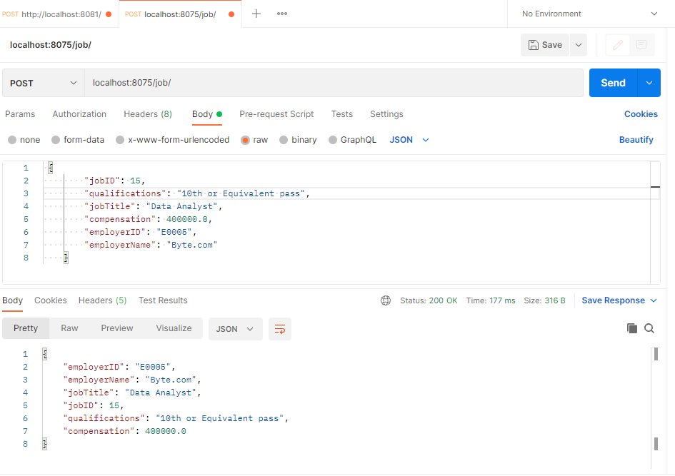
Testing in postman
Jain college of engineering and research

Slide 25
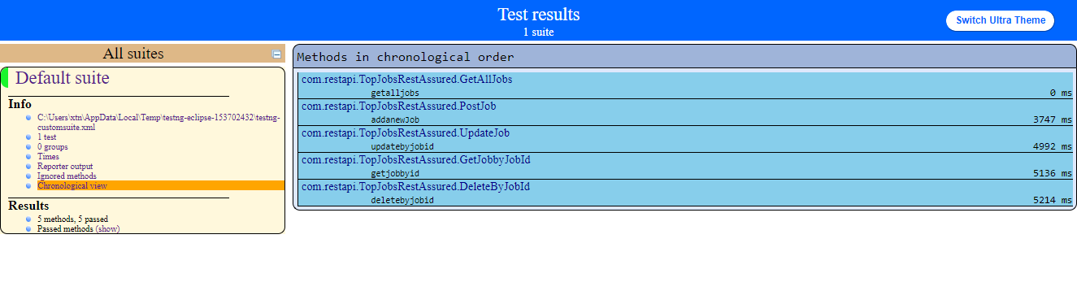
Testng report for the automation of api
Jain college of engineering and research

Slide 26
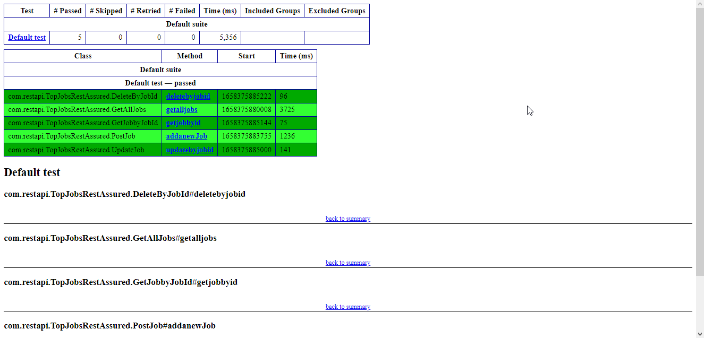
Emailable Testng report for the automation of api
Jain college of engineering and research

Slide 27
THANK YOU

