Slide 1
Tutorial 2 – the outline
Bayesian decision making with discrete
probabilities – an example
Looking at continuous densities
Bayesian decision making with continuous
probabilities – an example
The Bayesian Doctor Example

Slide 2
Prior Probability
w - state of nature, e.g.
  w₁ the object is a fish, w₂ the object is a bird, etc.
  w₁ the course is good, w₂ the course is bad
  etc.
A priory probability (or prior) P(w_{i})

Slide 3
Class-Conditional Probability
Observation x, e.g.
  the objects has wings
  The object’s length is 20 cm
  The first lecture is interesting
Class-conditional probability density (mass) function p(x|w)

Slide 4
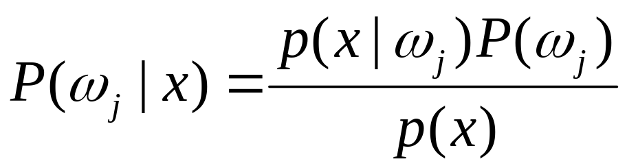
Bayes Formula
Suppose the priors P(w_{j}) and conditional densities p(x|w_{j}) are known,
prior
likelihood
posterior
evidence

Slide 5
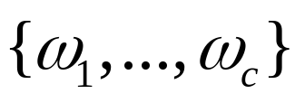
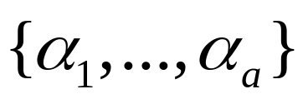
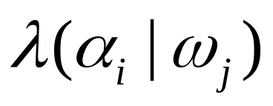
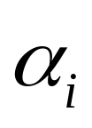
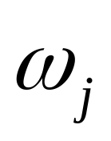
Loss function
the finite set of C states of nature (categories)
the finite set of a possible actions
The function determines the loss incurred by taking action when the state of nature is

Slide 6

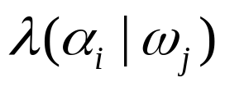
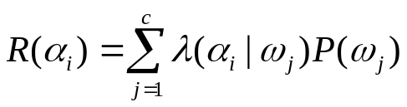
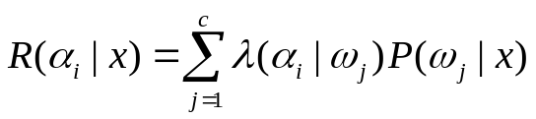
Conditional Risk
Suppose we observe a particular x and that we consider taking action
If the true state of nature is , the incurred loss is
The expected loss,
The conditional risk:

Slide 7
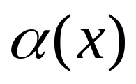
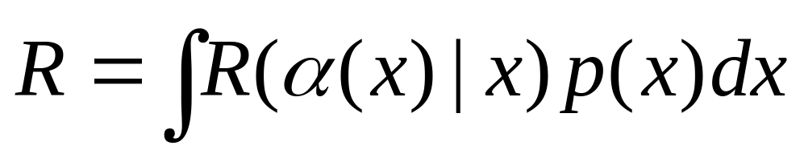
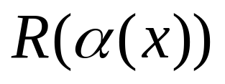
Decision Rule
Decision rule is - what action to take in each situation
Overall risk
is chosen so that is minimized for each x
Decision rule: minimize the overall risk

Slide 8
Example 1 – checking on a course
A student needs to make a decision which courses to take, based only on first lecture’s impression
From student’s previous experience:
These are prior probabilities.
Quality of the course | good | fair | bad
Probability (prior) | 0.2 | 0.4 | 0.4

Slide 9
Example 1 – continued
The student also knows the class-conditionals:
The loss function is given by the matrix
Pr(x|ω_{j}) | good | fair | bad
Interesting lecture | 0.8 | 0.5 | 0.1
Boring lecture | 0.2 | 0.5 | 0.9
λ(a_{i}|ω_{j}) | good course | fair course | bad course
Taking the course | 0 | 5 | 10
Not taking the course | 20 | 5 | 0

Slide 10
Example 1 – continued
The student wants to make an optimal decision
The probability to get the “interesting lecture”(x= interesting):
Pr(interesting)= Pr(interesting|good course)* Pr(good course)
+ Pr(interesting|fair course)* Pr(fair course)
+ Pr(interesting|bad course)* Pr(bad course)
=0.8*0.2+0.5*0.4+0.1*0.4=0.4
Consequently, Pr(boring)=1-0.4=0.6
Suppose the lecture was interesting. Then we want to compute the posterior probabilities of each one of the 3 possible “states of nature”.

Slide 11
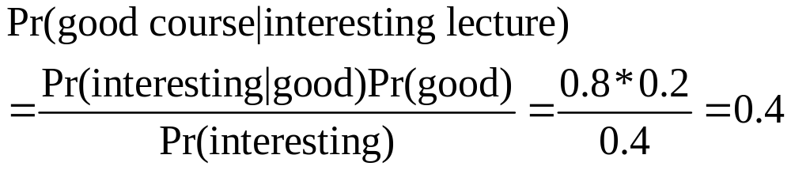
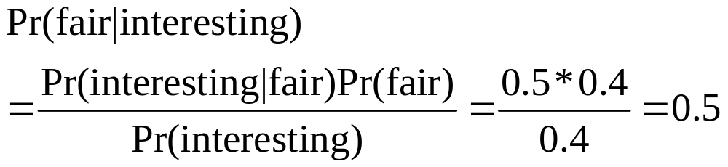
Example 1 – continued
We can get Pr(bad|interesting)=0.1 either by the same method, or by noting that it complements to 1 the above two.
Now, we have all we need for making an intelligent decision about an optimal action

Slide 12
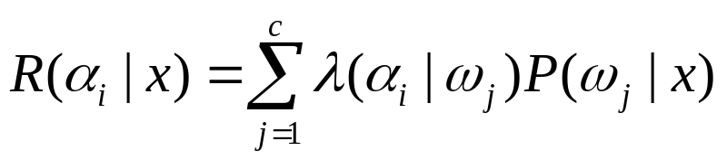
Example 1 – conclusion
The student needs to minimize the conditional risk; he can either take the course:
R(taking|interesting)= Pr(good|interesting)λ(taking good course) +Pr(fair|interesting)λ(taking fair course)
+Pr(bad|interesting)λ(taking bad course)
=0.4*0+0.5*5+0.1*10=3.5
or drop it: R(not taking|interesting)=
Pr(good|interesting)λ(not taking good course)
+Pr(fair|interesting)λ(not taking fair course)
+Pr(bad|interesting)λ(not taking bad course)
=0.4*20+0.5*5+0.1*0=10.5

Slide 13
Constructing an optimal decision function
So, if the first lecture was interesting, the student will minimize the conditional risk by taking the course.
In order to construct the full decision function, we need to define the risk minimization action for the case of boring lecture, as well.

Slide 14
Example 2 – continuous density
Let X be a real value r.v., representing a number randomly picked from the interval [0,1]; its distribution is known to be uniform.
Then let Y be a real r.v. whose value is chosen at random from [0, X] also with uniform distribution.
We are presented with the value of Y, and need to “guess” the most “likely” value of X.
In a more formal fashion:given the value of Y, find the probability density function p.d.f. of X and determine its maxima.

Slide 15
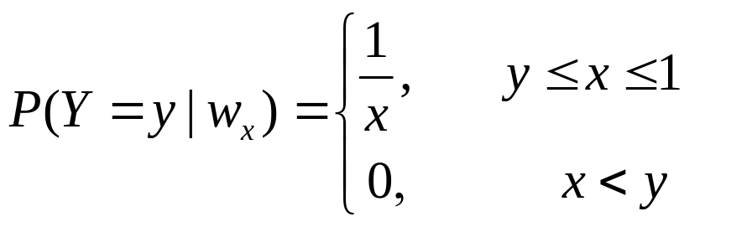
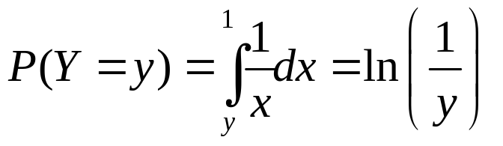
Example 2 – continued
Let w_{x} denote the “state of nature”, when X=x ;
What we look for is P(w_{x} | Y=y) – that is, the p.d.f.
The class-conditional (given the value of X):
For the given evidence:
(using total probability)

Slide 16
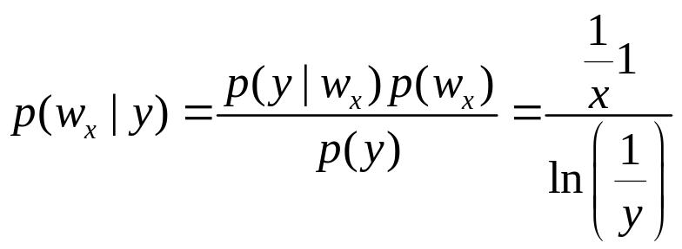
Example 2 – conclusion
Applying Bayes’ rule:
This is monotonically decreasing function of x, over [y,1].
So (informally) the most “likely” value of X (the one with highest probability density value) is X=y.

Slide 17
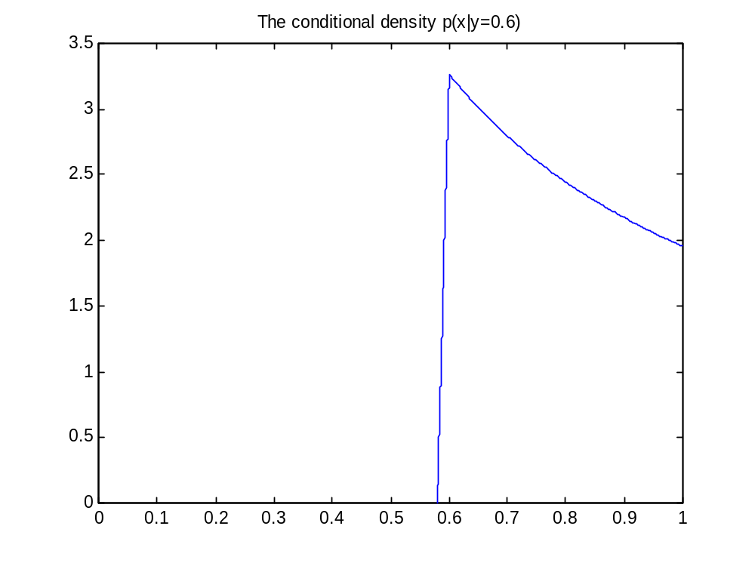
Illustration – conditional p.d.f.

Slide 18
Example 3: hiring a secretary
A manager needs to hire a new secretary, and a good one.
Unfortunately, good secretary are hard to find:
Pr(w_{g})=0.2, Pr(w_{b})=0.8
The manager decides to use a new test. The grade is a real number in the range from 0 to 100.
The manager’s estimation of the possible losses:
λ(decision,w_{i} ) | w_{g} | w_{b}
Hire | 0 | 20
Reject | 5 | 0

Slide 19
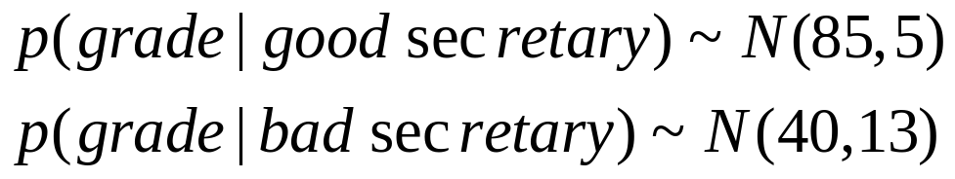
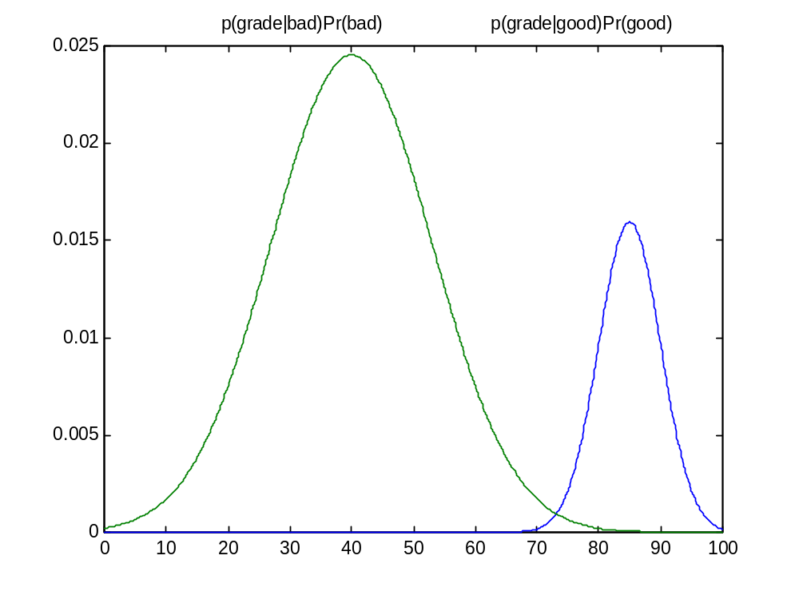
Example 3: continued
The class conditional densities are known to be approximated by a normal p.d.f.:

Slide 20
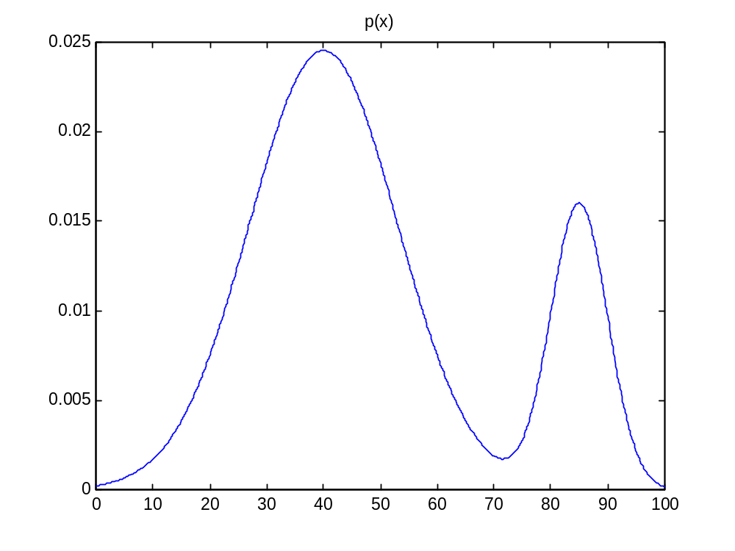
Example 3: continued
The resulting probability density for the grade looks as follows: p(x)=p( x|w_{b} )p( w_{b} )+ p( x|w_{g} )p( w_{g} )

Slide 21
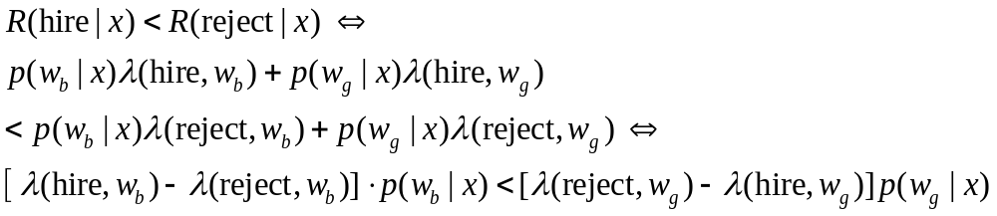
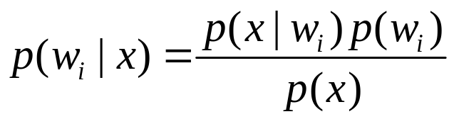
Example 3: continued
We need to know for which grade values hiring the secretary would minimize the risk:
The posteriors are given by

Slide 22


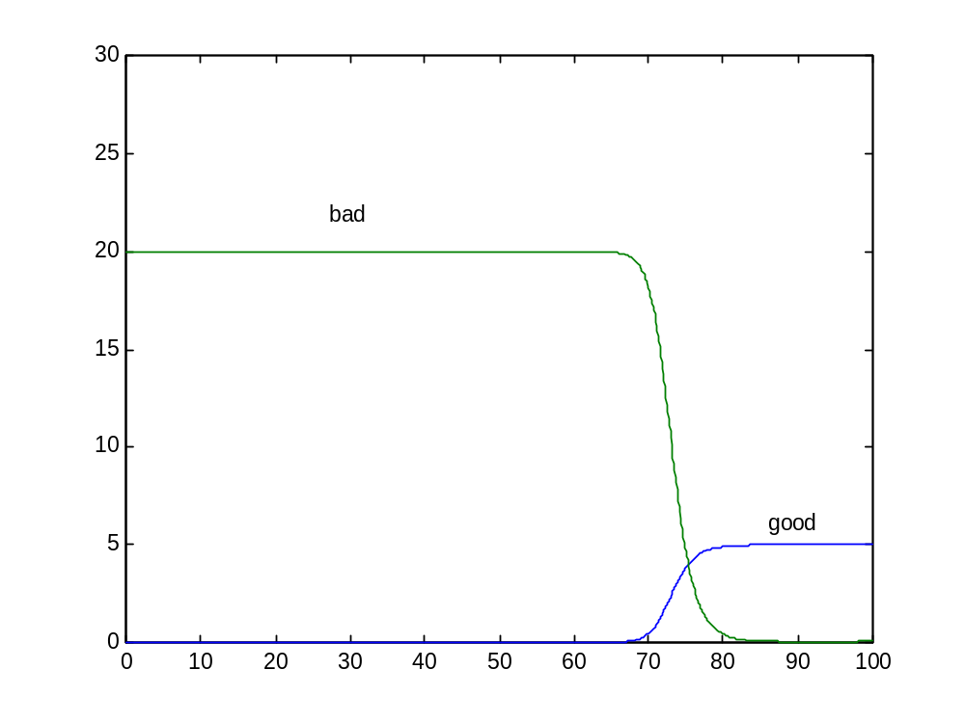
Example 3: continued
The posteriors scaled by the loss differences,
and
look like:

Slide 23
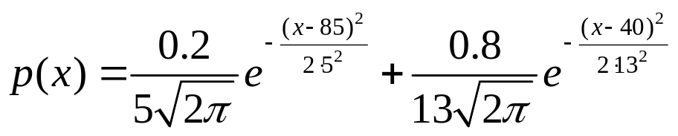
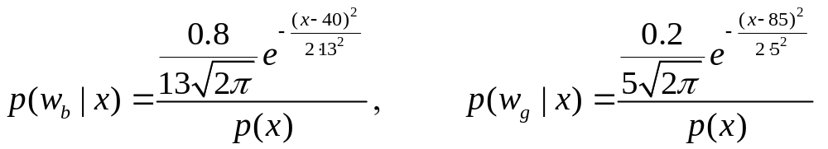
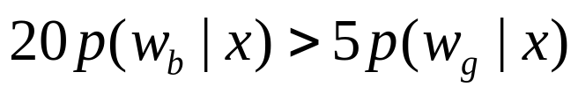
Example 3: continued
Numerically, we have:
We need to solve
Solving numerically yields one solution in [0, 100]:
x=76

Slide 24
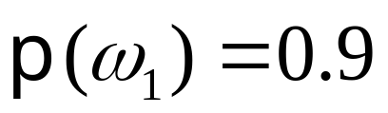
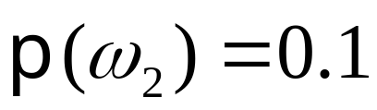
The Bayesian Doctor Example
A person doesn’t feel well and goes to the doctor.
Assume two states of nature:
ω₁ : The person has a common flue.
ω₂ : The person is really sick (a vicious bacterial infection).
The doctors prior is:
This doctor has two possible actions: ``prescribe’’ hot tea or antibiotics. Doctor can use prior and predict optimally: always flue. Therefore doctor will always prescribe hot tea.

Slide 25
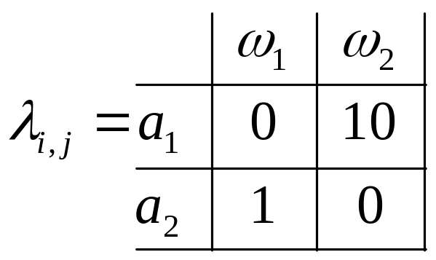
The Bayesian Doctor - Cntd.
But there is very high risk: Although this doctor can diagnose with very high rate of success using the prior, (s)he can lose a patient once in a while.
Denote the two possible actions:
a₁ = prescribe hot tea
a₂ = prescribe antibiotics
Now assume the following cost (loss) matrix:

Slide 26
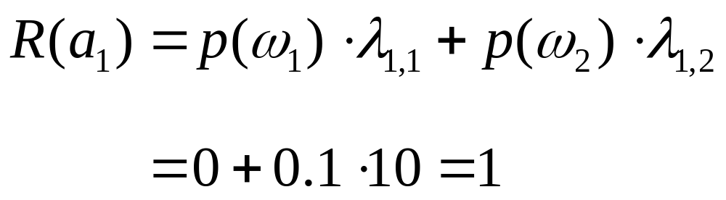
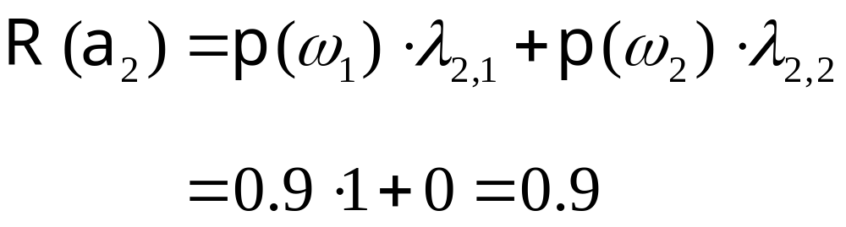
The Bayesian Doctor - Cntd.
Choosing a₁ results in expected risk of
Choosing a₂ results in expected risk of
So, considering the costs it’s much better (and optimal!) to always give antibiotics.

Slide 27
The Bayesian Doctor - Cntd.
But doctors can do more. For example, they can take some observations.
A reasonable observation is to perform a blood test.
Suppose the possible results of the blood test are:
  x₁ = negative (no bacterial infection)
  x₂ = positive (infection)
But blood tests can often fail. Suppose
(Called class conditional probabilities.)

Slide 28
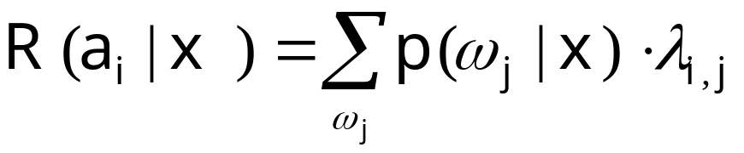
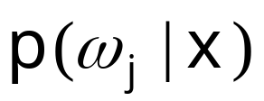
The Bayesian Doctor - Cntd.
Define the conditional risk given the observation
We would like to compute the conditional risk for each action and observation so that the doctor can choose an optimal action that minimizes risk.
How can we compute ?
We use the class conditional probabilities and Bayes inversion rule.

Slide 29
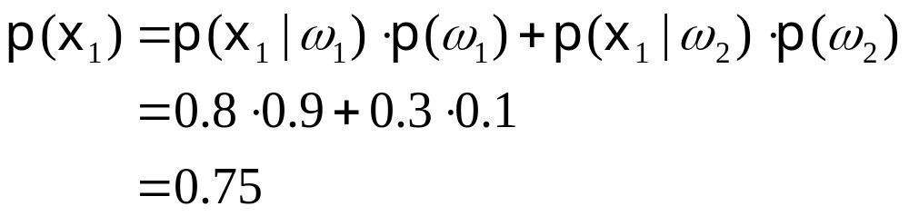
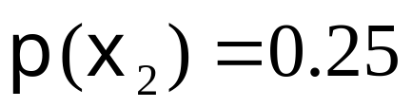
The Bayesian Doctor - Cntd.
Let’s calculate first p(x₁) and p(x₂)
p(x₂) is complementary to p(x₁) , so

Slide 30
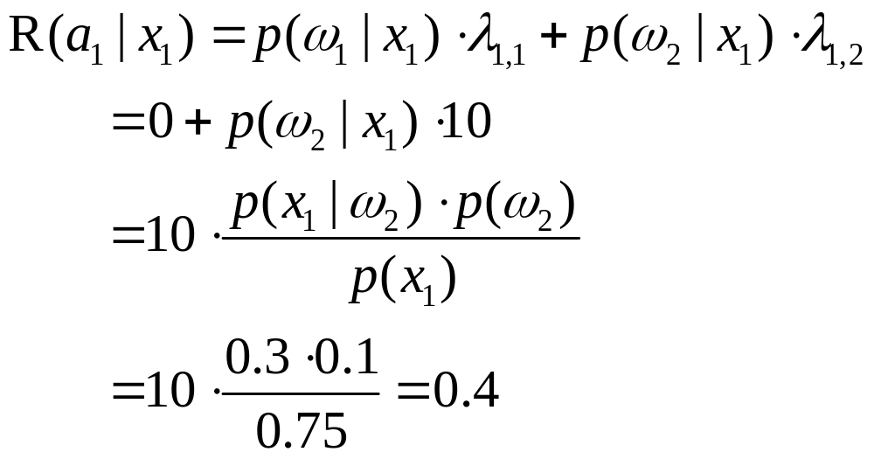
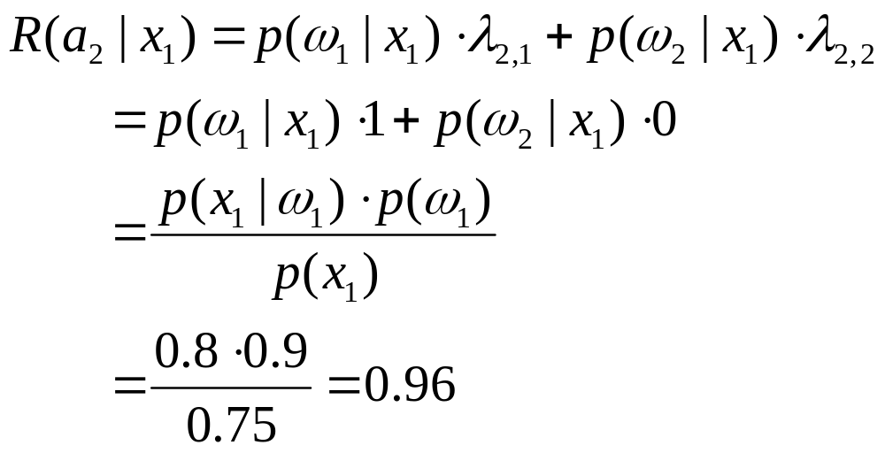
The Bayesian Doctor - Cntd.

Slide 31
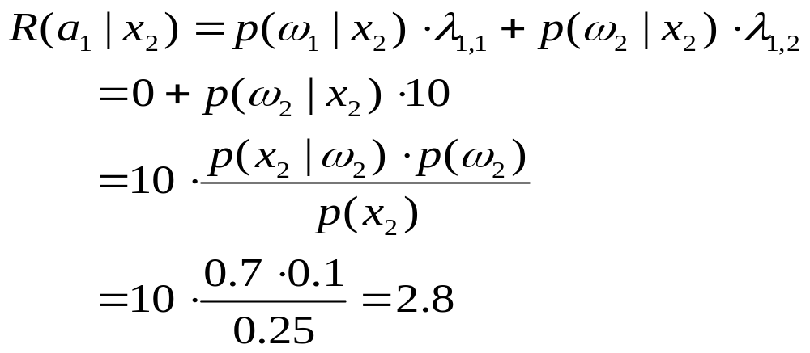
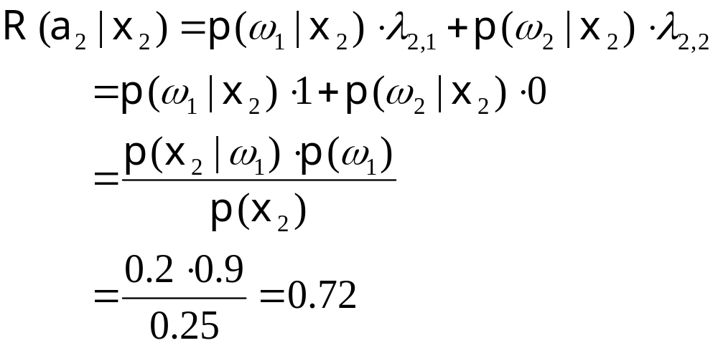
The Bayesian Doctor - Cntd.

Slide 32
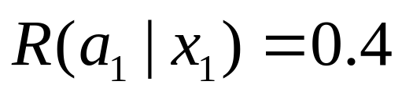
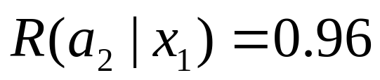
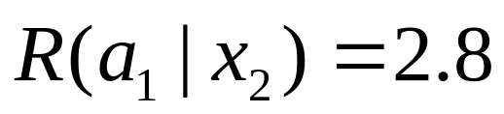
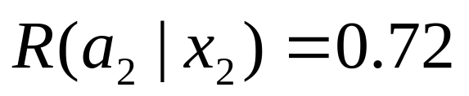
The Bayesian Doctor - Cntd.
To summarize:
Whenever we encounter an observation x, we can minimize the expected loss by minimizing the conditional risk.
Makes sense: Doctor chooses hot tea if blood test is negative, and antibiotics otherwise.

Slide 33
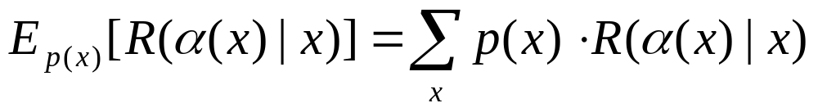
Optimal Bayes Decision Strategies
A strategy or decision function α(x) is a mapping from observations to actions.
The total risk of a decision function is given by
A decision function is optimal if it minimizes the total risk. This optimal total risk is called Bayes risk.
In the Bayesian doctor example:
  Total risk if doctor always gives antibiotics: 0.9
  Bayes risk: 0.48

