Slide 1

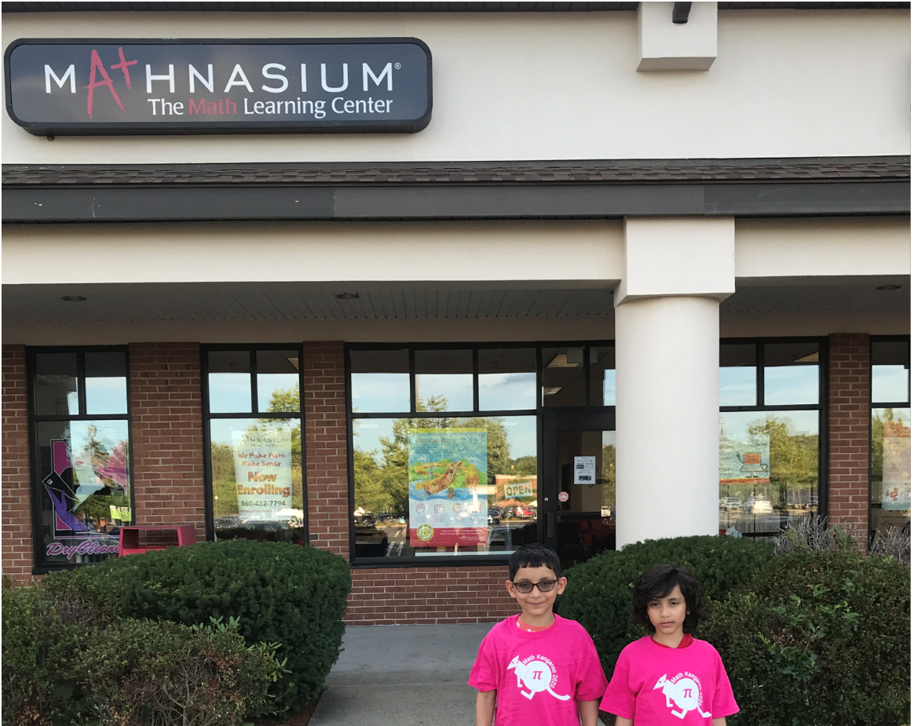
Kids Math
State (CT) – 3rd
National - 3rd

Slide 2
Avg biker speed, 10-12 miles per hour
Unable to push against gravity not even 5 times
Beach – Virginia, RI
Hampi - World Heritage Center
Kodaikanal – Hill Station
Washington (East wing tour) – Monument (500ft ), Lincoln Memorial, World war 2 memorial
Trees- Mango, berries, Sapota, Jackfruit, white rose apple

