Slide 1
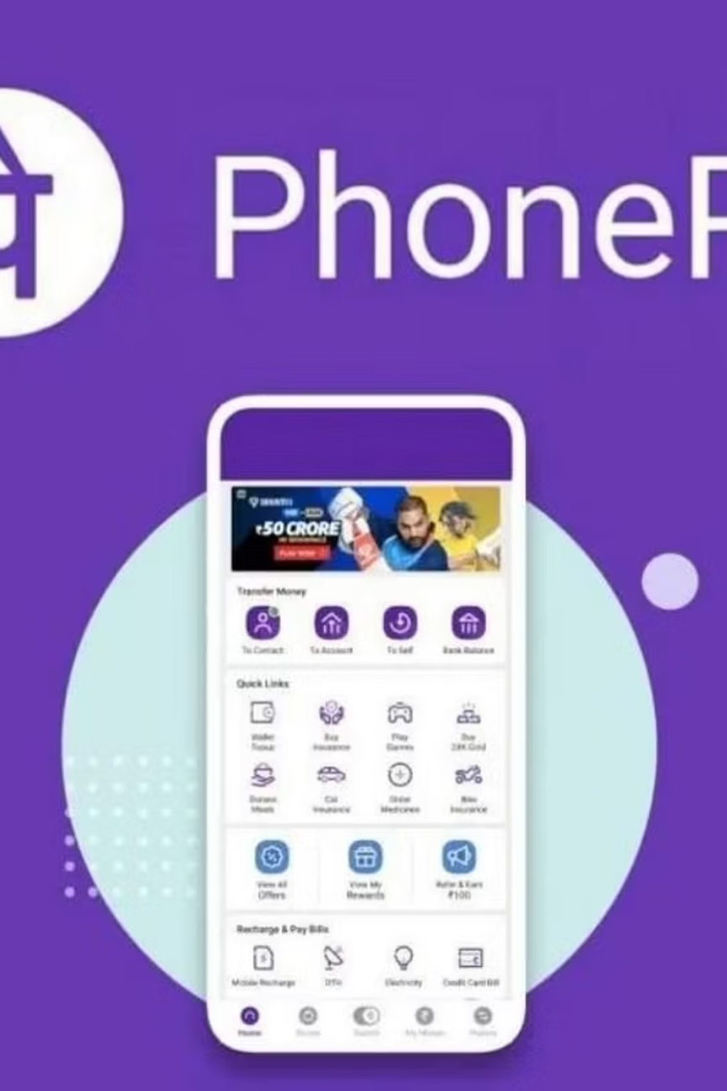

PhonePe Transaction Insights
Data Engineering & Exploratory Data Analysis
By Sourabh Khamankar
Notes:
1

Slide 2








Executive Summary & Objectives
PhonePe facilitates millions of transactions daily, generating a massive and complex data trail. This project harnesses the PhonePe Pulse dataset to decode transaction dynamics and drive strategic decision-making.
Analyze Transaction Behavior
Map Regional Performance
Identify high-revenue streams and underperforming payment categories to optimize product strategy.
Pinpoint top-performing and underperforming geographic markets for targeted expansion.
Evaluate User Engagement
Assess Insurance Penetration
Segment the user base by device preferences and app usage frequency to improve retention.
Track the adoption rates of newly launched insurance products across different demographics.
Notes:
2

Slide 3

Technology Stack & Architecture
Building a Robust Data Pipeline
Core Components
Language & Manipulation: Python, Pandas, JSON
Database Management: SQLite3 (Relational Database)
Data Visualization: Plotly Express, Seaborn, Matplotlib
Dashboard & Deployment: Streamlit, Streamlit Community Cloud
Key Features
Interactive dynamic filtering, real-time geographical mapping, and structured financial analysis.
Notes:
3

Slide 4




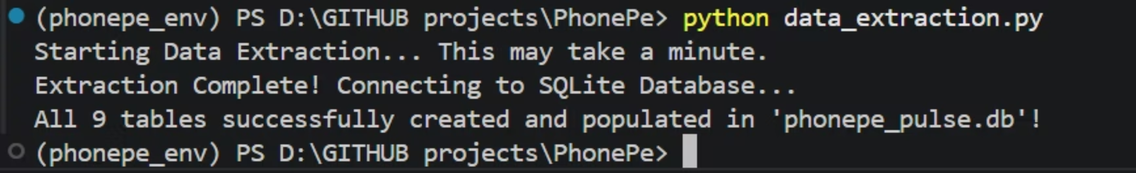
Methodology: The ETL Pipeline
Extract, Transform, Load
To handle massive volumes of nested data, an automated Python pipeline was constructed.
Extract
Transform
Load
Cloned highly nested JSON files organized by year, quarter, and state from the official PhonePe Pulse GitHub repository.
Flattened complex JSON structures into 9 clean, structured Pandas DataFrames (Aggregated, Map, and Top metrics).
Established a connection to a local sqlite3 database and pushed the DataFrames into 9 separate SQL tables for efficient querying.
Notes:
4

Slide 5
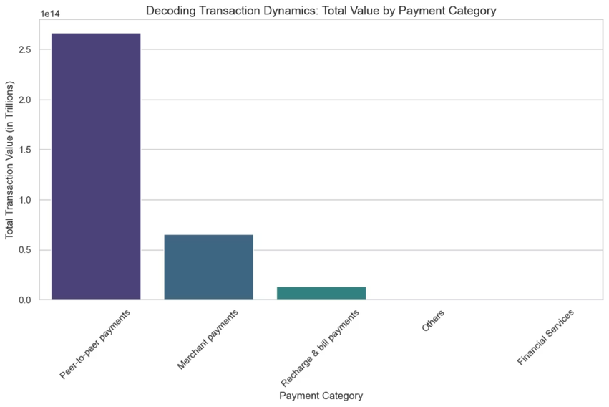
Business Case 1: Transaction Dynamics
Decoding Payment Categories
The Insight
Peer-to-Peer (P2P) and Merchant payments form the absolute backbone of the platform (Merchant volume at 55.4%). However, high-margin categories like "Financial Services" show minimal contribution and stagnant growth.
The Impact
Deep integration into daily commerce is proven, but a lack of revenue diversification poses a risk.
Recommendation
Leverage the massive P2P user base to aggressively cross-sell financial services like micro-loans and mutual funds.
Notes:
5

Slide 6
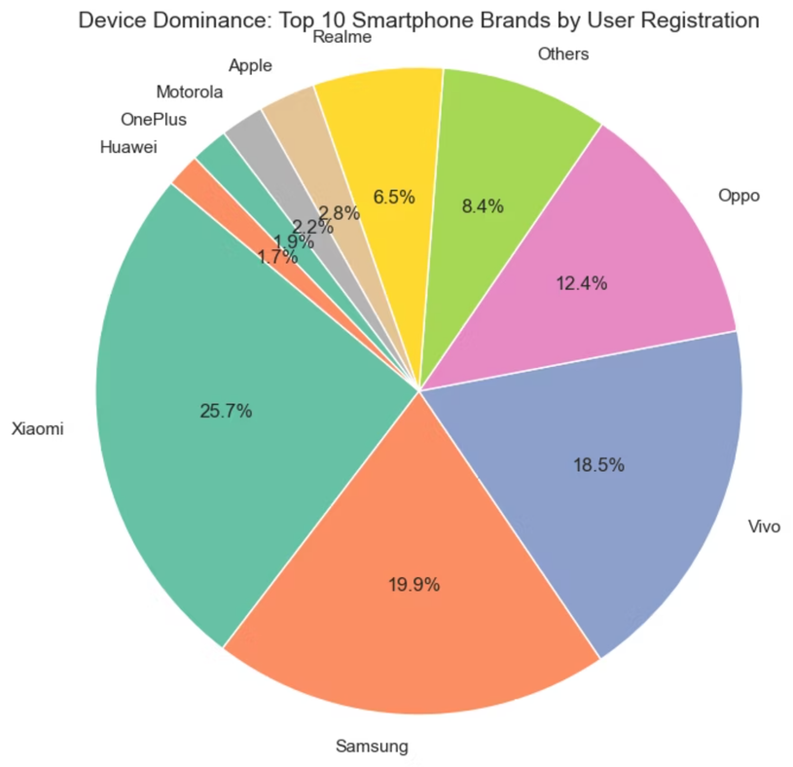
Business Case 2: Device Dominance
Optimizing for the User Ecosystem
The Insight
PhonePe's user base is overwhelmingly driven by the Android ecosystem. Xiaomi leads with 25.7% market share, followed by Samsung (19.9%) and Vivo (18.5%). Apple users constitute a niche minority (~2.8%).
The Impact
Clear direction for technical and marketing resource allocation.
Recommendation
Product development must prioritize Android app optimization, particularly for mid-range devices, ensuring the app remains lightweight, fast, and crash-free.
Notes:
6

Slide 7

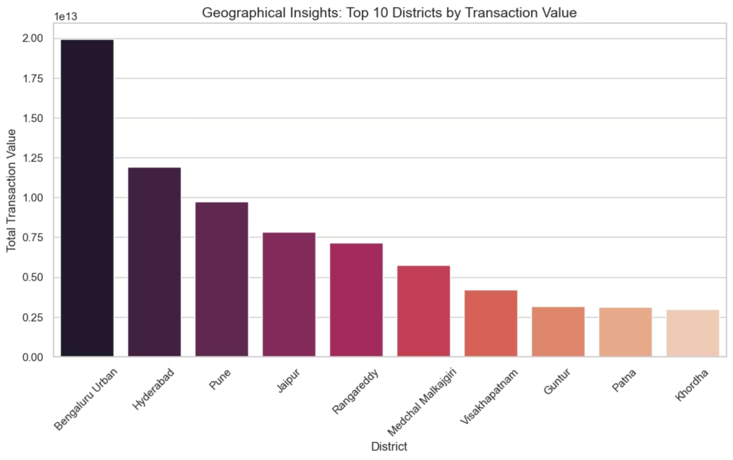
Business Case 3 & 4: Geographical Expansion
The Urban-Rural Digital Divide
The Insight
Tier-1 urban districts (Bengaluru Urban, Hyderabad, Pune) and states (Karnataka, Maharashtra) heavily dominate transaction volumes and insurance adoption. Rural districts (e.g., Nuiland) show minimal digital penetration.
The Impact
Reliable revenue comes from cities, but the next wave of growth lies in untapped rural markets.
Recommendation
Maintain urban dominance with premium features, while launching localized, vernacular educational campaigns and low-bandwidth "lite" app versions for rural districts.
Notes:
7

Slide 8
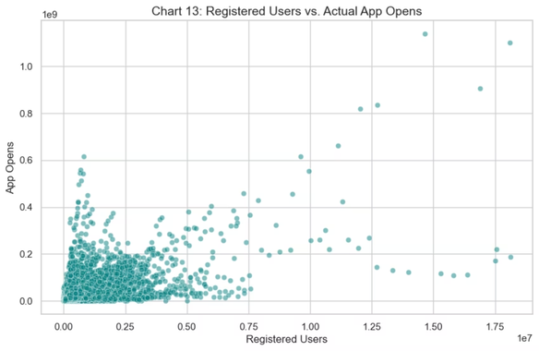
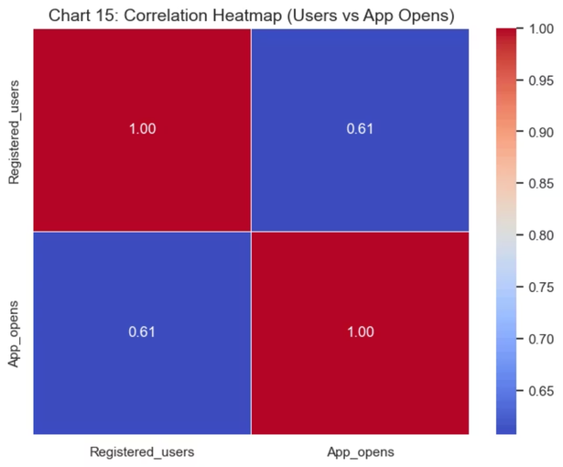
Business Case 5: User Engagement Trends
Registrations vs. Actual App Opens
The Insight
Analysis reveals only a moderate correlation (0.61) between total registered users and actual app opens. Furthermore, a sharp drop in user registration momentum was observed in 2022.
The Impact
A significant portion of the acquired user base is dormant or engages infrequently.
Strategic Shift Required
Implementation Tactics
Shift focus from pure user acquisition to user retention strategies.
Implement personalized push notifications, gamified rewards, and loyalty programs to boost Daily Active Users (DAU).
Notes:
8

Slide 9

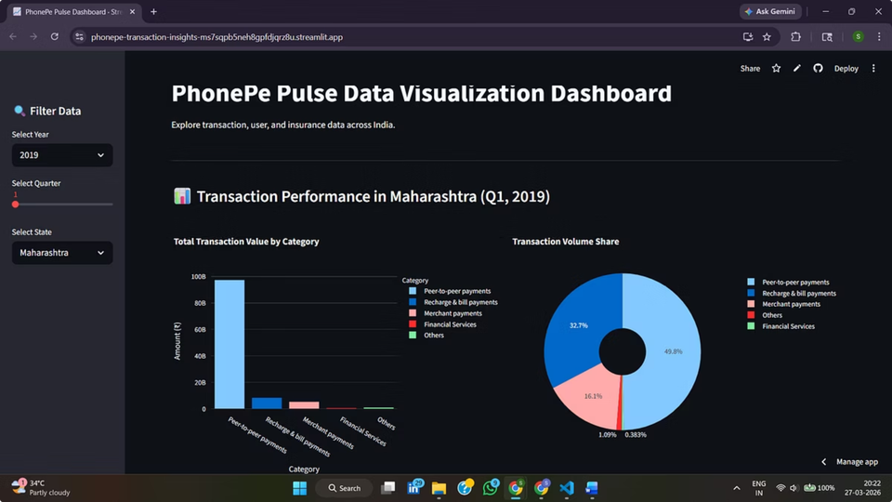


Live Interactive Dashboard
Deploying Insights via Streamlit
To make the SQL data accessible to stakeholders, a live web application was built using Streamlit Community Cloud.
Real-Time Exploration
Users can dynamically slice data by Year, Quarter, and State.
Visual Storytelling
Integrates Plotly for interactive maps, pie charts, and trend lines without requiring users to write SQL queries.
Notes:
9

Slide 10
Conclusion & Strategic Roadmap
Data-Driven Next Steps for PhonePe
01
02
03
Diversify Revenue
Bridge the Divide
Tech Optimization
Push high-margin financial services to the existing massive P2P user base.
Launch targeted rural awareness campaigns to boost transaction and insurance penetration outside Tier-1 cities.
Focus heavily on Android performance and retention strategies for dormant users.
Access the Dashboard & Code
Live App: PhonePe Dashboard
Source Code: GitHub Repository
Notes:
10

