Slide 1


✈️ Voyage Analytics: Integrating MLOps in Travel Systems
An end-to-end Machine Learning and MLOps platform tailored for the travel and tourism industry — delivering real-time predictions and recommendations from multi-modal travel datasets.
Notes:
1

Slide 2


Project Overview & Live Access
Why We Built This
Key Capabilities
Voyage Analytics bridges the gap between raw travel data and user-facing applications by integrating statistical models into an interactive, deployed web dashboard.
Real-time flight price prediction
User demographic classification
Destination-based hotel recommendations
Notes:
2

Slide 3




System Architecture
Data Ingestion
Raw CSV data is collected, cleaned, and prepared for downstream processing.
Model Training
ML models are trained and evaluated using tracked experiments in MLflow.
Artifact Generation
Saved models, metrics, and outputs are packaged as reusable deployment artifacts.
Cloud Deployment
The final application is deployed and served in real time on Streamlit Community Cloud.
The platform follows a clean end-to-end pipeline — from raw CSV ingestion through MLflow-tracked training to real-time inference served on Streamlit Community Cloud.
Notes:
3

Slide 4
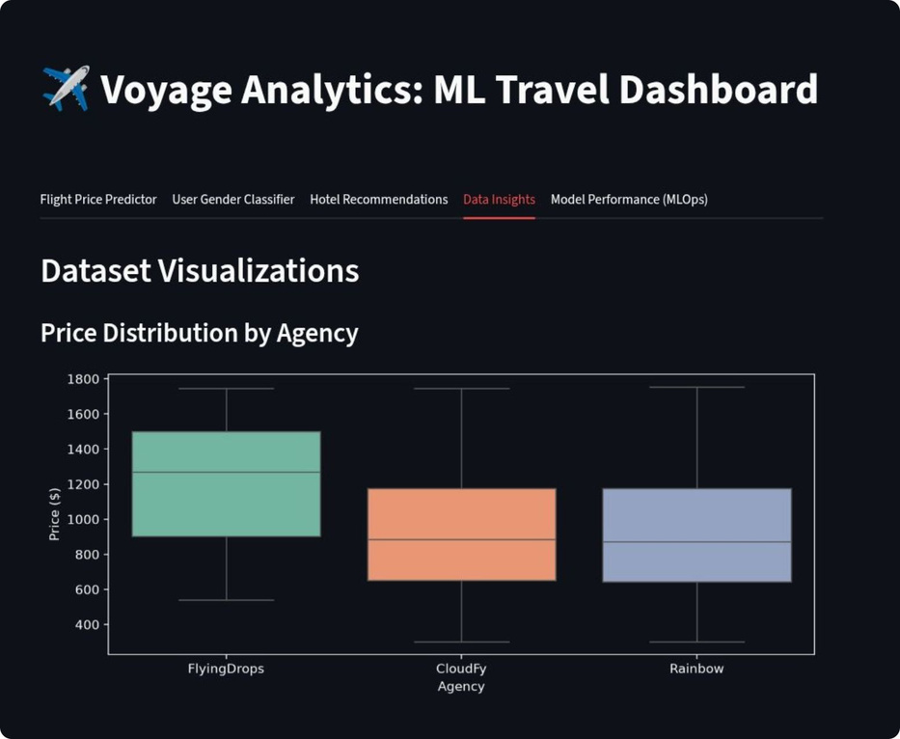
Dataset Overview & Data Insights
✈️ Flight Data
271,888 records for predicting ticket prices
🏨 Hotel Data
40,552 booking logs for the recommendation engine
👤 User Data
1,340 demographic profiles for classification
Exploratory Data Analysis (EDA) revealed pricing trends across multiple flight agencies to understand market distribution.
Notes:
4

Slide 5
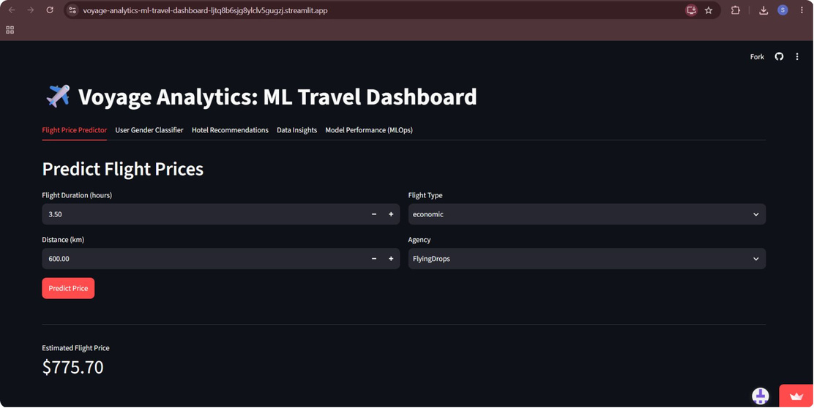
Flight Price Predictor (Regression)
Objective
Predict real-time flight ticket prices based on key journey attributes.
Algorithm
RandomForestRegressor
Features Engineered
Model Performance
Flight duration & distance
Flight cabin class
Airline agency
R² Score
MAE
0.84 — Strong Explanatory Power
$102.83 Mean Absolute Error
Notes:
5

Slide 6
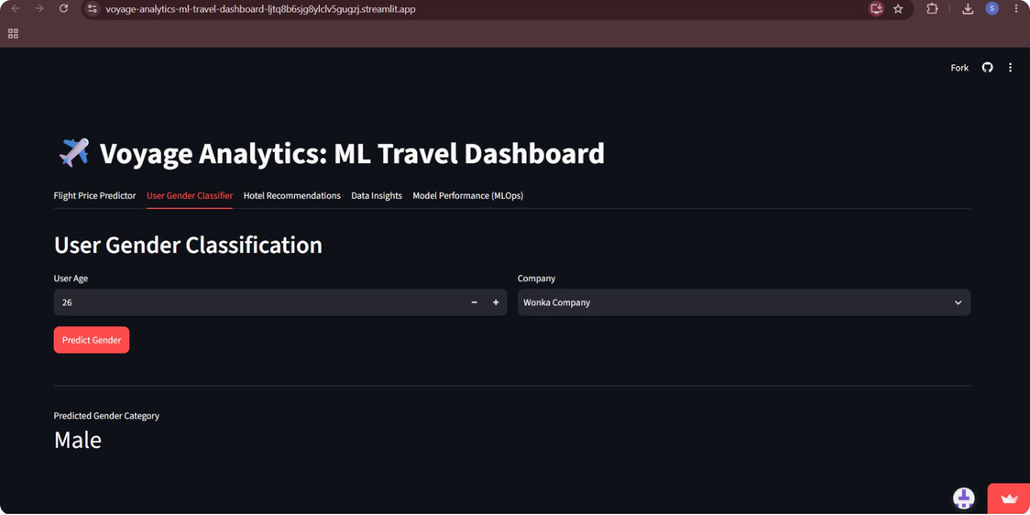
User Gender Classifier (Classification)
Objective
Algorithm
Preprocessing
Categorize user demographic profiles based on age and corporate affiliation.
RandomForestClassifier
Handled invalid data by pre-filtering non-informative classes (e.g., 'none') to ensure clean binary classification.
Notes:
6

Slide 7
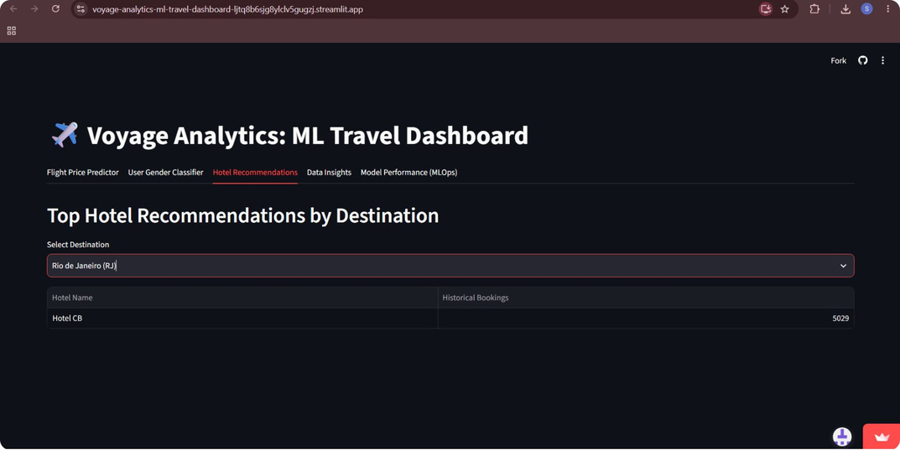

Destination Hotel Recommendations
Objective
Algorithm
Suggest the top-ranked hotels for any selected travel destination in the dataset.
Popularity-Based Recommendation Matrix
Methodology
Aggregated historical booking frequencies per location to extract and rank the top 3 hotels dynamically for each destination.
Rankings are computed dynamically from 40,552 booking logs — no hardcoded placeholders.
Notes:
7

Slide 8
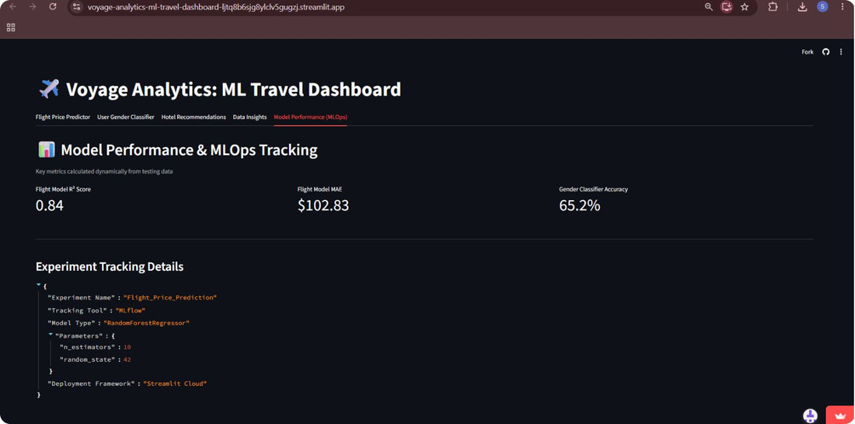
MLOps & Model Performance Tracking
MLflow Integration
Dynamic Dashboard
Experiment Configs
Offline evaluation and experiment tracking — logging metrics, parameters, and model artifacts across every training run.
The Streamlit app calculates and displays real metrics on the fly rather than using hardcoded placeholders.
Track dynamic model performance metrics and experiment configurations across iterations for reproducibility.
Notes:
8

Slide 9

Team Contributions
Abhinav Reddy
Kirti Dixit
Full-Stack ML Engineer & UI Integrator
Designed the multi-tab Streamlit dashboard, integrated .pkl artifacts, and managed cloud deployment.
Data Scientist
Cleaned user profiles, developed the classification model, and constructed the hotel recommendation matrix.
1
2
3
4
Kartik Bingi
Sourabh Khamankar
Lead Data Scientist
Preprocessed flight datasets, trained the price regression model, and managed MLflow tracking.
Data Analyst & Infrastructure Specialist
Conducted EDA, designed dark-themed visualizations, and managed virtual environment configurations.
Notes:
9

Slide 10
Conclusion & Q&A
Voyage Analytics successfully transforms static travel data into a live, interactive, and scalable MLOps platform.
Future Scope
Real-Time API Integration
Integrating live flight tracking APIs for up-to-the-minute data feeds.
Deep Learning Models
Deploying advanced neural networks for personalized recommendation systems.
Thank You
Notes:
10

