Slide 1

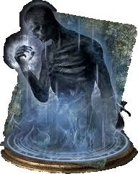
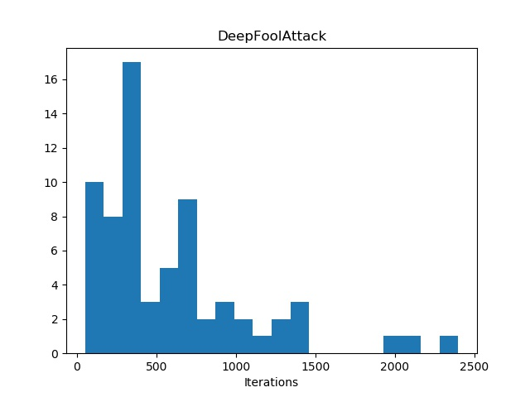
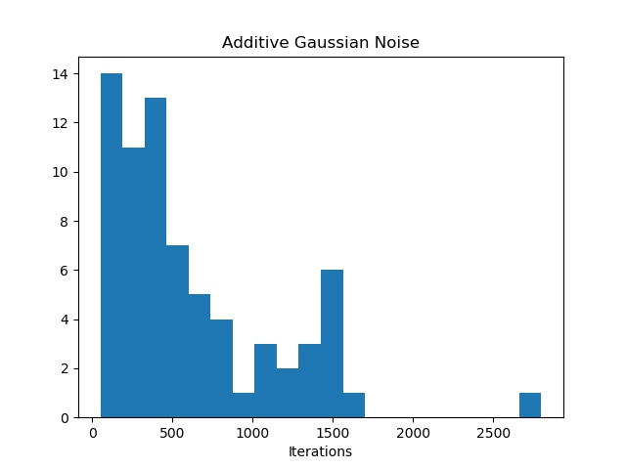
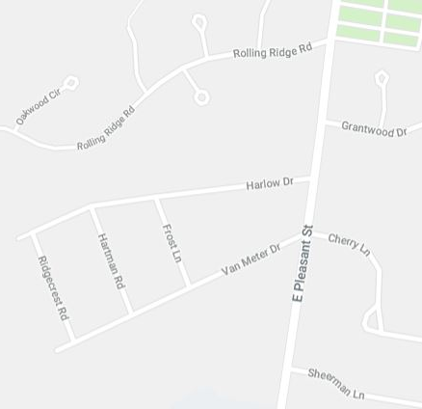
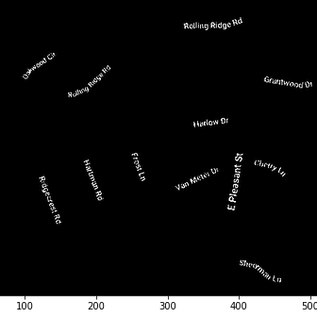
Deep Protection Universal Defense against Adversarial Examples
Sourabh Kulkarni, Pradeep Ambati
Overview
Deep learning models have been widely successful and are being employed in several computer vision (CV) applications.
This widespread use has left the CV application spaces open to adversarial attacks – images that have been slightly perturbed to cause misclassification.
There exists several attacks types, and defenses against them are attack specific and hence not very practical in real world.
We re-imagine adversarial defense problem as an image restoration problem - restore non-adversarial prior from the adversarial image.
We use Deep Image Prior (DIP) – an image restoration technique, and modify it to protect against adversarial images
We successfully demonstrate protection of deep networks (Deep Protection) against 8 different adversarial attack types and gain several insights in the process.
Results
Automatic termination case:
Iterations stop when ‘true’ class in top 5
Represents Ideal accuracy
Avg accuracy: 97.4%
Determining iteration for fixed termination:
Observed histogram of terminations in automatic case
Majority terminations <1500 iterations; 1750 chosen
Fixed termination case:
Process runs on all images for 1750 iterations
Avg accuracy: 84.4%
Errors in fixed termination:
Overfit: Process ran too long; adversarial noise started to reappear
Underfit: Process stopped too soon; reconstruction not sufficient for recognition
Real-world example:
Tested on commercially available service (clarifai.com)
Text extraction from maps:
Successfully extracted text from maps
Termination fine tuned by observation
Determining iteration for fixed termination
Iter = 1750
Iter = 1750
Fixed termination
Background
DIP: Uses structure of a generative deep convnet to regenerate target image from noise. Applications include denoising, in-filling etc.
Adversarial Attacks: Various techniques that slightly perturb image in pixel space to cause departure in feature/class space of a target deep network model. Several approaches exist, but basic premise stays the same.
Defense Strategies: Existing strategies usually target only one attack type, e.g., training models with adversarial samples, filtering images, rotations and other linear operations.
Original Adversarial Image Deep Protection output
Approach
Key Idea: Modify DIP and use it to obtain the non-adversarial prior of an adversarial image. (Treat adversarial image as a corrupted version of the original and run restoration on it)
Deep Protection Process:
Initialization: random weights, random inputs
Loss: L2 MSE with target image
Hyperparamter tuning: chosen config – ADAM optimizer and swish activation
Termination: Automatic (Image specific, complex) and Static (Fixed iteration, simple)
Classification: Off-the-shelf classifier (ResNet18)
Original Map Extracted Text
Key Insights
Universality: In both modes, Deep Protection is quite effective on all 8 attacks, though need to work on automatic termination strategies to maximize accuracy
Attack type invariance: No matter how the image is perturbed, the process of restoring image is the same – could indicate that this process is robust to any future attacks
Market ready: No training required, can be deployed in-field right away
No Free Lunch: Deep Protection is time consuming, though automatic termination could help speed it up
Experimental Stuff
Main experiment - Check effectiveness of Deep Protection:
100 ImageNet examples (from 25 categories)
Apply 8 attacks per image using foolbox (800 inputs in total)
Deep Protection in two modes – automatic and static
Classify the obtained priors using resnet18
Test it in the real world
Exploring DIP application space – Text extraction from maps:
Key idea – text is harder to draw than terrain/roads
Use Deep Image Residual (what is NOT generated by DIP yet)
With some processing, at correct iteration, all text can be extracted from maps
Going Ahead
Work on strategies for automatic termination of Deep Protection process
Design a binary classifier to detect if Deep Protection process is required for an input
Explore other datasets (e.g., will this work on medical images?)
Explore other applications of DIP technique
Acknowledgements: We thank Prof. Learned-Miller and Aruni Roy Choudhary for their guidance.

