Slide 1


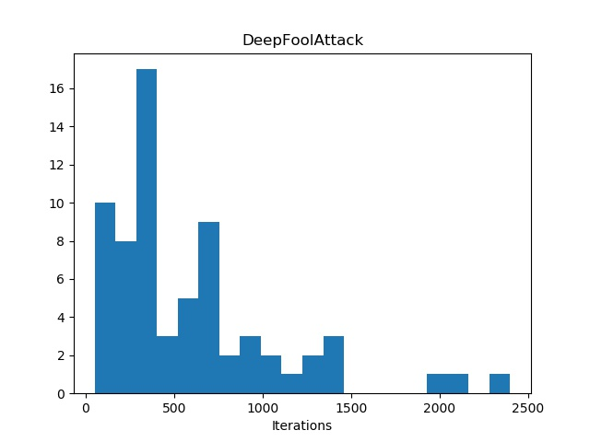
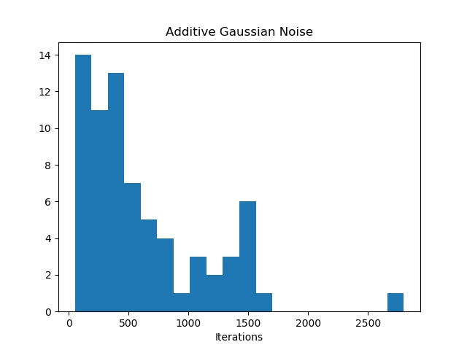
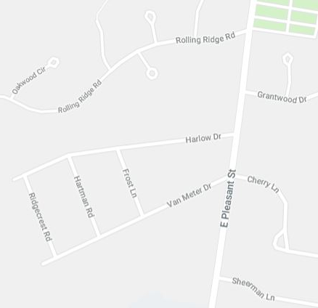
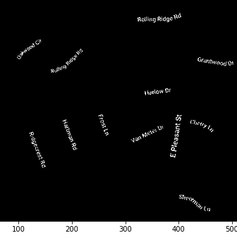
Deep Protection Universal Defense against Adversarial Examples
Sourabh Kulkarni, Pradeep Ambati
Advised by: Prof. Learned-Miller
Overview
Deep learning models have been widely successful and are being deployed in several computer vision applications.
This widespread use has left the application spaces open to adversarial attacks – images that have been slightly perturbed to cause misclassification in models.
There are several types of attacks, and defenses against them are attack specific, not very practical in real world!
We reimagine adversarial defense problem as an image restoration problem - restore non-adversarial prior from the adversarial image.
We use Deep Image Prior (DIP) – an image restoration technique, and modify it to protect against adversarial images
We successfully demonstrate protection of deep networks (Deep Protection) against 8 different adversarial attacks and gain several in use of DIP in this application space.
Results
Automatic termination case:
Iterations stop when ‘true’ class in top 5
Represents Ideal performance
Avg accuracy:
Determining iteration for fixed termination:
Observed histogram of terminations in automatic case
Majority terminations <1500 iterations; 1750 chosen
Fixed termination case:
Process runs on all images for 1750 iterations
Lower avg accuracy:
Errors in fixed termination:
Overfit: Process ran too long; adversarial noise started to creep in
Underfit: Process stopped too soon; reconstruction not sufficient for recognition
Real-world example:
Tested on commercially available service (clarifai.com)
Text extraction from maps:
Successfully extracted text from maps
Termination fine tuned by observation
Determining iteration for fixed termination
Iter = 1750
Iter = 1750
Fixed termination
Background
DIP: Uses structure of a generative deep convnet to regenerate target image from noise. Applications include denoising, in-filling etc.
Adversarial Attacks: Various techniques that slightly perturb image in pixel space to cause departure in feature/class space of a target deep network model. Have several types/subtypes, but basic premise stays the same.
Defense Strategies: Existing strategies usually target only one type of attack, examples: training models with adversarial examples, filtering input images, rotations and other linear operations.
Original Adversarial Image Deep Protection output
Approach
Key Idea: modify DIP and use it to obtain non-adversarial prior of an adversarial image. Treat adversarial image as a corrupted version of the original and run restoration on it.
Architecture (block diagram, talk to it, no text)
Deep Protection Process:
Initialization: random weights, random inputs
Loss: L2 MSE with target image
Hyperparamter tuning: chosen config – ADAM optimizer, swish activation.
Termination: Dynamic (Image specific, Hard), Static (Fixed iteration, easy)
Classification: Off-the-shelf classifier (ResNet18)
Original Map Extracted Text
Key Insights
Universality: In both modes, Deep Protection is quite effective on all attacks, though need to work on dynamic stopping strategies to make best use
Attack type invariance: No matter how the image is perturbed, the process of obtaining non-adversarial prior is the same – could mean that this process could be robust to any number of future attacks
Market ready: No training required, can be deployed in-field right away
No Free Lunch: Deep Protection is time consuming, though automatic termination could help speed it up
Other applications: Use of network architecture for processing may have further applications (even non-vision)
Experimental Stuff
Main experiment - Check effectiveness of Deep Protection:
Take 100 ImageNet examples
Apply 8 attacks per image using foolbox, 800 total
Run Deep Protect in two modes – dynamic and static
Classify the obtained priors using resnet18
Test it in the real world
Some side experimentation – Text extraction from maps:
Key idea – text is harder to draw than terrain/roads
Use Deep Image Residual (what is NOT generated by DIP yet)
With some processing, at correct iteration, all text can be extracted from maps
Going Ahead
Work on strategies for automatic termination of Deep Protection process
Design a binary classifier to detect if Deep Protection process is required for an input
Explore other datasets: will this work on medical images?
Explore other applications of this approach
Acknowledgements: We thank Prof. Learned-Miller and Aruni Roy Choudhary for their guidance.

