Slide 1


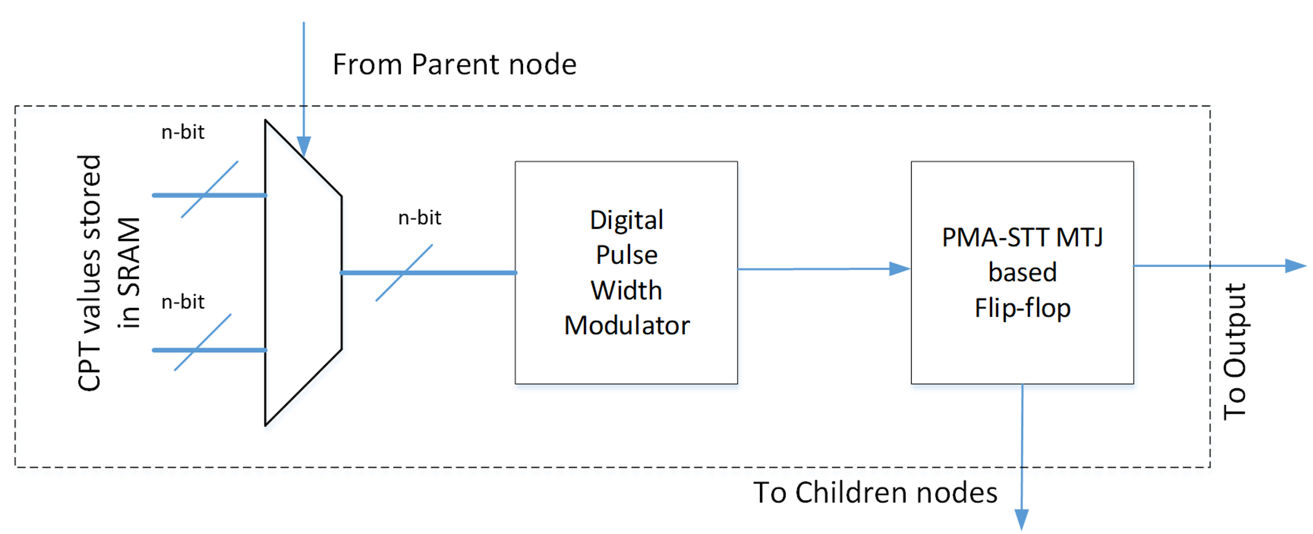
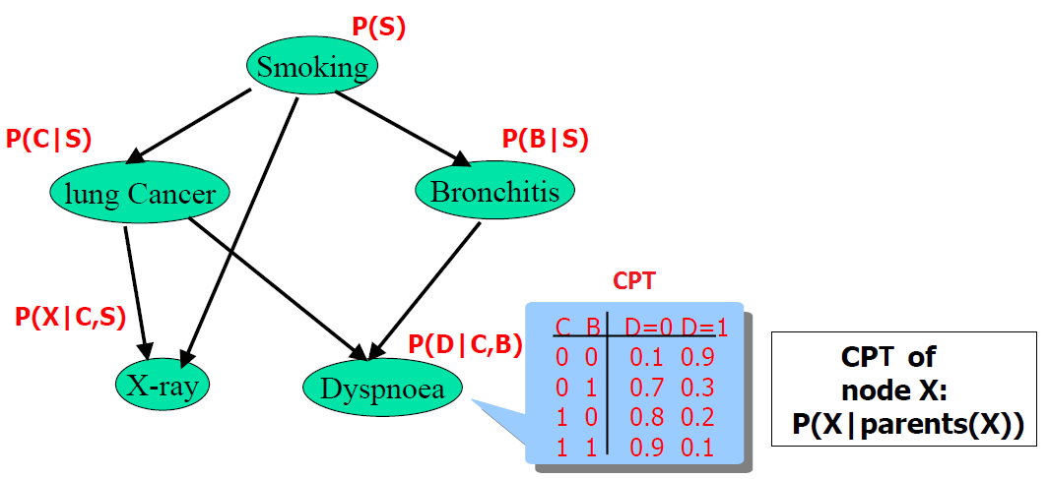
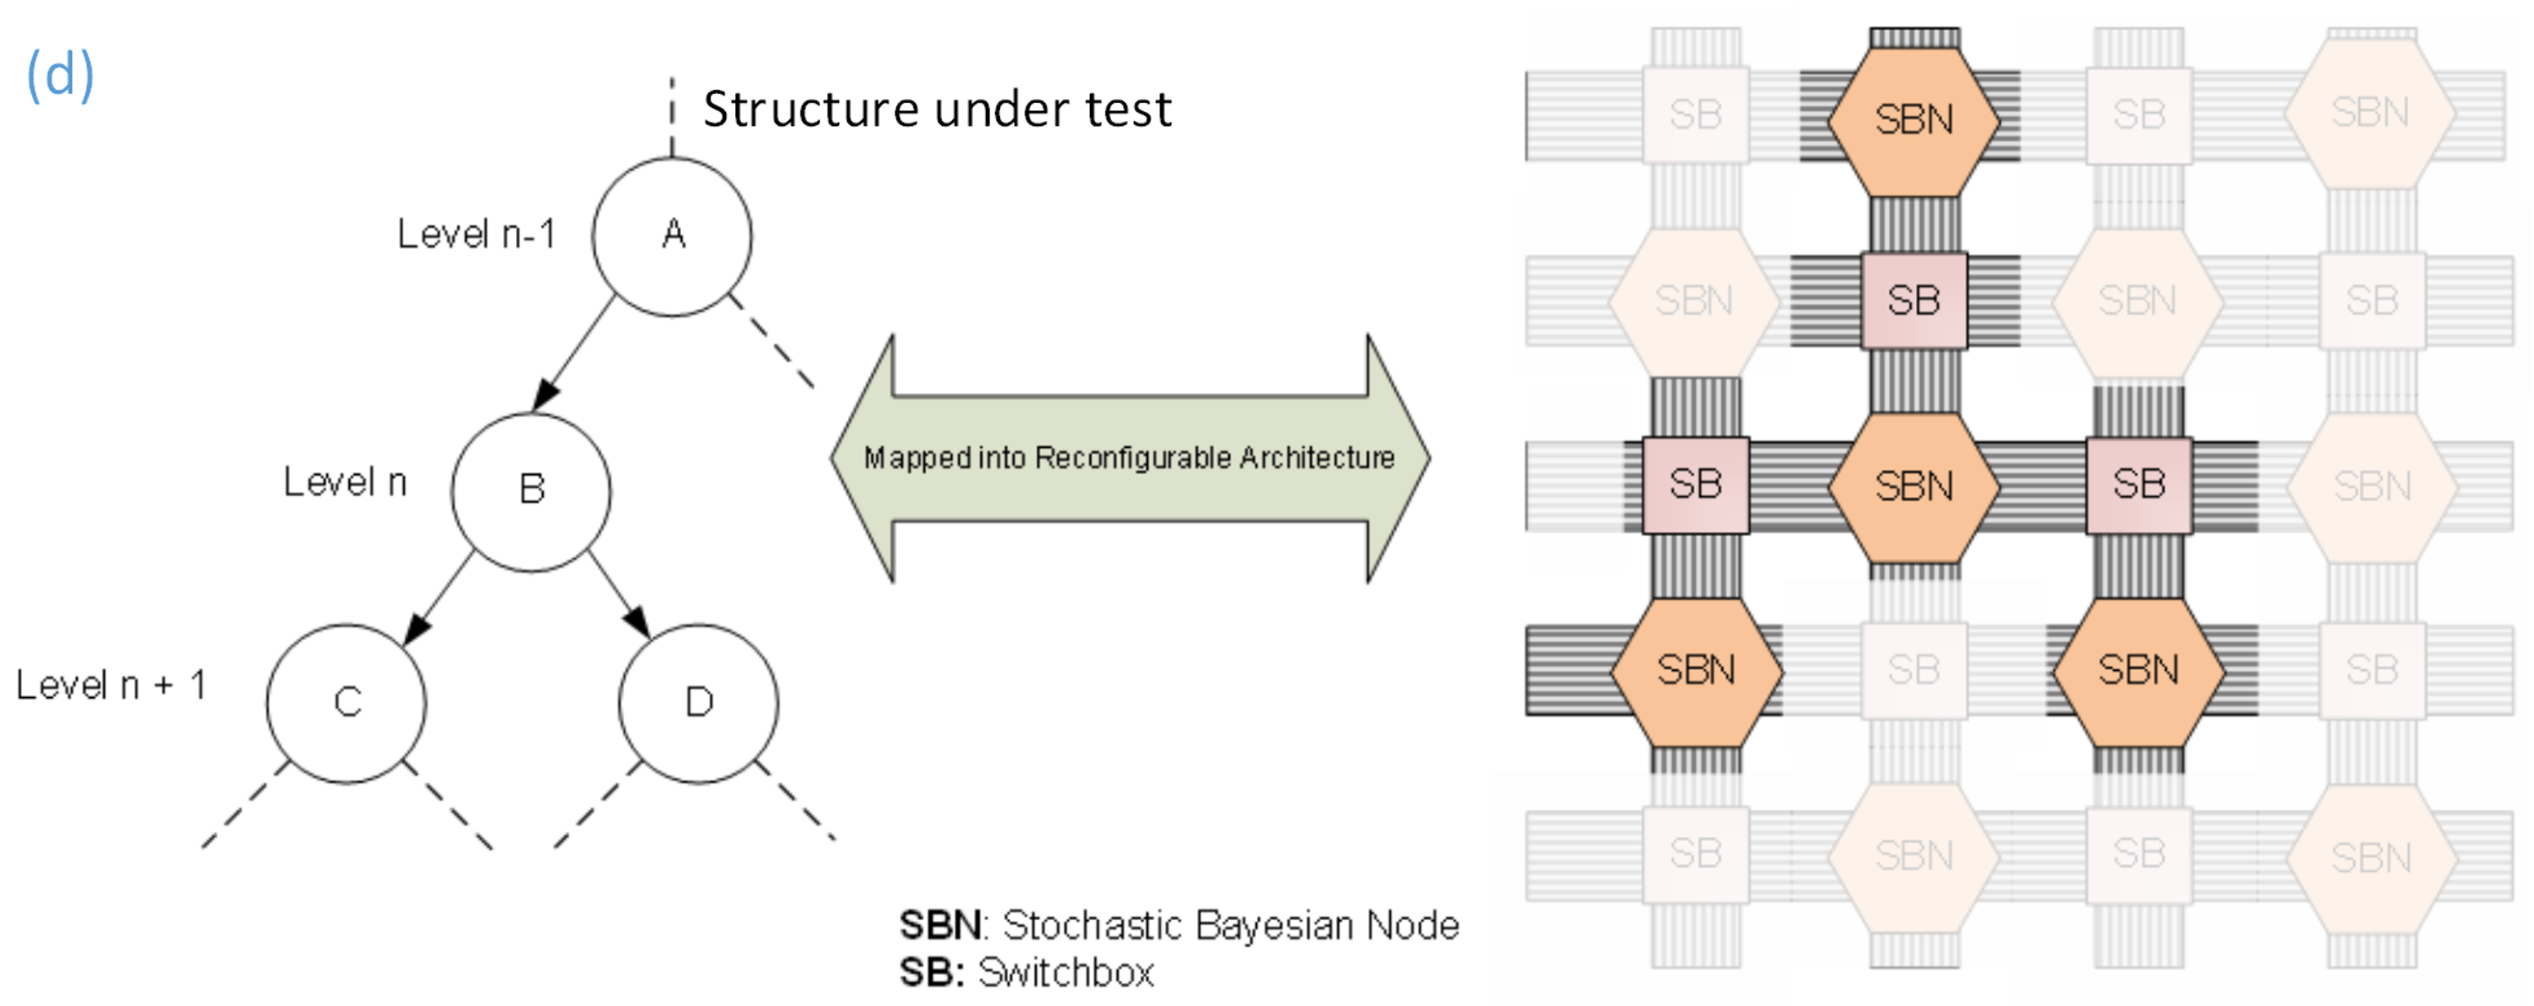
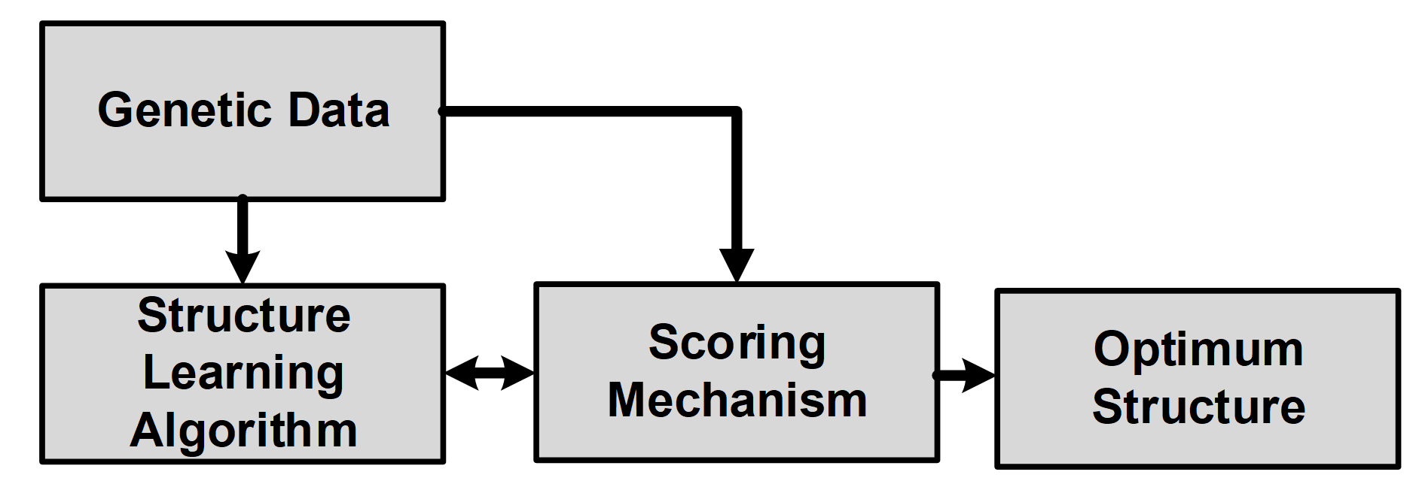
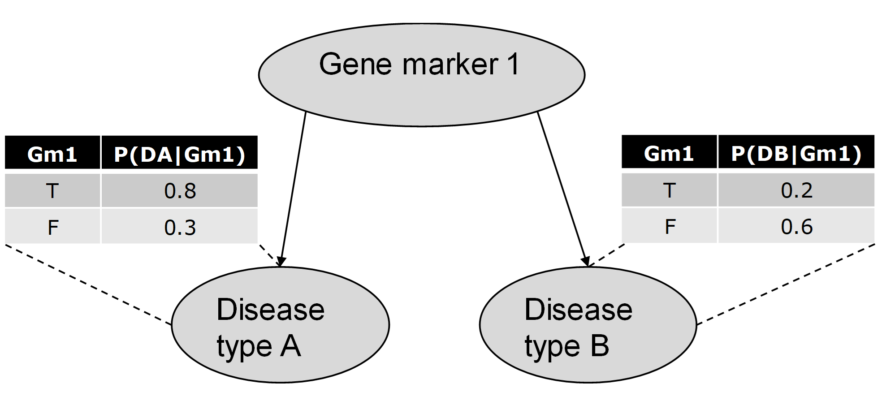
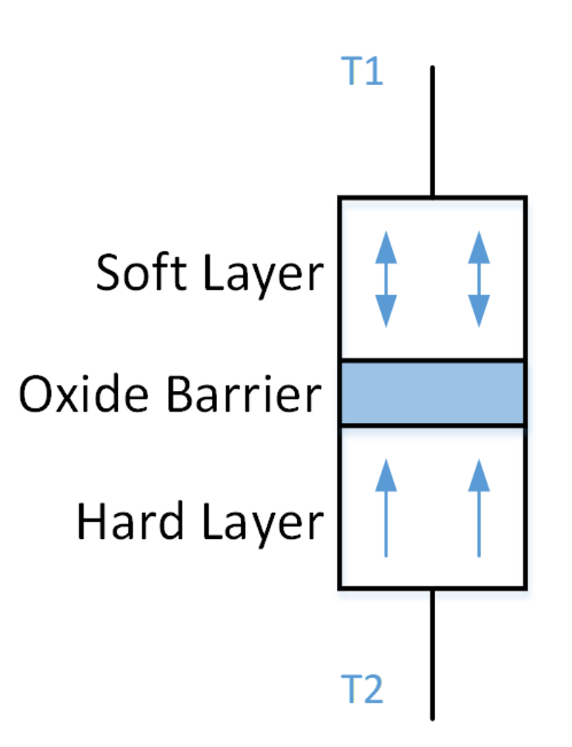
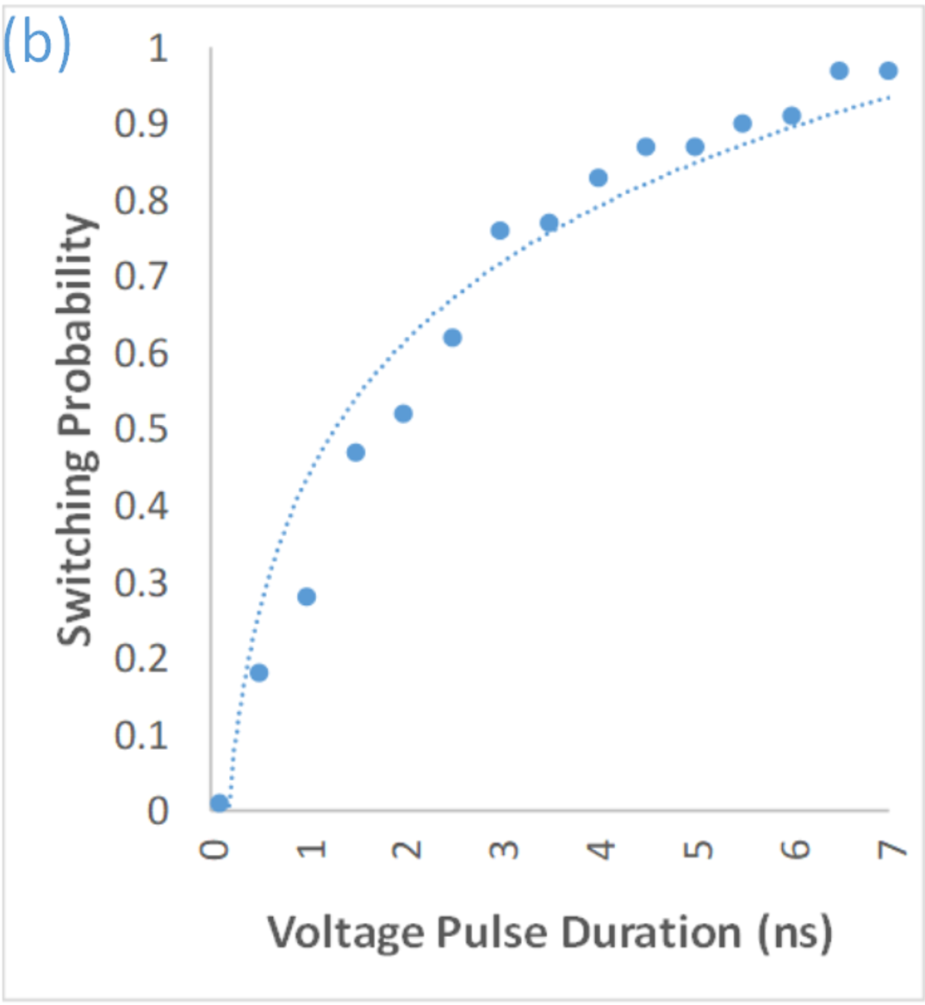


Deep Protection Universal Defense against Adversarial Examples
Sourabh Kulkarni, Pradeep Ambati
COMSCI-682 Class Project, Prof. Learned-Miller
Overview
Deep learning models have been widely successful and are being deployed in several computer vision applications.
This widespread use has left the application spaces open to adversarial attacks – images that have been slightly perturbed to cause misclassification in models.
There are several types of attacks, and defenses against them are attack specific, hence we need a universal defense
Search performed efficiently in software, while Scoring, with inherent parallelism, is efficient in specialized hardware.
New nanoscale hardware acceleration framework significantly accelerates the scoring aspect of the BN learning of GENs using a combination of emerging stochastic devices and CMOS technology.
Performance benefits of five orders of magnitude in performing inference operations is estimated with this architecture, over software-only approaches.
Stochastic Bayesian Node
Building block of the proposed framework; is a combination of CMOS circuits and PMA-STT MTJs
SBN models a node in a Bayesian network to perform stochastic sampling
Block diagram view of SBN
Structure Discovery in BNs
BNs are probabilistic models which encode domain knowledge in Graphs
Structure Discovery: Learning the BN graph given data; widely used in genetic applications
$$P\left(Structure\right|Data)∝P\left(Data | Structure\right).P\left(Structure\right)$$
Reconfigurable Framework
SBNs and switchboxes in a FPGA-like architecture
BN structure to be scored is mapped onto the reconfigurable framework
The configured Bayesian structure is stochastically sampled for scoring
Example Bayesian Network
Reconfigurable SBN-SB framework
Evaluation and Results
~84k speedup in performance vs. software implementation
Design Flow for Structure Learning
Emerging Stochastic Hardware
Perpendicular Magnetic Anisotropy Spin Transfer Torque Magnetic Tunnel Junctions (PMA-STT MTJs)
Experiments | Conditioned Inferences |  |  |  | Inference Runtime
 | P(Da|Gm1=T) | P(Db|Gm1=T) | P(Da|Gm1=F) | P(Db|Gm1=F) | Gm=T | Gm=F
Proposed Framework | 0.77 | 0.18 | 0.28 | 0.62 | 2µs | 2µs
Baseline | 0.8 | 0.2 | 0.3 | 0.6 | 132ms | 168ms
On-going Work
Be careful not to divulge unpublished results or ideas without advisor consent
Acknowledgements: This project has been funded by the National Science Foundation under grant # etc. ...
Device schematic and stochastic behavior
Department of Electrical and Computer Engineering
IEEE Iinternational
College of Engineering - University of Massachusetts Amherst
Additional logos of your lab, sponsor, etc.

