Slide 1
MEMORIES
By:
Sourabh Nirwan
Purnendu Mishra
Sanika Vyavahare

Slide 2
Outline
●Problem Statement
●Objective
●Project Overview
●Architecture
●Technology and Tools Used
●Conclusion

Slide 3
Problem Statement
Making Memories is really important for everyone , So here is something which makes you easier to visit the memories and enjoy them.

Slide 4
Objective
Our objective is to provide user the best experience so that they can share and save memories online .

Slide 5
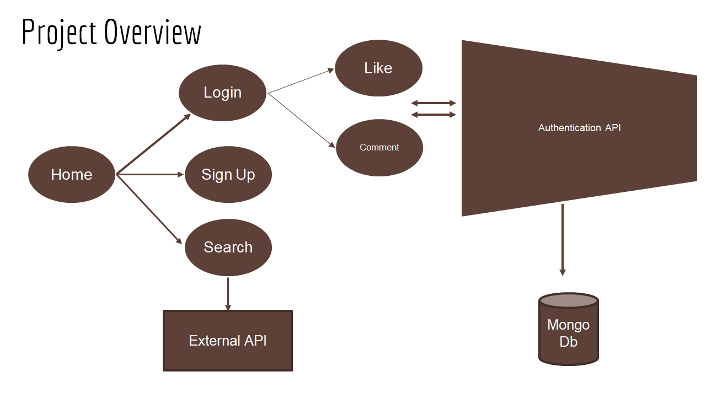

Slide 6
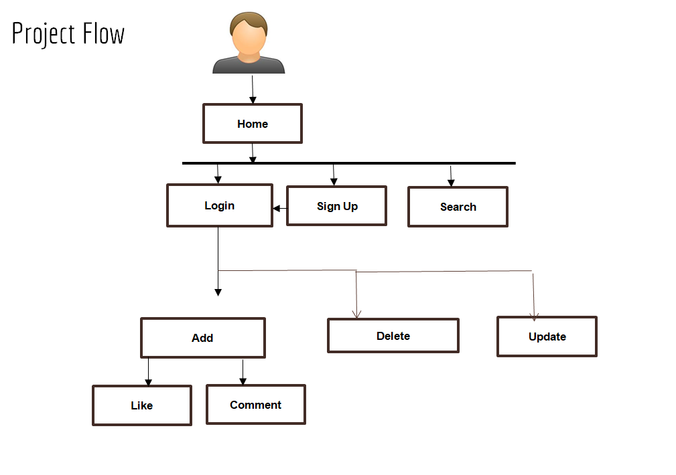

Slide 7
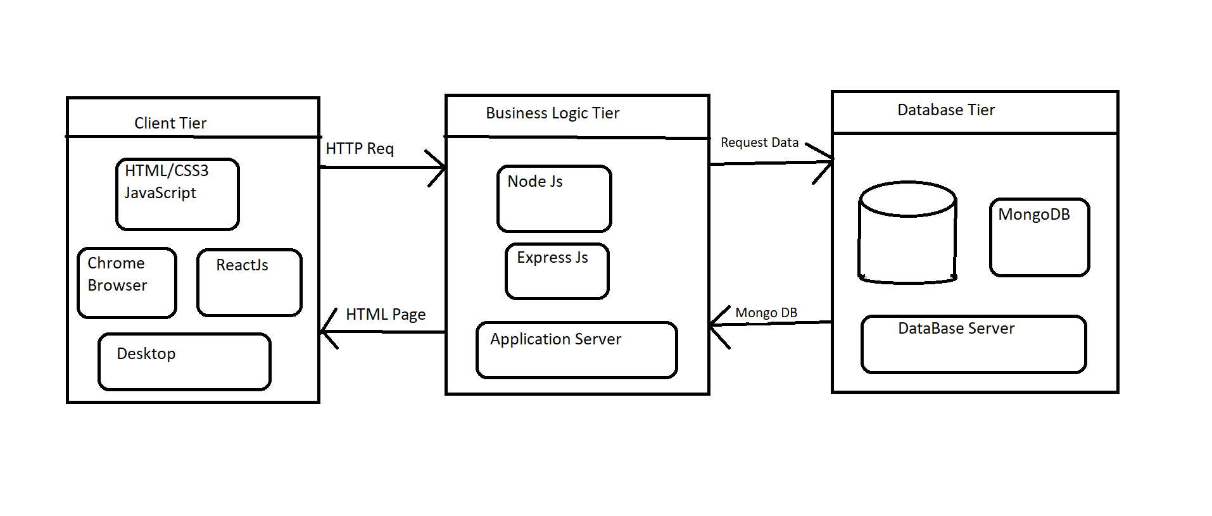
Architecture

Slide 8
Technologies Used
> React
>Redux
>Node.js
>Express.js
>MongoDb

Slide 9
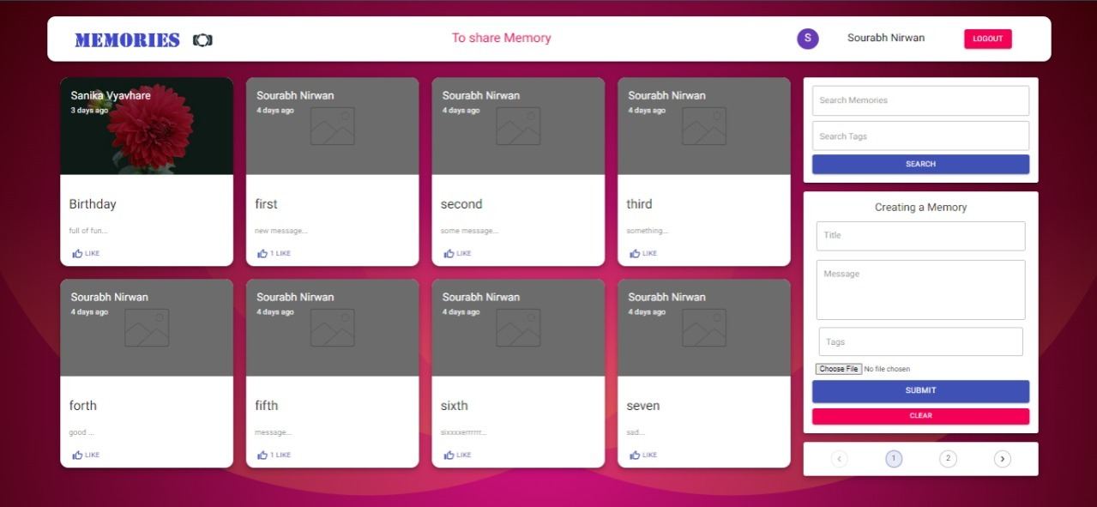
Home page

Slide 10
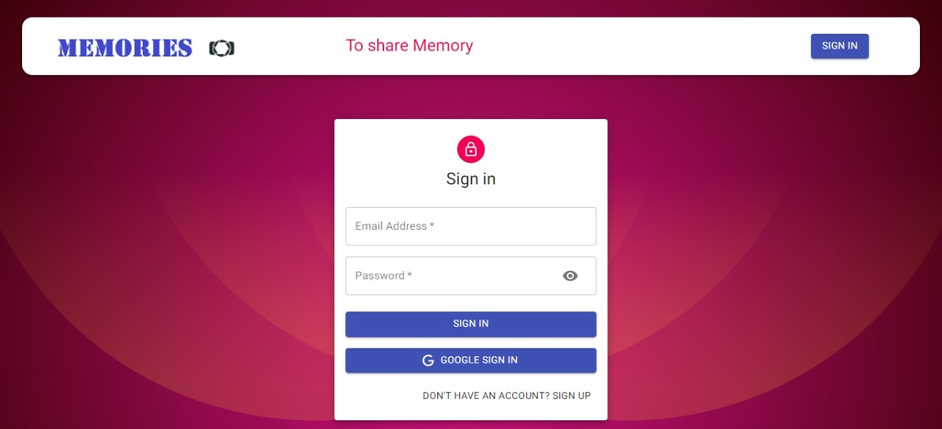

Slide 11
Conclusion
The Memories helps the user to post their memories online . It also helps user to Add, Delete , Update the post .

Slide 12
Thank You

