Slide 1
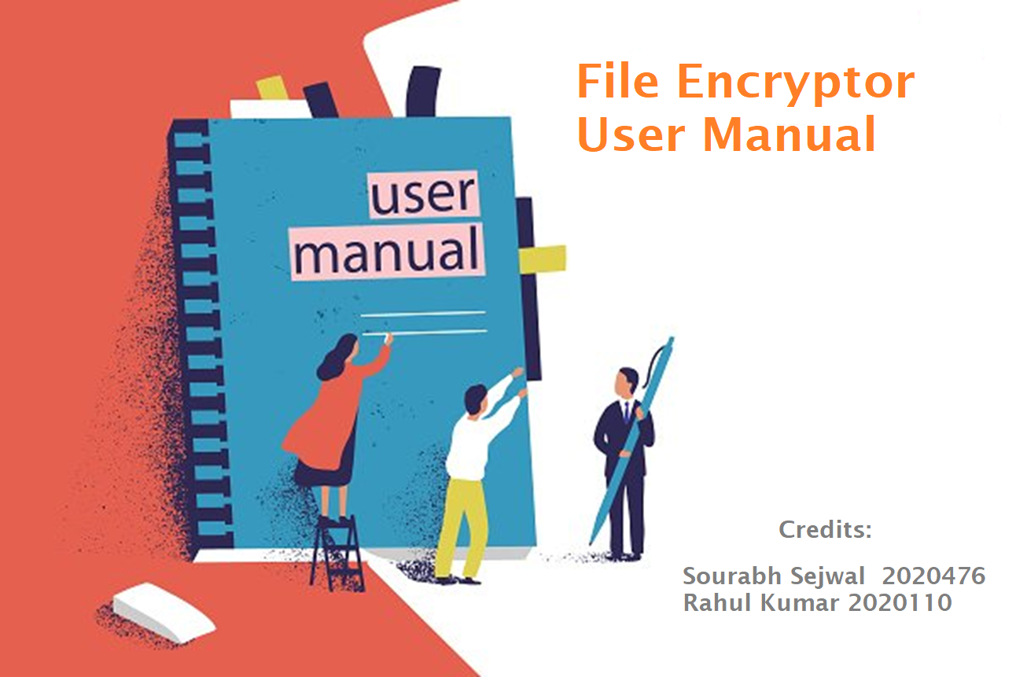


Slide 2
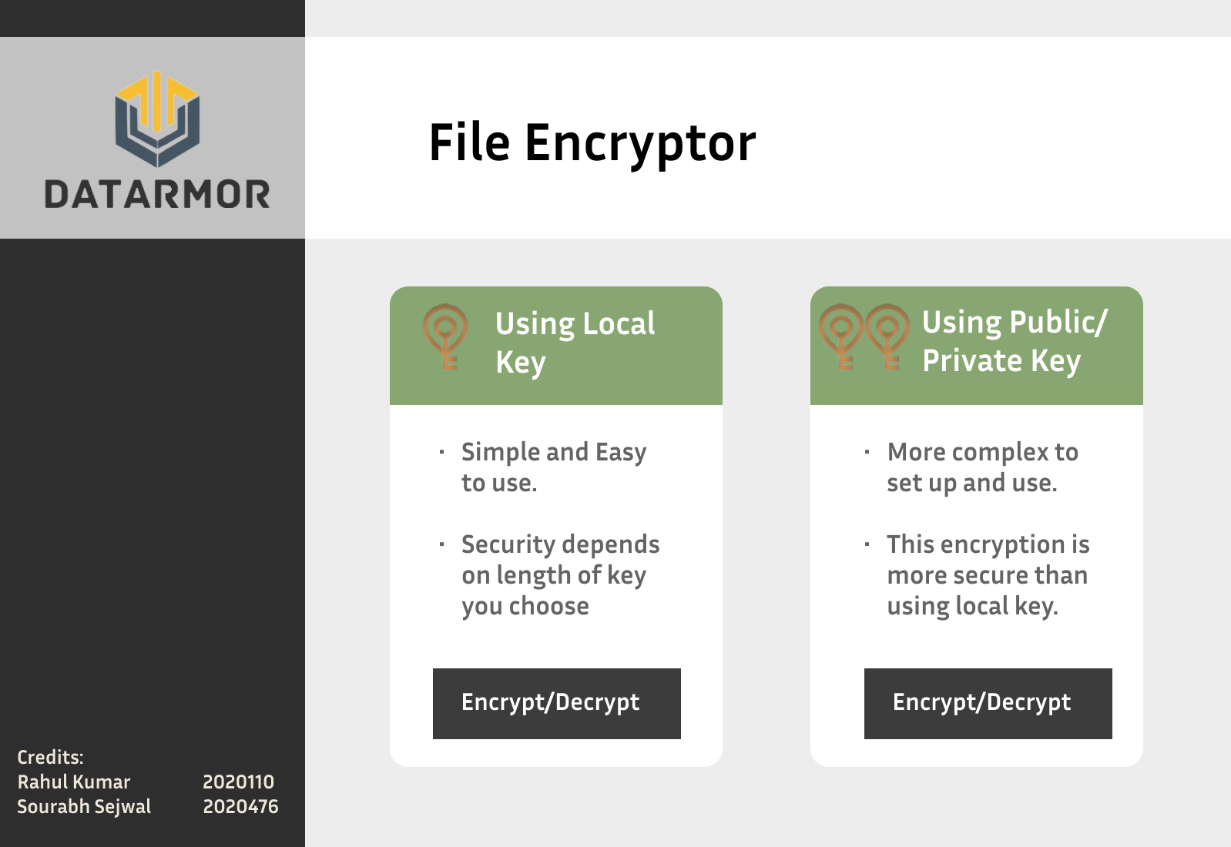
Let us begin!
How to start
Start the program using the Main.exe.
Github:
SourabhSejwal/Uss-file-encryptor (github.com)
Then you would see the following Home Screen.
Choose one of the two option based on your preference.

Slide 3
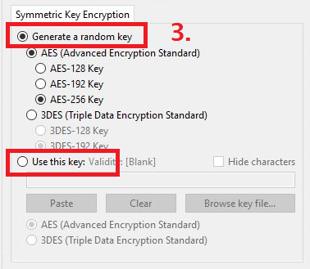
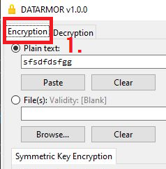
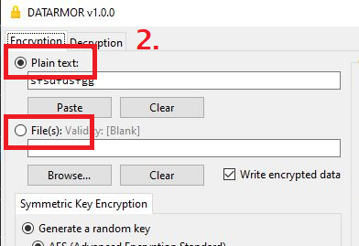
2. Encryption using Local Key
2.1 Encrypting Files
Select Encrypt tab. (It is selected by Default)
Then choose whether you want to encrypt plain text or any file.
Select your Local key or select generate key. If you select “Use this key”, also select what type of key you have AES or 3DES.

Slide 4
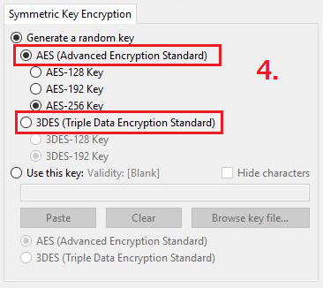
4. Select the type of encryption you wish to apply to your files. Here are some key points to help you choose your encryption algorithm.
When to choose AES:
When you need a high level of security.
When you need faster encryption and decryption speeds than 3DES.
When you need to encrypt large amounts of data.
When to choose 3DES:
When you need backward compatibility with legacy systems that use 3DES.
When you are restricted to using a 56-bit key size due to regulatory or policy requirements.
When you need a relatively simple encryption algorithm that is easy to implement.
NOTE - Same type of key needs to be selected later when you decrypt.

Slide 5
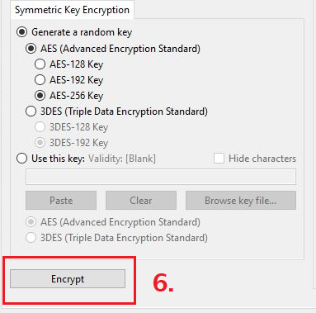
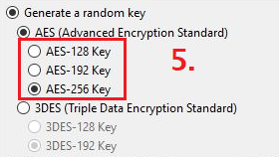
6. Click Encrypt button.
5. Choose the length of the encryption key.
Higher the length, more secure encryption is, but key file size would also be more.

Slide 6
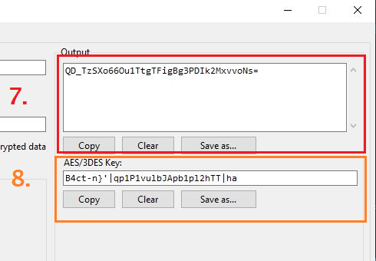
7.
If you chose a file to encrypt. The file will be saved automatically.
And if you chose plain text to encrypt, the encrypted text would be displayed in the text box. You can copy the text or save it as text file as per your preference.
8.
If you chose generate Key in the previous steps, then the generated key would appear in the key text box. And similarly you can copy or save it.
You have successfully encrypted your file(s).

Slide 7
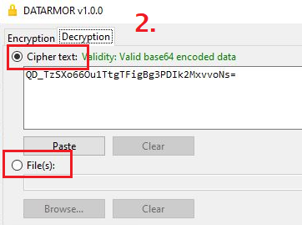
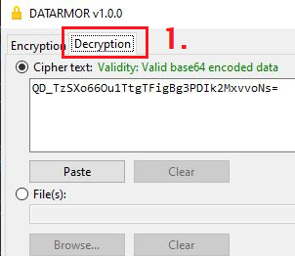
2.2 Decrypting Files
Select Decryption tab.
Note - When you paste encrypted text make sure there are no extra lines. If there is a new empty line, you should remove it to avoid errors.
Paste the encrypted text or select encrypted file.

Slide 8
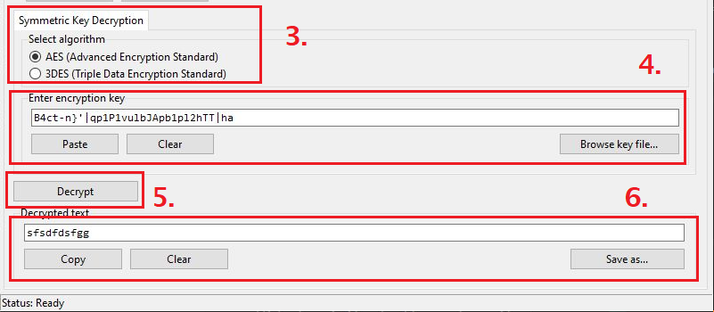
3. Select the algorithm you used to encrypt your file.
4. Paste or browse the key.
5. Press the Decrypt button.
6. If you chose text then decrypted text would appear here. You can copy or save it.
If it was another file type, then it would be saved automatically
You have successfully decrypted your file(s).

Slide 9
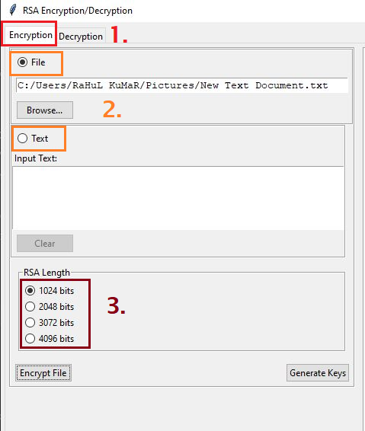
3.1 Encryption using Public/Private Key
Select the encryption tab
Choose file or paste the text to encrypt
Select the RSA Key length

Slide 10
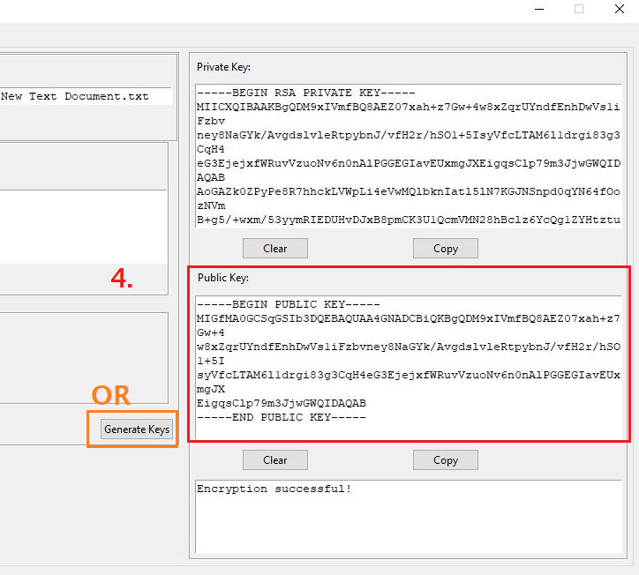
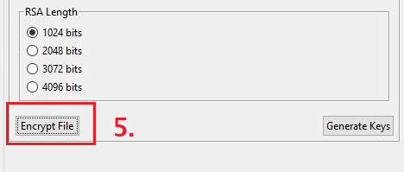
4. Enter the public key. Or click generate keys to generate a pair of Public and Private keys.
Save the keys for your future needs.
5. Click encrypt File button

Slide 11
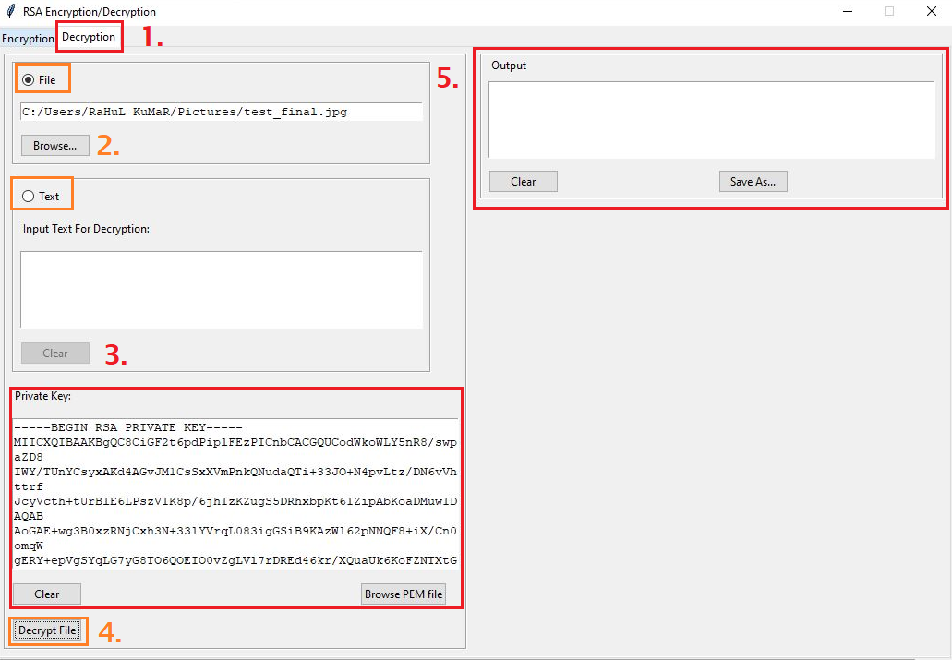
3.2. Decryption using Public/Private Key
Select the decryption tab.
Browse your file or enter the encrypted text.
Browse/Paste your private key.
Click Decrypt
File will be saved automatically or in case you entered encrypted text, then decrypted text will be shown in output text box.

Slide 12


