Slide 1
Mocks and Stubs (Engineering Software as a Service §8.4)
© 2013 Armando Fox & David Patterson, all rights reserved

Slide 2
It Should Make Search Results Available to Template
Another rspec-rails addition: assigns()
pass symbol that names controller instance variable
returns value that controller assigned to variable
But our current code doesn’t set any instance variables:
TCWWWH: list of matches in @movies
http://pastebin.com/DxzFURiu
http://pastebin.com/4W08wL0X
Notes:
TCWWWH – The Code We Wish We Had
DRY out code using Before block while we're at it

Slide 3
Two New Seam Concepts
stub
similar to should_receive, but not expectation
and_return optionally controls return value
mock: “stunt double” object, often used for behavior verification (did method get called)
stub individual methods on it:
m=double('movie1',:title=>'Rambo')
each seam enables just enough functionality for some specific behavior under test

Slide 4


RSpec Cookery #1
Each spec should test just one behavior
Use seams as needed to isolate that behavior
Determine what type of expectation will check the behavior
Write the test and make sure it fails for the right reason
Add code until test is green
Look for opportunities to refactor/beautify

Slide 5
Test Techniques We Know
obj.should_receive(a).with(b).and_return(c)
obj.stub(a).and_return(b)
d = double('impostor')
obj.should match-condition
Rails-specific extensions to RSpec:
assigns(:instance_var)
response()
render_template()
Optional!
Notes:
Difference between stub and should_receive

Slide 6
END

Slide 7
should_receive combines _____ and _____, whereas stub is only _____.
A mock and an expectation; a double
☐
A mock and an expectation; an expectation
☐
A seam and an expectation; an expectation
☐
☐
A seam and an expectation; a seam
Notes:
Seam is the more general name of a place where you can alter program behavior without editing that place. For example, a stub providing a double method in place of the real method.
True
False
False
False

Slide 8
END

Slide 9
Fixtures and Factories (Engineering Software as a Service §8.5)
© 2013 Armando Fox & David Patterson, all rights reserved

Slide 10
When You Need the Real Thing
Where to get a real object:
Fixture: statically preload some known data into database tables
Factory: create only what you need per-test
http://pastebin.com/N3s1A193

Slide 11
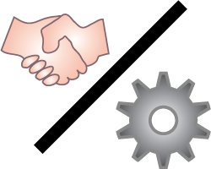
Fixtures
Database wiped & reloaded before each spec
add fixtures :movies at beginning of describe
spec/fixtures/movies.yml are Movies and will be added to movies table
Pros/uses
truly static data, e.g. configuration info that never changes
easy to see all test data in one place
Cons/reasons not to use
may introduce dependency on fixture data

Slide 12
Factories
Set up “helpers” to quickly create objects with default attributes, as needed per-test
Example: FactoryGirl gem
or just add your own code in spec/support/
Pros/uses:
Keep tests Independent: unaffected by presence of objects they don’t care about
Cons/reasons not to use:
Complex relationships may be hard to set up (but may indicate too-tight coupling in code!)
http://pastebin.com/bzvKG0VB
Notes:
Don't forget how to use a Gem: add to Gemfile, if appropriate under :test group only, then 'bundle install'

Slide 13

Pitfall: mock trainwreck
Goal: test searching for movie by its director or by awards it received
m.award.type.should == 'Oscar'
m.director.name.split(/ +/).last. should == 'Aronovsky'
Mock setup:
a = double('Award', :type => 'Oscar')
d = double('Director', :name => 'Darren Aronovsky'
m = double('Movie', :award => a,
:director => d)
Notes:
If a movie's award type or last name of its director are important entities in a testing scenario, Movie class should abstract how to get those things.
We will learn a design pattern called 'delegation' that helps with this, among other things.

Slide 14
END

Slide 15
Which of the following kinds of data, if any, should not be set up as fixtures?
☐
Movies and their ratings
☐
The TMDb API key
☐
The application’s time zone settings
☐
Fixtures would be fine for all of these
Notes:
A fixture is a fixed state used as a baseline for one or more tests, like a test fixture in a factory. Typically a fixture is a YAML file that defines a set of objects that is loaded into the test database that are then used in the tests. See Figure 8.10.
False. Movies and ratings are in fact the example in Figure 8.10.
True probably. The approved TMDb API key for RottenPotatoes will likely be stored in a configuration file or global constant. If the system was set up to require each user to have their own key, then these would need to be stored in a database, and so multiple of them could be set up in a test database. But usually the test database is of fake data, where here it would have to be real data.
True probably. The time zone will generally not be stored in the database, but obtained as a system call and kept in memory. If there was some reason to test for many time zones, these still would likely not be in the database.
False.

Slide 16
END

Slide 17
TDD for the Model & Stubbing the Internet (Engineering Software as a Service §8.6)
© 2013 Armando Fox & David Patterson, all rights reserved

Slide 18
Explicit vs. Implicit Requirements
find_in_tmdb should call TmdbRuby gem with title keywords
If we had no gem: It should directly submit a RESTful URI to remote TMDb site
What if TmdbRuby gem signals error?
API key is invalid
API key is not provided
Use context & describe to divide up tests
http://pastebin.com/ELQfC8Je

Slide 19
Review
Implicit requirements derived from explicit
by reading docs/specs
as byproduct of designing classes
We used 2 different stubbing approaches
case 1: we know TMDb gem will immediately throw error; test that we catch & convert it
case 2: need to prevent gem from contacting TMDb at all
context & describe group similar tests
in book: using before(:each) to setup common preconditions that apply to whole group of tests

Slide 20
Where to Stub in Service Oriented Architecture?
movie.rb
Movie.stub(:find_in_tmdb). and_return(...)
ruby-tmdb
TmdbMovie.stub(:find).with(...). and_return(...)
Rule of thumb:
• for unit testing, stub nearby, for maximum isolation of class under test (Fast, Independent)
• for integration testing, stub far away, to test as many interfaces as possible
Net::HTTP/OpenURI
Net::HTTP.stub(:get). with(...). and_return(...)
OS - TCP/IP
Internet
Parse contrived request
Return canned value(s) (using FakeWeb gem, for example)
TMDb
TMDb-dev
Notes:
ensure model working right?
…ensure model can deal with external error?
…ensure model’s collaborators working right?
FakeWeb:
observe service’s behavior (read API docs, try it yourself)
mimic behavior in your stubs

Slide 21
Test Techniques We Know
obj.should_receive(a).with(b).and_return(c) .with(hash_including 'k'=>'v')
obj.stub(a).and_raise(SomeClass::SomeError)
d = double('impostor')
{ action }.should raise_error(Some::Error)
describe, context
Rails-specific extensions to RSpec:
assigns(:instance_var)
response()
render_template()
Notes:
Difference between stub and should_receive

Slide 22
END

Slide 23
Which statement(s) are TRUE about Implicit requirements?
☐
They are often, but not always, derived from explicit requirements
☐
They apply only to unit & functional tests, not integration tests
☐
Testing them is lower priority than testing explicit requirements, since they don’t come from the customer
☐
All of the above are true
Notes:
Implicit requirements are the logical consequence of explicit requirements. For example, an explicit requirement might be to list all movies, which has the implicit requirement of specifying an ordering (e.g. by release date, or title). Implicit requirements typically correspond to integration tests.
True. They might also come from interaction of an explicit requirement with existing infrastructure, e.g. a gem.
False. They generally apply to integration tests.
False. They are just as important to system functionality, even if they are not in the user stories.
False.

Slide 24
END

Slide 25
Coverage, Unit vs. Integration Tests (Engineering Software as a Service §8.7)
© 2013 Armando Fox & David Patterson, all rights reserved

Slide 26
How Much Testing is Enough?
Bad: “Until time to ship”
A bit better: (Lines of test) / (Lines of code)
1.2–1.5 not unreasonable
Often much higher for production systems
Better question: “How thorough is my testing?”
Formal methods
Coverage measurement
We focus on the latter, though the former is gaining traction

Slide 27
Measuring Coverage - Basics
S0: every method called
S1: every method from every call site
C0: every statement
Ruby SimpleCov gem
C1: every branch in both directions
C1+decision coverage: every subexpression in conditional
C2: every path (difficult, and disagreement on how valuable)
class MyClass
def foo(x,y,z)
if x
if (y && z) then bar(0) end
else
bar(1)
end
end
def bar(x) ; @w = x ; end
end

Slide 28
What Kinds of Tests?
Unit (one method/class)
Functional or module (few methods/classes)
Integration/system
e.g. model specs
Runs fast
Runs slow
High coverage
Low coverage
Fine resolution
Coarse resolution
Many mocks;
Doesn’t test interfaces
Few mocksf;
tests interfaces
e.g. ctrlr
specs
e.g. Cuke
scena-
rios

Slide 29
Going to Extremes
“I kicked the tires, it works”
“Don’t ship until 100% covered & green”
Use coverage to identify untested or undertested parts of code
“Focus on unit tests, they’re more thorough”
“Focus on integration tests, they’re more realistic”
Each finds bugs the other misses

Slide 30
END

Slide 31
Which of these is POOR advice for TDD?
☐
Mock & stub early & often in unit tests
☐
Aim for high unit test coverage
Sometimes it’s OK to use stubs & mocks in integration tests
☐
☐
Unit tests give you higher confidence of system correctness than integration tests
Notes:
True. This allows sections of code to be tested in isolation.
True. It is much easier to find and fix coding errors at unit test than at a higher layer in the design.
True. It is possible to test the API between modules before a module is complete. For example, the unhappy path may not exist yet.
False. Unit tests check the correctness of units, but do not test the correctness of API usage across units (integration tests).

Slide 32
END

Slide 33
Other Testing Concepts; Testing vs. Debugging (Engineering Software as a Service §8.8, 8.11)
© 2013 Armando Fox & David Patterson, all rights reserved

Slide 34
Other Testing Terms You May Hear
Mutation testing: introduce deliberate error in code, do tests fail?
Fuzz testing: 10,000 monkeys throw random input at your code
Find ~20% MS bugs, crash ~25% UNIX utilities
Tests app the way it wasn’t meant to be used
DU-coverage: is every pair <define x/use x> executed?
Black-box vs. white-box/glass-box
Notes:
MS == Microsoft
Black box – cannot see inside code, only functional test
White/glass box – see code, do structural/unit/interface testing

Slide 35
TDD vs. Conventional Debugging
Conventional | TDD
Write 10s of lines, run, hit bug: break out debugger | Write a few lines, with test first; know immediately if broken
Insert printf’s to print variables while running repeatedly | Test short pieces of code using expectations
Stop in debugger, tweak/set variables to control code path | Use mocks and stubs to control code path
Darn, I thought for sure I fixed it, now have to do this all again | Re-run test automatically
Lesson 1: TDD uses same skills & techniques as conventional debugging - but more productive (FIRST)
Lesson 2: writing tests before code takes more time up-front, but often less time overall

Slide 36
TDD Summary
Red – Green – Refactor, and always have working code
Test one behavior at a time, using seams
Use it “placeholders” or pending to note tests you know you’ll need
Read & understand coverage reports
“Defense in depth”: don’t rely too heavily on any one kind of test
They only hit what they are aiming at

Slide 37
END

Slide 38
Which non-obvious statement about testing is FALSE?
Even 100% test coverage is not a guarantee of being bug-free
☐
If you can stimulate a bug-causing condition in a debugger, you can capture it in a test
☐
☐
Testing eliminates the need to use a debugger
☐
When you change your code, you need to change your tests as well
Notes:
True. 100% test coverage is with respect to some metric (e.g. statement coverage), which may not catch all bugs.
True. Assumes the condition is repeatable.
False. Once a test fails, a debugger is often needed to trace the source of the error that was detected by the test. The latency of the bug is the time between when it was triggered and when it is detected.
True. This is not true of acceptance tests (assuming the specification/user stories did not change), but is true of unit/integration tests.

Slide 39
END

Slide 40

Plan-And-Document Perspective on Software Testing (Engineering Software as a Service §8.9)
© 2013 Armando Fox & David Patterson, all rights reserved

Slide 41
P&D Testing?
BDD/TDD writes tests before code
When do P&D developers write tests?
BDD/TDD starts from user stories
Where do P&D developers start?
BDD/TDD developers write tests & code
Does P&D use same or different people for testing and coding?
What does the Testing Plan and Testing Documentation look like?

Slide 42

P&D Project Manager
P&D depends on Project Managers
Document project management plan
Creates Software Requirements Specification (SRS)
Can be 100s of pages
IEEE standard to follow
Must document Test Plan
IEEE standard to follow

Slide 43

P&D Approach to Testing
Manager divides SRS into programming units
Developers code units
Developers perform unit testing
Separate Quality Assurance (QA) team does higher level tests:
Module, Integration, System, Acceptance

Slide 44

3 QA Integration Options
Top-down integration
Start at top of dependency graph
High-level functions (UI) work soon
Many stubs to get app to “work”
Bottom-up integration
Start at bottom of dependency graph
No stubs, integrate everything in a module
Can’t see app working until all code written & integrated

Slide 45
3 QA Integration Options
3. Sandwich integration
Best of both worlds?
Reduce stubs by integrating some units bottom up
Try to get UI operational by integrating some units top down

Slide 46
QA Team Testing
Next QA Team does System Test
Full app should work
Test non-functional requirements (performance) + functional requirements (features in SRS)
When is P&D System Testing Done?
Organization policy
E.g., test coverage level (e.g. all statements)
E.g., all inputs tested with good and bad data
Final step: Customer or User Acceptance tests (UAT) - validation vs. verification

Slide 47
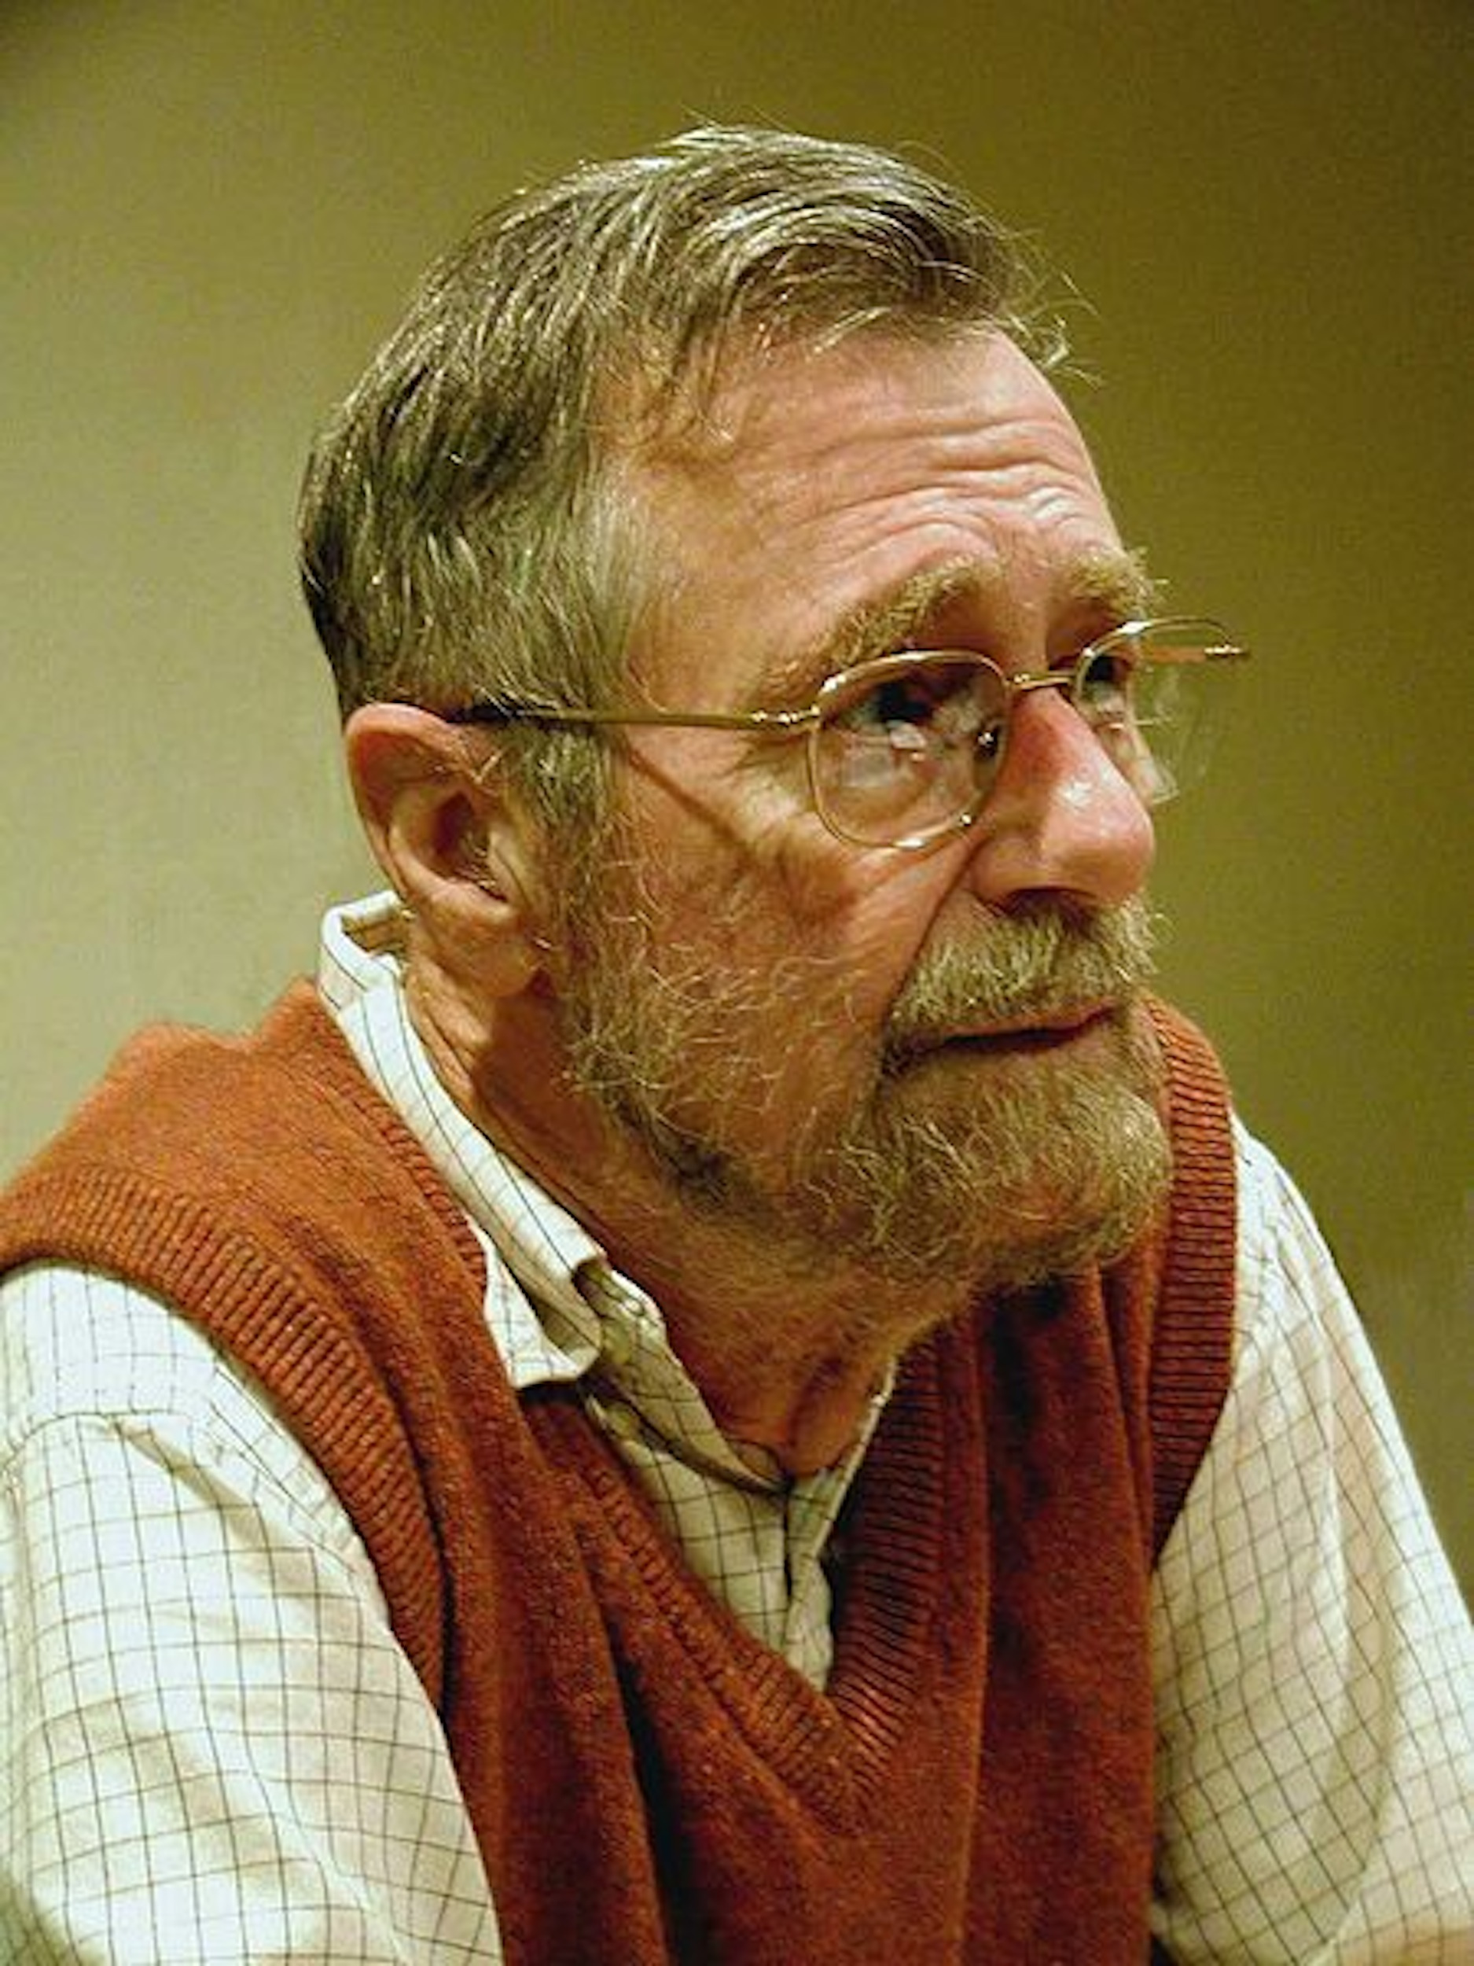
Limits of Testing
Program testing can be used to show the presence of bugs, but never to show their absence!
Edsger W. Dijkstra
(received the 1972 Turing Award for
fundamental contributions to
developing programming languages)
(Photo by Hamilton Richards. Used by permission under CC-BY-SA-3.0.)

Slide 48
Formal Methods
Start with formal specification & prove program behavior follows spec.
Human does proof
Computer via automatic theorem proving
Uses inference + logical axioms to produce proofs from scratch
Computer via model checking
Verifies selected properties by exhaustive search of all possible states that a system could enter during execution

Slide 49

Formal Methods
Computationally expensive, so use when
Small, fixed function
Expensive to repair, very hard to test
E.g. Network protocols, safety critical SW
Biggest: OS kernel 10K LOC @ $500/LOC
NASA SW $80/LOC
This course: rapidly changing SW (SaaS), easy to repair, easy to test => no formal methods

Slide 50
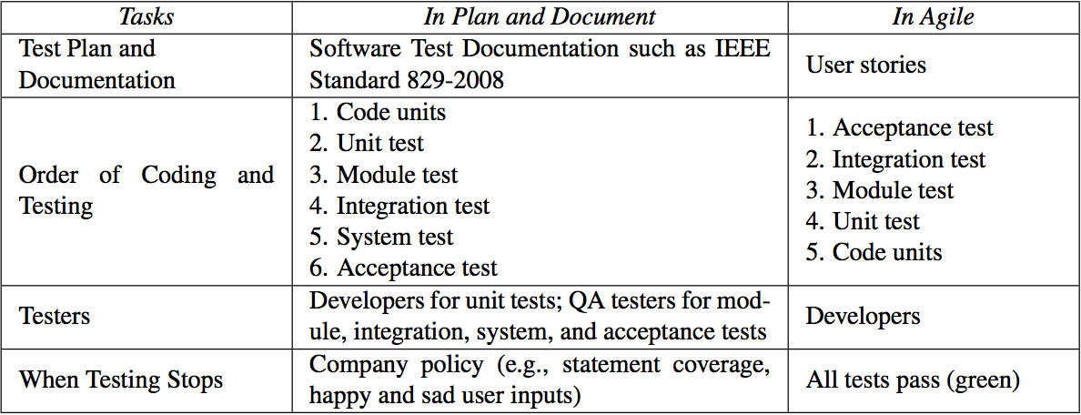
SW Testing: P&D vs. Agile (Fig. 8.23)

Slide 51
END

Slide 52
Which statement regarding testing is FALSE?
1.
Formal methods are expensive but worthwhile to verify important applications
2.
P&D developers code before they write tests while its vice versa for Agile developers
3.
Agile developers perform module, integration, system, and acceptance tests; P&D developers don’t
4.
Sandwich integration in P&D aims to reduce effort making stubs while trying to get general functionality early
Notes:
False. There are important applications (e.g., Google Search) that are far too expensive to use formal methods to test.
True. P&D developers write unit tests after they code.
True. In P&D, the QA team often does those tests.
True. Best of both worlds is goal.

Slide 53
END

