Slide 1
String Searching Algorithms Summary
- Sourabh S Shenoy

Slide 2
Table of Contents
Naïve pattern matching
Finite State Automaton
Rabin Karp
Boyer Moore Horsepool
Boyer Moore
Baeza Vates
Morris Pratt
Knuth Morris Pratt
Horsepool
Reverse Factor
Aho Corasick

Slide 3
Naïve String Matching

Slide 4
Naïve String Matching pseudocode
NAÏVE_STRING_MATCHER (T, P)
n ← length [T]
m ← length [P]
for s ← 0 to n - m do
if P[1 . . m] = T[s +1 . . s + m]
then return valid shift s

Slide 5
The inner loop is executed at most n - m +1 times, and the while-loop is executed at most m times
Hence, the running time of the algorithm is O((n - m +1)m), which is clearly O(nm).
Hence, in the worst case, when the length of the pattern, m are roughly equal, this algorithm runs in the quadratic time.
Eg: aa..b in aaa…a

Slide 6
Finite State Automaton

Slide 7
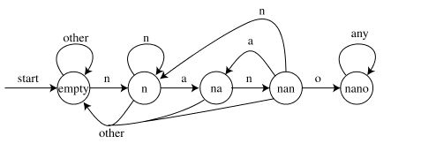
For the string “banananona” we get the states empty, empty, empty, "n", "na", "nan", "na", "nan", "nano", "nano", "nano". Since we end in state "nano", this string contains "nano" in it somewhere
O(m^3 + n) time: O(m^3) to build the state table described above, and O(n) to simulate it on the input file.

Slide 8
Rabin-Karp

Slide 9
The idea
The Rabin-Karp string searching algorithm calculates a hash value for the pattern, and for each M-character subsequence of text to be compared.
If the hash values are unequal, the algorithm will calculate the hash value for next M-character sequence.
If the hash values are equal, the algorithm will compare the pattern and the M-character sequence.
In this way, there is only one comparison per text subsequence, and character matching is only needed when hash values match.

Slide 10
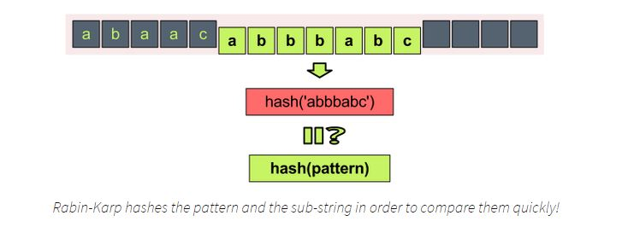
Suppose we have the string “hello world”, and let’s assume that its hash is hash(‘hello world’) = 12345. So if hash(‘he’) = 1 we can say that the pattern “he” is contained in the text “hello world”. Thus on every step we take from the text a sub-string with the length of m, where m is the pattern length.

Slide 11
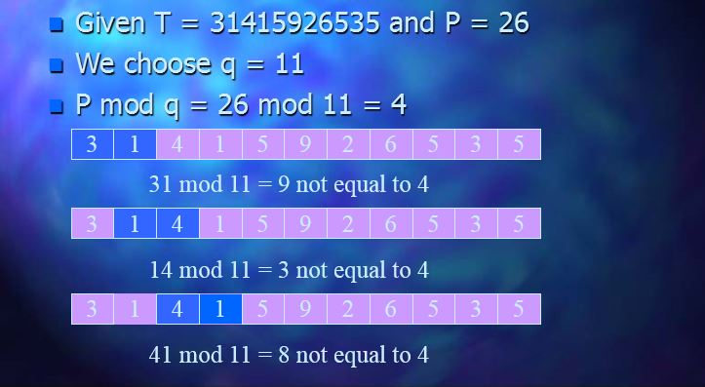

Slide 12
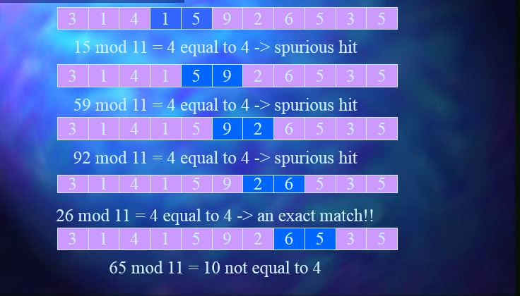

Slide 13
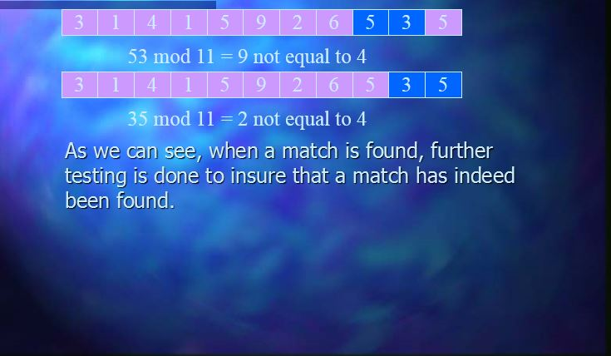

Slide 14
Boyer-Moore-Horsepool string matching

Slide 15
Boyer-Moore-Horsepool String Matching
It is useful when pattern is shorter than the String
Has a lower constant factor than many other string algorithms
A brute-force search of all alignments takes m-n+1 steps, whereas Boyer-Moore uses information gained by preprocessing the pattern to skip as many alignments as possible.
Time complexity of O(m+n)
Notes:
The Boyer-Moore algorithm uses information gathered during the preprocess step to skip sections of the text, resulting in a lower constant factor than many other string algorithms.
Naïve string matching has worst case scenario of O(NM). For instance, When text is aaaa…b and pattern is aa..b.
Boyer Moore also has worst case of O(MN). For instance, searching 01..1 in 1^n.
Best case: searching 0^m in 1^n. O(M/N)
Average Case: O(M/|E|)

Slide 16
Steps
Create a “Bad Match table” for all the letters.
Value of a letter present in the pattern = length of the pattern – index – 1
For every other letter, value = length
No letter is repeated in the table
Also, last letter of the pattern = length

Slide 17
Sample Bad Match Table
Pattern = nittenmamit
Length = 11
n i t t e n m a m i t
0 1 2 3 4 5 6 7 8 9 10
BMT
N | I | T | E | M | A | *
Value
7
1
11
3
11
10
9
6
5
8
2
4
Value = 11 - Index - 1

Slide 18
Example
N | I | T | E | M | A | *
5 | 1 | 11 | 6 | 2 | 3 | 11
Hello world i am from nmamit nmite
also knoan as nittenmamit and am …
nittenmamit

Slide 19
Example
N | I | T | E | M | A | *
5 | 1 | 11 | 6 | 2 | 3 | 11
Hello world i am from nmamit nmite
also knoan as nittenmamit and am …
nittenmamit

Slide 20
Example
N | I | T | E | M | A | *
5 | 1 | 11 | 6 | 2 | 3 | 11
Hello world i am from nmamit nmite
also knoan as nittenmamit and am …
ni
ttenmamit

Slide 21
Example
N | I | T | E | M | A | *
5 | 1 | 11 | 6 | 2 | 3 | 11
Hello world i am from nmamit nmite
also knoan as nittenmamit and am …
nittenmamit

Slide 22
Example
N | I | T | E | M | A | *
5 | 1 | 11 | 6 | 2 | 3 | 11
Hello world i am from nmamit nmite
also knoan as nittenmamit and am …
nittenmamit

Slide 23
Example
N | I | T | E | M | A | *
5 | 1 | 11 | 6 | 2 | 3 | 11
Hello world i am from nmamit nmite
also knoan as nittenmamit and am …
nittenmamit
Match Found!!

Slide 24
Boyer-Moore string matching

Slide 25
2 Rules
Bad Character Rule (seen in BMH Algorithm)
Good Suffix Rule

Slide 26
Good Suffix Rule
Suppose for a given alignment of P and T, a substring t of T matches a suffix of P, but a mismatch occurs at the next comparison to the left. Then find, if it exists, the right-most copy t' of t in P such that t' is not a suffix of P and the character to the left of t' in P differs from the character to the left of t in P. Shift P to the right so that substring t' in P aligns with substring t in T. If t' does not exist, then shift the left end of P past the left end of t in T by the least amount so that a prefix of the shifted pattern matches a suffix of t in T. If no such shift is possible, then shift P by n places to the right. If an occurrence of P is found, then shift P by the least amount so that a proper prefix of the shifted P matches a suffix of the occurrence of P in T. If no such shift is possible, then shift P by n places, that is, shift P past t.

Slide 27
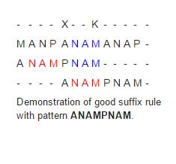

Slide 28
Baeza-Vates (Bitap) String Matching

Slide 29
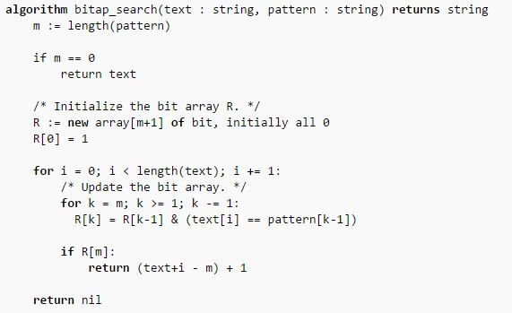

Slide 30
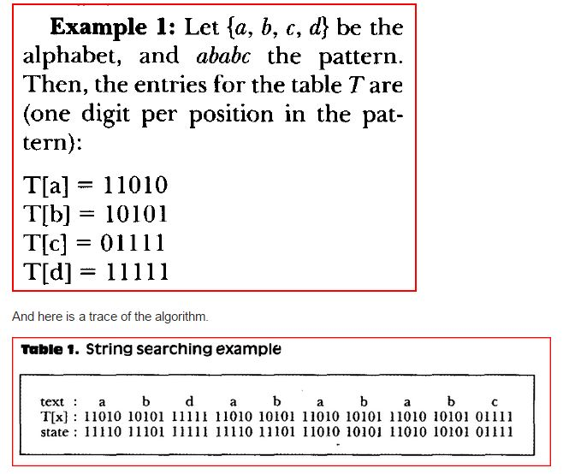

Slide 31
Morris-Pratt String Matching

Slide 32
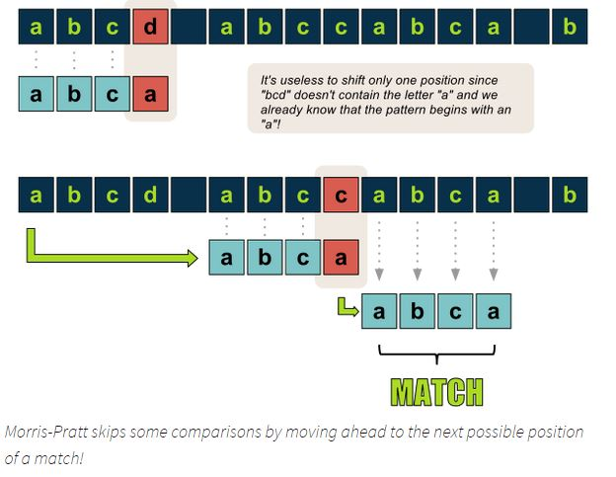

Slide 33
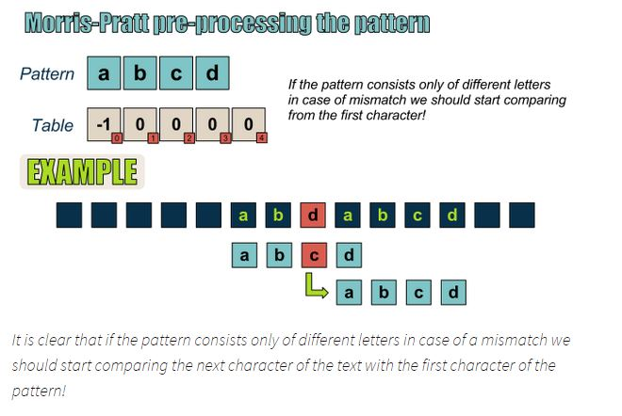

Slide 34
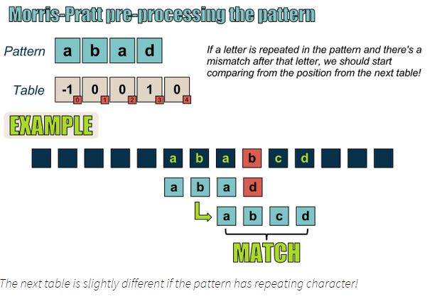

Slide 35
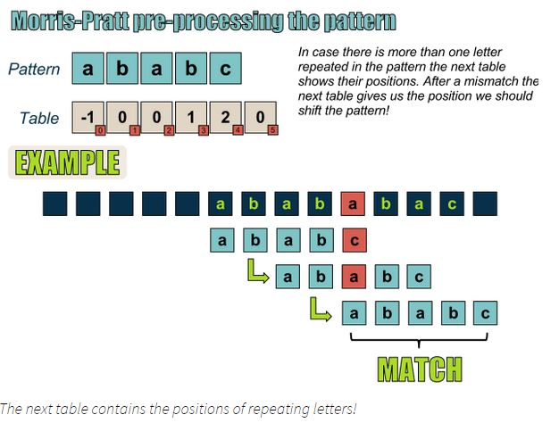

Slide 36
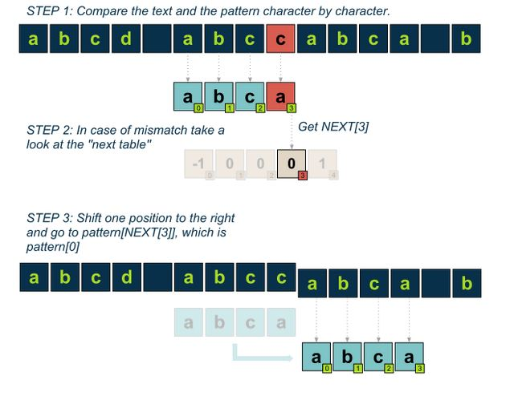

Slide 37
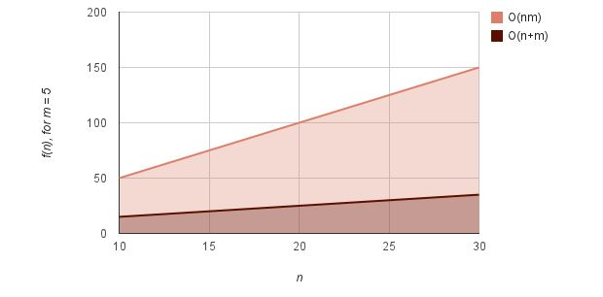
This algorithm needs some time and space for preprocessing.
Thus the preprocess of the pattern can be done in O(m), where m is the length of the pattern, while the search itself needs O(m+n)

Slide 38
Knuth-Morris-Pratt String Matching

Slide 39
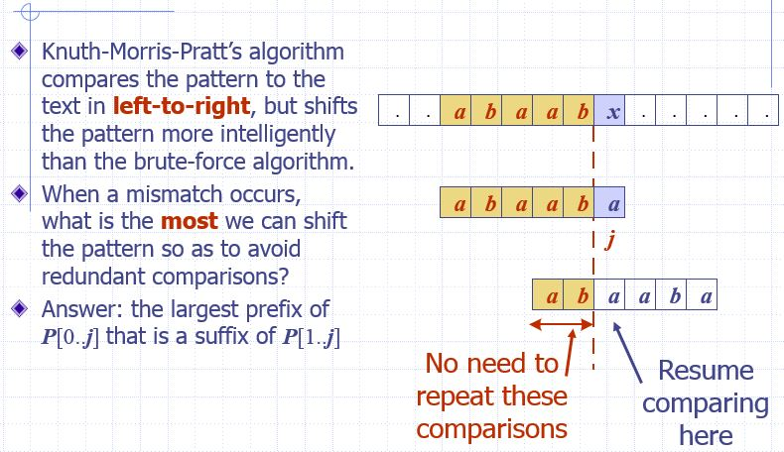

Slide 40
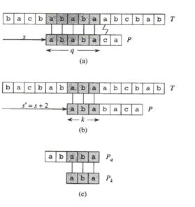

Slide 41
Horspool String Matching

Slide 42
For each position of the window, we compare its last character(ß) with the last character of the pattern.
If they match, we scan the window backwardly against the pattern until we either find the pattern or fail on a text character.
Suffix search
Text
α
ß
Pattern
σ
match

Slide 43
Then, no matter whether there is a match or not, we shift the window so that the pattern matches ß. Note that ß is the last
character of the previous window.
Suffix search
Text
α
ß
Pattern
σ
match
Text
ß
Safe shift
ß
no ß in this part

Slide 44
Preprocessing phase
HpBc table
The value bmBc for a particular alphabet is defined as the rightmost position of that character in the pattern – 1.
Example :
T : GCATCGCAGAGAGTATACAGTACG
P : GCAGAGAG
7 6 5 4 3 2 1
a | A C G *
HpBc[a] | 1 6 2 8

Slide 45
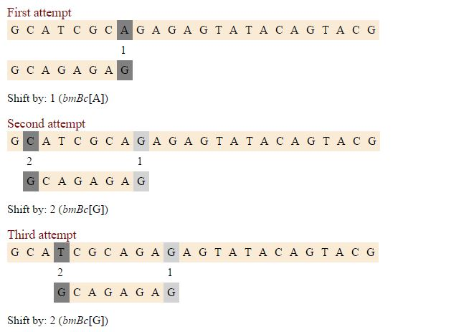

Slide 46
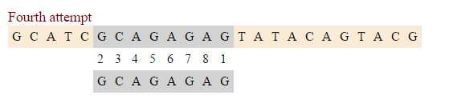

Slide 47
Reverse Factor

Slide 48
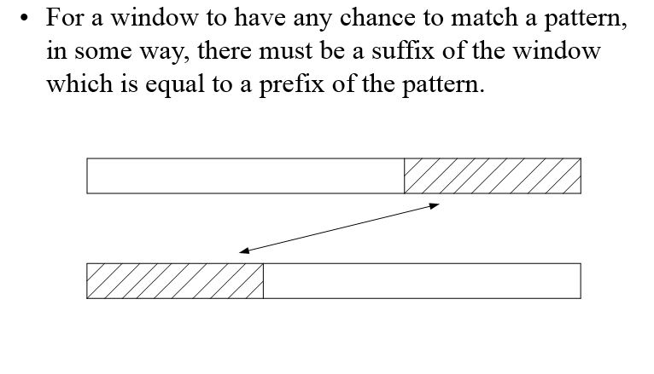

Slide 49
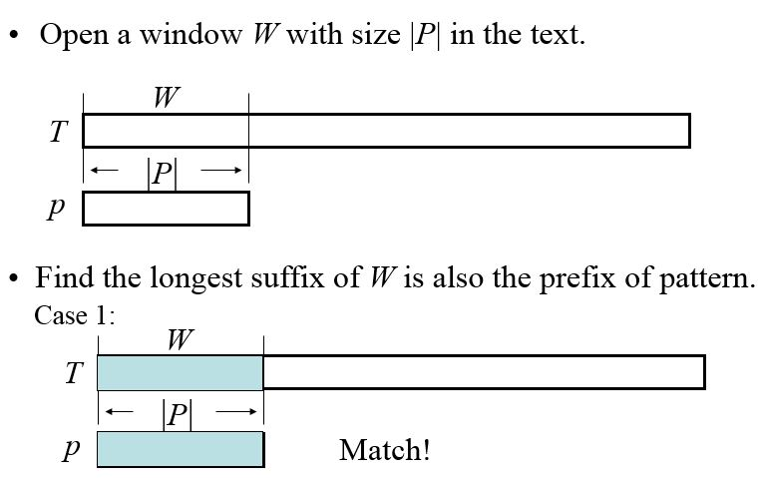

Slide 50
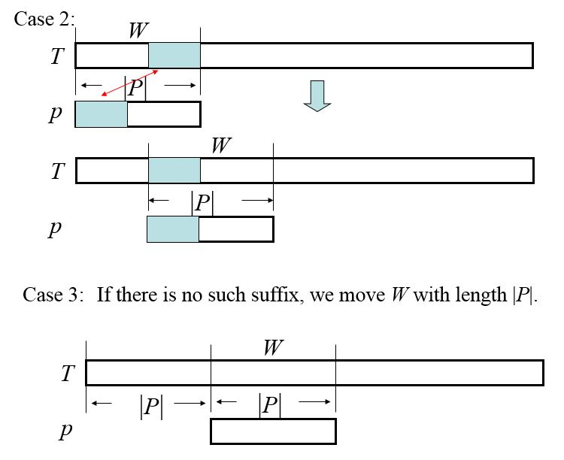

Slide 51
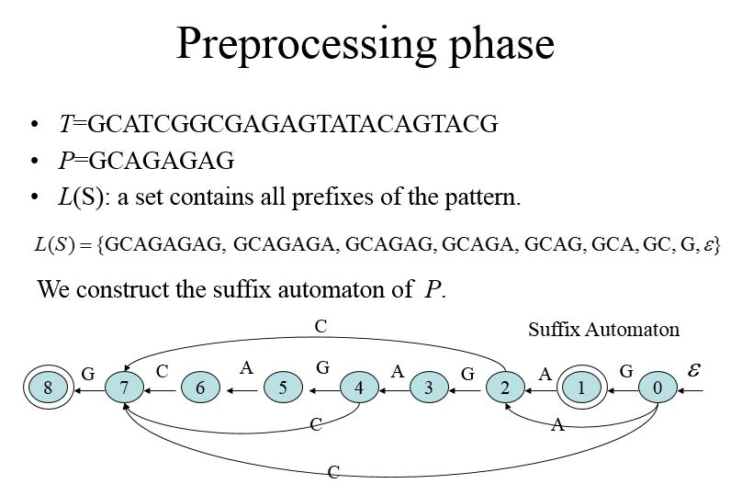

Slide 52
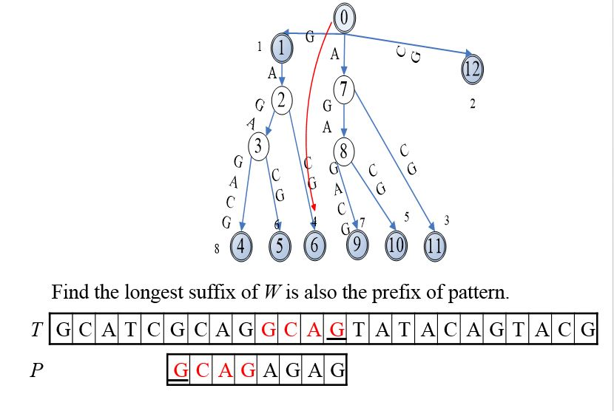

Slide 53
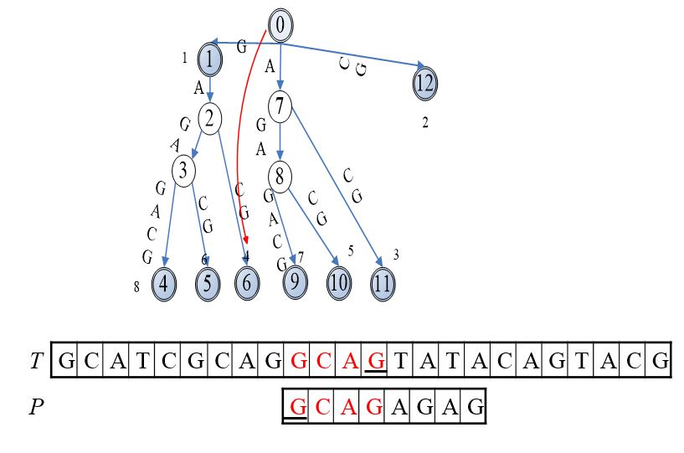

Slide 54
Aho Corasick using tries
http://blog.ivank.net/aho-corasick-algorithm-in-as3.html

Slide 55
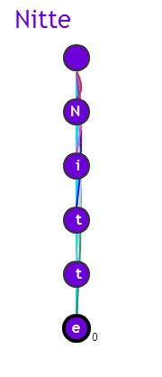


Slide 56
Thank You!

