Slide 1
PIP4004 - INTERNSHIP Final Presentation WEB DEVELOPMENT-UPTOSKILLS
Student Details
Name | S SOURABHA
Roll No | 20211CIT0145
Section | 8CIT01
Batch No. | Internship
Under the Supervision of,
Dr. Sharmasth Vali Y
Assistant Professor
School of Computer Science and Engineering
Presidency University
Name of the Program: B.Tech-CSE(IOT)
Name of the HoD: Dr. Anandraj S P
Name of the Program Project Coordinator: Dr. Sharmasth Vali Y
Name of the School Internship/Project Coordinators: Mr. Md Ziaur Rahman

Slide 2
Content
About Company or Organization
Working domain or the technology
About your team and reporting Manager
Challenges Faced in Internship
Objectives of the work
Literature Review
Proposed System
Problem Statement
System Requirements
Advantages of Proposed System/Work
Architecture Implemented
Internship Roadmap
Github Link
Outputs

Slide 3
About Company or Organization
UptoSkills provides free training programs in both technical and non-technical skills, particularly in collaboration with colleges. These programs are designed to help users enhance their career prospects by gaining relevant skills without any cost.
Additionally, UpToSkills offers free internships in various domains like digital marketing, graphic design, AI/ML, web development and more. These internships are work-from-home opportunities and are structured to provide real-world experience. Importantly, these internships are free, and they explicitly state that no fees should be paid by interns.

Slide 4
About Company or Organization
Moreover, UptoSkills also has free courses available on their platform across a wide range of subjects, including engineering, computer science, and agriculture, among others.
These resources make UptoSkills an accessible option for those looking to upskill without incurring costs.
Some of their clients include IBM, L&T Infotech, Wipro, MuSigma, Mindtree, Cognizant apart from many others.
They offer a wide range of customized training programs designed to enhance skills and advance careers, and their expert trainers and career advisors work closely with clients to provide ongoing support and guidance.

Slide 5
Working domain or the technology
Web Development Domain involves creating and maintaining websites and web applications to ensure functionality and a seamless user experience.
It includes frontend development which focuses on the user interface , and backend development which manages the server database and application logic.
Developers use programming languages like HTML, CSS, JavaScript Python, along with frameworks and libraries to build responsive and dynamic websites.

Slide 6
About your team and reporting Manager
Structure of your team, working project and reporting to etc.
Team- 3 members
Task 1- Create a website for UptoSkills with header, footer, and dropdown menu for discover button. From the dropdown menu, users can choose from the various courses offered, by filling a simple enrolment form. (Only frontend)
Task 2- Create CAPTCHA for login page in Human Resource Management System.

Slide 7
Challenges Faced in Internship
Cracking the interview
Completing given tasks within the specific time frame
Steep learning curve
Collaborating with teammates
Self-learning

Slide 8
Objectives of the work
Gain real-time knowledge and experience of working in the Web Development domain by creating user-friendly, attractive websites.
Team-work and collaboration amongst teammates encourages us to brainstorm and co-operate efficiently.
Learn end-to-end deployment of applications using React, Node.js, etc.
Report to Mr. Ranjot Dhillon about the work done on a daily basis.

Slide 9
Literature Review
Title | Authors | Proposed idea
Achieving Human Resource Management Sustainability in Universities | Muhammad Mohiuddin, Elahe Hosseini et al. (2022) | The study investigates the sustainability of HRM in Iranian public universities, highlighting its importance for future growth and competitiveness. The findings reveal that factors like employer branding, social & psychological variables, HR practices, and economic aspects significantly influence HRM sustainability.
Sustainable human resource management: six defining characteristics | Robin Kramar (2022) | It emphasizes the integration of social, environmental, and economic factors into HR practices, highlighting the importance of stakeholder engagement, alignment with corporate strategy, commitment to ethical standards, emphasis on employee development, consideration of environmental impacts, and the cultivation of a sustainable culture.

Slide 10
Literature Review
Title | Authors | Proposed idea
Socially responsible human resource management and employee ethical voice: Roles of employee ethical self-efficacy and organizational identification | Zhongju Liao, Jialin Cheng, Qian Chen (2022) | The study examines how socially responsible HRM practices influence employees' willingness to raise ethical concerns. It highlights that employee ethical self-efficacy is a crucial factor in this process. Additionally, organizational identification, enhances employees' ethical voice. Organizations implementing socially responsible HRM practices empower employees to express ethical concerns, fostering a more ethical workplace culture

Slide 11
Literature Review
Title | Authors | Proposed idea
Inclusive human resource management in freelancers' employment relationships: The role of organizational needs and freelancers' psychological contracts’ | Sjanne Marie E. van den Groenendaal, Charissa Freese et al. (2022) | Through qualitative interviews with 8 dyads of HR managers and freelancers, the research explores organizational demands & psychological contracts between the two parties. While both groups agree on the meaning of inclusive HRM in their work relationships, they often have differing perspectives. This highlights the importance of negotiating expectations to prevent contract breakdowns.
Human Resource Management in the Era of AI | Poonam Khurana, Shruti Thakral et al. (2025) | The study explores the impact of AI on HRM, highlighting both its benefits and challenges for workforce management, employee engagement, and talent acquisition. It examines AI tools like recruitment algorithms and performance management systems, while addressing ethical concerns, confidentiality, and algorithmic bias.

Slide 12
Proposed System / Work
A Fully Integrated Solution: Combines recruitment, on-boarding, attendance and leave management, and off-boarding into a single platform.
Automation of Manual Tasks: Uses digital workflows for offer letter generation, attendance tracking, and leave approvals.
Enhanced Employee Interaction: Incorporates a private social media module to facilitate collaboration.

Slide 13
Problem Statement
The absence of integration between crucial procedures like recruitment, on-boarding, and attendance management is one of the major issues in today's HRMS, which results in ineffective manual workflows and increased errors. Furthermore, a lot of HRMS platforms limit internal communication and collaboration by failing to adequately encourage employee participation. A contemporary, integrated HRMS that improves user experience and expedites procedures is desperately needed.

Slide 14
System Requirements
Component | Technology Used
Frontend | React.js
Backend | Node.js
Database | MongoDB
Security | JWT Authentication
Hosting | AWS, Firebase

Slide 15
Advantages of Proposed System/Work
The system follows a modular development approach:
Recruitment & On-boarding Module
Attendance & Leave Management
Social Media Platform
Off boarding Module
Security Features

Slide 16
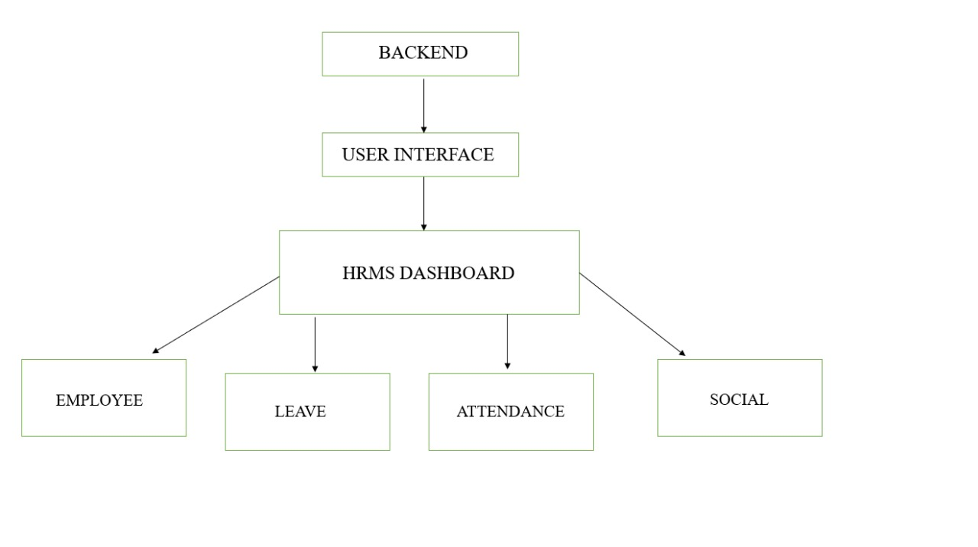
Architecture Implemented

Slide 17
Internship Road Map
Review 0
Review 1
Review 2
Review 3
Company profile
Domain/ technology of the work
About the working team and reporting manager
Title
Abstract
Lit. review
Objectives
Problem statement
Road map
References
Spiral bind hardcopy of report
Algorithm
Source code
Implement-ation
100% report hardcopy & softcopy
Live demo of project
100% live demo
Report hardcopy & softcopy
Plagiarism report
Publications (if any)

Slide 18
Github Link
https://github.com/Sourabhashiva/Internship

Slide 19
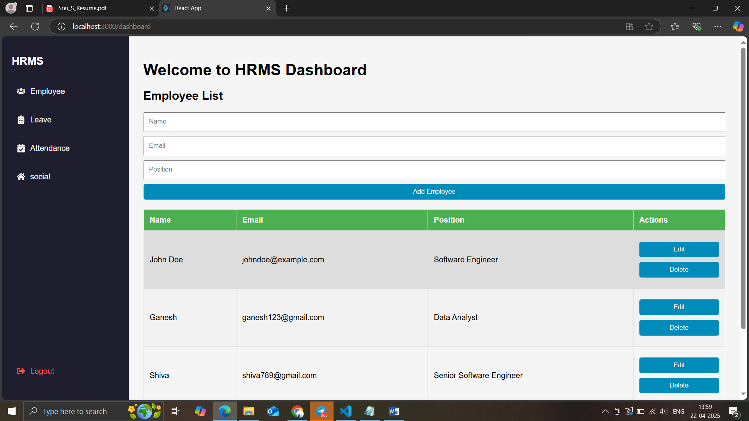
OUTPUTS

Slide 20
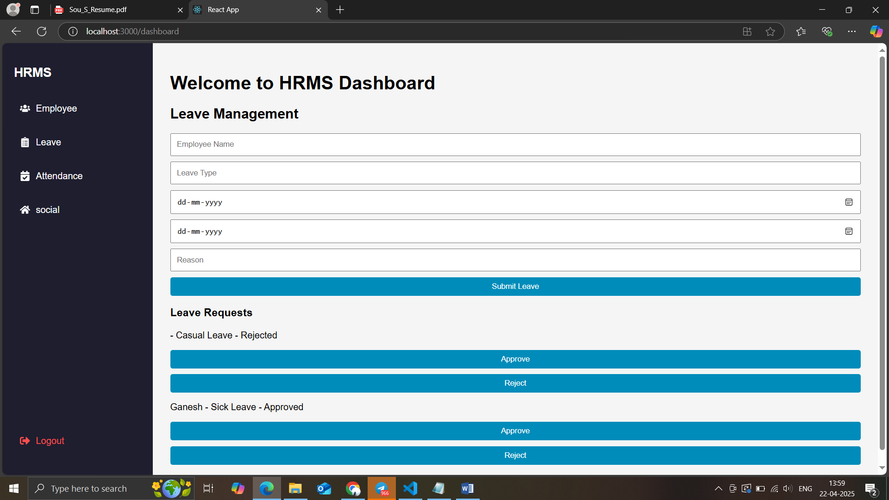

Slide 21
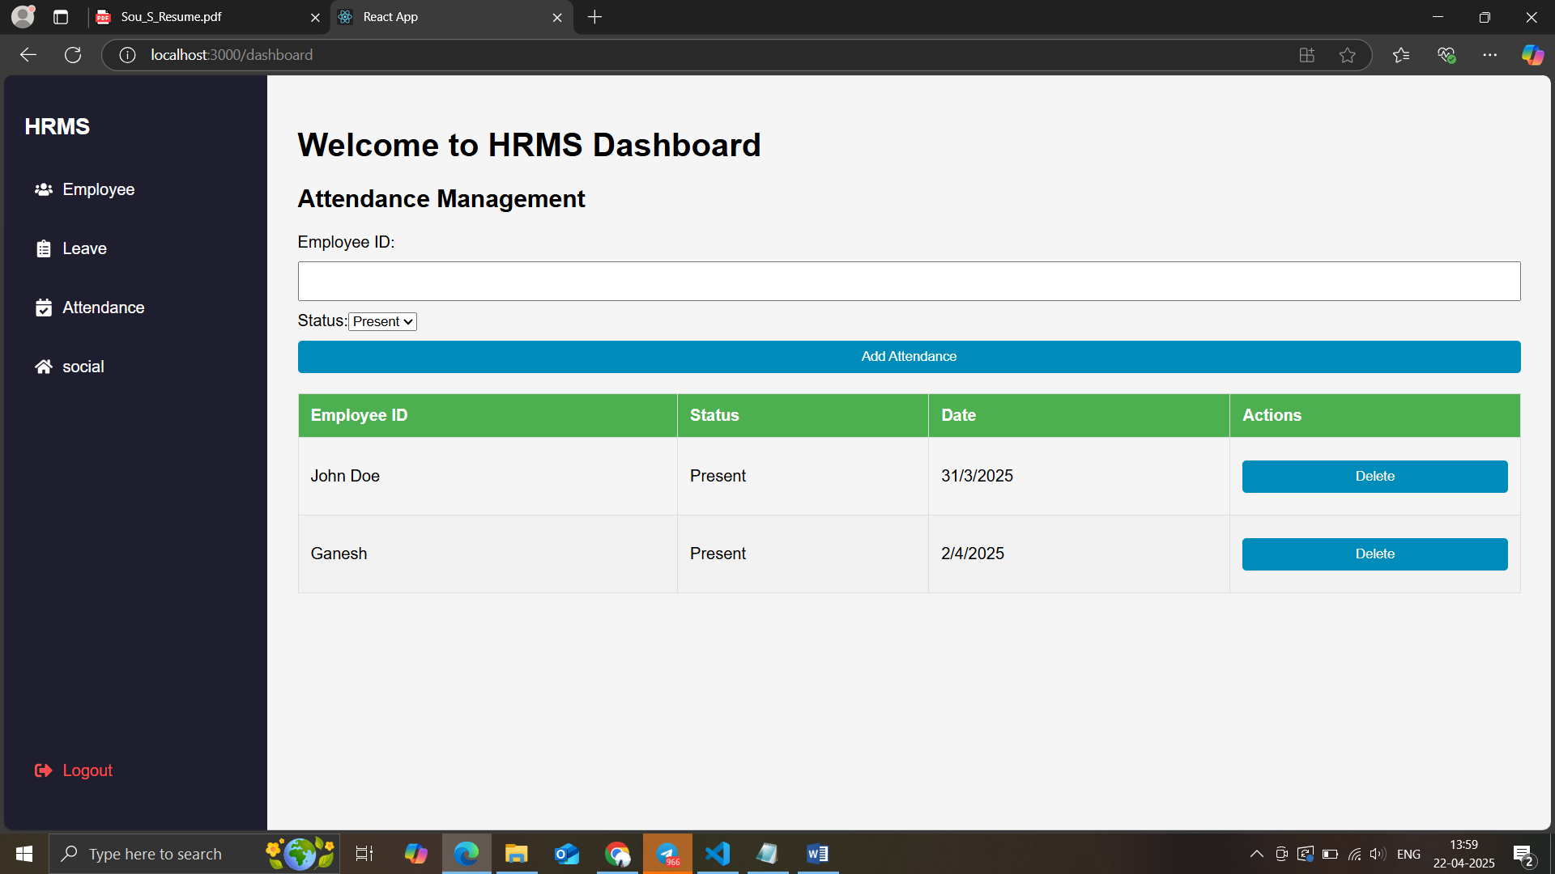

Slide 22
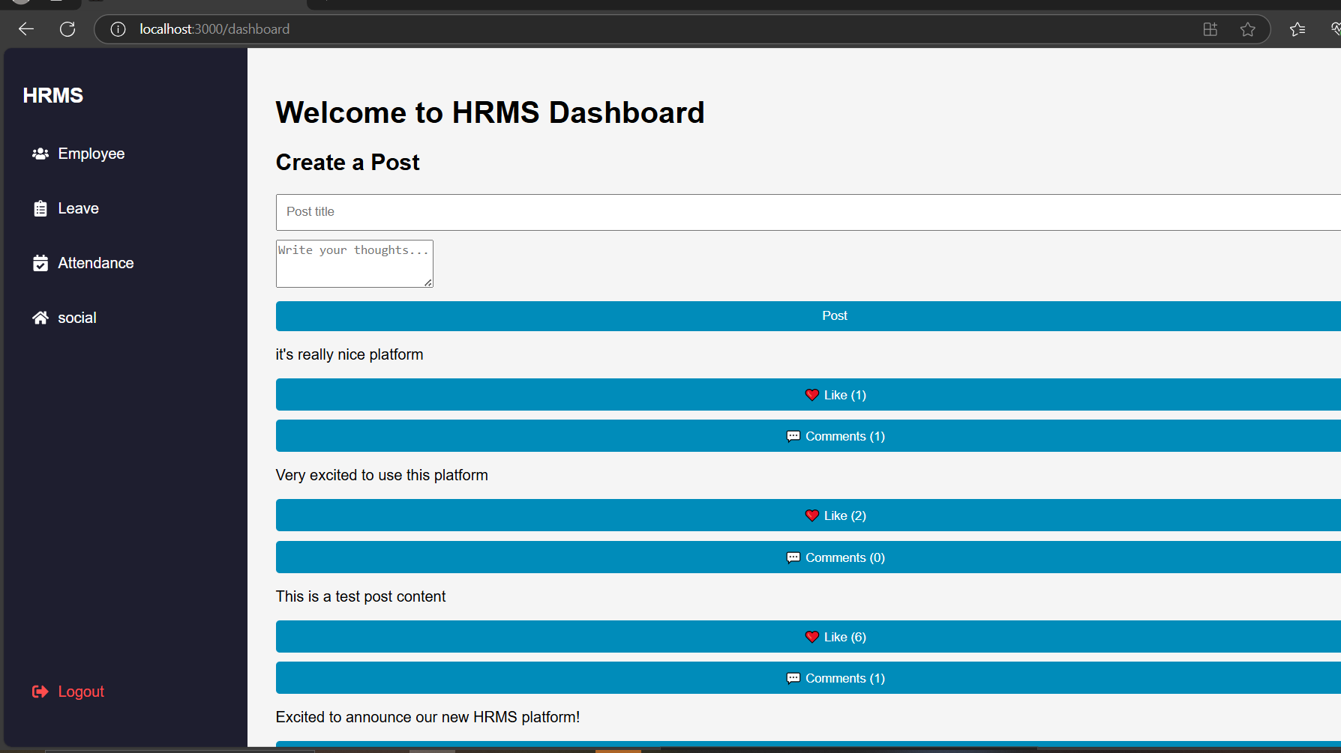

Slide 23
Q&A

Slide 24
Thank you !!

