Slide 1
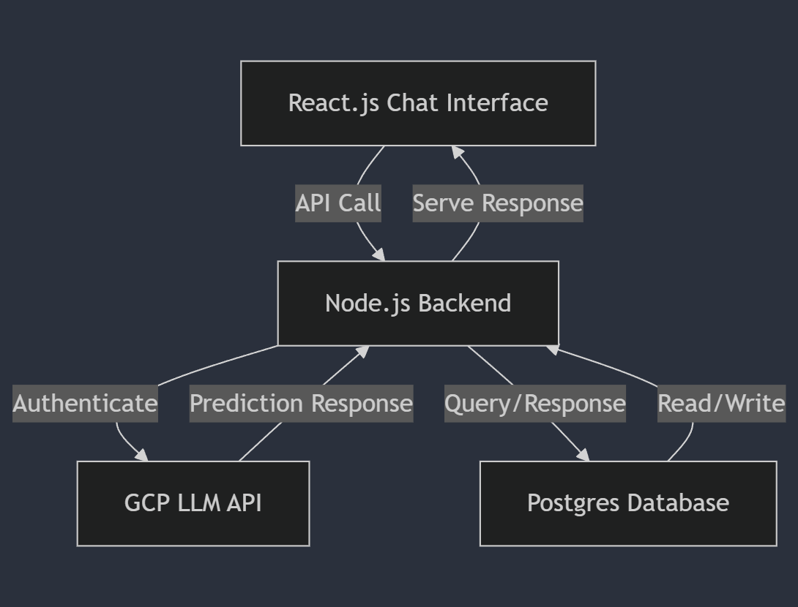
Bot architecture in Production

