Slide 1
Process flow (Part 1 & 2)
Part 1 : defining intents and collecting inputs
Part 2 : Actually handling inquiry

Slide 2
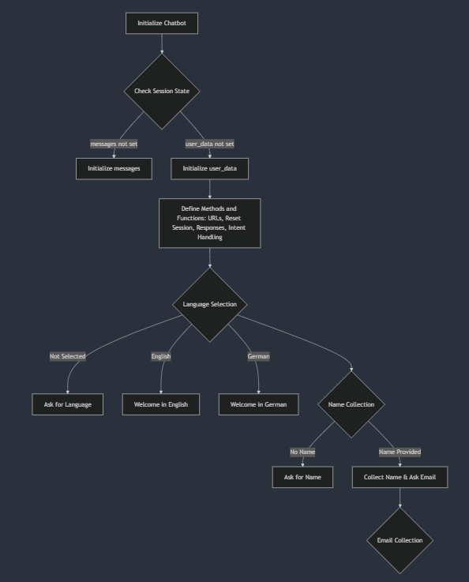
1. input collection

Slide 3
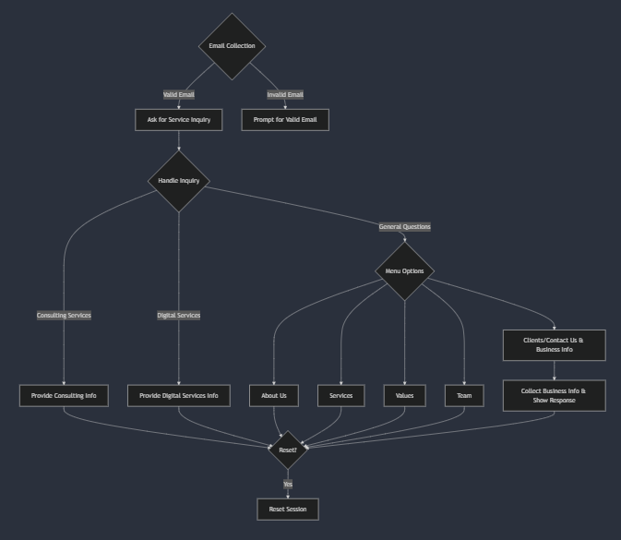
2. Fulfilment: handling query

