Slide 1

STOCK MARKET PREDICTION

Slide 2
CONTENT
Project Architecture
Introduction to Stock Market Prediction
Workflow Overview
Methodology and Dataset Details
Data Preprocessing and EDA
Model Building
Model Selection
Model Deployment
Conclusion and Future Work

Slide 3
PROJECT ARCHITECTURE
Datasets
Import Libraries
Data Cleaning
Handle Missing Values
Remove Duplicates
Data Preprocessing/EDA
Feature Scaling
Load Datasets
Explore Data Summary
Fix Datatypes
Visualize Data Patterns
Model Building
Select Algorithms
Train the Model
Model Evaluation
Evaluate Accuracy
Cross-Validation
Model Deployment
Deploy Model To Production
Update Model as Needed

Slide 4
INTRODUCTION
Stock prediction is the process of forecasting the future price or movement of a stock using various techniques such as statistical analysis, machine learning, technical indicators, or fundamental analysis. It aims to help investors make informed decisions about buying, holding, or selling stocks.
Use cases:
- Forecasting future stock prices based on historical data.
- Applications in trading, risk management, and investment strategies.

Slide 5
WORKFLOW OVERVIEW
1. Data Collection: Collect the historical stock data for past years (e.g., Yahoo Finance).
2. Data Preprocessing: Cleaning, normalization, and splitting into training/testing sets.
3. Model Development: Designing and training the LSTM model.
4. Evaluation: Using metrics like RMSE.
5. Prediction: Predict future stock prices.

Slide 6
METHODOLOGY
Python language:
It is a rich language for data science and AI.
Libraries:
Pandas, Numpy, Sklearn, Tenserflow etc.
Algorithms used:
We have used LSTM, ARIMA, SARIMA and PROPHET and after the evaluation we decided to choose LSTM.
Streamlit UI
Provided user interface using streamlit.

Slide 7
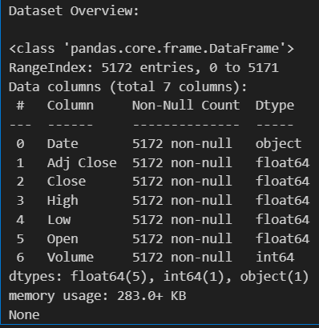
DATASET DEATAILS
Source:
We selected Infosys dataset and downloaded it from Yahoo Finance.
Features Used:
We selected Close as our target.
Time Period:
We have used dataset of past 20 years i.e. from 2004-2024.

Slide 8
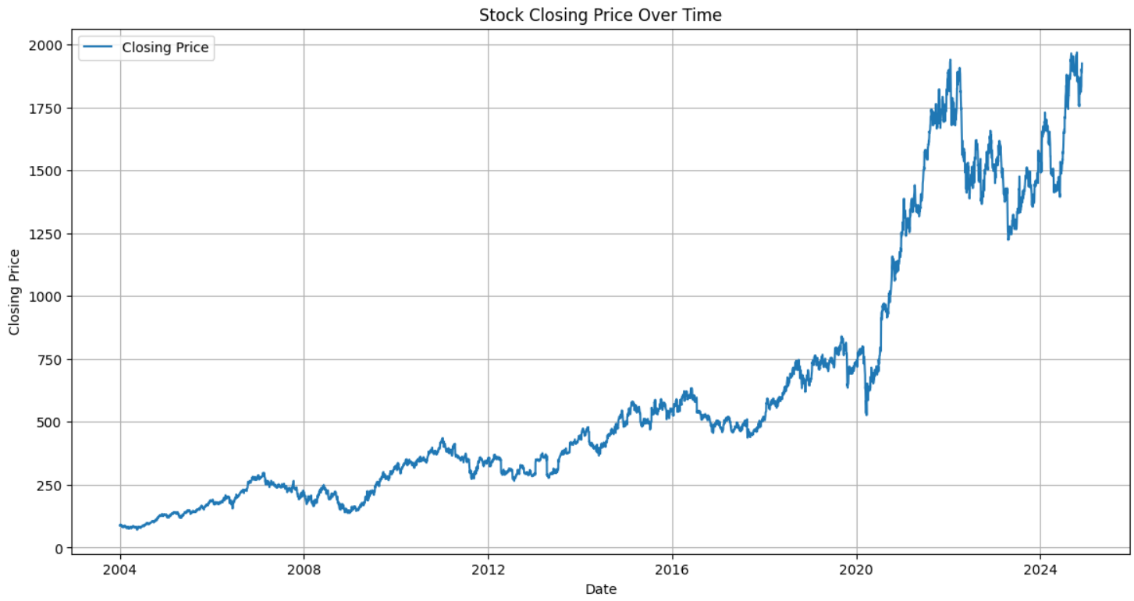
DATA PREPROCESSING AND EDA
CLEAN DATA: Handle missing values, duplicates, and fix data types.
INSIGHTS: Study about the closing price over the years.
VISUALIZE TRENDS: Use charts to reveal the key patterns.

Slide 9
MODEL BUILDING
1) Auto Regressive Integrated Moving Average (ARIMA)
- ARIMA model is a Statistical model used for capturing linear trends and seasonality in stationary data.
- Evaluated ARIMA Model got an RMSE value as 552.3598317425018.
2) Seasonal ARIMA (SARIMA)
- SARIMA model is an Extended ARIMA model for handling seasonality in time series data.
- Evaluated SARIMA Model got an RMSE value as 441.23192549539857.

Slide 10
3) Prophet
- PROPHET model is a Bayesian structural time series model used for handling time series data with trends, seasonality, and holidays.
- Evaluated PROPHET model got an RMSE value as 572.3762069887296.
4) Long Short-Term Memory (LSTM)
- LSTM is a Recurrent Neural Network (RNN) model is designed to handle sequential data and learn long-term dependencies.
- Evaluated LSTM model got an RMSE value as 27.835446069199502.

Slide 11
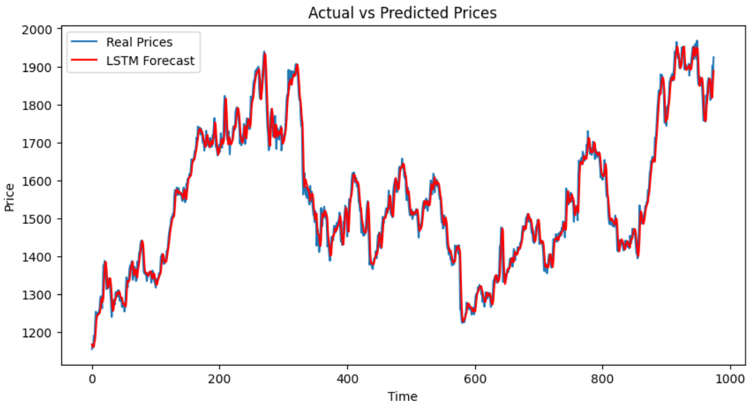
MODEL SELECTION
Model Selection: Choosing the best model based on performance metrics.
Comparative Analysis: Comparing multiple models to choose the best performer.
By comparing all the models for giving best model for deployment based on performance metrics we got LSTM Model with an RMSE value of 27.84.

Slide 12
MODEL DEPLOYMENT
- Model deployment is the process of integrating a trained machine learning model into a production environment to provide predictions or insights to end-users or systems.
- It involves setting up the infrastructure, creating apis or user interfaces, and ensuring scalability and reliability for real-world usage.
- Deployment platforms like streamlit, flask, aws, azure, or docker are commonly used for deploying models as web applications or services.
- We have used pickle library for deployment purpose.
- We converted our LSTM model to .pkl file and also created .pkl file for scaler.
- Then we used streamlit to view the predictions on web.

Slide 13
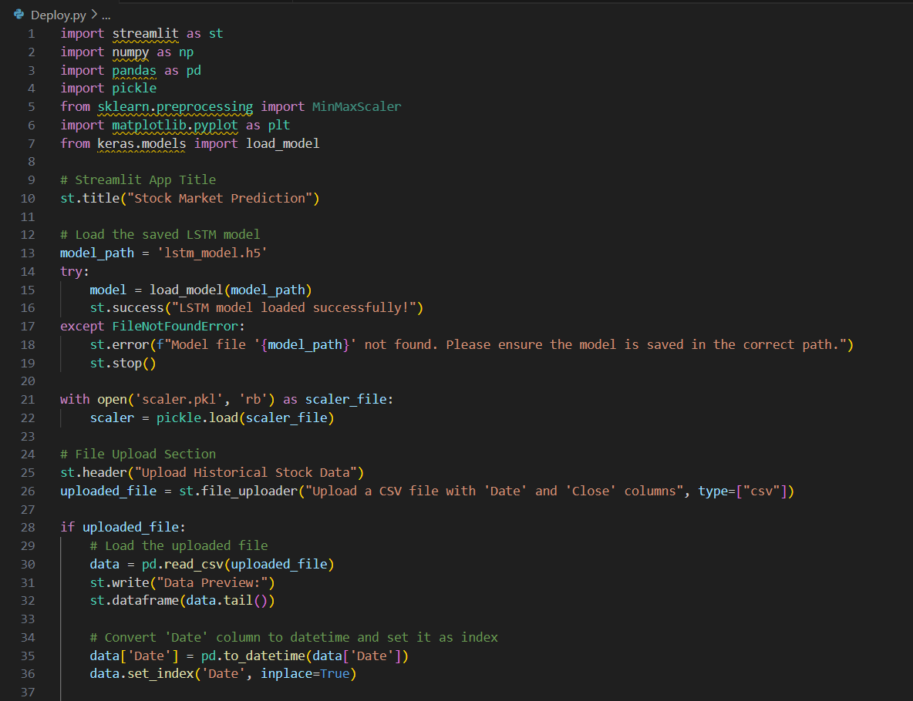
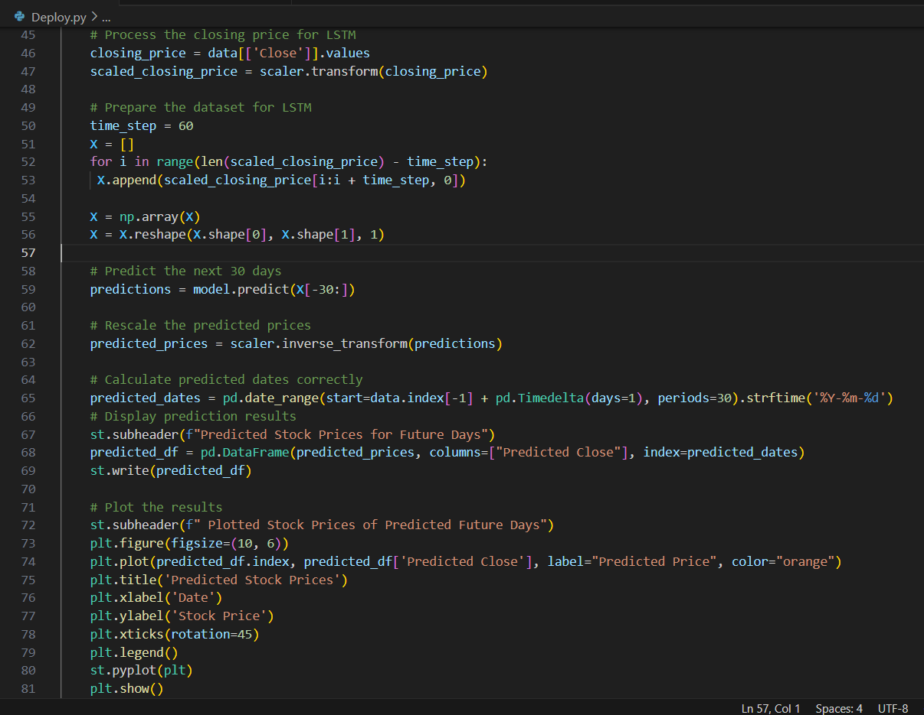
Using Streamlit for Deployment

Slide 14
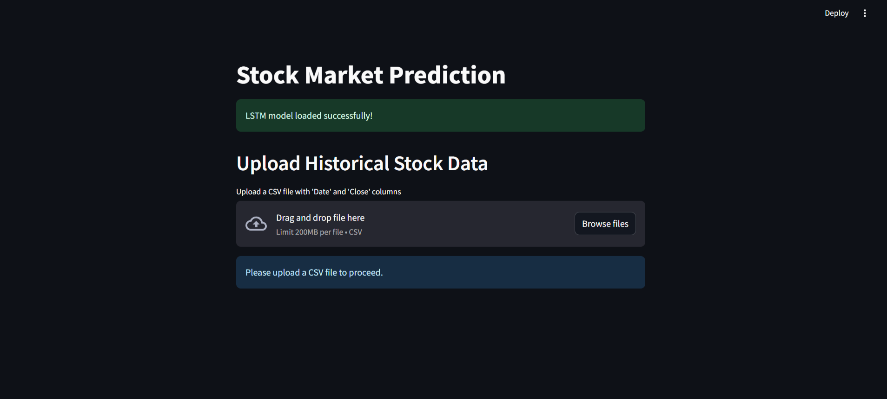
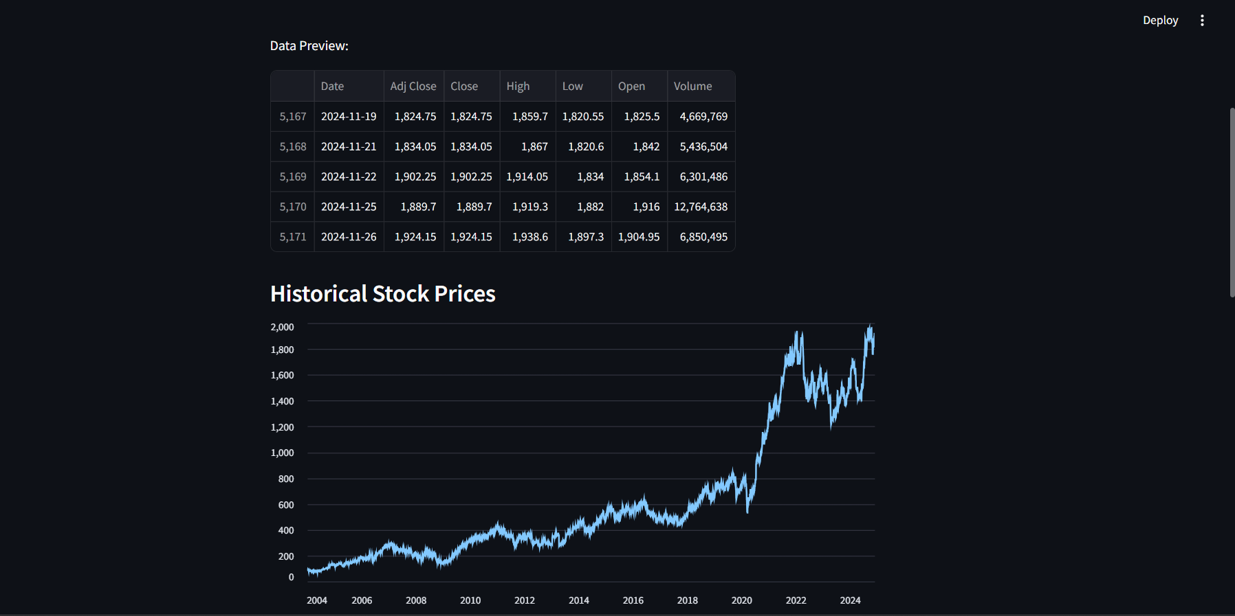
Streamlit Interface

Slide 15
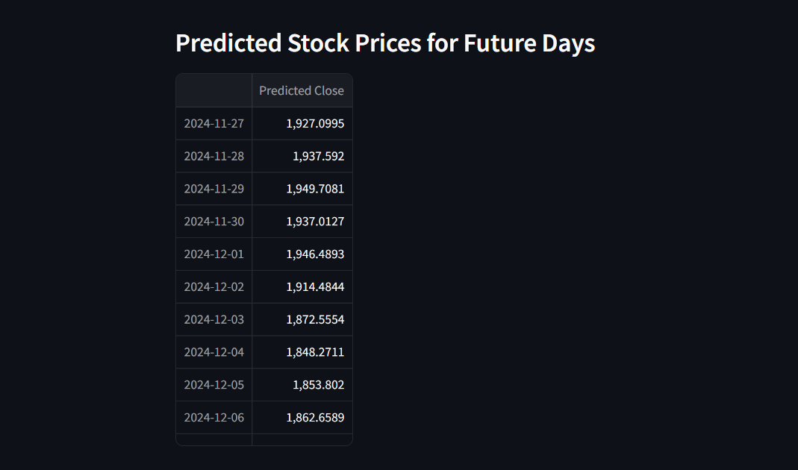
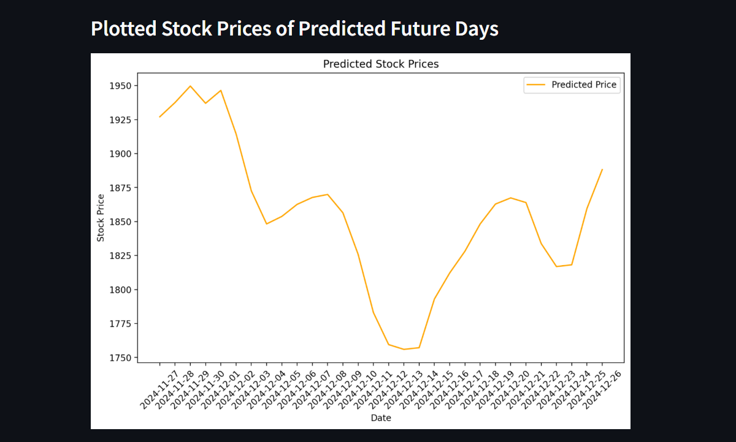
Predicted Stock Prices

Slide 16
CONCLUSION
Conclusion:
- LSTMs shows promise for stock prediction.
- Results depend on data quality and model tuning.
Future Directions:
We can incorporate additional features also (e.g., sentiment analysis).

Slide 17
THANK YOU
BY GROUP 4
MRIDUL RAJEEV
ARAV KUMAR
GAVVALA HIMATEJA
LIPITH ROSHANI H.M
VANNALA AJAY
SHRUTI NIRAJ AGRAWAL

