Slide 1
Roadmate
Making the trip easy and adventurous

Slide 2
TEAM
Sourabh Deshmukh
Akanksha Parihar
Mentor
Mr. Harshal Sir
Mrs. Monika Ma’am

Slide 3
ABSTRACT
The system is implemented using a 3-tier approach, with a backend database, a middle tier of spring boot server application, and the react front end client accessed through a web browser. Garden Fever uses multi-tier MVC architecture, server and client-side scripting techniques, and implementation technologies such as Java(OOP), Spring Boot, Hibernate, BOOTSTRAP, HTML5, CSS, ReactJS, relational databases (MySQL) etc.

Slide 4
INTRODUCTION
The riding industry in India has been growing leaps and bounds over the last decade.What used to earlier be a niche group of riders has now grown to a thriving and kicking industry.
Simultaneously the growth path has been marked with high end motorcycle brands coming into the country.The growth of motorcycle festivals in the country over the last few years is testimony to the growing popularity of riders and the riding community in India.
An increasing number of people are recognizing not only the utility of motorcycles but bringing out the passion in them and bonding with like-minded people.Many people like to travel long distances.Being a rider to travel to a far destination with group of friends who are riders make the trips very adventurous and fun.
Because being a part of biking group has many benefits.Biking groups take brotherhood to another level. When you ride in a group you know you are safe, protected and have people to watch your back, bike breakdowns, accidents and a host of other worries are almost nullified when you ride in a group as support is always at hand.

Slide 5
Purpose
Many people find bike riding as their hobby so Roadmate is an application which will help the riders to get along with all other riders on the same route. As travelling alone can be risky and boring so by getting a group of people who are also going for bike ride on the same route can be a good way of communication with strangers and continue to explore new places in an effective manner. By using this application, rider can plan for a trip by mentioning the duration so that he/she can plan accordingly. This application will also help the new riders to get the feedbacks of the experienced riders who had already went through that route in past days. The application also provides facilities like hotels, restaurants available so that the rider can search for the hotels to stay and rest for some time. This application is a one stop solution which will provide a rider all the necessities that he/she may require in his road trip.

Slide 6
Scope
This application allows riders to search for a company by logging into the website and provides the details regarding the journey. One can also register himself/herself so that anyone who is willing to go for a ride can also join him. The application also provides the riders with some facilities like hotels, restrooms, and restaurants available in the way so that if they want to rest for some time then they can search for the available options.

Slide 7
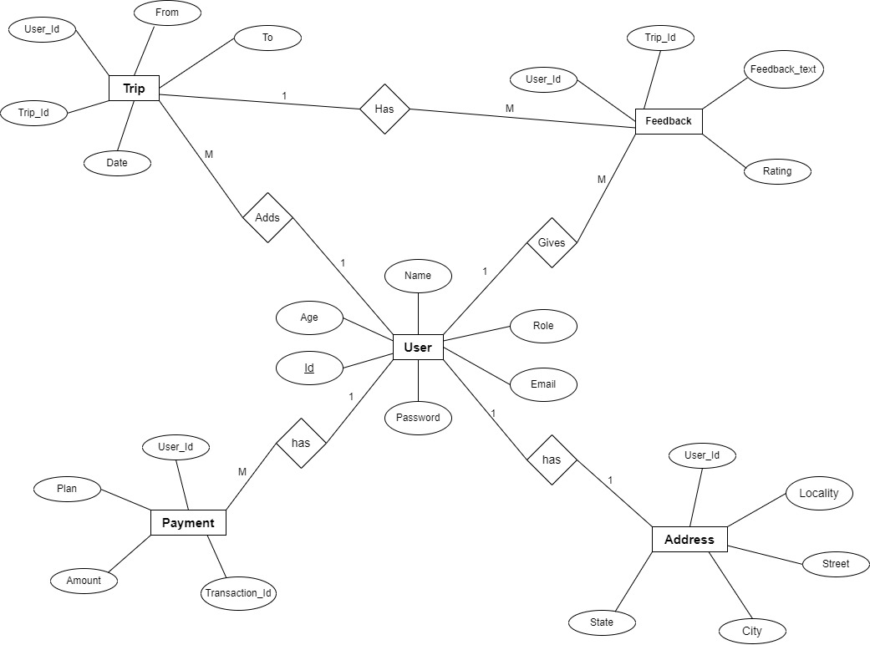
ER Diagram

Slide 8
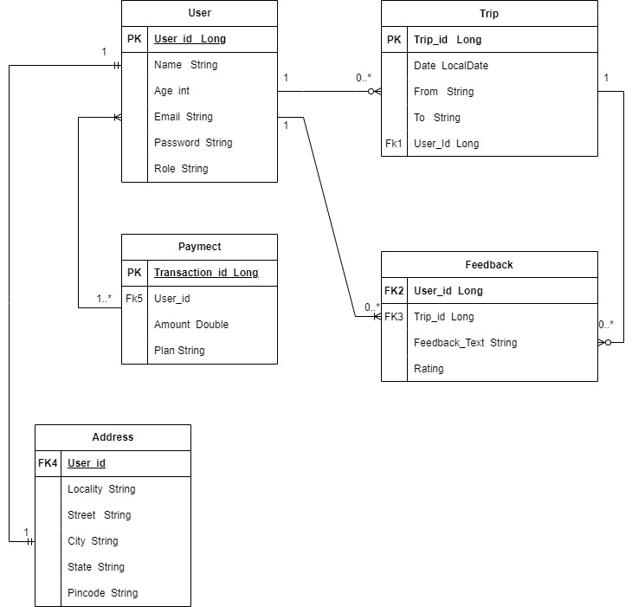
Class Diagram

Slide 9
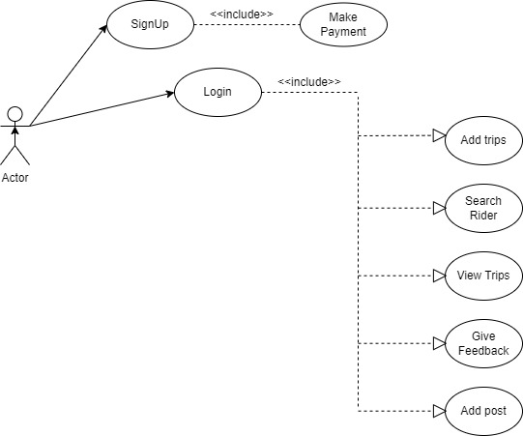
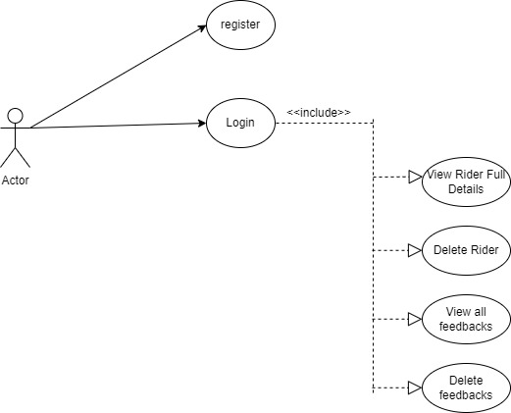
Use Case Diagram

Slide 10
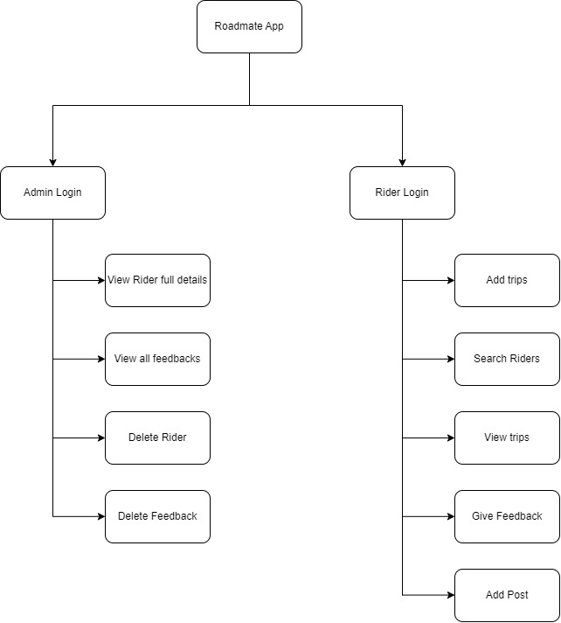
Functional Decomposition Diagram

Slide 11
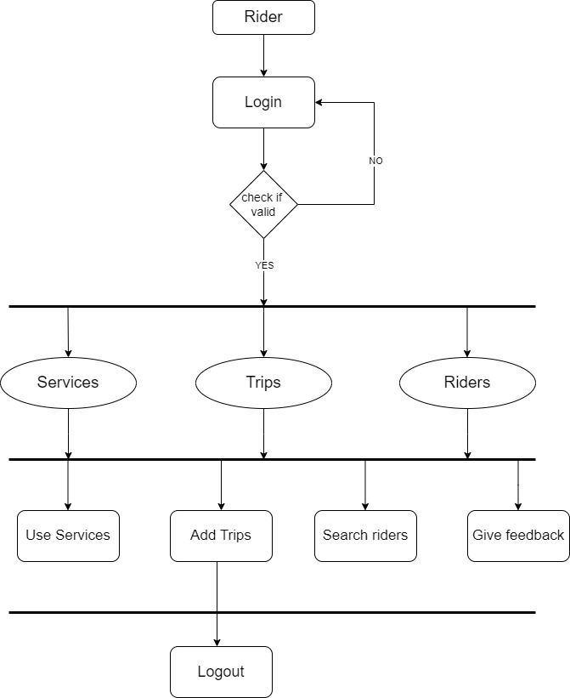
Activity Diagram

Slide 12
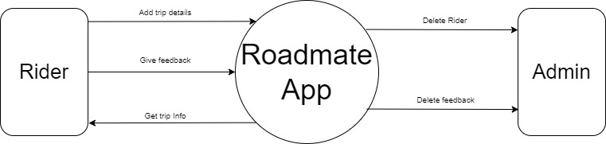
DFD level 0

Slide 13
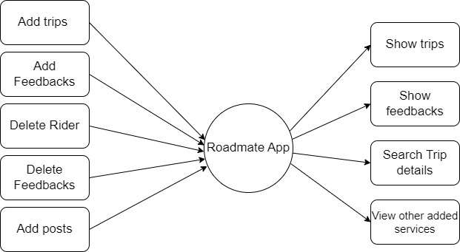
DFD level 1

Slide 14
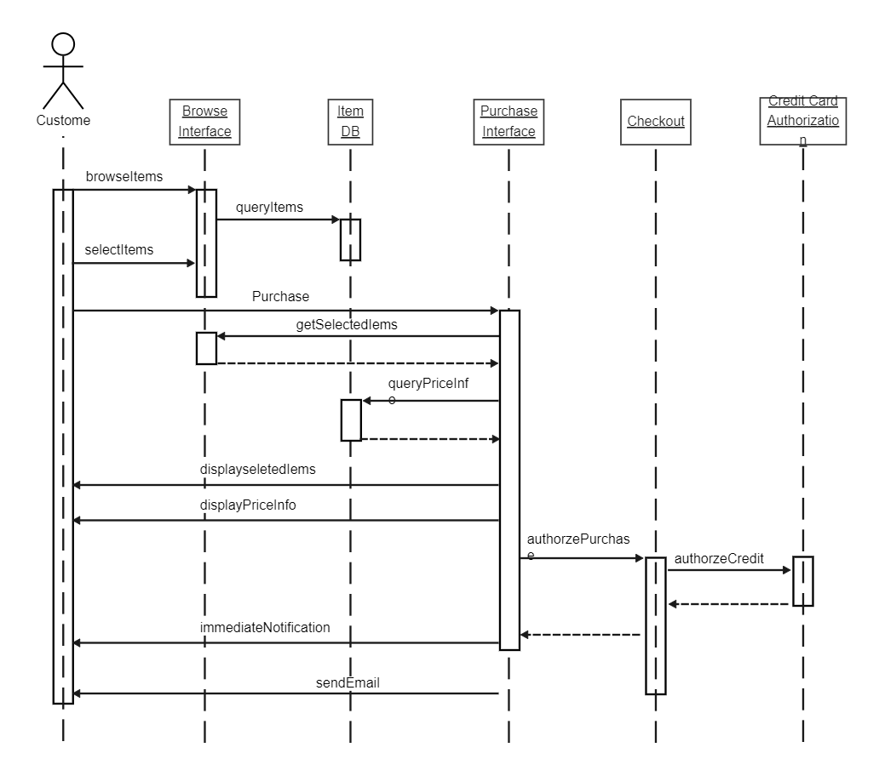
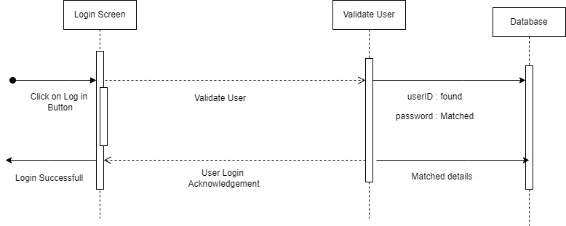
Sequence Diagram

Slide 15
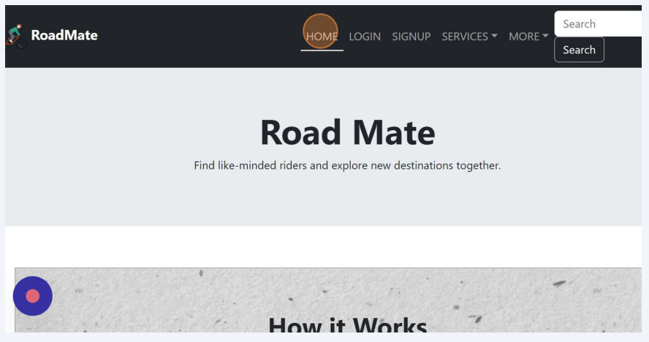
Home Page

Slide 16
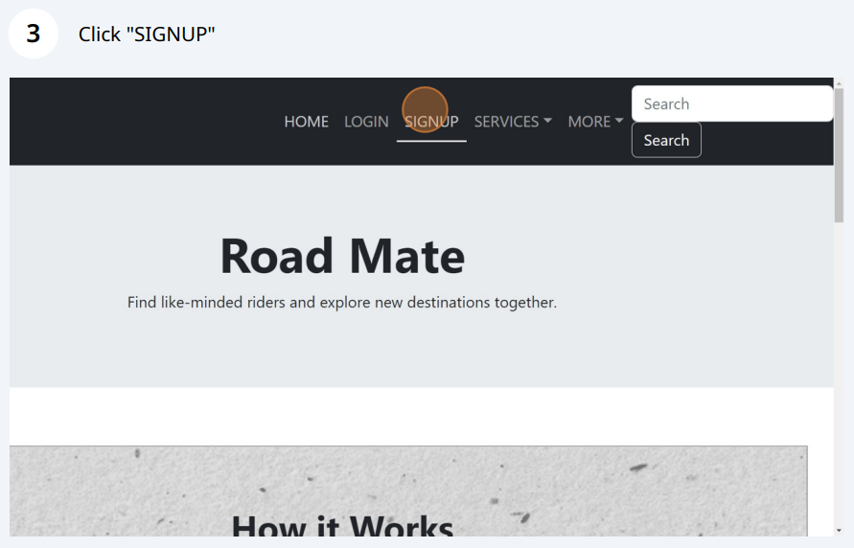
Signup Page

Slide 17
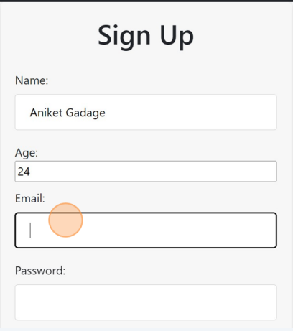
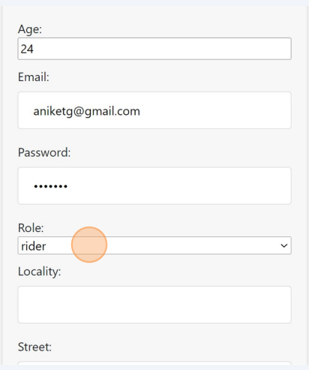
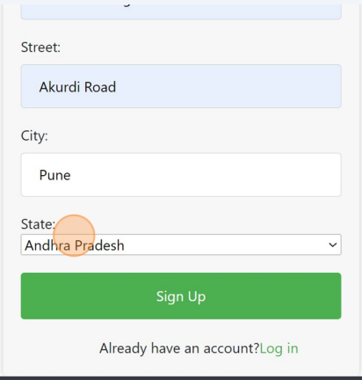
Enter the details like name, age, email, password, locality, street, city and state

Slide 18
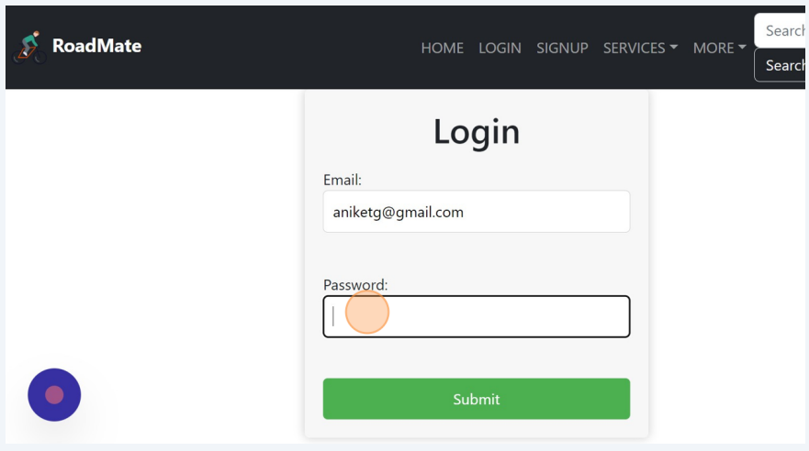
Login page

Slide 19
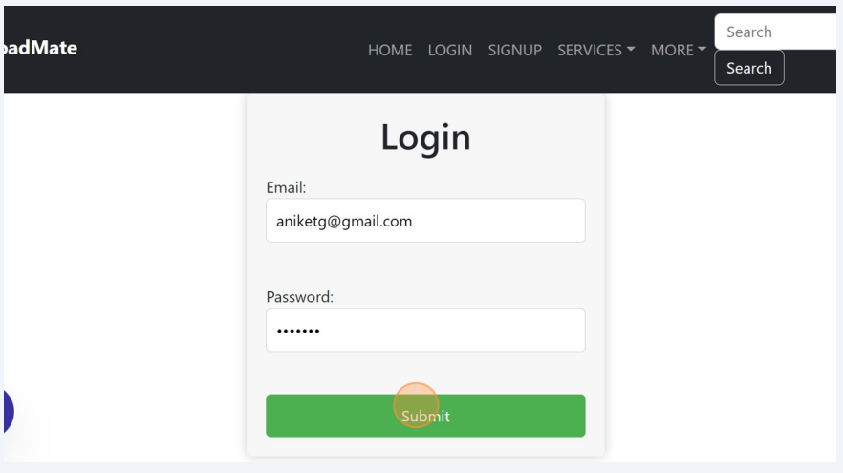
Enter Login details and click on submit button

Slide 20
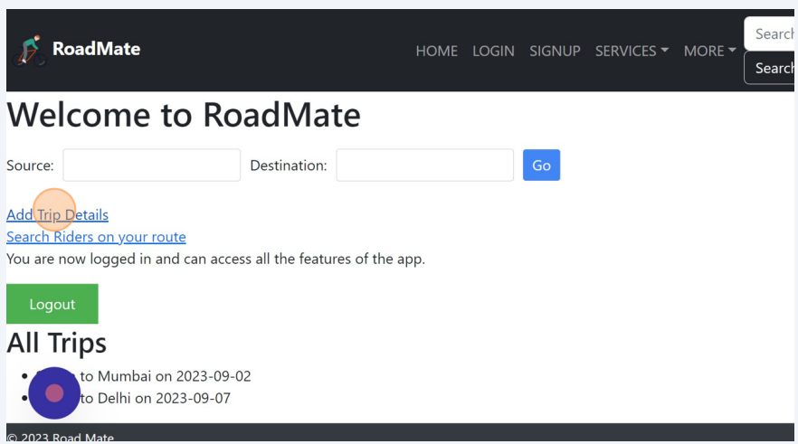
Click on ‘Add trips details’ to add trips.

Slide 21
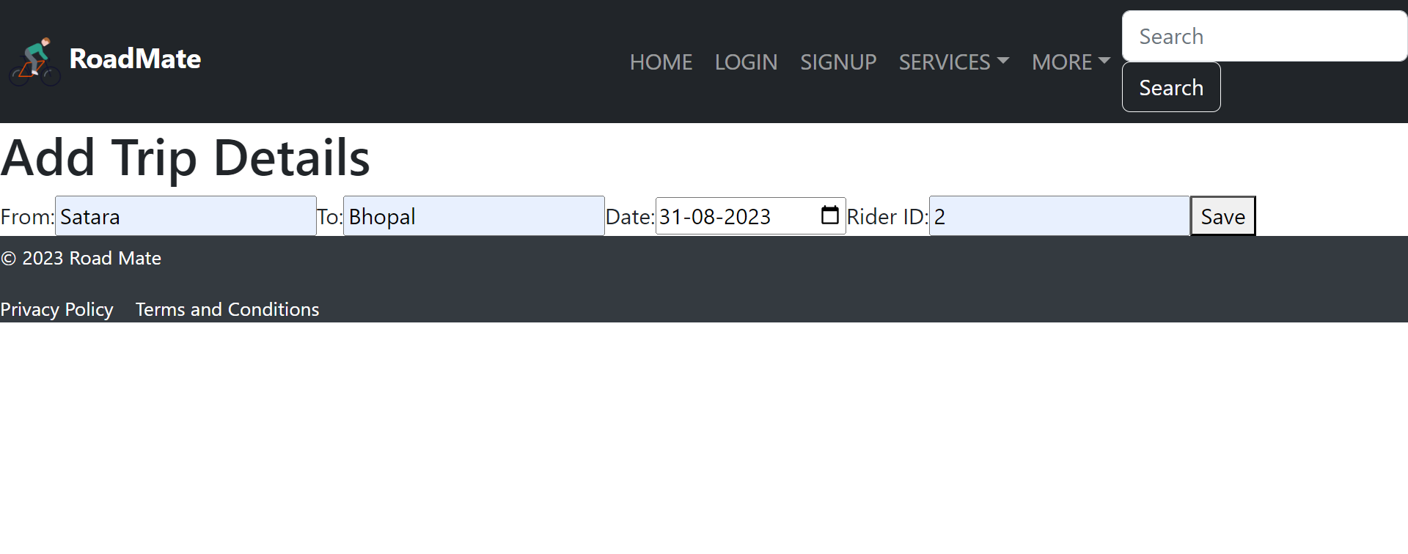
Enter Trip details and click save.

Slide 22
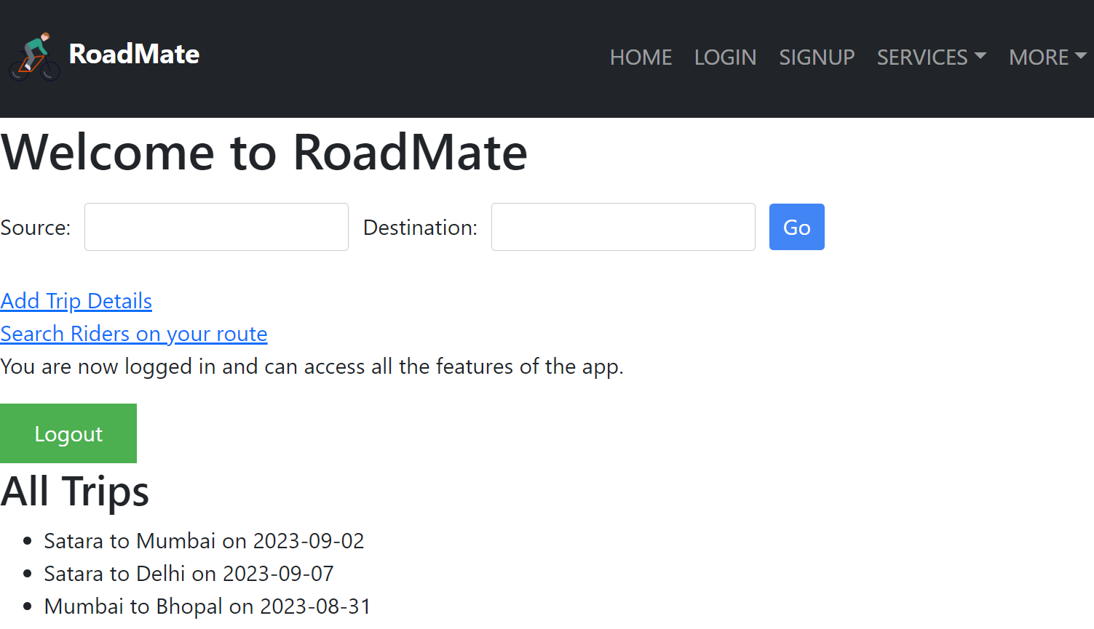
User will see the trips on after login page.

Slide 23
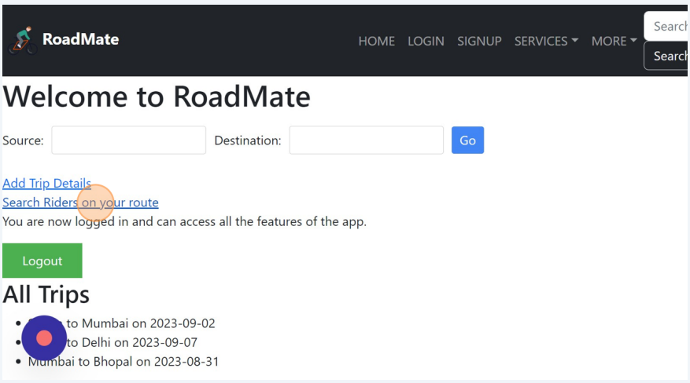
User can search for rider on your route.

Slide 24
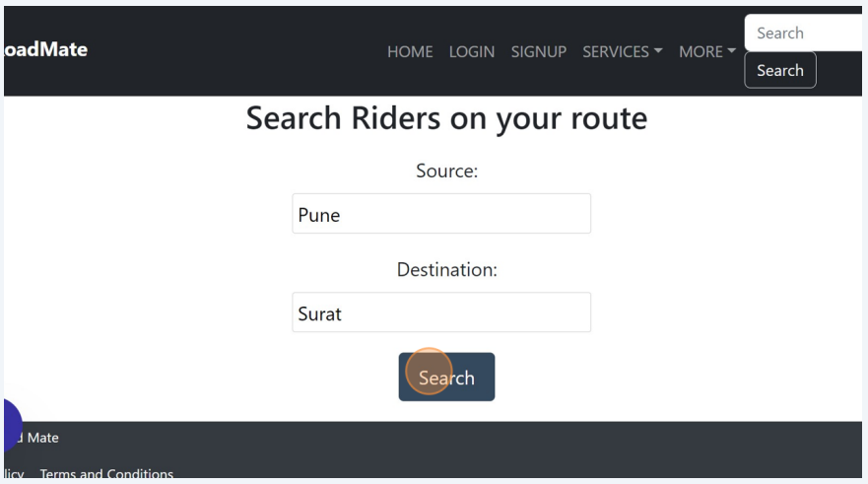
Enter the source and destination of your route and search.

Slide 25
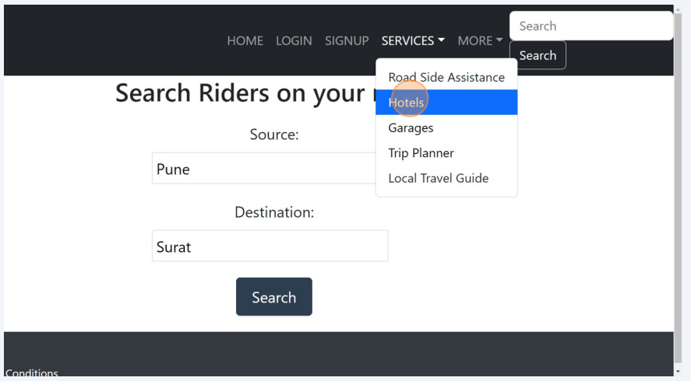
User can access various added services in services dropdown menu.

Slide 26
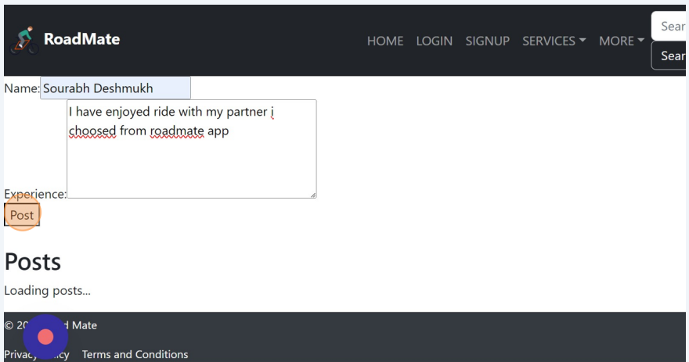
User can post his/her experience.

Slide 27
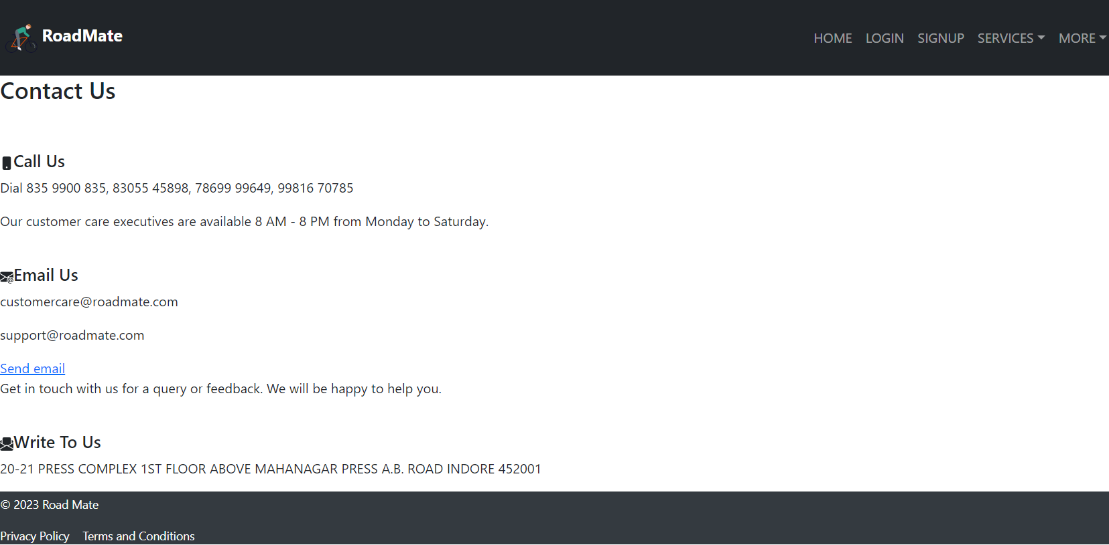
Contact us page.

Slide 28
References
Stack Overflow - https://stackoverflow.com/
Java docs -https://docs.oracle.com/javase/8/docs/technotes/tools/windows/javadoc.html
Lucid Chart - https://www.lucidchart.com/
Javatpoint - https://www.javatpoint.com/
Spring Boot Docs - https://docs.spring.io/spring-boot/docs/current/reference/htmlsingle/
ReactJS Docs - https://reactjs.org/docs/getting-started.html
Scribe - https://scribehow.com/

