Slide 1

Dynamic ETL using ML PaaS
Presented by
Tribe f

Slide 2
Contents
What is ETL?
ETL concept
Why is ETL Important?
ETL Requirements
Illustration of the ETL process : extract, transform and load
Extract
Transform
Load
Data Warehouse
ETL Process using AWS Functions
AWS Lambda
Amazon S3 Bucket
ML PaaS
What to expect from ML Platform?
Using Python for ETL

Slide 3

What is ETL?
ETL = Extract – Transform – Load
Extract
Get the data from source system as efficiently as possible
Transform
Perform calculations on data
Load
Load the data in the target storage

Slide 4
ETL Concept
A company may be scattered in different locations and with different formats. Companies need a way to analyze their data for critical business decisions.
ETL allows you to:
Migrate the data into a data warehouse.
Converts the various formats and types to adhere to one consistent system.
ETL is a predefined process for access and manipulate source data and loading it into a target database.

Slide 5
Why is ETL Important?
Companies need a way to analyze their data for critical business decisions.
Transactional Database can’t answer complex business questions.
A data warehouse provide a common data repository.
ETL provides a method of moving the data from various source into a data warehouse.
Adds value to the data
Removes mistakes and corrects data
Adjusts data from multiple sources to be used together(conforming)

Slide 6
ETL Requirements
Any ETL Architecture must meet the following requirements:
Business Requirement
Compliance Requirement
Data Profiling
Data Security
Data integration
Right Data at Right Time

Slide 7
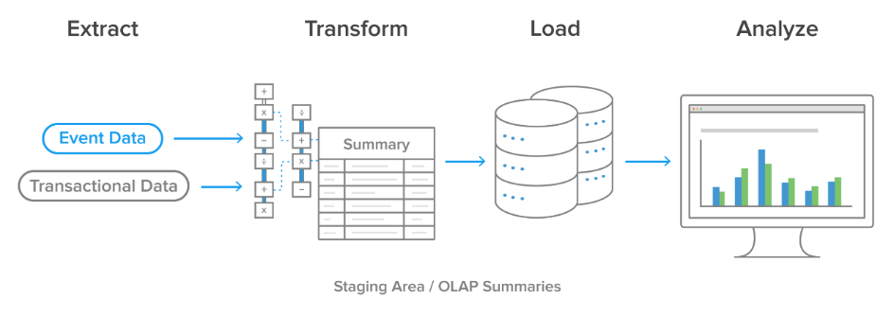
Illustration of the ETL process: extract, transform and load

Slide 8
Extract
Gathering the data
Raw data that was written directly into the disk
Data written to flat files or relational tables from structured source systems
Data can be read multiple times, if needed
Cleansing the data
Exclude unwanted / unneeded information

Slide 9
Transform
Preparing the data to be housed in the data warehouse
Converting the extracted data
Using rules and lookup tables
Combining data
Verification and validity checks
Standardization

Slide 10
Load
Storing the transformed data in the data warehouse
Batch/ Real-time processing
Can follow star schema and snowflake schema

Slide 11
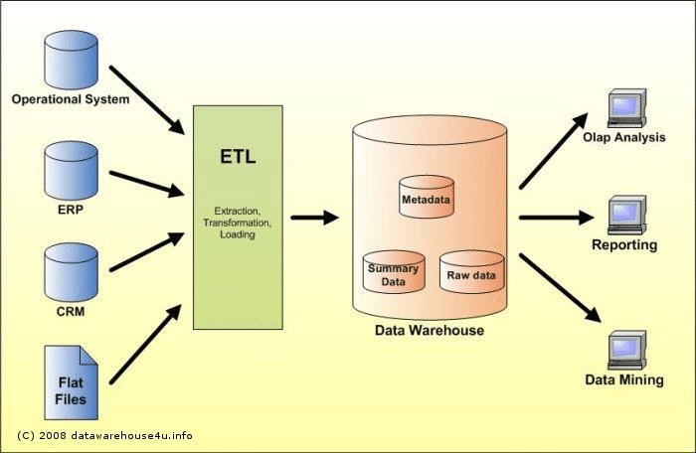
Data Warehouse
Data warehouse is a central location that is used to store consolidated data from multiple data sources.
Data warehouse is a system that supports the business intelligence process.
It converts the data into meaningful information for analyzing the business.
It is subject oriented, integrated, time variant and nonvolatile.

Slide 12
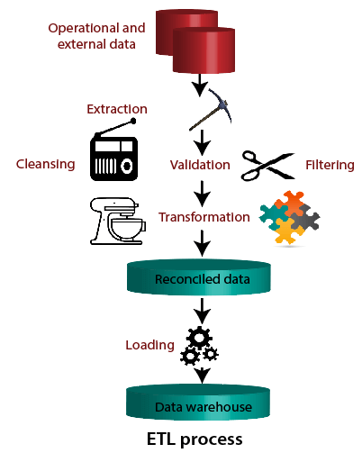

Slide 13
ETL Process using AWS Functions
ETL processes work best with serverless architecture, which is why you use AWS Serverless Application Model(AWS SAM) for this solution.
The project includes a local environment to inspect the data, experiment, and deploy the stack using the AWS SAM CLI.
The deployment includes an time-based event that triggers an AWS Lambda function.
This function ingests and stores the raw data from an external source, transforms the content, and saves the clean information.
The raw and clean data is stored in an Amazon Simple Storage Service (Amazon S3) bucket.

Slide 14

AWS Lambda
AWS Lambda is an event-driven, serverless compute service.
Lambda enables you to run code without provisioning or managing servers.
You create a Lambda function, which is the AWS resource that contains the code that you upload.
You then set the Lambda function to be triggered, either on a scheduled basis or in response to an event.
Your code only runs when it is triggered.
You pay only for the compute time you consume—you are not charged when your code is not running.

Slide 15

Amazon S3 Bucket
Amazon S3 is object-level storage, stores data as objects within resources that are called buckets.
You can store virtually as many objects as you want in a bucket, and you can write, read, and delete objects in your bucket.
Bucket names are universal and must be unique across all existing bucket names in Amazon S3.
The data that you store in Amazon S3 is not associated with any particular server, and you do not need manage any infrastructure yourself.

Slide 16
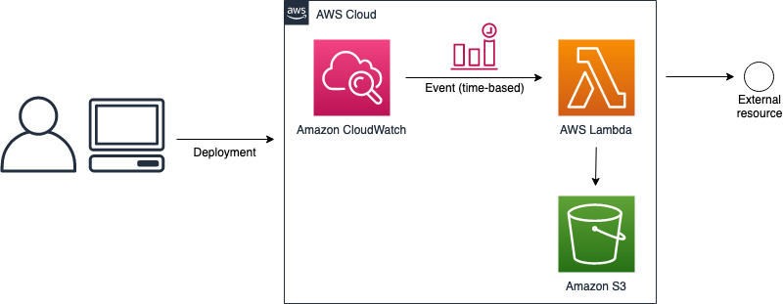
Data using AWS Lambda and Amazon S3

Slide 17
ML PaaS
Machine-Learning-Platform-as-a-Service (ML PaaS) is one of the fastest growing services in the public cloud.
It delivers efficient lifecycle management of machine learning models.
At a high level, there are three phases involved in training and deploying a machine learning model.
These phases remain the same from classic ML models to advanced models built using sophisticated neural network architecture.

Slide 18
What to expect from ML Platform?
Data Management
Access to ML tools
Ease of use
Cost efficiency

Slide 19

Using Python for ETL
Python ETL is a general-purpose tool for extracting, transforming, and loading various types of tables of data imported from sources like XML, CSV, Text, or JSON.
When ETL is coupled with the programming capabilities of Python, it becomes flexible for the organizations to create ETL pipelines.
ETL pipelines that not only manage data of customers and team members well but also move and transform it in accordance with business requirements in a simplified manner.
Analysts and engineers can alternatively use programming languages like Python to build their own ETL pipelines.

Slide 20


