Slide 1

Med-Tracker: Android app for medicine tracking
Project Mentor :
Prof. Deepti Lawand
Members :
Shubham Ture
Shrutika Deokar
Sourabh Khandake

Slide 2
Contents
Introduction
Literature Review
Existing System
Proposed System
Functions
Key Points
Hardware and Software Specs
Application
Reference

Slide 3
Introduction
Med-Tracker is an android based application, created for tracking the medicine intake of the patient.
The main aim of our project is to make sure people remember to take their medications on time.
The application allows user to set alarms based either on intervals or multiple times a day.
This application also keeps track of the available stocks and reminds user when the stocks are low.
This application will provide users to search for local clinics and medical stores.
This application also uses Google Cloud Vision API to extract the text from the prescription.

Slide 4
Literature Review
Paper | Author and Year Of Publication | Abstract | Advantages and Disadvantages
[1]An Intelligent Patient Medicine System Reminder | R.Sunder Reddy, C. Niharika, Rohit Sharma, Bharat Kumar. February 2017 | The aim of this project is to remind individuals who forget to take their medicines on time. This project will support to remind the patient to take his/her medicinal drug at prescribed time. The proposed system is best suited for elderly persons and those who're very busy, as this device will now not most effective remind them of their drug treatments with a buzzer sound however also shows the call of the medication to be taken at that time. The patient can store the respective time of the unique medicine by a matrix keypad. Based on an RTC (Real Time Clock) interfaced to the microcontroller, the programmed time for medicinal drug is displayed on the LCD | Advantages: Easy to use Disadvantages: If the device gets damaged, the complete information is lost.
[2]ArduMed - Smart Medicine Reminder for Old People | Mayuresh Waykole, Vatsalya Prakash, Himanshu Singh. May 2016 | It is a frequent observation that people give more preference to their work and other material things than taking care of their health. Often they forget to take their medications or take overdose of it, resulting in further health deterioration. Our system aims to reduce this problem by reminding patients about their medications and showing them the correct amount of medication to take. | Advantages: serves reliable reminders, has a good and easy to use user interface and supports a lot of feature adhering to medicines. Disadvantages: System are not up on alarms so if the user skips the alarm, we don’t bug him continuously. If the data is not saved on daily basis it is hard for the patient to maintain the history/progress

Slide 5
Paper | Author and Year of Publication | Abstract | Advantages and Disadvantages
[3]Smartphone based Medicine Intake reminder using GCM | Akshay Pandey, Rahul Kumar, Vinay Yadav October 2016 | Most of the medication administration errors happened when patients acquired over-the- counter and prescribed medicines from several pharmacies and use them at their homes without proper guidance. | Advantages: This system will provide the information about the medicine timings and quantity. The appointments which are scheduled with the doctor including the contact details including visiting time. Disadvantages: If A patient misses or skips the dose or medication, this app will not continuously prompt the user to forcefully take their medications.
[4]MedRem: An Interactive Medication Reminder and tracking system | MD. Aby Sayeed Mondol, Ifat Afrin Emi, John Stankovic. September 2016 | Medication adherence is pivotal for effective health outcomes. One of the main reasons behind poor medication adherence is forgetfulness, and reminder systems are often used in addressing the problem. This paper presents MedRem, a novel medication reminder and tracking system on wearable wrist devices. The system is handy and interactive, and it is enriched with several useful features. To address the limitations of the tiny display size of the wrist devices, MedRem incorporates speech recognition and text-to-speech features along with clever interface design. | Advantages: State of the art speech recognition tools are combined with novel approaches that makes the system very usable and robust. Disadvantages: System are not up on alarms so if the user skips the alarm, we don’t bug him continuously. If the data is not saved on daily basis it is hard for the patient to maintain the history/progress towards their medications.

Slide 6
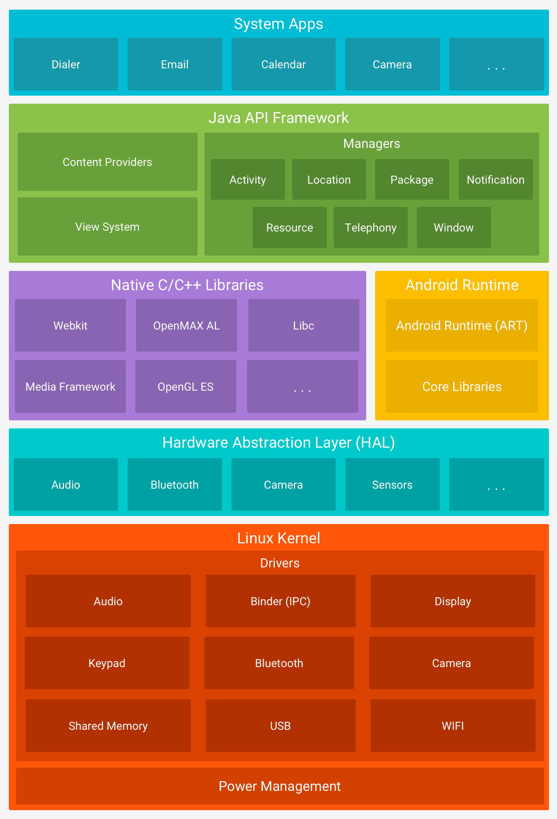
Android Architecture

Slide 7
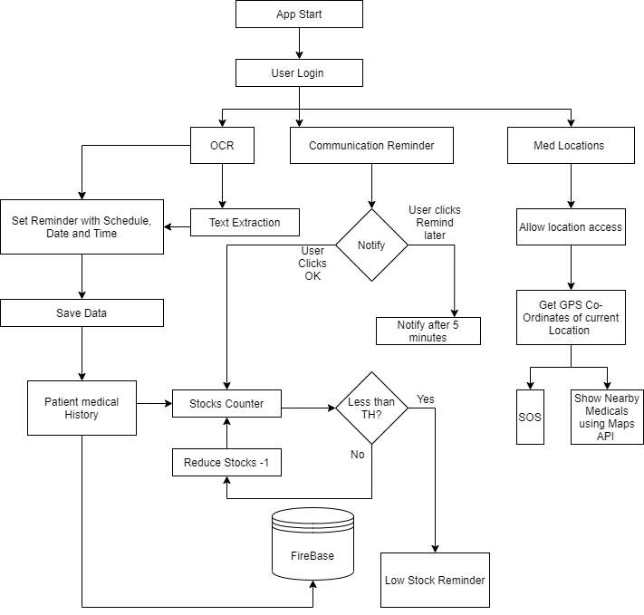
Proposed System

Slide 8
Functions
Alarm Manager - Android Alarm Manager allows you to access system alarm. By the help of Android Alarm Manager in android, you can schedule your application to run at a specific time in the future.
Maps Fragment - This is a fragment code for adding the maps to the application.
Tracker Function - This function will help track the total hits for the application.
Google Cloud Vision API - Powerful image analysis.
Counter function – This function will keep the track of the stocks mentioned in the application.
Time Picker function – This is used in conjunction with the Alarm Manager.
Shared preferences - This function allow user to store small amounts of primitive data as key/value pairs in a file on the device.

Slide 9
Functions
ViewPager – This function helps to navigate between activities throughout the application.
Toast Function – This helps give user small information only toast, which are not user interactable.
SOS Emergency - This function helps the user to locate and contact nearby Hospitals, clinics, relatives in case of emergency and can even book an appointment.
Stocks - This function helps user to check how many medicines are left in the stock so that if it is low, user can restock it.
Broadcast receiver - It is an Android component which allows you to register for system or application events.
RecyclerView - The RecyclerView class extends the ViewGroup class and implements ScrollingView interface.
OnClickListener - It is an Interface definition for a callback to be invoked when a view is clicked.

Slide 10
Hardware and Software Specification
Hardware Software
Processor | Intel Xeon Platinum /Intel Core i7 /Ryzen 5 1600
HDD | Western Digital Black / Seagate 180 GB
RAM | 8 GB GDDR4
Operating System | Windows 10/8/7
Programming Language | Java, Android Studio
Database | Google Firebase API

Slide 11
Key Points
Prescription Scanner
-Scans the prescription with the help of OCR.
Nearby Locations
- The application will provide nearby locations of the medicals and clinics.
Medicine Reminder
- A notification pops up to remind the user to take medicine.
Stocks Reminder
- User will be notified about stocks when they reach a certain low threshold
User profile
- Medications taken up to date, with time stamps.
SOS
Emerygency message to pre-added contacts and an option to view nearby hospitals.

Slide 12
Application
Can be used by old people to set medication reminders just in case they forget to take the medication themselves.
Can be used by busy people so that they can set their medications based on their schedule.

Slide 13
References
[1]Intelligent Reminder System of Having Medicine for Chronic Patients. R.Sunder, Reddy, C, Niharika, Rohit Sharma, Bharat Kumar. February 2017.
[2] ArduMed -Smart Medicine Reminder for Old People. Mayuresh Waykole, Vatsalya Prakash, Himanshu Singh. May 2016.
[3] Smartphone based medicine intake reminder using GCM. Akshay Pandey, Rahul Kumar, Vinay Yadav. October 2016.
[4] MedRem: An Interactive Medication Reminder and Tracking System on Wrist Devices. MD. Aby, Sayeed Mondol, Ifat Afrin Emi, John Stankovic. September 2016.
[5] Medical Reminder and Healthcare. Deepti Ameta, Kalpana Mudaliar and Palak Patel. June 2015.
[6]Mickael B. Marques, Bruno M. Silva, Ivo M. Lopes, Joel J.P.C. Rodrigues, and Mario L.Proença Jr , “A Mobile Health Application for Out-patients Medication Management”, IEEE(2013).
[7] Swarup Kumar Raj, Kakoli De. "chapter 17 Electronic Resource Management and Digitization", IGI Global, 2020.

Slide 14
THANK YOU.

