Slide 1
L06
DNS
Dr. Ram P Rustagi
rprustagi@ksit.edu.in
http://www.rprustagi.com
https://www.youtube.com/rprustagi
Ram P Rustagi/CSE/KSIT
18CS52-CN-L06-DNS

Slide 2
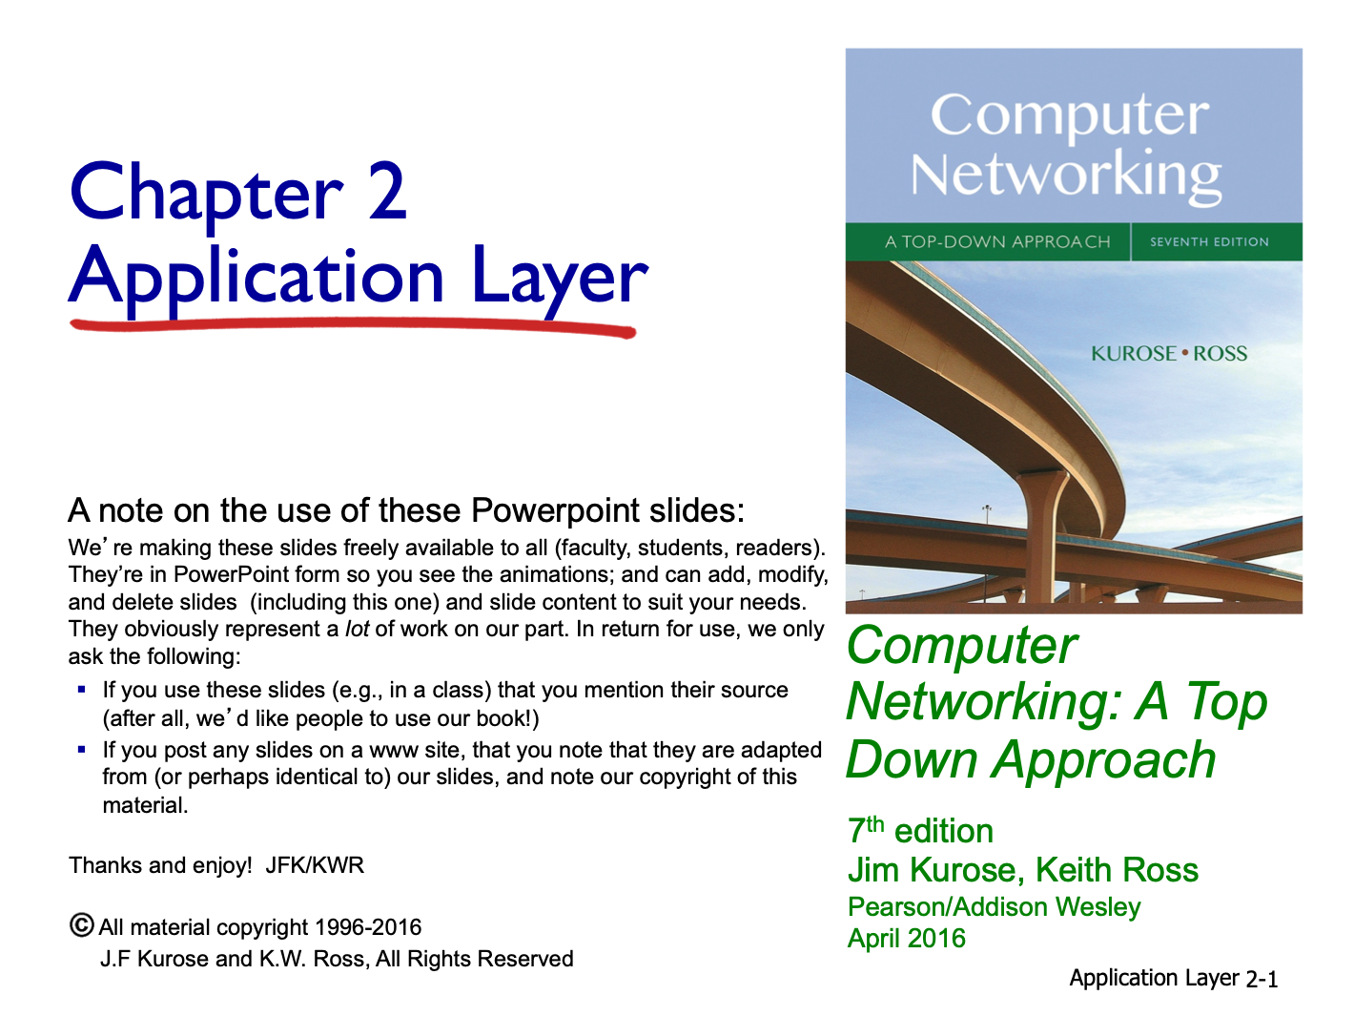
Resources Acknowledgement
Ram P Rustagi/CSE/KSIT
18CS52-CN-L06-DNS

Slide 3
Resources
RFC 1034, 1035
Dynamic DNS updates: RFC 2136, 3007
https://danielmiessler.com/study/dns/
DNS Inventor paper: Mockapetris%202005-Development%20of%20DNS.pdf
https://www.icann.org/en/system/files/files/presentation-gdd-summit-dns-primer-11may17-en.pdf
Ram P Rustagi/CSE/KSIT
18CS52-CN-L06-DNS

Slide 4
DNS: domain name system
people: many identifiers:
SSN, name, passport #
Internet hosts, routers:
IP address (32 bit) - used for addressing datagrams
“name”, e.g., www.yahoo.com - used by humans
Q: how to map between IP address and name, and vice versa ?
Clients DNS Resolver
Unix: /etc/resolv.conf
gethostbyname()
Domain Name System:
distributed database implemented in hierarchy of many name servers
application-layer protocol: hosts, name servers communicate to resolve names (address/name translation)
note: core Internet function, implemented as application-layer protocol
complexity at network’s “edge”
Ram P Rustagi/CSE/KSIT
18CS52-CN-L06-DNS

Slide 5
DNS: services, structure
why not centralize DNS?
Single point of failure
Traffic volume
Distant centralized database
Update? , delete?
Maintenance
DNS services
Hostname to IP address translation
Host aliasing
Canonical, alias names
Mail server aliasing
Load distribution
Replicated Web servers: many IP addresses correspond to one name, e.g. Google, Yahoo
Different from other applications
End user does not use directly
A: doesn’t scale!
Ram P Rustagi/CSE/KSIT
18CS52-CN-L06-DNS

Slide 6
DNS: a distributed, hierarchical database
Root DNS Servers
…
…
com DNS servers
org DNS servers
edu DNS servers
yahoo.com
DNS servers
pbs.org
DNS servers
poly.edu
DNS servers
umass.edu
DNS servers
amazon.com
DNS servers
client wants IP for www.amazon.com; 1st approx:
client queries root server to find .com DNS server
client queries .com DNS server to get amazon.com DNS server
client queries amazon.com DNS server to get IP address for www.amazon.com
Ram P Rustagi/CSE/KSIT
18CS52-CN-L06-DNS

Slide 7
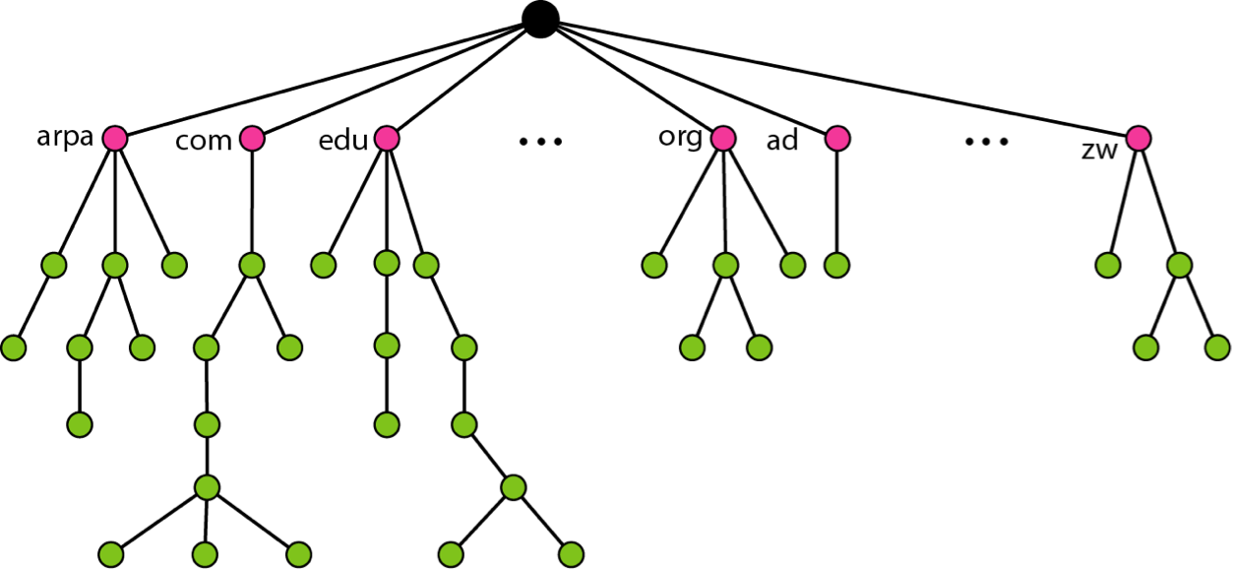
Domain Name Space
Root (top) level domains
http://www.iana.org/domains/root/db/
Ram P Rustagi/CSE/KSIT
18CS52-CN-L06-DNS

Slide 8
DNS Node Labels
Limits
Labels
63 octets or less
High order 2 bits of length field should be 0
Case insensitive
Only DNS name, and not URI path
Labels must be unique within parent domain
Names: 255 octets or less
UDP messages: 512 octets or less
Ram P Rustagi/CSE/KSIT
18CS52-CN-L06-DNS

Slide 9
Longest Label and URL
Longest label
http://thelongestlistofthelongeststuffatthelongestdomainnameatlonglast.com/
Welsh village with the name in Britain!
http://llanfairpwllgwyngyllgogerychwyrndrobwllllantysiliogogogochuchaf.org.uk
Ram P Rustagi/CSE/KSIT
18CS52-CN-L06-DNS

Slide 10
DNS
FQDN: ends with a period(.)
also called, absolute domain
PQDN: does not end with a period
assumption is name needs to be completed
two or more labels may be considered complete
general practice usage (browser, email)
Reserved domain names (RFC 2606)
Top level
.test, .example, .invalid, .localhost
2nd level domains
Example.com (192.0.43.10),
Example.net (192.0.43.10),
Example.org (192.0.43.10)
Ram P Rustagi/CSE/KSIT
18CS52-CN-L06-DNS

Slide 11
DNS: root name servers
Contacted by local name server that can not resolve name
root name server:
http://www.iana.org/domains/root/servers
contacts authoritative name server if name mapping not known
gets mapping
returns mapping to local name server
Shortcut (temporary) approach
make an entry in DNS local file
/etc/hosts in linux
e.g. 10.211.55.10 mywww.com
\Windows\System32/drivers\etc\hosts
Ram P Rustagi/CSE/KSIT
18CS52-CN-L06-DNS

Slide 12
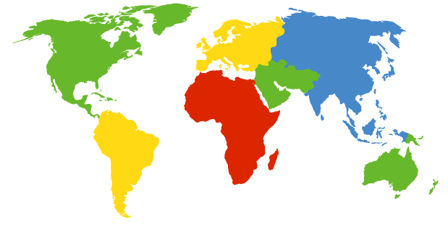
DNS: root name servers
c. Cogent, Herndon, VA (5 other sites)
d. U Maryland College Park, MD
h. ARL Aberdeen, MD
j. Verisign, Dulles VA (69 other sites )
k. RIPE London (17 other sites)
e. NASA Mt View, CA
f. Internet Software C.
Palo Alto, CA (and 48 other sites)
i. Netnod, Stockholm (37 other sites)
m. WIDE Tokyo
(5 other sites)
a. Verisign, Los Angeles CA
(5 other sites)
b. USC-ISI Marina del Rey, CA
l. ICANN Los Angeles, CA
(41 other sites)
13 root name “servers” worldwide
g. US DoD Columbus, OH (5 other sites)
Ram P Rustagi/CSE/KSIT
18CS52-CN-L06-DNS

Slide 13
TLD, authoritative servers
Top-level domain (TLD) servers:
for .com, .org, .net, .edu etc.
for top-level country domains, e.g.: uk, fr, in
Network Solutions maintains servers for .com
Educause for .edu TLD
https://data.iana.org/TLD/tlds-alpha-by-domain.txt
Authoritative DNS servers:
Organization’s own DNS server(s), providing authoritative hostname to IP mappings for organization’s named hosts
Can be maintained by organization or service provider
Ram P Rustagi/CSE/KSIT
18CS52-CN-L06-DNS

Slide 14
Local DNS name server
Does not strictly belong to hierarchy
Each ISP (residential ISP, company, university) has one
also called “default name server”
When host makes DNS query, query is sent to its local DNS server
has local cache of recent name-to-address translation pairs (but may be out of date!)
acts as proxy, forwards query into hierarchy
Ram P Rustagi/CSE/KSIT
18CS52-CN-L06-DNS

Slide 15

DNS name resolution example
root DNS server
host at cis.poly.edu wants IP address for
gaia.cs.umass.edu
2
3
TLD DNS server
4
5
iterated query:
contacted server replies with name of server to contact
“I don’t know this name, but ask this server”
local DNS server
dns.poly.edu
7
6
1
8
authoritative DNS server
dns.cs.umass.edu
requesting host
cis.poly.edu
gaia.cs.umass.edu
Ram P Rustagi/CSE/KSIT
18CS52-CN-L06-DNS

Slide 16
DNS name resolution example
root DNS server
2
3
recursive query:
puts burden of name resolution on contacted name server
heavy load at upper levels of hierarchy?
7
6
TLD DNS
server
local DNS server
dns.poly.edu
5
4
1
8
authoritative DNS server
dns.cs.umass.edu
requesting host
cis.poly.edu
gaia.cs.umass.edu
Ram P Rustagi/CSE/KSIT
18CS52-CN-L06-DNS

Slide 17
DNS: caching, updating records
once (any) name server learns mapping, it caches mapping
cache entries timeout (disappear) after some time (TTL)
TLD servers typically cached in local name servers
thus root name servers not often visited
cached entries may be out-of-date (best effort name-to-address translation!)
if name host changes IP address, may not be known Internet-wide until all TTLs expire
update/notify mechanisms proposed IETF standard
RFC 2136
Ram P Rustagi/CSE/KSIT
18CS52-CN-L06-DNS

Slide 18
DNS records
DNS: distributed db storing resource records (RR)
RR format: (name, value, type, ttl)
type=A (default)
name is hostname
value is IP address
type=CNAME
name is alias name for some “canonical” (the real) name
www.ibm.com is really
servereast.backup2.ibm.com
value is canonical name
type=NS
name is domain (e.g., foo.com)
value is hostname of authoritative name server for this domain
type=MX
value is name of mailserver associated with name
Ram P Rustagi/CSE/KSIT
18CS52-CN-L06-DNS

Slide 19
DNS Examples
dig -t A rprustagi.com @8.8.8.8
;; QUESTION SECTION:
;rprustagi.com. IN NS
;; ANSWER SECTION:
rprustagi.com. 7069 IN A 69.161.146.196
dig -t ns rprustagi.com @8.8.8.8
;; QUESTION SECTION:
;rprustagi.com. IN A
;; ANSWER SECTION:
rprustagi.com. 7199 IN NS dns1.doteasy.com.
rprustagi.com. 7199 IN NS dns2.doteasy.com.
Ram P Rustagi/CSE/KSIT
18CS52-CN-L06-DNS

Slide 20
DNS Examples
dig -t MX rprustagi.com @8.8.8.8
;; QUESTION SECTION:
;rprustagi.com. IN MX
;; ANSWER SECTION:
rprustagi.com. 6934 IN MX 15 dpmailbu.doteasy.com.
rprustagi.com. 6934 IN MX 10 dpmail06.doteasy.com.
Ram P Rustagi/CSE/KSIT
18CS52-CN-L06-DNS

Slide 21
DNS protocol, messages
query and reply messages, both with same message format
2 bytes
2 bytes
msg header
identification: 16 bit # for query, reply to query uses same #
flags:
query or reply
recursion desired
recursion available
reply is authoritative
identification
flags
# questions
# answer RRs
# authority RRs
# additional RRs
questions (variable # of questions)
answers (variable # of RRs)
authority (variable # of RRs)
additional info (variable # of RRs)
Ram P Rustagi/CSE/KSIT
18CS52-CN-L06-DNS

Slide 22
DNS protocol, messages
2 bytes
2 bytes
identification
flags
# questions
# answer RRs
# authority RRs
# additional RRs
name, type fields
for a query
questions (variable # of questions)
RRs in response
to query
answers (variable # of RRs)
records for
authoritative servers
authority (variable # of RRs)
additional “helpful”
info that may be used
additional info (variable # of RRs)
Ram P Rustagi/CSE/KSIT
18CS52-CN-L06-DNS

Slide 23
DNS query/response example
Capture file: ksit-dns-query.pcap
$ dig @4.2.2.2 ksit.edu.in ANY
; <<>> DiG 9.10.6 <<>> @4.2.2.2 ksit.edu.in ANY
; (1 server found)
;; global options: +cmd
;; Got answer:
;; ->>HEADER<<- opcode: QUERY, status: NOERROR, id: 46228
;; flags: qr rd ra; QUERY: 1, ANSWER: 12, AUTHORITY: 0, ADDITIONAL: 1
;; OPT PSEUDOSECTION:
; EDNS: version: 0, flags:; udp: 8192
;; QUESTION SECTION:
;ksit.edu.in. IN ANY
;; ANSWER SECTION:
ksit.edu.in. 10471 IN A 166.62.27.184
Ram P Rustagi/CSE/KSIT
18CS52-CN-L06-DNS

Slide 24
DNS query/response example…
ksit.edu.in. 3406 IN NS ns21.domaincontrol.com.
ksit.edu.in. 3406 IN NS ns22.domaincontrol.com.
ksit.edu.in. 3406 IN SOA ns21.domaincontrol.com. dns.jomax.net. 2018061700 28800 7200 604800 600
ksit.edu.in. 3406 IN MX 5 alt1.aspmx.l.google.com.
ksit.edu.in. 3406 IN MX 5 alt2.aspmx.l.google.com.
ksit.edu.in. 3406 IN MX 1 aspmx.l.google.com.
ksit.edu.in. 3406 IN MX 10 aspmx2.googlemail.com.
ksit.edu.in. 3406 IN MX 10 aspmx3.googlemail.com.
ksit.edu.in. 3406 IN TXT "google-site-verification=NyjmOua0GXrP8rj27-a6zlABkSmXMGyBaoQ0hTstGwc"
ksit.edu.in. 3406 IN TXT "MS=ms69244281"
ksit.edu.in. 3406 IN TXT "v=spf1 include:_spf.google.com ~all"
;; Query time: 524 msec
;; SERVER: 4.2.2.2#53(4.2.2.2)
;; WHEN: Tue Aug 14 16:18:59 IST 2018
;; MSG SIZE rcvd: 445
Ram P Rustagi/CSE/KSIT
18CS52-CN-L06-DNS

Slide 25
Inserting records into DNS
example: new startup “Network Utopia”
register name networkuptopia.com at DNS registrar (e.g., Network Solutions)
provide names, IP addresses of authoritative name server (primary and secondary)
registrar inserts two RRs into .com TLD server: (networkutopia.com, dns1.networkutopia.com, NS)
(dns1.networkutopia.com, 212.212.212.1, A)
create authoritative server type A record for www.networkuptopia.com; type MX record for networkutopia.com
Ram P Rustagi/CSE/KSIT
18CS52-CN-L06-DNS

Slide 26
Attacking DNS
DDoS attacks
Bombard root servers with traffic
Not successful to date
Traffic Filtering
Local DNS servers cache IPs of TLD servers, allowing root server bypass
Bombard TLD servers
Potentially more dangerous
Redirect attacks
Man-in-middle
Intercept queries
DNS poisoning
Send bogus relies to DNS server, which caches
Exploit DNS for DDoS
Send queries with spoofed source address: target IP
Requires amplification
Ram P Rustagi/CSE/KSIT
18CS52-CN-L06-DNS

Slide 27
Summary
DNS protocol
Top level domains
Query type
Iterative
Recursive
DNS record structure
Query and Answer
DNS Servers
Ram P Rustagi/CSE/KSIT
18CS52-CN-L06-DNS

