Slide 1
L07
FTP
Dr. Ram P Rustagi
rprustagi@ksit.edu.in
http://www.rprustagi.com
https://www.youtube.com/rprustagi
Ram P Rustagi/CSE/KSIT
18CS52-CN-L06-DNS

Slide 2
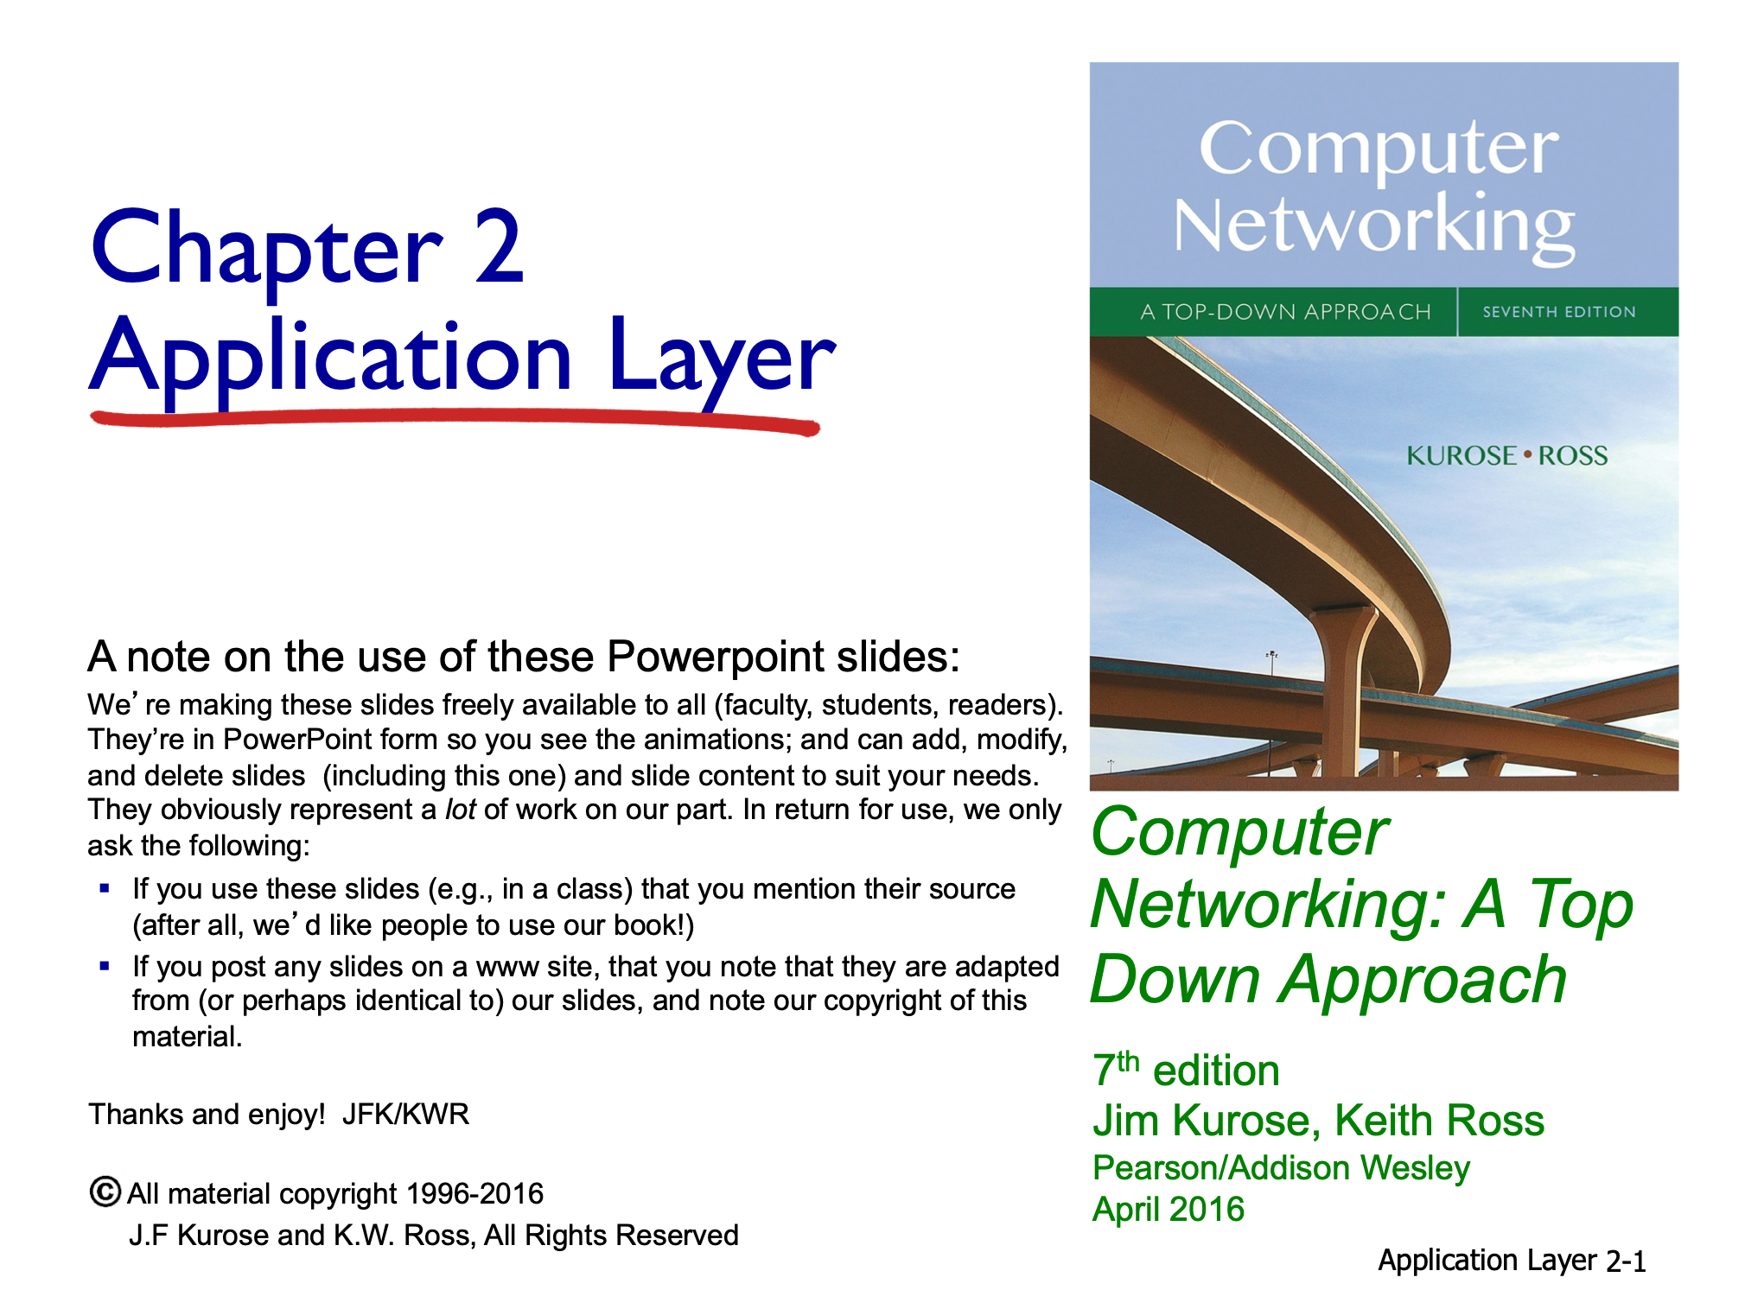
Ram P Rustagi/CSE/KSIT
18CS52-CN-L07-FTP

Slide 3


FTP: the file transfer protocol
file transfer
FTP
user
interface
FTP
client
FTP
server
user
at host
remote file
system
local file
system
Transfer file to/from remote host
Client/server model
Client: side that initiates transfer (either to/from remote)
Server: remote host
ftp: RFC 959
ftp server: port 21
Ram P Rustagi/CSE/KSIT
18CS52-CN-L07-FTP

Slide 4
FTP: the file transfer protocol
Challenges
Different filename conventions on two systems
Different ways to represent text and data
Different directory structures
Ram P Rustagi/CSE/KSIT
18CS52-CN-L07-FTP

Slide 5
FTP: separate control, data connections
FTP client contacts FTP server at port 21, using TCP
Client gets authorized over control connection
Client browses remote directory, sends commands over control connection
When server receives file transfer command, server opens 2nd TCP data connection (for file) to client
After transferring one file, server closes data connection
Control connection remains open for entire session
TCP control connection,
server port 21
FTP
client
TCP data connection,
server port 20
FTP
server
Server opens another TCP data connection to transfer another file
Control connection: “out of band”
FTP server maintains “state”: current directory, earlier authentication
Ram P Rustagi/CSE/KSIT
18CS52-CN-L07-FTP

Slide 6
FTP: data connections
Opened and closed for each file transfer
Client issues a passive open using ephemeral port
Sends the port number to server
Using PORT a,b,c,d,mm,nn command
a.b.c.d: IP address
mm * 256 + nn : Port number
Server issues the active open using port 20
When client behind a firewall,
Server can’t initiate the connection
Ram P Rustagi/CSE/KSIT
18CS52-CN-L07-FTP

Slide 7
FTP commands, responses
Sample commands:
Sent as ASCII text over control channel
USER username
PASS password
LIST return list of file in current directory
RETR filename retrieves (gets) file
STOR filename stores (puts) file onto remote host
Note: These are different from ftp application commands
sample return codes
Status code and phrase (as in HTTP)
331 Username OK, password required
125 data connection already open; transfer starting
425 Can’t open data connection
452 Error writing file
Ram P Rustagi/CSE/KSIT
18CS52-CN-L07-FTP

Slide 8
FTP - Command Responses
Each response has two parts
Three digit number (xyz) followed by text
First digit defines the status of the command
1yz: positive preliminary reply
2yz: (positive completion reply)
3yz: (positive intermediate reply)
4yz: (transient negative reply)
5yz: (permanent negative reply)
2nd digits provides further information about status
0 (syntax), 1(information) 2(connection), 3(auth/acct)
4 (unspecified), 5(file system)
Ram P Rustagi/CSE/KSIT
18CS52-CN-L07-FTP

Slide 9
FTP Example
$ ftp 10.211.55.10
Connected to 10.211.55.10.
220 Welcome to KSIT FTP service.
Name (10.211.55.10:rprustagi): dummy
331 Please specify the password.
Password:
230 Login successful.
Remote system type is UNIX.
Using binary mode to transfer files.
ftp> pwd
257 "/home/dummy" is the current directory
ftp> ls
200 PORT command successful. Consider using PASV.
150 Here comes the directory listing.
-rw-r--r-- 1 1002 1002 8980 Apr 20 2016 examples.desktop
226 Directory send OK.
ftp>
Ram P Rustagi/CSE/KSIT
18CS52-CN-L07-FTP

Slide 10
FTP Example...
ftp> put udp.tcl
local: udp.tcl remote: udp.tcl
200 PORT command successful. Consider using PASV.
150 Ok to send data.
226 Transfer complete.
2725 bytes sent in 0.00 secs (1.1664 MB/s)
ftp>
Ram P Rustagi/CSE/KSIT
18CS52-CN-L07-FTP

Slide 11
FTP Example...
ftp> get maths.c
local: maths.c remote: maths.c
200 PORT command successful.
150 Opening BINARY mode data connection for 'maths.c' (738 bytes).
226 Transfer complete.
738 bytes received in 0.00 secs (15014.6 kB/s)
ftp> quit
221 Goodbye.
Analyze using wireshark capture: ftpxfer.pcap
Ram P Rustagi/CSE/KSIT
18CS52-CN-L07-FTP

Slide 12
FTP Example...
ftp> help
Commands may be abbreviated. Commands are:
! dir mdelete qc site
$ disconnect mdir sendport size
account exit mget put status
append form mkdir pwd struct
ascii get mls quit system
bell glob mode quote sunique
binary hash modtime recv tenex
bye help mput reget tick
case idle newer rstatus trace
cd image nmap rhelp type
cdup ipany nlist rename user
chmod ipv4 ntrans reset umask
close ipv6 open restart verbose
cr lcd prompt rmdir ?
delete ls passive runique
debug macdef proxy send
ftp>
Ram P Rustagi/CSE/KSIT
18CS52-CN-L07-FTP

Slide 13
FTP with firewalls
When client is behind a firewall
Firewall doesn’t permit incoming connection
Use PASV command
Client issues PASV command
Server responds with port number
Client opens new connection to new port number
Data xfer takes place
Ram P Rustagi/CSE/KSIT
18CS52-CN-L07-FTP

Slide 14
FTP Protocol Commands Example
$ telnet 10.211.55.10 21
Trying 10.211.55.10...
Connected to 10.211.55.10.
Escape character is '^]'.
220 Welcome to KSIT FTP service.
USER dummy
331 Please specify the password.
PASS dummy
230 Login successful.
PWD
257 "/home/dummy" is the current directory
CWD /home/dummyuser
250 Directory successfully changed.
Ram P Rustagi/CSE/KSIT
18CS52-CN-L07-FTP

Slide 15
FTP Protocol Commands Example
PWD
257 "/home/dummyuser" is the current directory
PORT 10,211,55,10,86,206
# run a server at port 86*256+206=22222
200 PORT command successful. Consider using PASV.
LIST
150 Here comes the directory listing.
226 Directory send OK.
QUIT
221 Goodbye.
$ nc -l 22222 [# after PORT command]
-rw------- 1 1003 1003 448710 Aug 11 09:07 AFCU-2017-07.pdf
-rw------- 1 1003 1003 522 Aug 11 09:09 Mem04.c
-rw-r--r-- 1 1003 1003 8980 Apr 20 2016 examples.desktop
-rw------- 1 1003 1003 24 Aug 11 09:12 goodcgi.sh
$
Ram P Rustagi/CSE/KSIT
18CS52-CN-L07-FTP

Slide 16
FTP Protocol Commands Example
230 Login successful.
PASV
227 Entering Passive Mode (10,211,55,10,33,42).
# server listens on 8490=33*256+42
LIST
150 Here comes the directory listing.
226 Directory send OK.
QUIT
221 Goodbye
$ nc 10.211.55.10 8490 [# client connects to server]
-rw------- 1 1003 1003 448710 Aug 11 09:07 AFCU-2017-07.pdf
-rw------- 1 1003 1003 522 Aug 11 09:09 Mem04.c
-rw-r--r-- 1 1003 1003 8980 Apr 20 2016 examples.desktop
-rw------- 1 1003 1003 24 Aug 11 09:12 goodcgi.sh
-rw------- 1 1003 1003 120 Aug 11 09:17 req-normal.txt
-rw------- 1 1003 1003 118 Aug 11 09:14 shift.c
$
Ram P Rustagi/CSE/KSIT
18CS52-CN-L07-FTP

Slide 17
FTP: Anonymous/TFTP
Anonymous
To provide public access
Initially used for download
Now happens via web/HTTP
TFTP
Enables file transfer w/o extensive features
Typically used at bootstrap time
Uses UDP
Ram P Rustagi/CSE/KSIT
18CS52-CN-L07-FTP

Slide 18
SFTP/SCP
Secure FTP (SFTP)
Secure (SCP)
Works on port 22 (ssh)
Uses SSL
Working with certificate keys
No explicit login required
Need to generate public-private keys
Copy the public key (id_rsa.pub) to other end and copy it in the file .ssh/authorized_keys
Use ssh-copy-id to accomplish this step in 1 go.
Ram P Rustagi/CSE/KSIT
18CS52-CN-L07-FTP

Slide 19
File transfer over HTTP
The current norm of downloading files
Header Content-Type: application/...
Client will do necessary work
save the file
Ram P Rustagi/CSE/KSIT
18CS52-CN-L07-FTP

Slide 20
Summary
Client server protocol
In band and out of band signalling
Data Channel
Control channel
Passive mode
server opens data channel
Ram P Rustagi/CSE/KSIT
18CS52-CN-L07-FTP

