Slide 1
L08
Electronic Mail
Dr. Ram P Rustagi
rprustagi@ksit.edu.in
http://www.rprustagi.com
https://www.youtube.com/rprustagi
Ram P Rustagi/CSE/KSIT
18CS52-CN-L08-Email

Slide 2
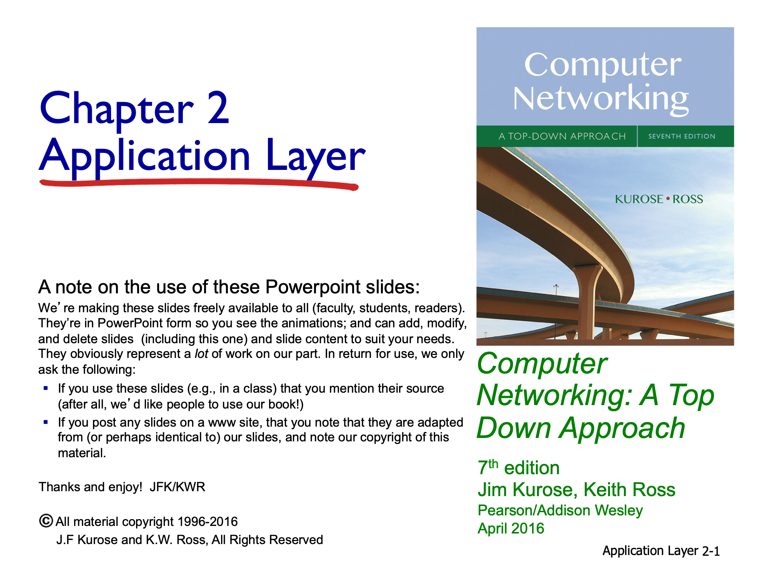
Resources Acknowledgement
Ram P Rustagi/CSE/KSIT
CN-Basic-L14-HTTP-Overview

Slide 3

Electronic mail
outgoing
message queue
Three major components:
user agents
mail servers
simple mail transfer protocol: SMTP (RFC 5321)
obsoletes RFC 2821
User Agent
a.k.a. “mail reader”
composing, editing, reading mail messages
e.g.: Applications: Outlook, Thunderbird, Mail(Apple)
Outgoing, incoming messages stored on server
user mailbox
user
agent
mail
server
user
agent
SMTP
mail
server
user
agent
SMTP
SMTP
user
agent
mail
server
user
agent
user
agent
Ram P Rustagi/CSE/KSIT
18CS52-CN-L08-Email

Slide 4
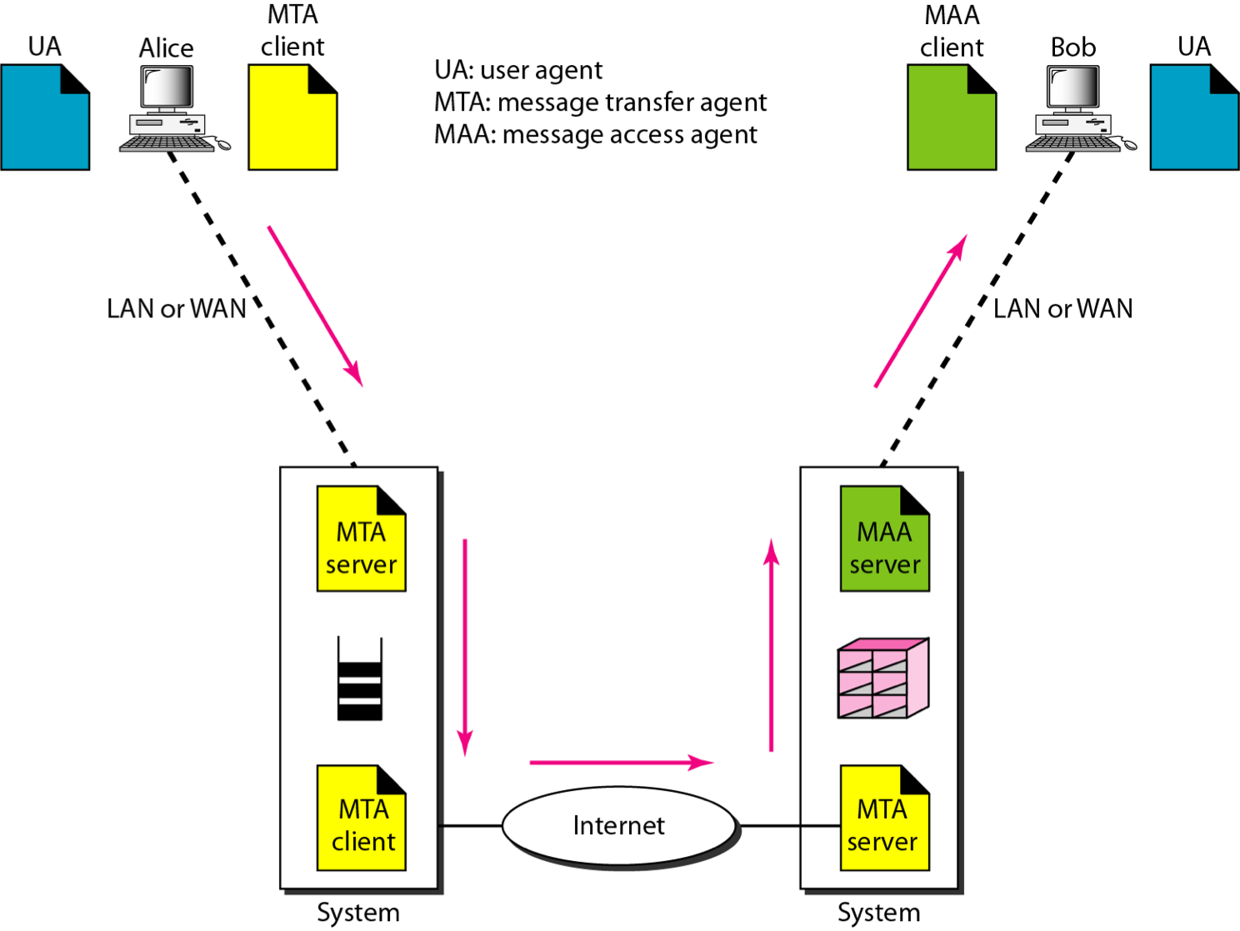
Email: General scenario
Src (fig): Forouzan - Computer Networking
Ram P Rustagi/CSE/KSIT
18CS52-CN-L08-Email

Slide 5
Electronic mail: mail servers
mail servers:
mailbox contains incoming messages for user
message queue of outgoing (to be sent) mail messages
SMTP protocol between mail servers to send email messages
client: sending mail server
“server”: receiving mail server
user
agent
mail
server
user
agent
SMTP
mail
server
user
agent
SMTP
SMTP
user
agent
mail
server
user
agent
user
agent
Ram P Rustagi/CSE/KSIT
18CS52-CN-L08-Email

Slide 6
Email - User Agent
User Agent functions
Compose
send
Read
Reply
Forward
Delete
Handling Mailboxes
Command line UAs
Mail, mailx, pine, elm etc
GUI UAs
iMail, Eudora, Outlook, Thunderbird etc
Ram P Rustagi/CSE/KSIT
18CS52-CN-L08-Email

Slide 7
Electronic Mail: SMTP [RFC 2821]
uses TCP to reliably transfer email message from client to server, port 25 (unsecure)
secure ports (465, 587)
direct transfer: sending server to receiving server
three phases of transfer
handshaking (greeting)
transfer of messages
closure
command/response interaction (like HTTP, FTP)
commands: ASCII text
response: status code and phrase
messages must be in 7-bit ASCII
Ram P Rustagi/CSE/KSIT
18CS52-CN-L08-Email

Slide 8


Scenario: Alice sends message to Bob
1) Alice uses UA to compose message “to” bob@someschool.edu
2) Alice’s UA sends message to her mail server; message placed in message queue
3) client side of SMTP opens TCP connection with Bob’s mail server
4) SMTP client sends Alice’s message over the TCP connection
5) Bob’s mail server places the message in Bob’s mailbox
6) Bob invokes his user agent to read message
user
agent
mail
server
user
agent
1
mail
server
2
3
6
4
5
Alice’s mail server
Bob’s mail server
Ram P Rustagi/CSE/KSIT
18CS52-CN-L08-Email

Slide 9
Sample SMTP interaction
$ nc 10.211.55.10 25
Trying 10.211.55.10...
Connected to 10.211.55.10.
Escape character is '^]'.
220 ubuntu.localdomain ESMTP Postfix (Ubuntu)
HELO ksit.edu.in
250 ubuntu.localdomain
MAIL FROM: rprustagi@ksit.edu.in
250 2.1.0 Ok
RCPT TO: dummy@ksit.local
250 2.1.5 Ok
RCPT TO: dummyuser@ksit.local
250 2.1.5 Ok
DATA
354 End data with <CR><LF>.<CR><LF>
Subject: mail trial with postfix
This is a test mail to try that POP and IMAP works
with mail delivery.
250 2.0.0 Ok: queued as 89715362D67
QUIT
221 2.0.0 Bye
Ram P Rustagi/CSE/KSIT
18CS52-CN-L08-Email

Slide 10
Try SMTP interaction for yourself:
nc servername 25
see 220 reply from server
enter HELO, MAIL FROM, RCPT TO, DATA, QUIT commands
Current EHLO is used in place of HELO
above lets you send email without using email client (reader)
Sending multiple mails in a single connection
Start with MAIL FROM after .(period)
Ram P Rustagi/CSE/KSIT
18CS52-CN-L08-Email

Slide 11
SMTP: and HTTP
comparison with HTTP:
HTTP: pull
SMTP: push
Similarities
ASCII command/response interaction
status codes
Differences
HTTP: each object encapsulated in its own response msg
SMTP: multiple objects sent in multipart msg
SMTP uses persistent connections
SMTP requires message (header & body) to be in 7-bit ASCII
SMTP server uses CRLF to determine end of message
Ram P Rustagi/CSE/KSIT
18CS52-CN-L08-Email

Slide 12
SMTP : Miscellaneous details
Secure SMTP: RFC 4954
Uses AUTH command
E.g AUTH DIGEST-MD5
Uses SASL (RFC 4422)
Simple Authentication and Secure Layer
Plaintext password is not to be used
Mail Exchange (MX) Records
DNS provides this information
Sendmail daemon
On unix systems
Internationalized Email: RFC 6351
vCard
Ram P Rustagi/CSE/KSIT
18CS52-CN-L08-Email

Slide 13
Mail message format
SMTP: protocol for exchanging email msgs
RFC 822: standard for text message format:
header lines, e.g.,
To:
From:
Subject:
different from SMTP
MAIL FROM, RCPT TO: commands!
Body: the “message”
ASCII characters only
header
blank
line
body
Ram P Rustagi/CSE/KSIT
18CS52-CN-L08-Email

Slide 14
Email
RFC 822 (obsoleted by 2822) initially defined message structure
Header and body
Header separated by body with a blank line
Header is a series of lines terminated by <CR><LF>
Header format is type: value
To:, Subject:, Date:, Received: etc
More details, see RFC 822 (or 2822)
RFC 822 extended in 1993/96
To carry different (than text) types of data
Audio, video, word docs, images,
MIME (Multipurpose Internet Mail Extension) format
Ram P Rustagi/CSE/KSIT
18CS52-CN-L08-Email

Slide 15
Mail access protocols
user
agent
mail access
protocol
user
agent
SMTP
SMTP
(e.g., POP,
IMAP)
sender’s mail
server
receiver’s mail
server
SMTP: delivery/storage to receiver’s server
mail access protocol: retrieval from server
POP: Post Office Protocol [RFC 1939]: authorization, download
IMAP: Internet Mail Access Protocol [RFC 3501]: more features, including manipulation of stored msgs on server
HTTP: Gmail, Hotmail, Yahoo! Mail, etc.
Ram P Rustagi/CSE/KSIT
18CS52-CN-L08-Email

Slide 16
POP3
RFC 1939
Basic operation
Server listens on port 110 (Default)
Client connects to the POP3 server
Client issues commands (case insensitive) with args
Typically 4 (or 3) character long keywords
Response consists of
status code, keyword, additional information
Two status indicators: “+OK”, “-ERR”
Session goes thru
Authorization state
Transaction state
Update and goodbye
Ram P Rustagi/CSE/KSIT
18CS52-CN-L08-Email

Slide 17
POP3 protocol
S: +OK POP3 server ready
C: user bob
S: +OK
C: pass hungry
S: +OK user successfully logged on
authorization phase
client commands:
user: declare username
pass: password
Alternatively APOP command
server responses
+OK
-ERR
transaction phase, client:
list: list message numbers
retr: retrieve message by number
dele: delete
quit
C: list
S: 1 498
S: 2 912
S: .
C: retr 1
S: <message 1 contents>
S: .
C: dele 1
C: retr 2
S: <message 1 contents>
S: .
C: dele 2
C: quit
S: +OK POP3 server signing off
Ram P Rustagi/CSE/KSIT
18CS52-CN-L08-Email

Slide 18
MIME Based Email
MIME based message structure
Collection of Header lines
Augment the original RFC822 headers
Describe the ways in which data is carried
Content type and sub-types
Defines how the content is to be interpreted
Encoding of various data types
Enables sending of data as an ASCII email msg
Intermediate gateways require
That email content be ASCII
Base64:
3 bytes of data represented in 4 bytes
Ram P Rustagi/CSE/KSIT
18CS52-CN-L08-Email

Slide 19
MIME Based Email
Email Header
MIME-Version: 1.1
Content-Type: <type/subtype>
Content-Transfer-Encoding: <encoding type>
7-bit, 8-bit, Base64, Binary, Quoted printable
Content-Id: <message id>
Content-Description: textual explanation
Examples:
Ch02-SMTP-attachment.pcap
Look at MIME headers
Ram P Rustagi/CSE/KSIT
18CS52-CN-L08-Email

Slide 20
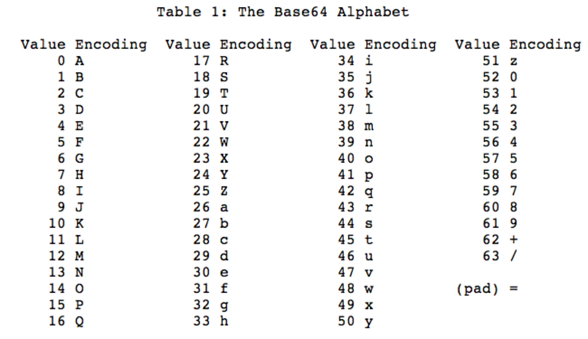

Base64 encoding
Ram P Rustagi/CSE/KSIT
18CS52-CN-L08-Email

Slide 21
Base64 encoding
Encode 18CS into base 64.
Write 18CS (ASCII) in hex/binary
Hex: 0x31384353
Binary: 00110001 00111000 01000011 01010011
Divide in blocks of 6 bits
001100 010011 100001 000011 010100 110000
(12) (19) (33) (3) (20) (48)
Index with these value in Base64 table
M(12) T(19) h(33) D(3) U(20) w(48)
Encoded characters should be in blocks of 4.
Add two filler characters ‘==‘
Base64 encoded value
MThDUw==
Ram P Rustagi/CSE/KSIT
18CS52-CN-L08-Email

Slide 22
Installing Mail programs
On Ubuntu
https://help.ubuntu.com/community/PostfixBasicSetupHowto
sudo apt-get install mailutils
sudo apt-get install courier-pop
sudo apt-get install courier-imap
Ram P Rustagi/CSE/KSIT
18CS52-CN-L08-Email

Slide 23
POP3 (more) and IMAP
IMAP (RFC 3501)
keeps all messages in one place: at server
allows user to organize messages in folders
keeps user state across sessions:
names of folders and mappings between message IDs and folder name
more about POP3
previous example uses POP3 “download and delete” mode
Bob cannot re-read e-mail if he changes client
POP3 “download-and-keep”: copies of messages on different clients
POP3 is stateless across sessions
Ram P Rustagi/CSE/KSIT
18CS52-CN-L08-Email

Slide 24
POP3 vs IMAP4
POP3 deficiencies
Does not allow user to organize mails on server
User can not have different folders on server
Use can create folders on local system
Does not allow partial email content check
IMAP4 features
User can check email header prior to download
User can search the contents prior to download
Allows partial download (MIME multipart)
User can create, delete, rename mailboxes
can create a hierarchy of mailboxes
Web based email
Using HTTP with a email website
Hotmail, gmail, etc
Ram P Rustagi/CSE/KSIT
18CS52-CN-L08-Email

Slide 25
Summary
User Agent
Mail agent
Mail transfer protocol
SMTP, POP3, IMAP4
Mail authorization
ASCII text
MIME email
uses Base64 encoding
Ram P Rustagi/CSE/KSIT
18CS52-CN-L08-Email

