Slide 1
UNIX Programming(18CS56)
Module 5
Signals and Daemon Processes: Signals: UNIX Kernel Support for Signals, Signal, Signal Mask, Sigaction, The SIGCHLD Signal and the waitpid function, The sigsetjmp and siglongjmp Functions, Kill,Alarm, Interval Timers, POSIX.1b Timers. Daemon Processes: Introduction, Daemon Characteristics, Coding Rules, Error Logging, Client-Server Model.
Dr Rekha B Venkatapur, Prof & Head, CSE

Slide 2
Contents
Introduction
The UNIX Kernel Support for Signals
Signal
Signal Mask
sigaction
The SIGCHLD Signal and the waitpid Function
The sigsetjmp and siglongjmp Functions
Kill
Alarm
Dr Rekha B Venkatapur, Prof & Head, CSE

Slide 3
Interval Timers
POSIX.lb Timers.
Daemon Processes
Introduction
Daemon Characteristics
Coding Rules
Error Logging
Client-Server Model.
Dr Rekha B Venkatapur, Prof & Head, CSE

Slide 4
INTRODUCTION
Signals are software interrupts. Signals provide a way of handling asynchronous events: a user at a terminal typing the interrupt key to stop a program or the next program in a pipeline terminating prematurely.
When a signal is sent to a process, it is pending on the process to handle it. The process can react to pending signals in one of three ways:
Accept the default action of the signal, which for most signals will terminate the process.
Ignore the signal. The signal will be discarded and it has no affect whatsoever on the recipient process.
Invoke a user-defined function. The function is known as a signal handler routine and the signal is said to be caught when this function is called.
Dr Rekha B Venkatapur, Prof & Head, CSE

Slide 5
THE UNIX KERNEL SUPPORT OF SIGNALS
When a signal is generated for a process, the kernel will set the corresponding signal flag in the process table slot of the recipient process.
If the recipient process is asleep, the kernel will awaken the process by scheduling it.
When the recipient process runs, the kernel will check the process U-area that contains an array of signal handling specifications.
If array entry contains a zero value, the process will accept the default action of the signal.
If array entry contains a 1 value, the process will ignore the signal and kernel will discard it.
If array entry contains any other value, it is used as the function pointer for a user-defined signal handler routine.
Dr Rekha B Venkatapur, Prof & Head, CSE

Slide 6
SIGNAL
The function prototype of the signal API is:
#include <signal.h>
void (*signal(int sig_no, void (*handler)(int)))(int);
The formal argument of the API are:
sig_no is a signal identifier like SIGINT or SIGTERM.
The handler argument is the function pointer of a user-defined signal handler function.
The following example attempts to catch the SIGTERM signal, ignores the SIGINT signal, and accepts the default action of the SIGSEGV signal. The pause API suspends the calling process until it is interrupted by a signal and the corresponding signal handler does a return:
Dr Rekha B Venkatapur, Prof & Head, CSE

Slide 7
#include<iostream.h>
#include<signal.h> /*signal handler function*/
void catch_sig(int sig_num)
{
signal (sig_num,catch_sig);
cout<<”catch_sig:”<<sig_num<<endl; }
/*main function*/
int main()
{
signal(SIGTERM,catch_sig);
signal(SIGINT,SIG_IGN);
signal(SIGSEGV,SIG_DFL);
pause( ); /*wait for a signal interruption*/
}
Dr Rekha B Venkatapur, Prof & Head, CSE

Slide 8
SIGNAL MASK
Engineered for Tomorrow
A process initially inherits the parent’s signal mask when it is created, but any pending signals for the parent process are not passed on.
A process may query or set its signal mask via the sigprocmask API:
#include <signal.h>
int sigprocmask(int cmd, const sigset_t *new_mask, sigset_t *old_mask);
Returns: 0 if OK, 1 on error
The new_mask argument defines a set of signals to be set or reset in a calling process signal mask, and the cmd argument specifies how the new_mask value is to be used by the API.
Dr Rekha B Venkatapur, Prof & Head, CSE

Slide 9
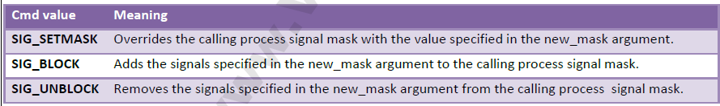
If the actual argument to new_mask argument is a NULL pointer, the cmd argument will be ignored, and the current process signal mask will not be altered.
If the actual argument to old_mask is a NULL pointer, no previous signal mask will be returned.
The sigset_t contains a collection of bit flags.
Dr Rekha B Venkatapur, Prof & Head, CSE

Slide 10
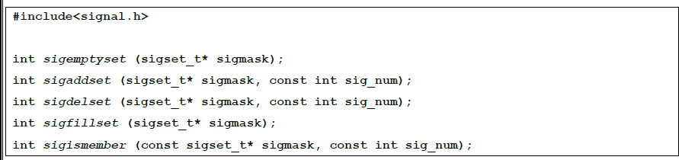
The BSD UNIX and POSIX.1 define a set of API known as sigsetops functions:
Dr Rekha B Venkatapur, Prof & Head, CSE

Slide 11
The sigemptyset API clears all signal flags in the sigmask argument.
The sigaddset API sets the flag corresponding to the signal_num signal in the sigmask argument.
The sigdelset API clears the flag corresponding to the signal_num signal in the sigmask argument.
The sigfillset API sets all the signal flags in the sigmask argument.
[ all the above functions return 0 if OK, -1 on error ]
The sigismember API returns 1 if flag is set, 0 if not set and -1 if the call fails.
Dr Rekha B Venkatapur, Prof & Head, CSE

Slide 12
A process can query which signals are pending for it via the sigpending API:
#include<signal.h>
int sigpending(sigset_t* sigmask);
Returns 0 if OK, -1 if fails.
The sigpending API can be useful to find out whether one or more signals are pending for a process and to set up special signal handling methods for these signals before the process calls the sigprocmask API to unblock them.
Dr Rekha B Venkatapur, Prof & Head, CSE

Slide 13
The following example reports to the console whether the SIGTERM signal is pending for the process:
#include<iostream.h>
#include<stdio.h>
#include<signal.h>
int main()
{
sigset_t sigmask;
sigemptyset(&sigmask);
if(sigpending(&sigmask)==-1)
perror(“sigpending”);
else cout << “SIGTERM signal is:” << (sigismember(&sigmask,SIGTERM) ? “Set” : “No Set”) << endl;
}
Dr Rekha B Venkatapur, Prof & Head, CSE

Slide 14
In addition to the above, UNIX also supports following APIs for signal mask manipulation: #include<signal.h>
int sighold(int signal_num);
int sigrelse(int signal_num);
int sigignore(int signal_num);
int sigpause(int signal_num);
Dr Rekha B Venkatapur, Prof & Head, CSE

Slide 15
SIGACTION
Engineered for Tomorrow
The sigaction API blocks the signal it is catching allowing a process to specify additional signals to be blocked when the API is handling a signal.
The sigaction API prototype is:
#include<signal.h>
int sigaction(int signal_num, struct sigaction* action, struct sigaction* old_action);
Returns: 0 if OK, 1 on error
The struct sigaction data type is defined in the <signal.h> header as:
struct sigaction {
void (*sa_handler)(int);
sigset_t sa_mask;
int sa_flag; }
Dr Rekha B Venkatapur, Prof & Head, CSE

Slide 16
The following program illustrates the uses of sigaction:
#include<iostream.h>
#include<stdio.h>
#include<unistd.h>
#include<signal.h>
void callme(int sig_num) { cout<<”catch signal:”<<sig_num<<endl; }
int main(int argc, char* argv[])
{
sigset_t sigmask;
struct sigaction action,old_action;
sigemptyset(&sigmask);
Dr Rekha B Venkatapur, Prof & Head, CSE

Slide 17
if(sigaddset(&sigmask,SIGTERM)==-1 || sigprocmask(SIG_SETMASK,&sigmask,0)==-1)
perror(“set signal mask”);
sigemptyset(&action.sa_mask); sigaddset(&action.sa_mask,SIGSEGV); action.sa_handler=callme;
action.sa_flags=0; if(sigaction(SIGINT,&action,&old_action)==-1) perror(“sigaction”); pause(); cout<<argv[0]<<”exists\n”;
return 0;
}
Dr Rekha B Venkatapur, Prof & Head, CSE

Slide 18
THE SIGCHLD SIGNAL AND THE waitpid API
When a child process terminates or stops, the kernel will generate a SIGCHLD signal to its parent process. Depending on how the parent sets up the handling of the SIGCHLD signal, different events may occur:
Parent accepts the default action of the SIGCHLD signal:
o SIGCHLD does not terminate the parent process.
o Parent process will be awakened.
o API will return the child’s exit status and process ID to the parent.
o Kernel will clear up the Process Table slot allocated for the child process.
o Parent process can call the waitpid API repeatedly to wait for each child it created.
Dr Rekha B Venkatapur, Prof & Head, CSE

Slide 19
Engineered for Tomorrow
Parent ignores the SIGCHLD signal:
o SIGCHLD signal will be discarded.
o Parent will not be disturbed even if it is executing the waitpid system call.
o If the parent calls the waitpid API, the API will suspend the parent until all its child processes have terminated.
o Child process table slots will be cleared up by the kernel.
o API will return a -1 value to the parent process.
Process catches the SIGCHLD signal:
o The signal handler function will be called in the parent process whenever a child process terminates.
o If the SIGCHLD arrives while the parent process is executing the waitpid system call, the waitpid API may be restarted to collect the child exit status and clear its process table slots.
o Depending on parent setup, the API may be aborted and child process table slot not freed.
Dr Rekha B Venkatapur, Prof & Head, CSE

Slide 20
THE sigsetjmp AND siglongjmp APIs
The function prototypes of the APIs are:
#include <setjmp.h>
int sigsetjmp(sigjmp_buf env, int savemask);
int siglongjmp(sigjmp_buf env, int val);
The sigsetjmp and siglongjmp are created to support signal mask processing.
Specifically, it is implementation-dependent on whether a process signal mask is saved and restored when it invokes the setjmp and longjmp APIs respectively.
Dr Rekha B Venkatapur, Prof & Head, CSE

Slide 21
KILL
A process can send a signal to a related process via the kill API. This is a simple means of inter-process communication or control. The function prototype of the API is:
#include<signal.h>
int kill(pid_t pid, int signal_num);
Returns: 0 on success, -1 on failure.
Dr Rekha B Venkatapur, Prof & Head, CSE

Slide 22
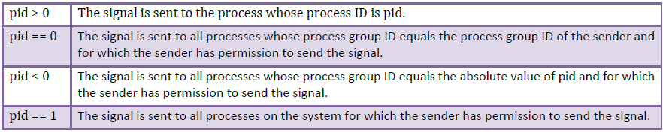
Engineered for Tomorrow
The signal_num argument is the integer value of a signal to be sent to one or more processes designated by pid. The possible values of pid and its use by the kill API are:
The UNIX kill command invocation syntax is: Kill [ -<signal_num> ] <pid>...... Where signal_num can be an integer number or the symbolic name of a signal. <pid> is process ID.
Dr Rekha B Venkatapur, Prof & Head, CSE

Slide 23
ALARM
Engineered for Tomorrow
The alarm API can be called by a process to request the kernel to send the SIGALRM signal after a certain number of real clock seconds.
The function prototype of the API is: #include<signal.h>
Unsigned int alarm(unsigned int time_interval); Returns: 0 or number of seconds until previously set alarm
Dr Rekha B Venkatapur, Prof & Head, CSE

Slide 24
The alarm API can be used to implement the sleep API:
#include<signal.h>
#include<stdio.h>
#include<unistd.h>
void wakeup( ) { ; }
unsigned int sleep (unsigned int timer )
{
struct sigaction action;
action.sa_handler=wakeup;
action.sa_flags=0;
sigemptyset(&action.sa_mask); if(sigaction(SIGALARM,&action,0)==-1)
{ perror(“sigaction”);
return -1;
}
(void) alarm (timer);
(void) pause( );
return 0;
}
Engineered for Tomorrow
Dr Rekha B Venkatapur, Prof & Head, CSE

Slide 25
INTERVAL TIMERS
Engineered for Tomorrow
The interval timer can be used to schedule a process to do some tasks at a fixed time interval, to time the execution of some operations, or to limit the time allowed for the execution of some tasks.
The following program illustrates how to set up a real-time clock interval timer using the alarm API:
#include<stdio.h>
#include<unistd.h>
#include<signal.h>
#define INTERVAL 5
void callme(int sig_no)
{
alarm(INTERVAL); /*do scheduled tasks*/ }
Dr Rekha B Venkatapur, Prof & Head, CSE

Slide 26
main()
{
struct sigaction action; sigemptyset(&action.sa_mask); action.sa_handler=(void(*)( )) callme; action.sa_flags=SA_RESTART; if(sigaction(SIGALARM,&action,0)==-1) { perror(“sigaction”); return 1; } if(alarm(INTERVAL)==-1)
perror(“alarm”);
else while(1)
{
/*do normal operation*/
}
return 0;
}
Engineered for Tomorrow
Dr Rekha B Venkatapur, Prof & Head, CSE

Slide 27
In addition to alarm API, UNIX also invented the setitimer API, which can be used to define up to three different types of timers in a process:
Real time clock timer
Timer based on the user time spent by a process
Timer based on the total user and system times spent by a process
The getitimer API is also defined for users to query the timer values that are set by the setitimer API. The setitimer and getitimer function prototypes are:
#include<sys/time.h>
int setitimer(int which, const struct itimerval * val, struct itimerval * old);
int getitimer(int which, struct itimerval * old);
Engineered for Tomorrow
Dr Rekha B Venkatapur, Prof & Head, CSE

Slide 28
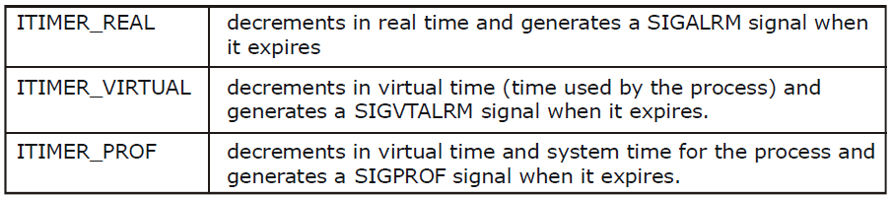
Engineered for Tomorrow…
The possible values and the corresponding timer types of which arguments are:
The struct itimerval datatype is defined as:
struct itimerval {
struct timeval it_value; /*current value*/
struct timeval it_interval; /* time interval*/
};
The setitimer and getitimer APIs return a zero value if they succeed or a -1 value if they fail
Dr Rekha B Venkatapur, Prof & Head, CSE

Slide 29
POSIX.1b TIMERS
POSIX.1b defines a set of APIs for interval timer manipulations. The POSIX.1b timers are more flexible and powerful than are the UNIX timers in the following ways:
Users may define multiple independent timers per system clock.
The timer resolution is in nanoseconds.
Users may specify the signal to be raised when a timer expires.
The time interval may be specified as either an absolute or a relative time.
Dr Rekha B Venkatapur, Prof & Head, CSE

Slide 30
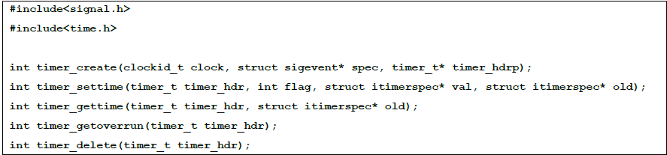
The POSIX.1b APIs for timer manipulations are:
Dr Rekha B Venkatapur, Prof & Head, CSE

Slide 31
Daemon Processes
Dr Rekha B Venkatapur, Prof & Head, CSE

Slide 32
Engineered for Tomorrow
INTRODUCTION
Daemons are processes that live for a long time. They are often started when the system is bootstrapped and terminate only when the system is shut down.
DAEMON CHARACTERISTICS
The characteristics of daemons are:
Daemons run in background.
Daemons have super-user privilege.
Daemons don’t have controlling terminal.
Daemons are session and group leaders.
Dr Rekha B Venkatapur, Prof & Head, CSE

Slide 33
CODING RULES
Call umask to set the file mode creation mask to 0.
Call fork and have the parent exit.
Call setsid to create a new session.
Change the current working directory to the root directory.
Unneeded file descriptors should be closed
Some daemons open file descriptors 0, 1, and 2 to /dev/null so that any library routines that try to read from standard input or write to standard output or standard error will have no effect.
Dr Rekha B Venkatapur, Prof & Head, CSE

Slide 34
Example Program:
#include <unistd,h>
#include <sys/types.h>
#include <fcntl.h>
int daemon_initialise( )
{
pid_t pid;
if (( pid = for() ) < 0)
return –1;
else if ( pid != 0)
exit(0); /* parent exits */ /* child continues */
setsid( );
chdir(“/”);
umask(0);
return 0;
}
Dr Rekha B Venkatapur, Prof & Head, CSE

Slide 35
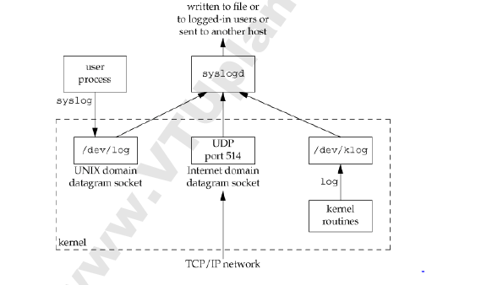
ERROR LOGGING
Engineered for Tomorrow
One problem a daemon has is how to handle error messages.
It can't simply write to standard error, since it shouldn't have a controlling terminal.
A central daemon error-logging facility is required.
Dr Rekha B Venkatapur, Prof & Head, CSE

Slide 36
There are three ways to generate log messages:
Kernel routines can call the log function. These messages can be read by any user process that opens and reads the /dev/klog device.
Most user processes (daemons) call the syslog(3) function to generate log messages. This causes the message to be sent to the UNIX domain datagram socket /dev/log.
A user process on this host, or on some other host that is connected to this host by a TCP/IP network, can send log messages to UDP port 514. Note that the syslog function never generates these UDP datagrams: they require explicit network programming by the process generating the log message.
Dr Rekha B Venkatapur, Prof & Head, CSE

Slide 37
Normally, the syslogd daemon reads all three forms of log messages.
On start-up, this daemon reads a configuration file, usually /etc/syslog.conf, which determines where different classes of messages are to be sent.
For example, urgent messages can be sent to the system administrator (if logged in) and printed on the console, whereas warnings may be logged to a file.
#include <syslog.h> void openlog(const char *ident, int option, int facility);
void syslog(int priority, const char *format, ...);
void closelog(void); int setlogmask(int maskpri);
Dr Rekha B Venkatapur, Prof & Head, CSE

Slide 38
SINGLE-INSTANCE DAEMONS
Engineered for Tomorrow
Some daemons are implemented so that only a single copy of the daemon should be running at a time for proper operation.
The file and record-locking mechanism provides the basis for one way to ensure that only one copy of a daemon is running.
If each daemon creates a file and places a write lock on the entire file, only one such write lock will be allowed to be created.
Successive attempts to create write locks will fail, serving as an indication to successive copies of the daemon that another instance is already running.
Dr Rekha B Venkatapur, Prof & Head, CSE

Slide 39
Engineered for Tomorrow
File and record locking provides a convenient mutual-exclusion mechanism.
If the daemon obtains a write-lock on an entire file, the lock will be removed automatically if the daemon exits.
This simplifies recovery, removing the need for us to clean up from the previous instance of the daemon.
Dr Rekha B Venkatapur, Prof & Head, CSE

Slide 40
DAEMON CONVENTIONS
If the daemon uses a lock file, the file is usually stored in /var/run. The daemon might need superuser permissions to create a file here. The name of the file is usually name.pid, where name is the name of the daemon or the service. For example, the name of the cron daemon's lock file is /var/run/crond.pid.
If the daemon supports configuration options, they are usually stored in /etc. The configuration file is named name.conf, where name is the name of the daemon or the name of the service. For example, the configuration for the syslogd daemon is /etc/syslog.conf.
Dr Rekha B Venkatapur, Prof & Head, CSE

Slide 41
Daemons can be started from the command line, but they are usually started from one of the system initialization scripts (/etc/rc* or /etc/init.d/*).
If a daemon has a configuration file, the daemon reads it when it starts, but usually won't look at it again. If an administrator changes the configuration, the daemon would need to be stopped and restarted to account for the configuration changes. To avoid this, some daemons will catch SIGHUP and reread their configuration files when they receive the signal.
Dr Rekha B Venkatapur, Prof & Head, CSE

Slide 42
CLIENT-SERVER MODEL
In general, a server is a process that waits for a client to contact it, requesting some type of service.
In one-way communication between the client and the server, the client sends its service request to the server; the server sends nothing back to the client.
In two-way communication between a client and a server, the client sends a request to the server, and the server sends a reply back to the client.
Dr Rekha B Venkatapur, Prof & Head, CSE

