Slide 1
CPU Load Balancer & Multi-Core Scheduler Simulator (CORESHIFT)
BY S.LAKSHMI ABHISHIKTHA

Slide 2
Department & University
Department
Computer Science & Engineering
University
K L (Deemed to be) University
Bowrampet, Hyderabad

Slide 3
Introduction
A CPU Load Balancer & Multi‑Core Scheduler Simulator is a tool that models how an operating system assigns tasks across CPU cores to improve performance.
In multi‑tasking systems, tasks or “processes” compete for CPU time — the scheduler must decide which runs when and on which core to maximize efficiency.
Load balancing ensures no core is idle while others are overloaded.

Slide 4
Problem Statement
In multi-core systems, improper workload distribution can lead to:
CPU core overload
Poor resource utilization
Scheduling inefficiency
Reduced system performance
Need . A system is required to simulate and visualize how CPU load balancing improves performance and efficiency.

Slide 5
Project Overview:
CoreShift is a simulation-based OS project that demonstrates how tasks are distributed across multiple CPU cores.
It focuses on:
Process Scheduling
Load Balancing
Task Migration
Core Utilization
Goal
To provide a practical understanding of how operating systems manage workloads efficiently.

Slide 6
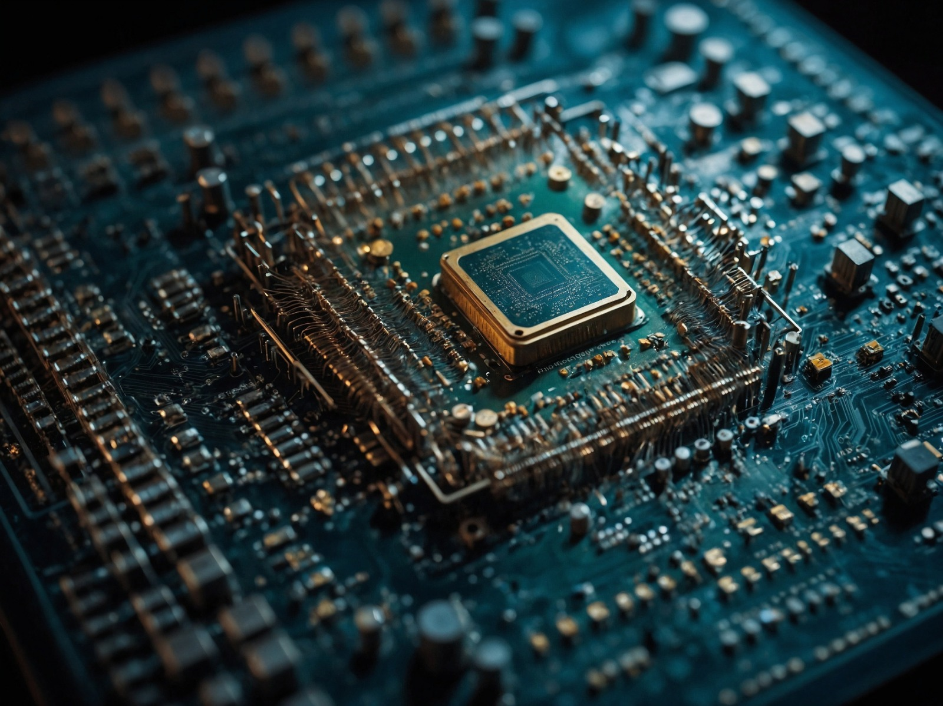
Objectives
Simulate CPU load balancing
Distribute tasks across multiple cores
Visualize process migration
Improve understanding of OS scheduling
Analyze CPU utilization efficiency

Slide 7
Key Features
Multi-Core CPU Simulation
Dynamic Task Allocation
Load Balancing Mechanism
Task Migration
Core Utilization Monitoring
Interactive Visualization

Slide 8
FEATURES:
12.1 System Control Module
Start/Stop/Reset simulation
Scheduler strategy selection
12.2 App Usage Insights
Real‑time CPU, memory, and process usage
12.3 Significant CPU Usage Reduction
Adaptive load balancing prevents core overloads
12.4 Memory Consumption Optimization
Integrated memory impact insights

Slide 9
Tech Stack
Frontend:
HTML
CSS
JavaScript
React
Backend / Logic:
JavaScript
Online Deployment:
Netlify (for deployment)

Slide 10
System Architecture
1. Input Layer:
User enters tasks / processes
2. Scheduling Layer:
Assigns tasks to CPU cores
3. Load Balancer:
Monitors and redistributes workload
4. Output Layer:
Displays CPU usage and task distribution

Slide 11
Working of CoreShift
Step 1:
Input tasks are added to the simulator
Step 2:
Tasks are assigned to available CPU cores
Step 3:
CPU load is monitored continuously
Step 4:
Overloaded cores transfer tasks to less loaded cores
Step 5:
Balanced workload distribution is displayed

Slide 12
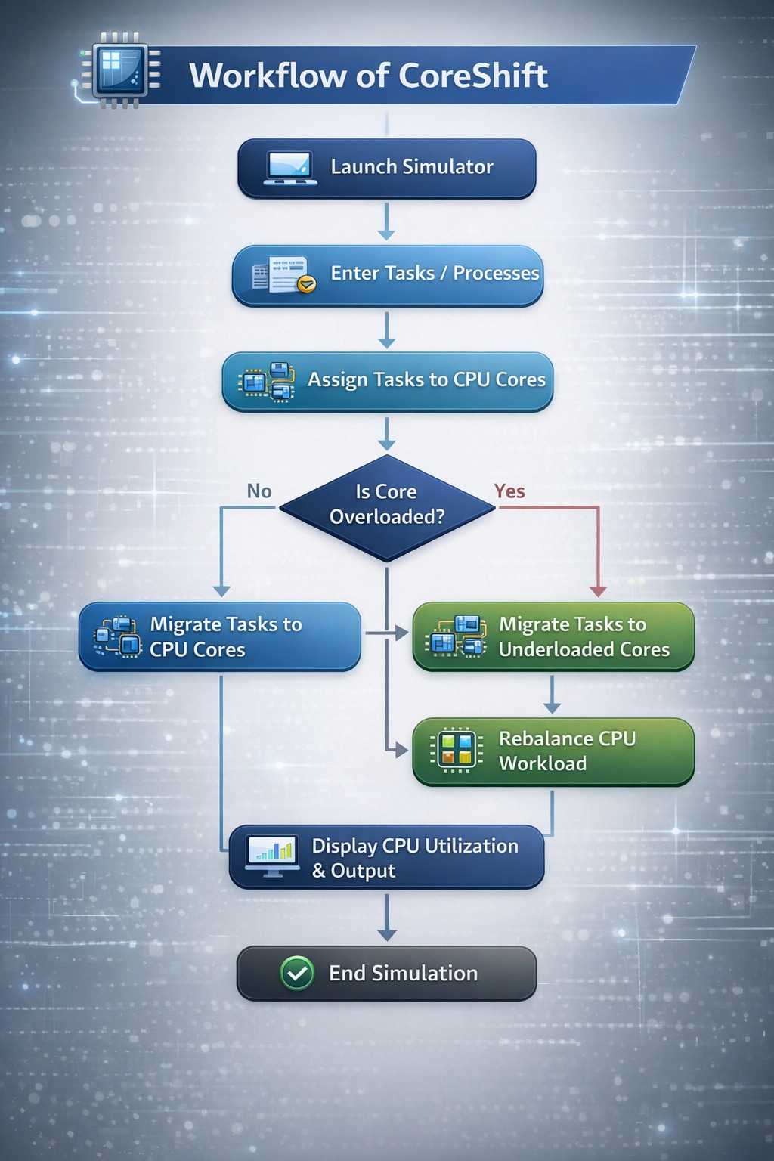

Slide 13
Load Balancing Concept
CPU Load Balancing:
CPU Load Balancing is the process of evenly distributing workloads across processor cores.
Benefits:
Better CPU utilization
Reduced overload
Improved performance
Efficient task execution
CoreShift demonstrates this behavior through simulation.

Slide 14
Advantages:
Easy to understand OS concepts
Demonstrates real-time workload distribution
Improves learning of CPU scheduling
Useful for academic demonstrations
Interactive and visually clear

Slide 15
Applications:
Operating Systems learning
CPU scheduling demonstrations
Multi-core processing simulation
Academic project presentations
Performance analysis education

Slide 16
User‑Friendly GUI
Visual graphs of CPU usage per core
Controls for scheduling parameters
Side‑by‑side comparison of performance metrics

Slide 17
Future Scope:
Add scheduling algorithms
(FCFS, Round Robin, Priority, SJF)
Include real-time graphs
Add thread-level simulation
Improve dashboard visualization
Implement AI-based balancing logic

Slide 18
Conclusion
Core Shift successfully simulates CPU load balancing in a multi-core environment.
It helps visualize:
Process scheduling
Task migration
Core utilization
Workload balancing
It serves as an effective tool for understanding key Operating Systems concepts.

Slide 19
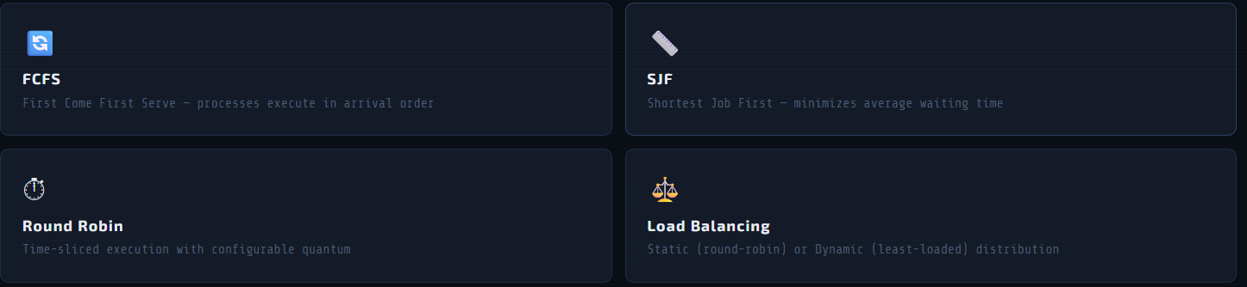
Results
Demonstrate load distribution improvements
Compare traditional scheduler vs. your simulator
Efficiency gains in key scenarios

Slide 20
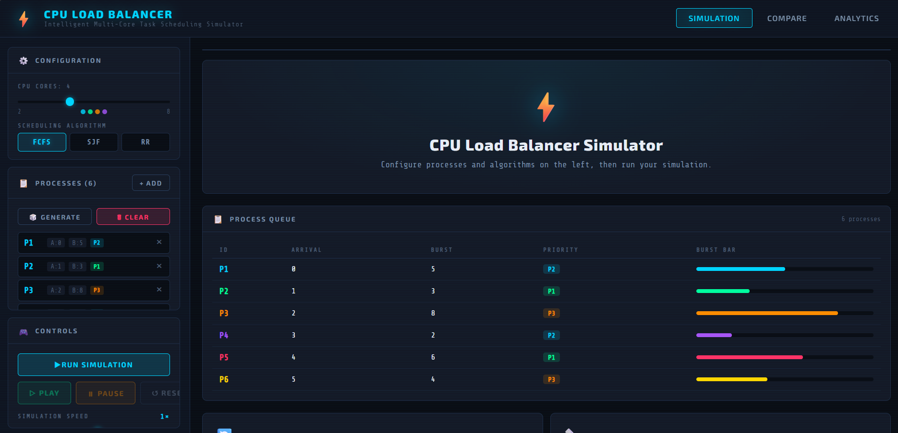

Slide 21
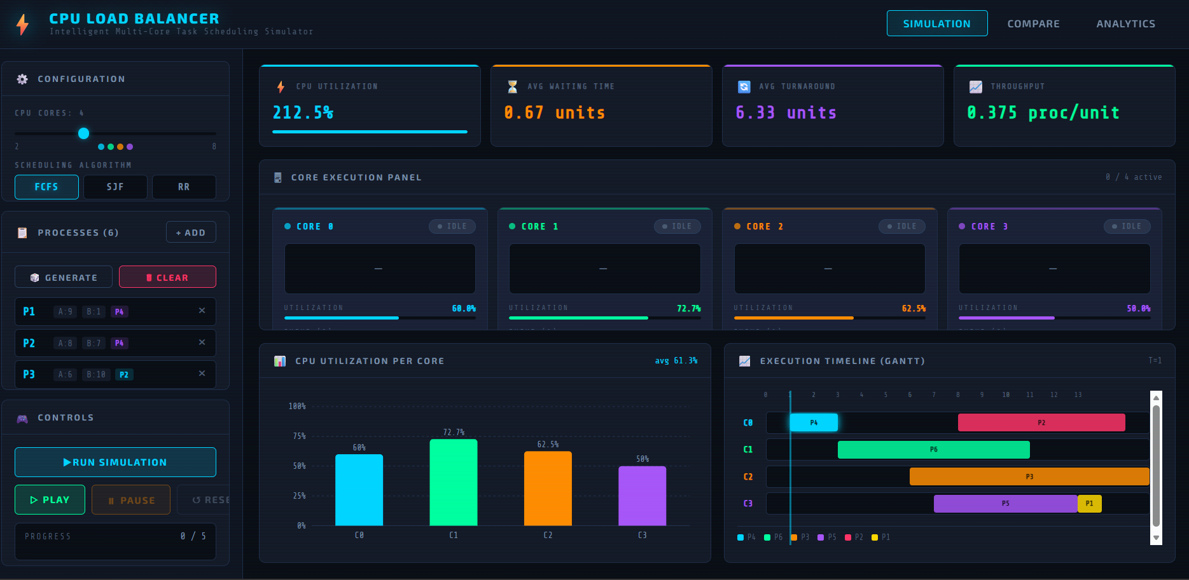

Slide 22
STATS:
Include key simulation results such as:
CPU utilization per core
Response time improvement
Throughput changes

