Slide 1


Basic Details of the Team and Problem Statement
Ministry/Organization Name/Student Innovation:
Ministry of power
PS Code: SIH1300 Problem Statement Title: AUTOMATED PUBLIC LIGHTING Team Name: INNOVISON
Team Leader Name: SOUMIL MAJUMDAR Institute Code (AISHE): Institute Name: B.P. PODDAR INSTITUTE OF MANAGEMENT AND TECHNOLOGY
Theme Name: Smart Automation - HARDWARE

Slide 2
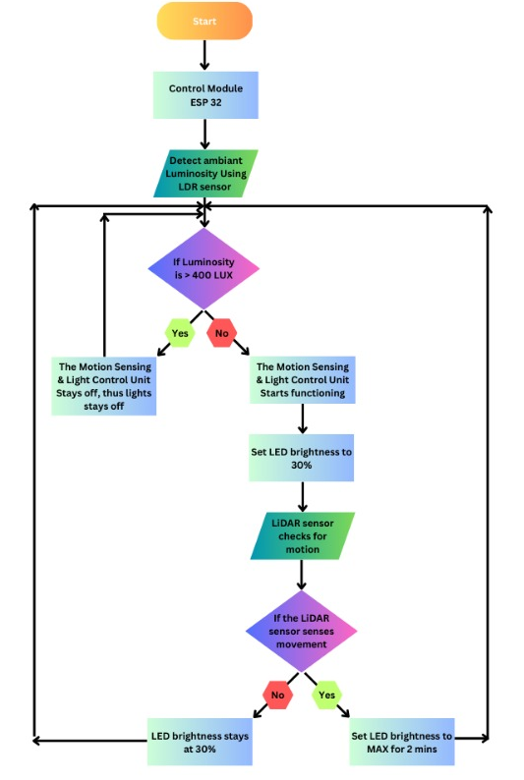
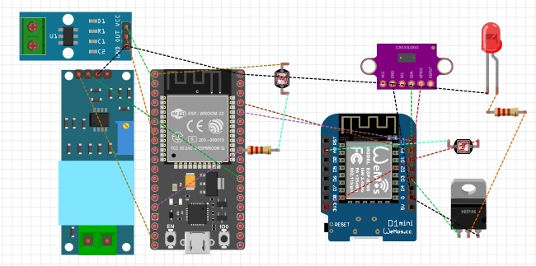



Idea/Approach Details
Flow Chart
This project is about smart street lighting that utilise sensors to conserve electricity. When it's dark, the lights turn on at 30% brightness, and as someone approaches, they get brighter. If no one is around for a time, they revert to 30%. Along with the aid of our server module implementing IoT, we will be able to detect faults, such as a broken light, and this module will also supply us with information such as current and voltage consumed. This information will further be presented in the app that we will create.
Hardware:
Motion Detection Unit: When the server unit's Light Dependent Resistor (LDR) detects Lux values less than 400, this unit activates lights at 30% brightness.-
Motion Control: When the LED is turned on, the device runs at 30% brightness until the LiDAR sensor detects motion. It then goes to 100% brightness and stays there for up to 120 seconds without changing.
Detection of Faults: An LDR sensor detects errors when no light is detected or when Lux values are lower than expected after the LED are turned on.
Software:
Display of Data: The software's major job is to show data received from both the server unit and the motion sensor unit, namely voltage and current usage.
Cloud Inclusion: Firebase is used as a cloud server for data storage and management, as well as for remote access and control.
Android App: An Android app created Statistics Access: Users may access voltage and current usage statistics.
Control Functionality: Users may control the server unit, which is useful in an emergency.
Anomaly Detection: The app detects and shows any abnormalities or problems in the lights.
Describe your Technology stack here:

Slide 3
Idea/Approach Details
Describe your Use Cases here
Describe your Dependencies / Show stopper here
IoT enabled smart street light from current light.
Conservation of energy.
Reduces light pollution.
Monitoring of electricity consumed.
We can also help to modernize societal lightning system.
All the control modules are interconnected hence we can retrieve the data and display through web application or mobile application. Ability to remotely control the intensity of the street lights.
Smart lightning can enhance safety by increasing visibility on streets and also by detecting motion in public areas.
The business proposal of this idea is that we can provide smaller modules as a plug-in system which can convert any pre-existing light into smart light which will grant the user to access the details about consumption of electricity.
Power Supply: The system relies on a stable power supply, so any disruptions or power outages could impact its functionality. Implementing backup power solutions like batteries or solar panels may mitigate this dependency.
Network Connectivity: The central server and individual modules require reliable network connectivity to communicate. Ensure robust internet or cellular connections for consistent data transmission.
Sensor Reliability: The accuracy and reliability of sensors, especially the LiDAR and LDR, are critical for proper functioning. Regular maintenance and calibration are necessary.
Data Security: Protecting data collected by the system is vital. Implement robust security measures to safeguard against unauthorized access or data breaches.
SHOWSTOPPERS: -
Scalability Challenges: Scaling the system to cover larger areas or cities may pose logistical and financial challenges. Consider scalability options from the outset.
Maintenance Issues: Regular maintenance is essential to keep the system running optimally. Lack of maintenance could lead to sensor failures or inaccurate data.

Slide 4
Team Member Details
Team Leader Name: SOUMIL MAJUMDAR
Branch (Btech) Stream (ECE) Year (II)
Team Member 1 Name: SOURASHIS DAS
Branch (Btech) Stream (ECE) Year (II)
Team Member 2 Name: SOMNATH CHAKRABORTY
Branch (Btech) Stream (ECE) Year (II)
Team Member 3 Name: ARIN SEN
Branch (Btech) Stream (CSE) Year (II)
Team Member 4 Name: AKANKSHA KUMARI
Branch (Btech) Stream (CSE) Year (II)
Team Member 5 Name: SURAJ KUMAR
Branch (Btech) Stream (ECE) Year (II)
Team Mentor 1 Name: MR.RAMESH KUMAR
Category (Academic) Expertise (AI/ML/Blockchain etc): Domain Experience (in years):
Team Mentor 2 Name: MR.SUBHASISH DAS
Category (Academic) Expertise (AI/ML/Blockchain etc): Domain Experience (in years):

Slide 5
Important Pointers
Please ensure below pointers are met while
Kindly keep the maximum slides limit to 4 pages
All the topics should be utilized for description of your idea
Try to avoid paragraphs and post your idea in points
Keep your explanation precisely and easy to understand
Idea should be unique and novel. If it has a business potential more weightage will be given.
Apart from this PPT abstract of your idea will be asked separately while submitting
You need to save the file in PDF and upload the same on portal. No PPT, Word Doc or any other format will be supported
You can delete this slide (Important Pointers) when you upload the details of your idea on SIH portal.

