Slide 1

AI-Based Traffic Prediction Assistant
Design Thinking Based AI Ideation
Sourav C D | ECE – C

Slide 2


The Problem
"Students and staff often waste valuable time in traffic because they cannot accurately predict traffic congestion, travel time, and possible delays before starting their journey."
The Impact Chain
🚗 Traffic Congestion
⏱ Time Uncertainty
Unexpected delays derail schedules
Poor journey planning
😓 Stress & Anxiety
🎓 Late Arrivals
Reduced productivity
Direct academic impact

Slide 3

1. EMPATHIZE – Understand the Users
Primary Users
Common Pain Points
Unexpected traffic congestion blocking routes
Uncertain travel time estimates
Difficulty choosing optimal routes
Frequent late arrivals to college
Stress and anxiety from unpredictable delays
🎓 College Students
👨‍🏫 Staff & Faculty
Daily commuters
Regular campus commuters
🚌 Public Transport
🏙️ Regular Commuters
Bus & transit users
Daily route travelers

Slide 4

2. DEFINE – Identify the Core Problem
"Students and staff need a smart system that can predict traffic conditions and travel delays in advance, helping them choose better routes and reach their destination on time."
Traffic Prediction
On-Time Arrival
User Need
Better Route

Slide 5





Our Design Objective
Create an AI-powered traffic prediction assistant that can:
Analyze Traffic Data
Predict Congestion
Estimate Travel Time
Real-time and historical traffic patterns
Forecast traffic bottlenecks before they happen
Accurate ETA calculations for any route
Suggest Alternative Routes
Alert Users
Proactive delay notifications in real-time
Optimal path recommendations instantly

Slide 6

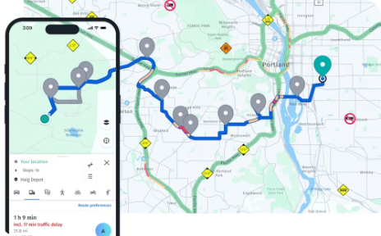
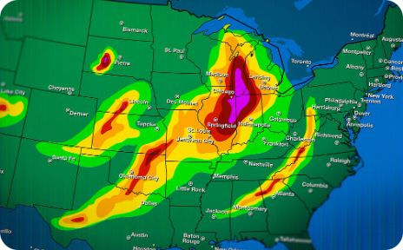
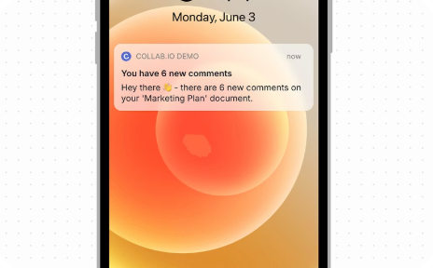
3. IDEATE – Generate AI Solutions
🤖 AI Traffic Prediction
🗺️ Smart Route Recommendation
🌦️ Weather Awareness
📱 Mobile Integration
Predict future traffic using ML models on historical and real-time data
Real-time app notifications and user-friendly interface for commuters
Suggest optimal routes avoiding congestion using graph algorithms
Factor weather conditions into traffic predictions for precision accuracy

Slide 7
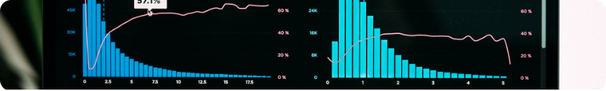


Proposed AI Solution Architecture
Sample Output
Complete System Flow
Traffic Level
🔴 HIGH – Congestion detected on main route
Estimated Time
⏱ 55 minutes via current route
User Input
Collect Traffic
AI Analysis
Predict Conditions
Calculate ETA
Alternative Route
🟢 Recommended – 35 min via alternate route
Time Saved
✅ 20 minutes saved with smart rerouting

Slide 8

Benefits & Conclusion
Key Benefits
"Design Thinking helped us understand the real traffic problems faced by students and staff and develop an AI-based solution that provides smarter, faster, and more efficient travel planning."
✅ Saves Travel Time
✅ Reduces Stress
Avoid congested routes
Predictable journey planning
Thank You! 🙏
Sourav C D | ECE-C
✅ On-Time Arrivals
✅ Eco-Friendly
Students reach college punctually
Reduces unnecessary fuel consumption
✅ Smart Route Selection
✅ Efficient Planning
Data-driven recommendations
Optimized travel schedules

