Slide 1

MA336 Customer Churn Prediction
By-2211606

Slide 2
Customer Churn Prediction
Customer churn is when a customer decides to terminate the services, content, or products from a company. Retaining the existing customers is less expensive than acquiring new customers.
Problem:
But due to customer churning the company loses its revenue stream and might get overtaken by other competitors.
Solution:
To reduce customer churn, companies need to predict which customers are at high risk of churn based on available features by the use of machine learning models.
Data:
Telco data from Kaggle:https://www.kaggle.com/datasets/blastchar/telco-customer-churn

Slide 3
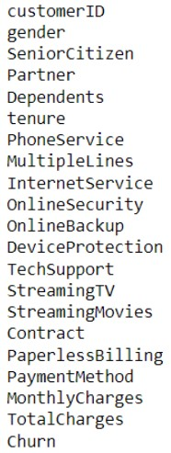
Dataset used for Churn Prediction
The Telco customer churn data contains information about a fictional telco company that provided home phone and Internet services to 7044 customers in California in Q3. It indicates which customers have left, stayed, or signed up for their service.
CustomerID: Unique identifier for each customer/client Gender: the gender of each customer/client (Male or Female)
SeniorCitizen: if the customer/client is a senior citizen (1 or 0)
Partner: if there is a partner with (Yes or No)
Dependents: if the customer/client has dependents (Yes or No)
Tenure: Number of months the customer/client has stayed with the company
PhoneService: Whether the customer/client has a phone service (Yes or No)
InternetService: customer's/client's internet service provider (DSL, Fiber optic, or No)
StreamingTV: Whether the customer/client has streaming TV service (Yes or No)
MonthlyCharges: The amount charged to the customer/client monthly
TotalCharges: The total amount charged to the customer/client
Churn: Whether the customer/client has churned (Yes or No)

Slide 4
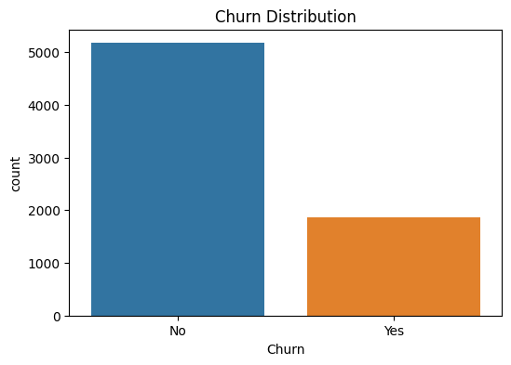
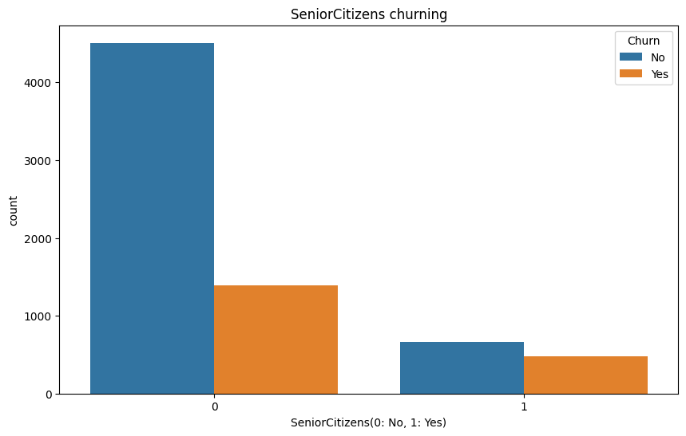
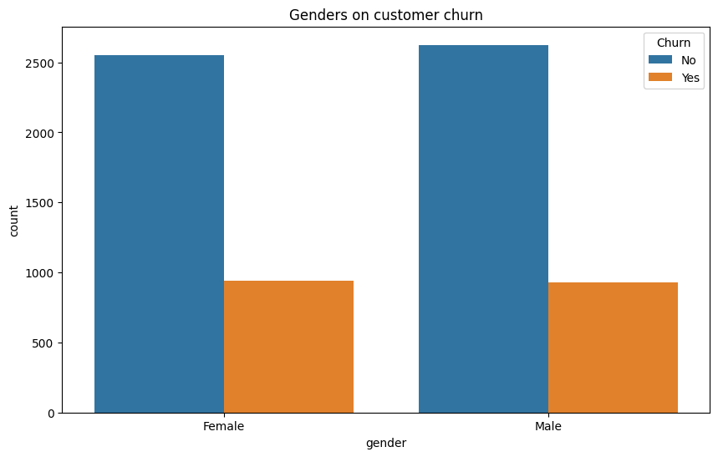
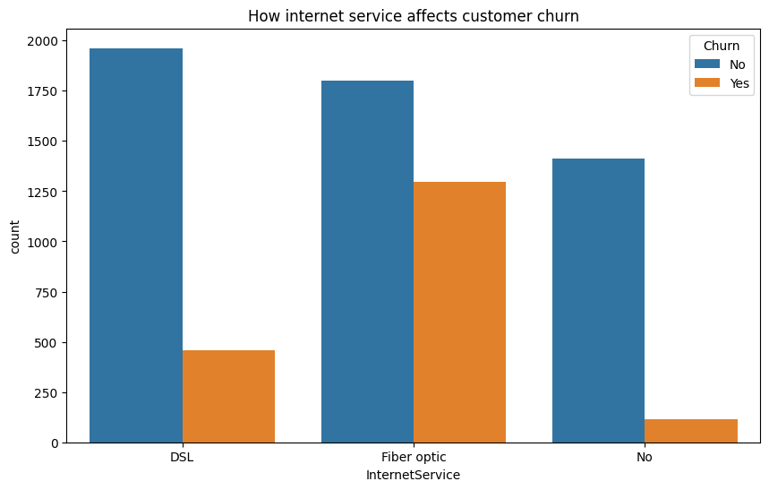
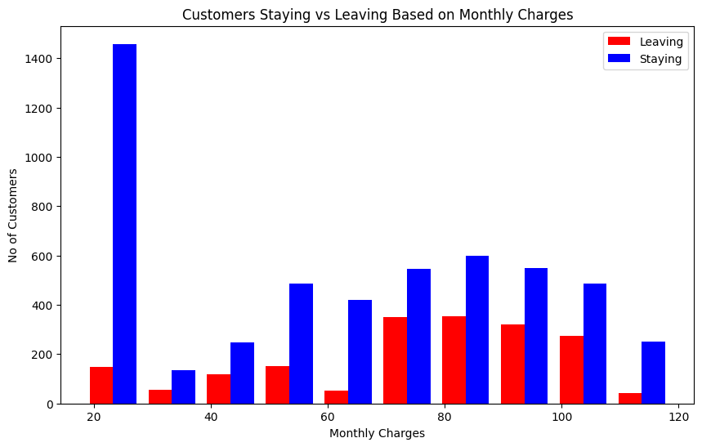
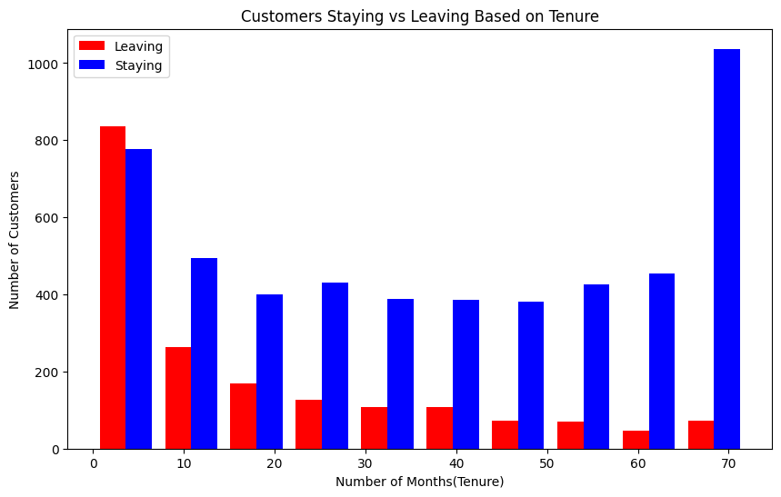
Preliminary Analysis
In this step we will try to visualize the data based on important features.
Most important loss is losing the loyal customers. Using feature 'tenure’ and ‘monthly charges’ we can explore such customers.

Slide 5
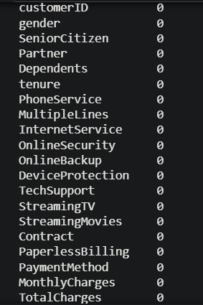
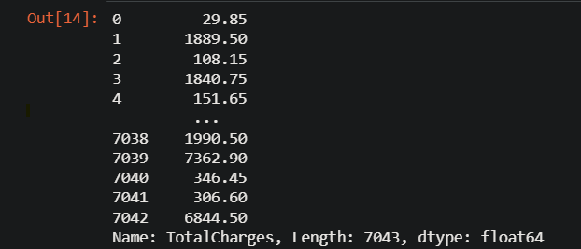
Data Cleaning & Preprocessing
Firstly we calculate all the number of null values in the dataset after we get isnull sum as ‘0’ which means that there are no null values in the data set.
After which we check that the ‘Total Charges’ data type is an object so we need to convert it to float.

Slide 6
Feature Selection
After converting the total charges to float we notice that around 0.16 % of the data in the total charges contain of NA values.
So we drop the customer ID column as it is not needed for this project and even the NA values are dropped.
Most of the columns have ‘Yes’ and ‘No’ values so we transform the categorical columns with (1,0) numeric format.
This method is known as one Hot Encoding.
Then we identify the the features which need scaling, so we use the MinMax Scaler to scale the columns ‘tenure’,’Monthly Charges’ & ’Total Charges’ columns to standardize the range of the input features so that the machine learning model can quickly learn from the data.

Slide 7
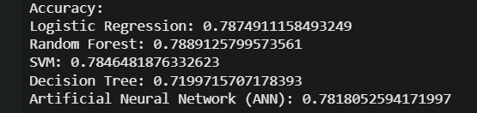
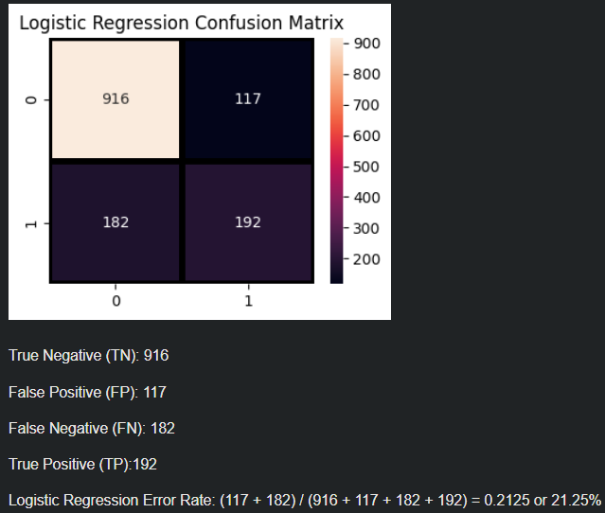
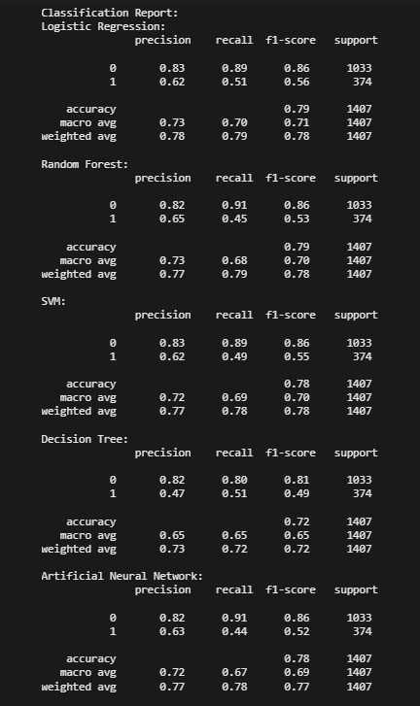
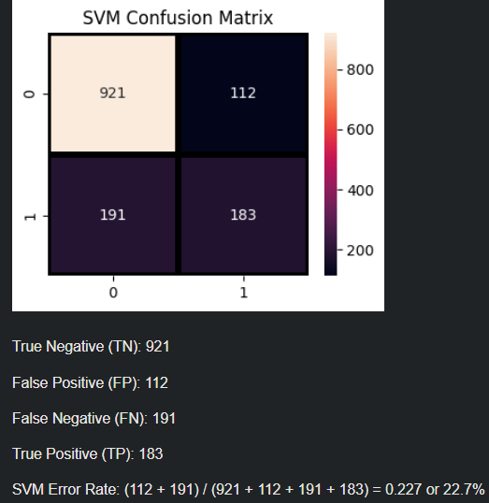
Methods Used
Algorithms:
Logistic Regression, Support Vector(SVM),Decision Trees, Random Forrest and Artificial Neural Networks(ANN)
Logistic Regression is a commonly used classification algorithm that models the relationship between the input features and the probability of a binary outcome (in this case, churn or not churn).
SVM can be used to separate churn and non-churn instances by finding an optimal hyperplane that maximizes the margin between the two classes.
Decision Trees can be used to build a tree-like model that makes decisions based on the input features to predict whether a customer will churn or not.
Random Forest can be used to improve the predictive accuracy by aggregating the predictions of multiple Decision Trees.
ANNs, particularly feedforward neural networks, can be used to build a predictive model that captures complex relationships between the input features and the target variable (churn).

Slide 8
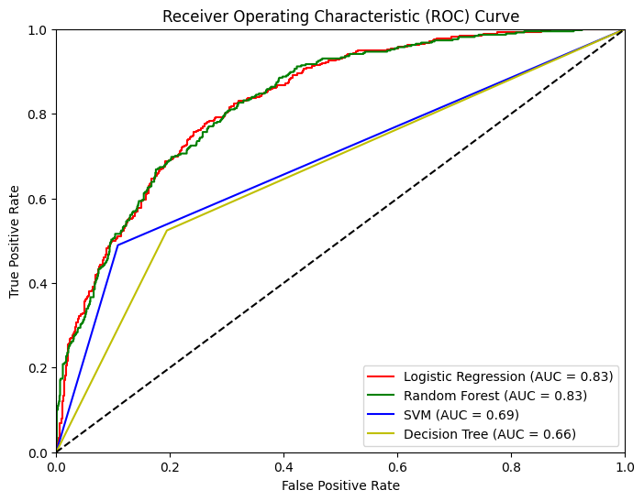
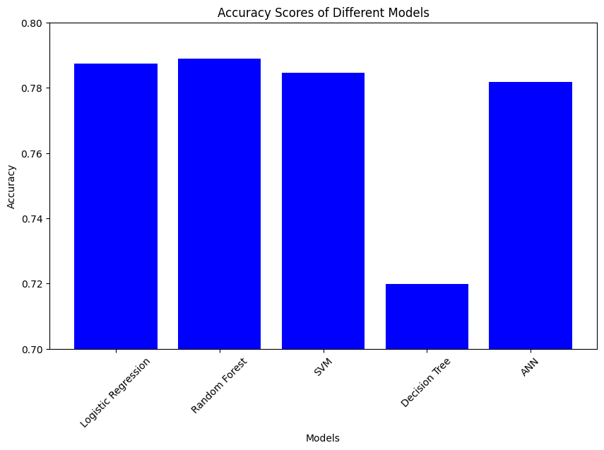
Conclusion
Logistic Regression and the Random Forest models give the highest accuracy out of the 5 models.
In the ROC graph the random forest curve overlaps the logistic regression curve.
According to the ROC graph logistic regression and random forest have the same AUC.

Slide 9
ThankYou

