Slide 1

EC 327 ARCHITECTURE DISCRIPTION
Kevin Chen

Slide 2
GOAL:
The goal of the project was create a website that displayed the major study buildings in Boston University and Give the user information on it’s location and availability by giving a capacity and current population.

Slide 3
Main Coding Infrastructure
The project uses three main platforms for implementation: Html for the front-end webpage, Python in order to handle backend data management and reading, and a database that stored gave out our data. The Data Base Portion was transformed into using an excel file once we discovered that it wouldn’t be feasible to implement the Data from the BU databases like we originally wanted to after meeting with our contact from the BU It department.
Python: The Python application utilizes Classes to store the data and Flask to run and host the server. Then uses openpyxl to read in the Data from The excel sheet.
Excel: Entered our Dummy data into the excel sheet and stored it alongside the python files in our repository
Html: Framework For displaying webpages and images after reading in different variables from our python files

Slide 4
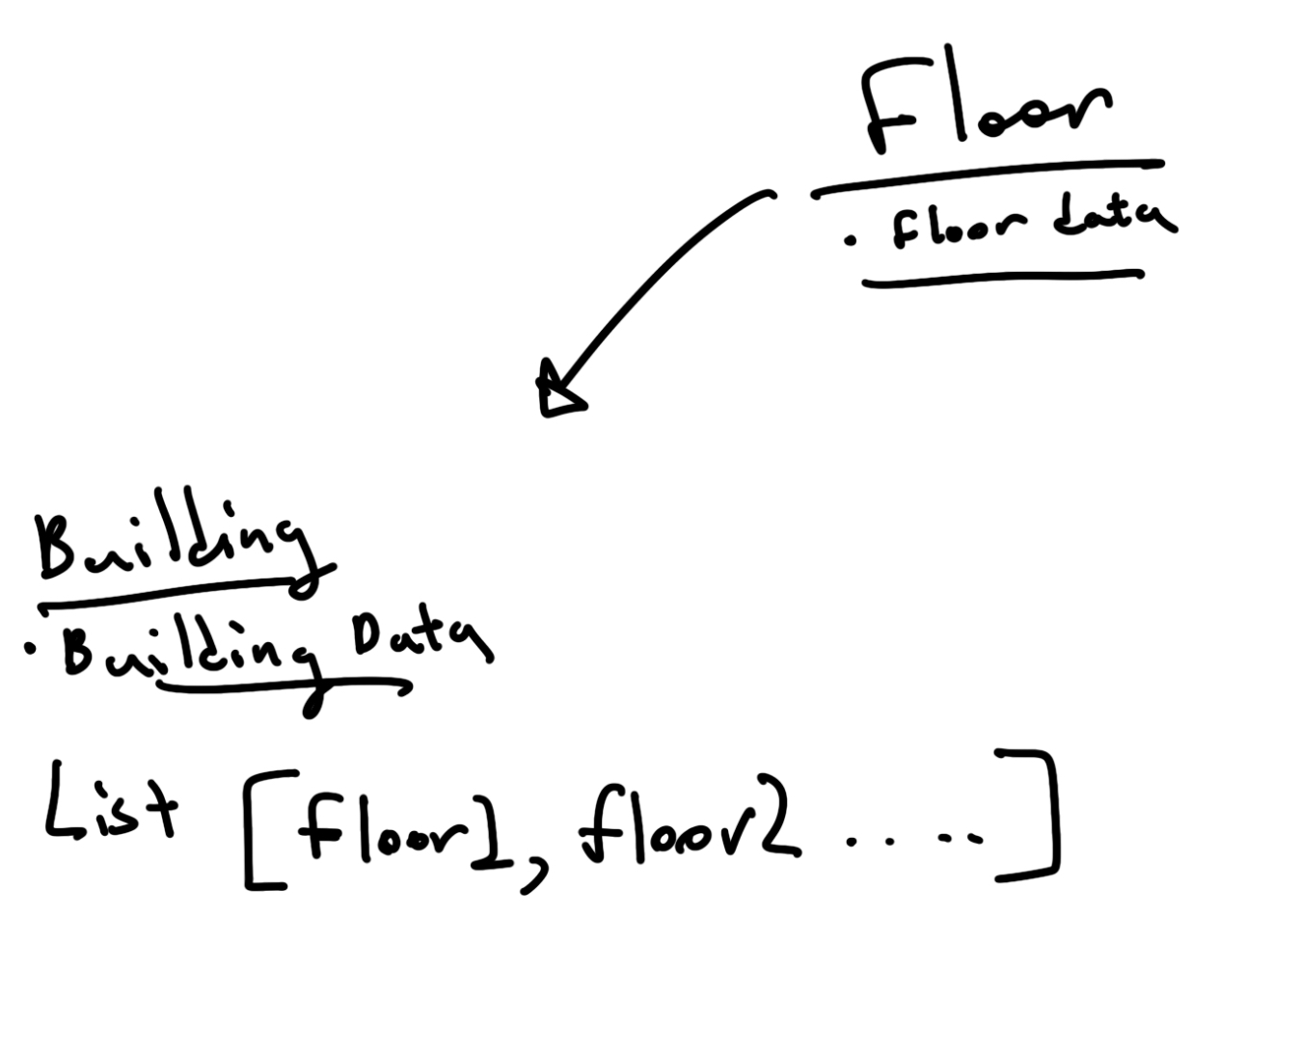
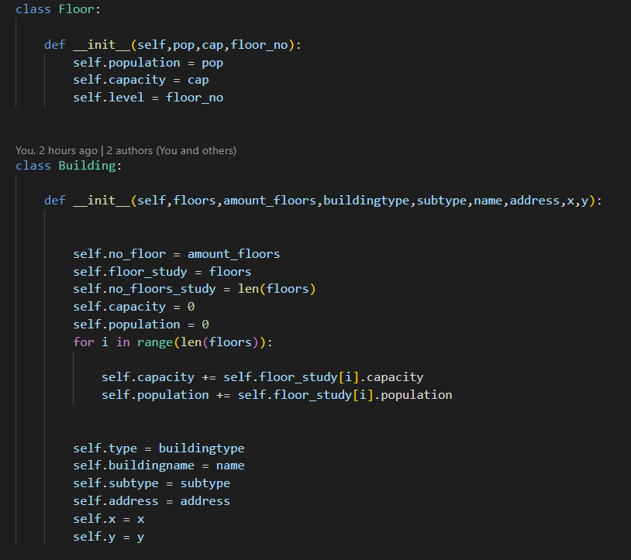
Objects
There are two classes used to store the data: Floor and Building
Floor is representative of each study floor and takes a floor number, population, and capacity.
Building: takes an array of the floors and calculates the total capacity and population from it’s information. It also takes other essential information denoted in the xlsx file.

Slide 5
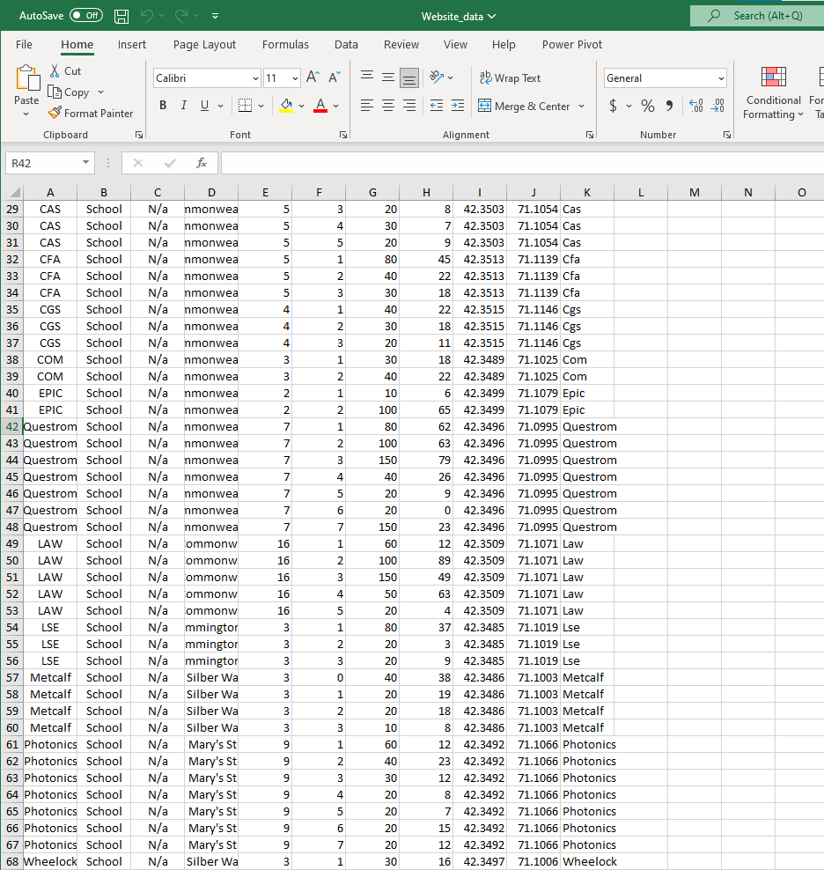
Excel: Data entry and storage
Here in the Excel we entered specifics for each building and the floors in it:
Each entry represented a floor in the building, and had a separate capacity,floor number, and population, but had the Buildingname, Buildingtype, Building Subtype, Address, Variable Name, Number of floors, and Longitude and Latitude.
Originally, Population would be calculated in the data base by reading in the amount of users connected to the wifi of each building but this was scrapped for dummy data once meeting with out connect in the IT department.
This allows for the Update of data and the subsequent display of the Website without actually changing the code.

Slide 6
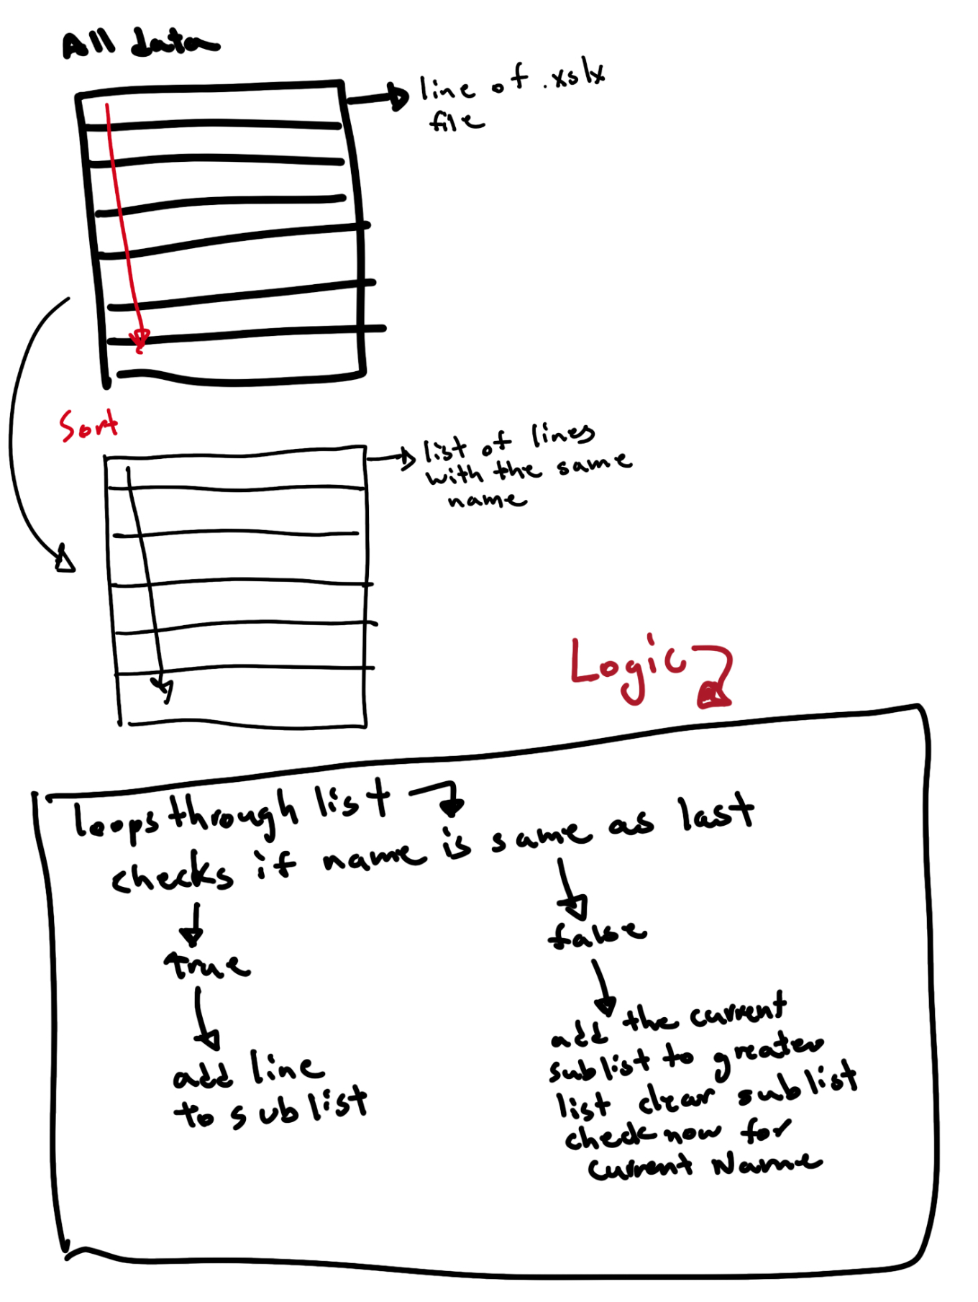
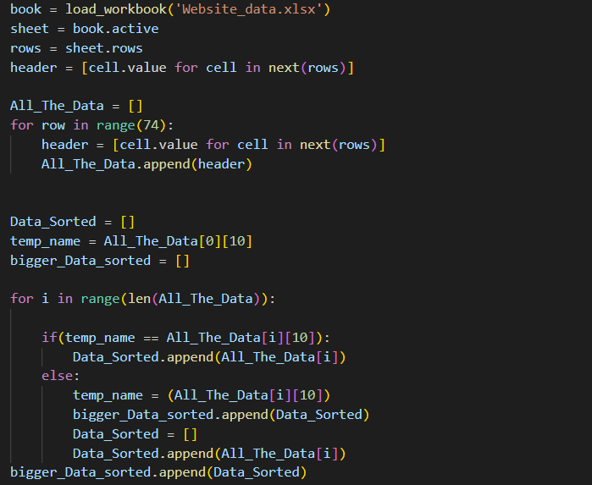
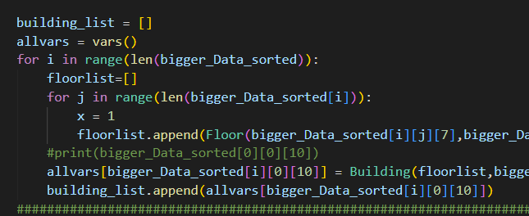
Excel to Python
Here importing the xlsx file using openpyxl created an iterator in Python which is used to create a General Data array that has an array of the data from each row in the file.
The Data is then sorted by building name so each index has an array of floor data.
Then by iterating through the array of arrays we instantiate an array of floors which are then instantiated into Building Objects.
Here the allvars functions dynamically allocates variable names so that each Object didn’t have to be made seperately

Slide 7
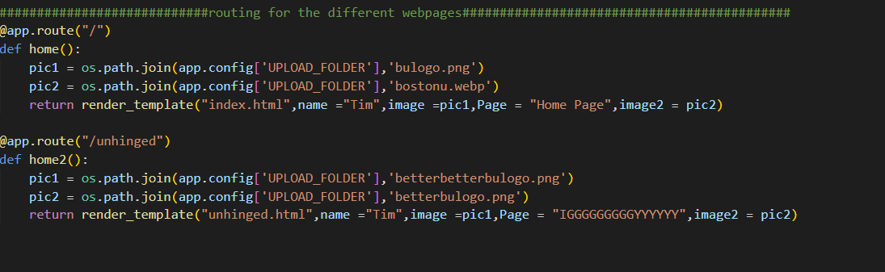
Website Routing
The @app.route(“ ”) in flask acts as a way to implement different webpage endpoints and feeds variables and images into an html file

Slide 8
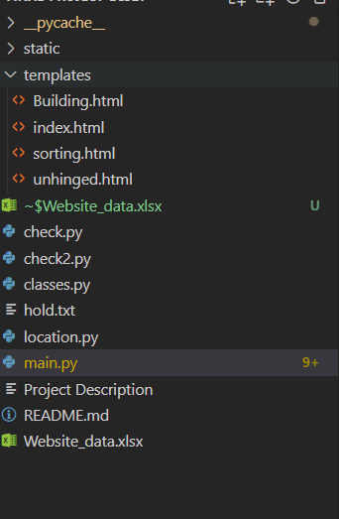
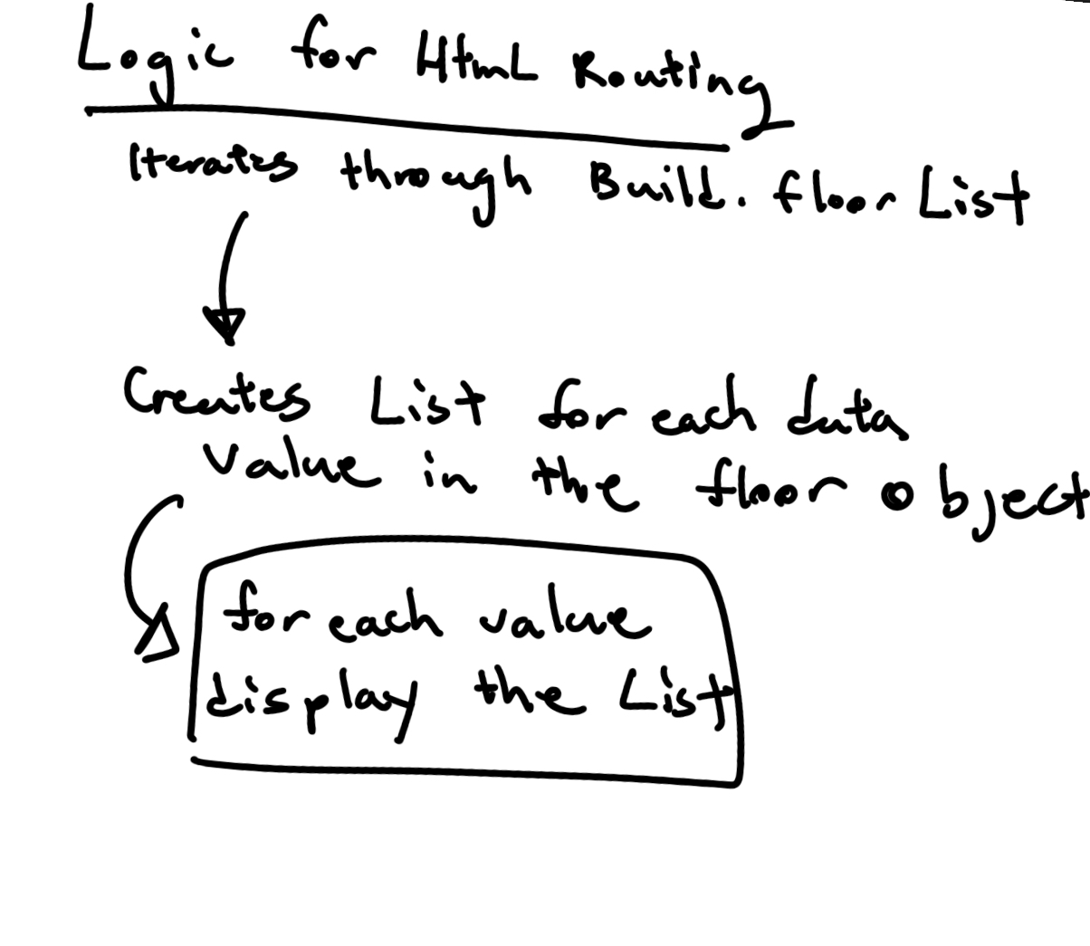
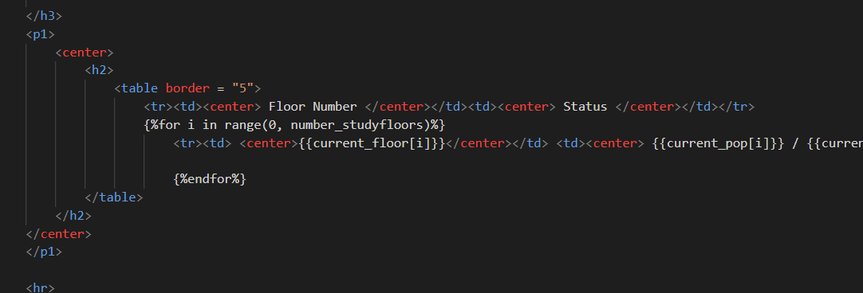
HTML
Stored in the Templates Directory, The Flask code previously described read in html files for each webpage.
In order to generalize our Html File for each Building webpage utilized a for loop and fed lists into the File to account for the varying amount of floors in each Building.

Slide 9
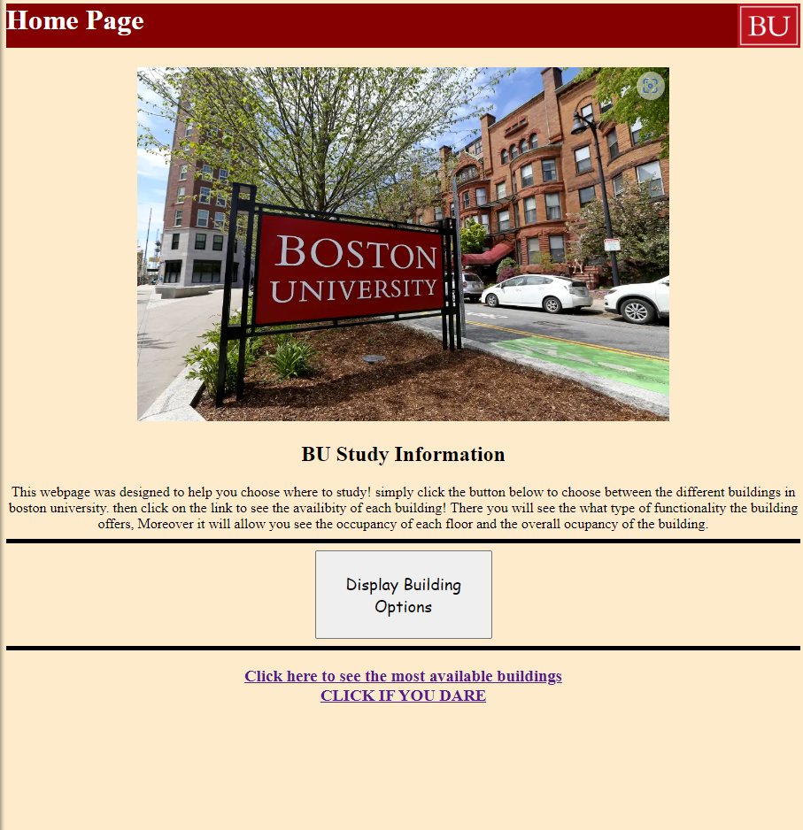
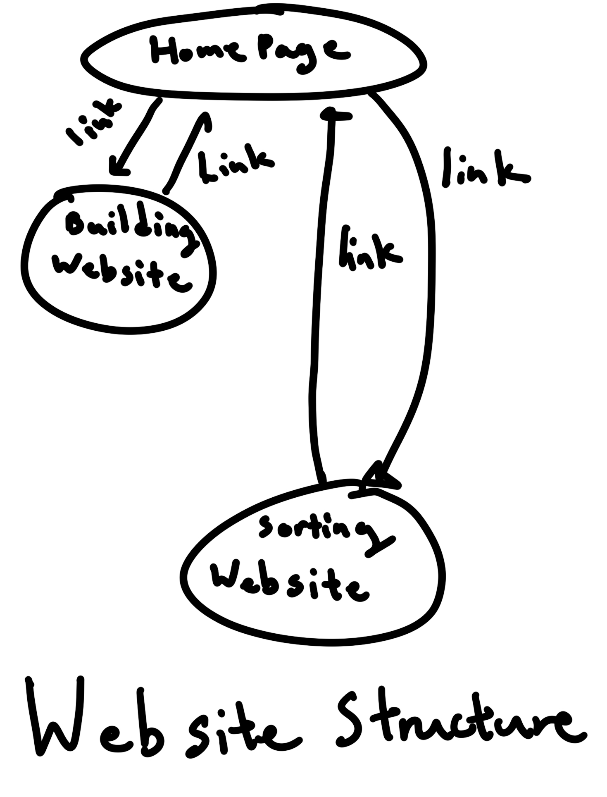
Website
Ultimately, Once running the Application using:
flask –app main run
And then clicking the link you are then sent to Our home page and able to navigate around to each building.

Slide 10
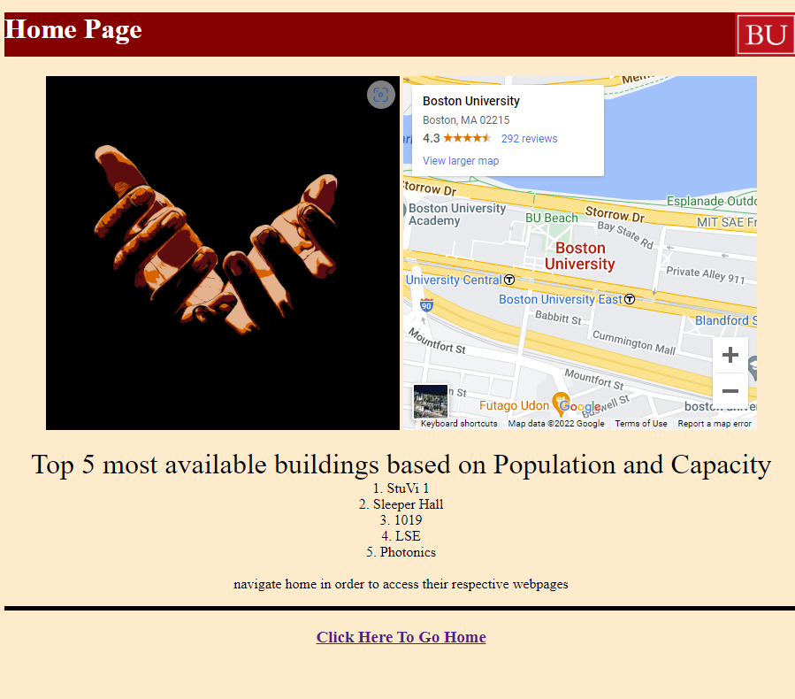
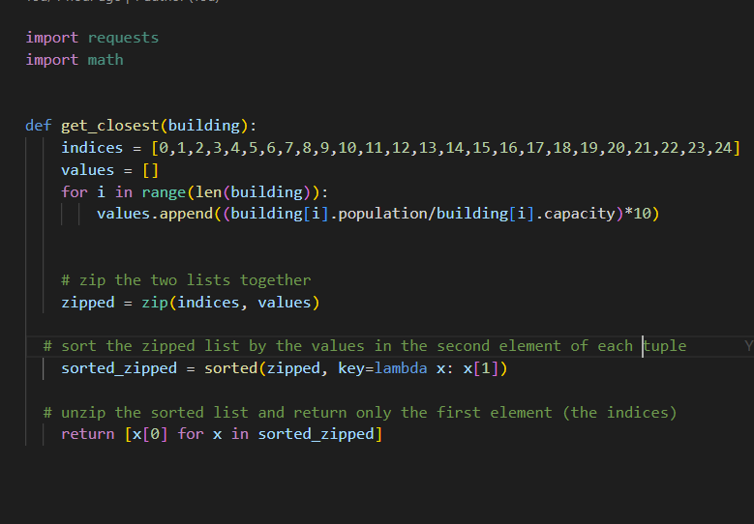
Added functionalities
We also implemented a Function that implemented a sorting of the occupancy of each building and returned the buildings that where currently most available. This used the sorted functionality in python to return an array of indices corresponding to a list of the objects.

