Slide 1

Seasonal Agriculture Performance Analysis
Sourav
Hindu College of Engineering
AICTE STU ID: STU682734490127a1747399753

Slide 2

PROBLEM STATEMENT
Agricultural activities are influenced by seasonal variations in environmental conditions, farming practices, resource availability and market conditions. As a result, agricultural performance may differ from one season to another. However, raw agricultural data does not clearly explain how agricultural performance changes across seasons or what patterns can be observed in different seasonal conditions. The problem is to analyze the given agricultural dataset and investigate seasonal differences in agricultural performance by identifying meaningful patterns, trends, relationships and variations within the available data.

Slide 3
Project Description
This project analyzes a farm-level agricultural dataset covering 8 Indian states, 8 crops and three growing seasons – Kharif, Rabi and Zaid – to understand how agricultural performance changes across seasons and what patterns explain those differences. It is a pure data analytics project (no Machine Learning), carried out end-to-end in Python on Google Colab.
Cleaned and prepared the raw dataset – handled missing values with justified median imputation, checked for duplicate records and verified data types.
Performed descriptive statistics, IQR-based outlier detection, and univariate, bivariate and multivariate analysis on the cleaned data.
Investigated correlations between environmental conditions, resource usage and economic outcomes such as yield and profit.
Compared yield, profit and resource efficiency across Kharif, Rabi and Zaid to identify the strongest and weakest seasons.
Carried out four independent student-designed analyses: irrigation method efficiency, crop profitability, state-wise seasonal profitability and disease/pest risk vs yield.
Delivered 10 evidence-based insights and data-driven recommendations to support better seasonal agricultural planning.

Slide 4

WHO ARE THE END USERS?
Farmers and agricultural cooperatives – to plan crop, irrigation and input choices season-wise.
State agriculture departments and policymakers – for evidence-based seasonal agricultural planning.
Agri-tech and precision farming companies – to fine-tune irrigation and resource-efficiency products.
Agricultural researchers and extension officers – to study seasonal performance patterns further.
Banks, crop insurers and microfinance providers – to assess seasonal risk for lending and insurance.
Agri-input suppliers and market/mandi bodies – to align supply with seasonal profitability trends.

Slide 5

Technology Used
Programming Language: Python
Data Handling: Pandas, NumPy
Visualization: Matplotlib, Seaborn
Development Environment: Google Colab / Jupyter Notebook
Version Control & Hosting: Git, GitHub

Slide 6
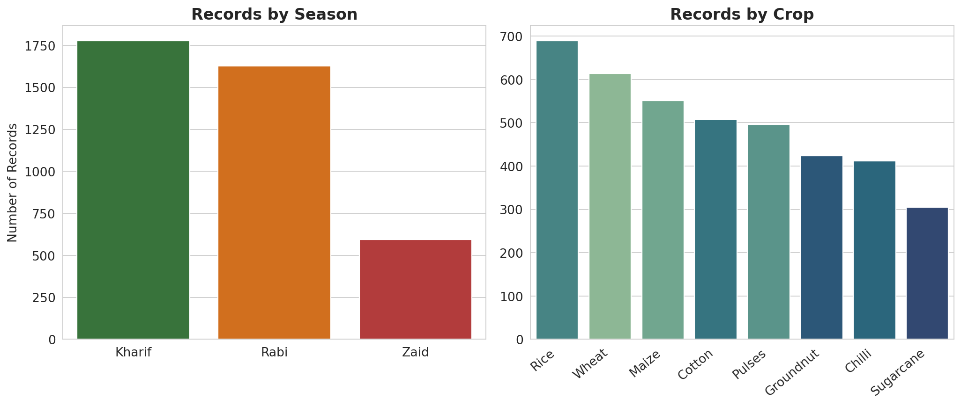
RESULTS
Distribution of Records: Season and Crop

Slide 7
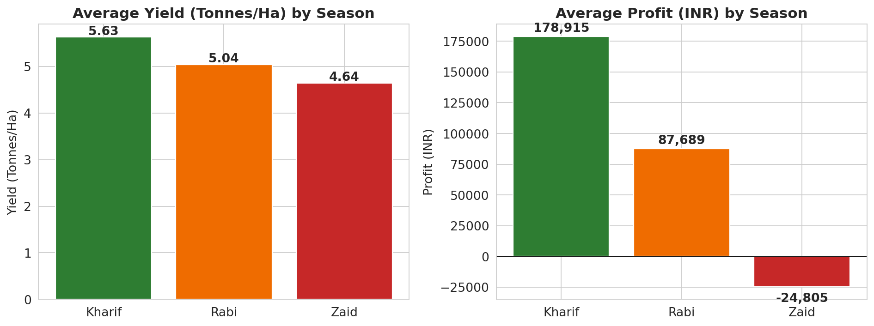
RESULTS
Seasonal Yield & Profit Comparison

Slide 8
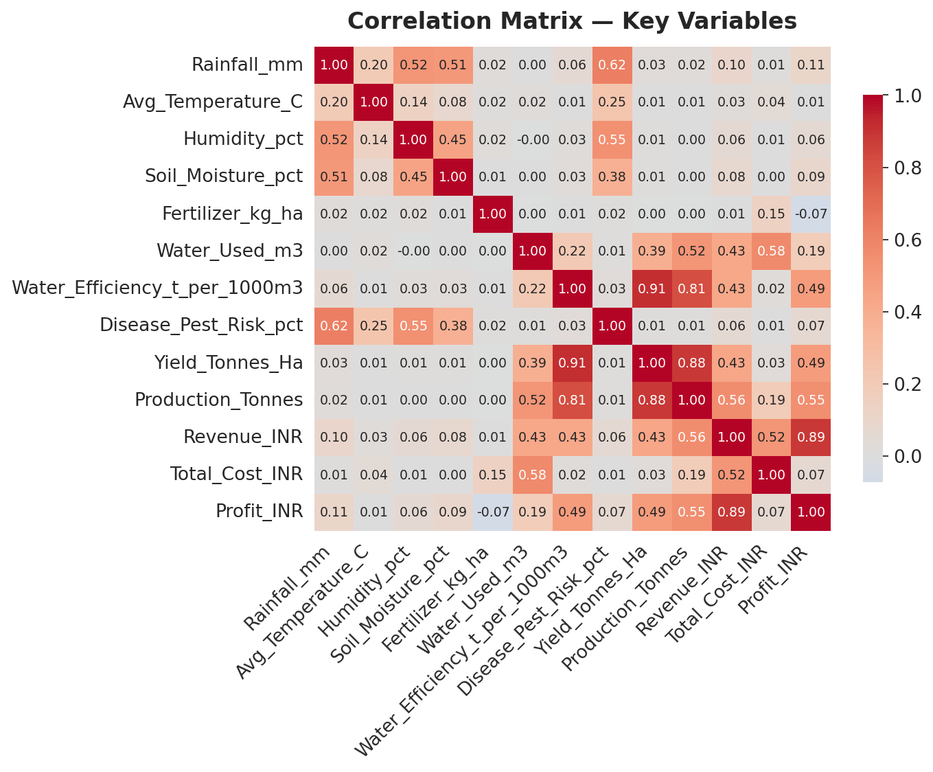
RESULTS
Correlation Analysis of Key Variables

Slide 9
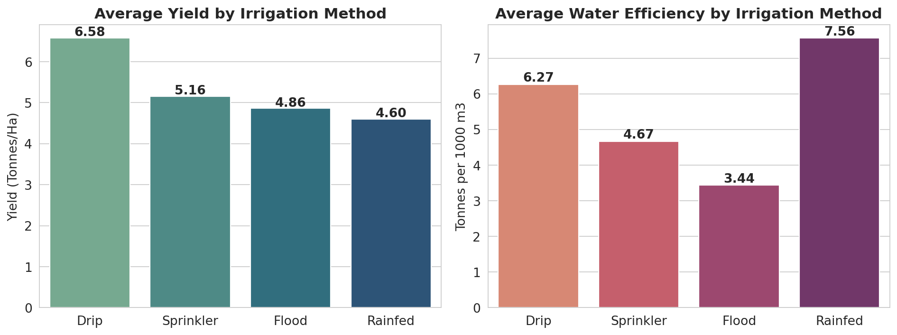
RESULTS
Irrigation Method: Yield & Water Efficiency

Slide 10
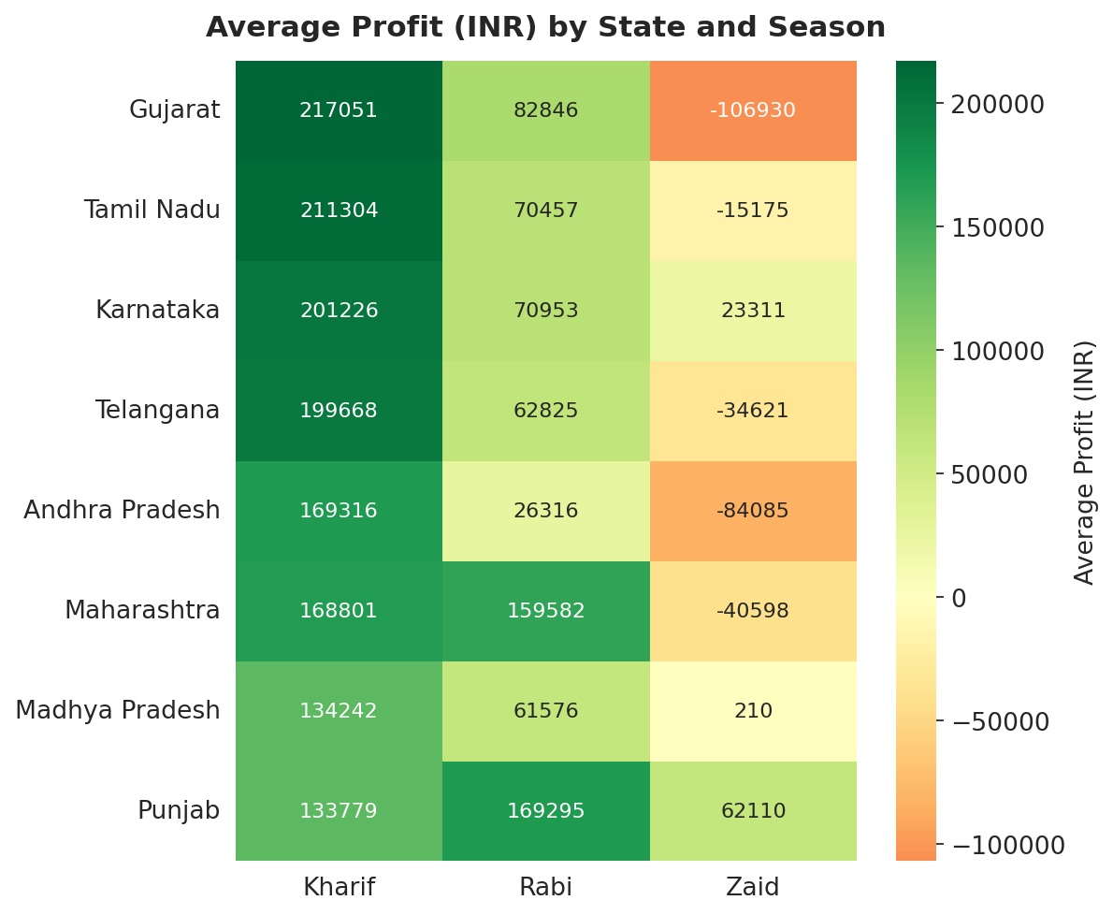
RESULTS
State-wise Profitability Across Seasons

Slide 11
Future scope
Extend the dataset to a multi-year time series to study year-on-year seasonal trends rather than a single-year snapshot.
Build an interactive dashboard (e.g. Power BI / Tableau) for real-time seasonal performance monitoring.
Incorporate weather forecast data to move from descriptive analysis toward predictive seasonal planning.
Expand coverage to more states, crops and irrigation methods for broader generalizability of the findings.
Investigate the disease/pest risk metric further with more granular, crop-specific data to explain its weak link with yield.

Slide 12
GitHub Link

Slide 13

VOIS Course completion certificate -
Course name- Data Visualization

Slide 14
Thank you
.
.

