Slide 1

Seasonal Agriculture Performance Analysis
Sourav
Hindu College of Engineering
AICTE STU ID: STU682734490127a1747399753

Slide 2

PROBLEM STATEMENT
Agricultural activities are influenced by seasonal variations in environmental conditions, farming practices, resource availability and market conditions. As a result, agricultural performance may differ from one season to another. However, raw agricultural data does not clearly explain how agricultural performance changes across seasons or what patterns can be observed in different seasonal conditions. The problem is to analyze the given agricultural dataset and investigate seasonal differences in agricultural performance by identifying meaningful patterns, trends, relationships and variations within the available data.

Slide 3
Project Description
This project analyzes a farm-level agricultural dataset covering 8 Indian states, 8 crops and three growing seasons – Kharif, Rabi and Zaid – to understand how agricultural performance changes across seasons and what patterns explain those differences. It is a pure data analytics project (no Machine Learning), carried out end-to-end in Python on Google Colab.
Cleaned and prepared the raw dataset – handled missing values with justified median imputation, checked for duplicate records and verified data types.
Performed descriptive statistics, IQR-based outlier detection, and univariate, bivariate and multivariate analysis on the cleaned data.
Investigated correlations between environmental conditions, resource usage and economic outcomes such as yield and profit.
Compared yield, profit and resource efficiency across Kharif, Rabi and Zaid to identify the strongest and weakest seasons.
Carried out four independent student-designed analyses: irrigation method efficiency, crop profitability, state-wise seasonal profitability and disease/pest risk vs yield.
Delivered 10 evidence-based insights and data-driven recommendations to support better seasonal agricultural planning.

Slide 4

WHO ARE THE END USERS?
Farmers and agricultural cooperatives – to plan crop, irrigation and input choices season-wise.
State agriculture departments and policymakers – for evidence-based seasonal agricultural planning.
Agri-tech and precision farming companies – to fine-tune irrigation and resource-efficiency products.
Agricultural researchers and extension officers – to study seasonal performance patterns further.
Banks, crop insurers and microfinance providers – to assess seasonal risk for lending and insurance.
Agri-input suppliers and market/mandi bodies – to align supply with seasonal profitability trends.

Slide 5

Technology Used
Programming Language: Python
Data Handling: Pandas, NumPy
Visualization: Matplotlib, Seaborn
Development Environment: Google Colab / Jupyter Notebook
Version Control & Hosting: Git, GitHub

Slide 6
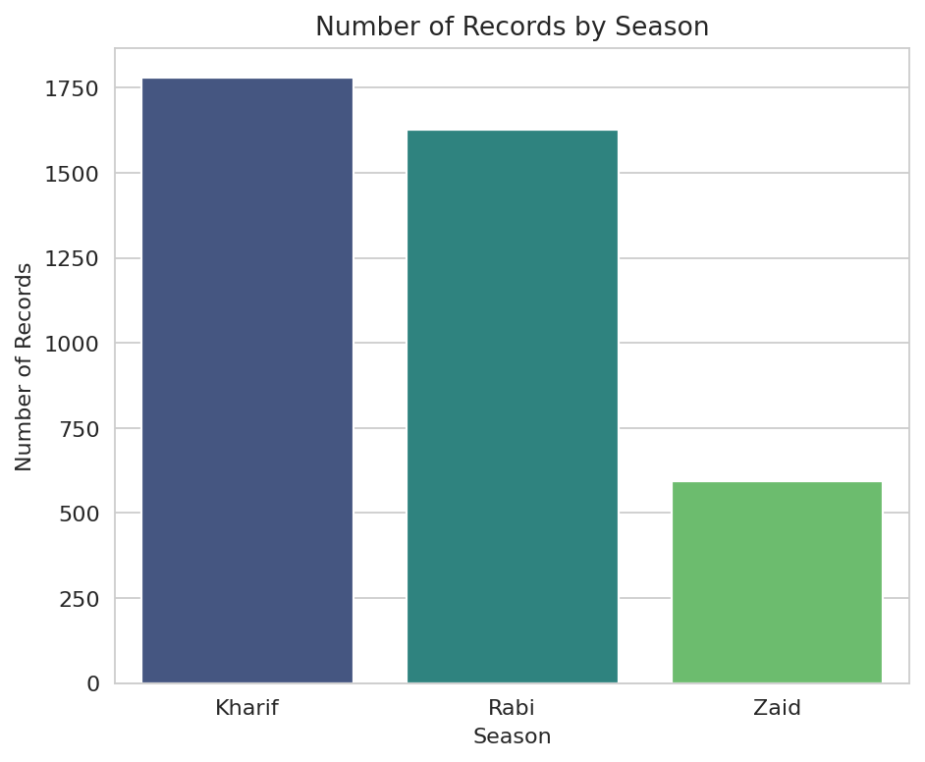
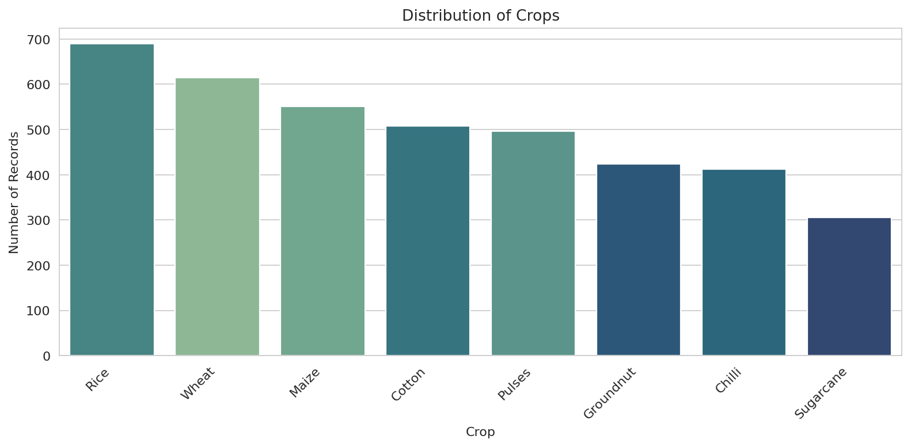
RESULTS
Distribution of Records: Season and Crop
Takeaway: Kharif and Rabi dominate the sample, and all 8 crops are well represented across seasons — a broad enough base for reliable seasonal comparisons.

Slide 7
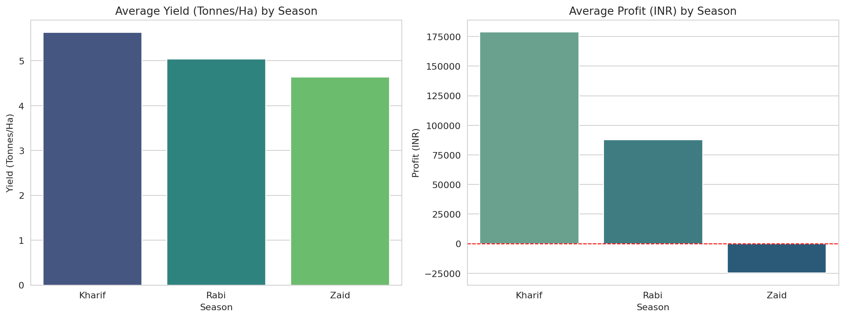
RESULTS
Seasonal Yield & Profit Comparison
Takeaway: Kharif delivers both the highest yield and the only positive average profit; Zaid is the weakest season on both counts.

Slide 8
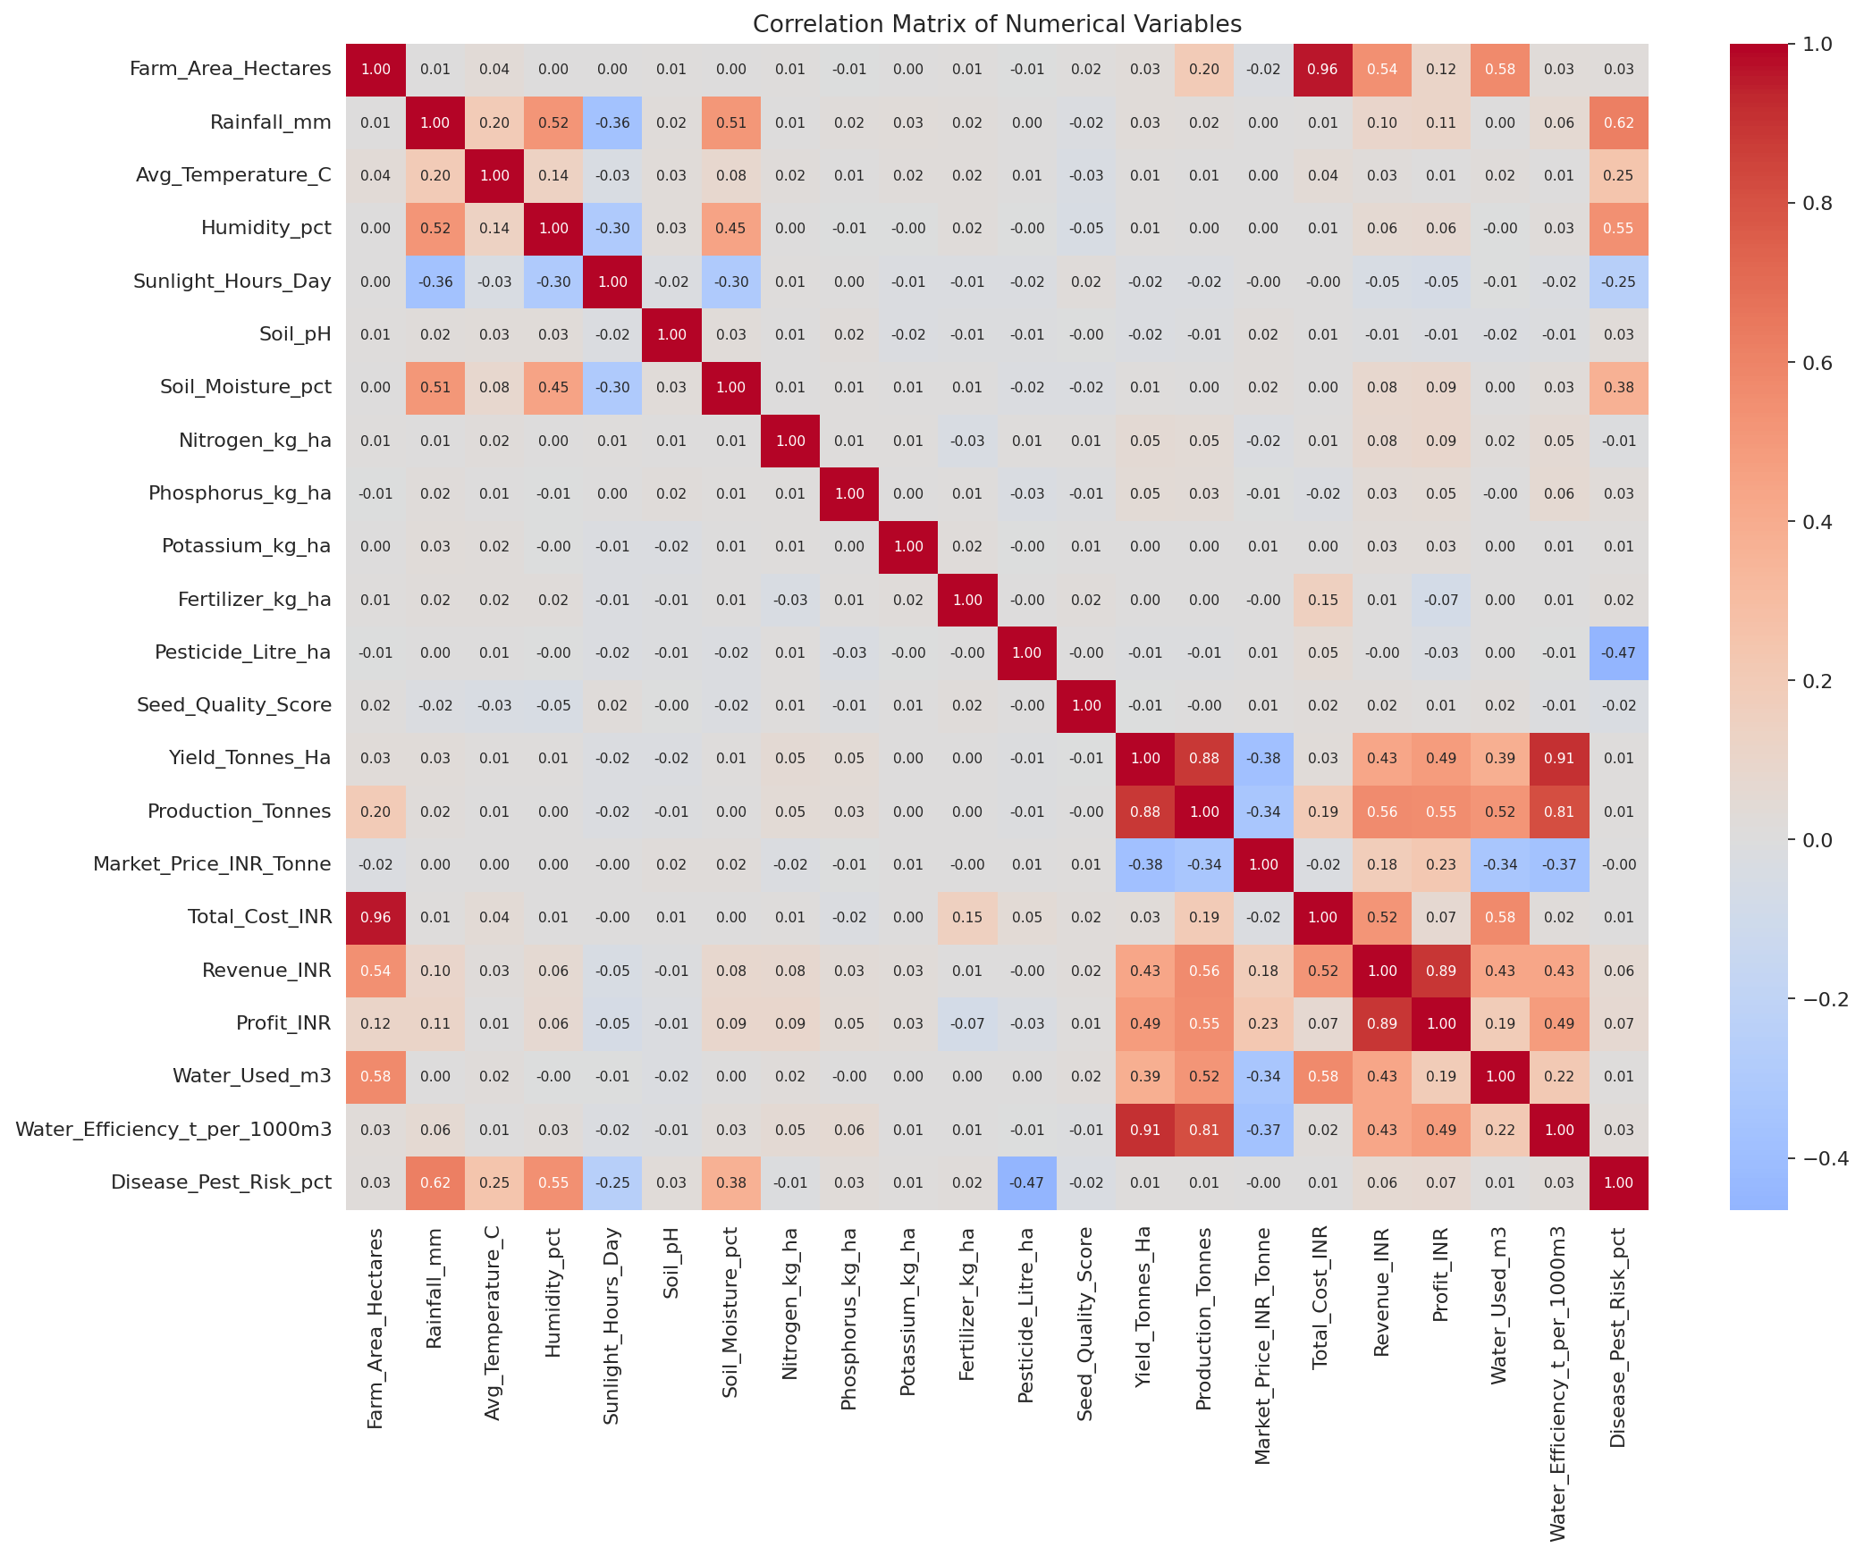
RESULTS
Correlation Analysis of Key Variables
Takeaway: Water-use efficiency has the strongest link to yield (r ≈ 0.92) — far more than rainfall or fertilizer — so efficient water use, not raw input, drives output.

Slide 9
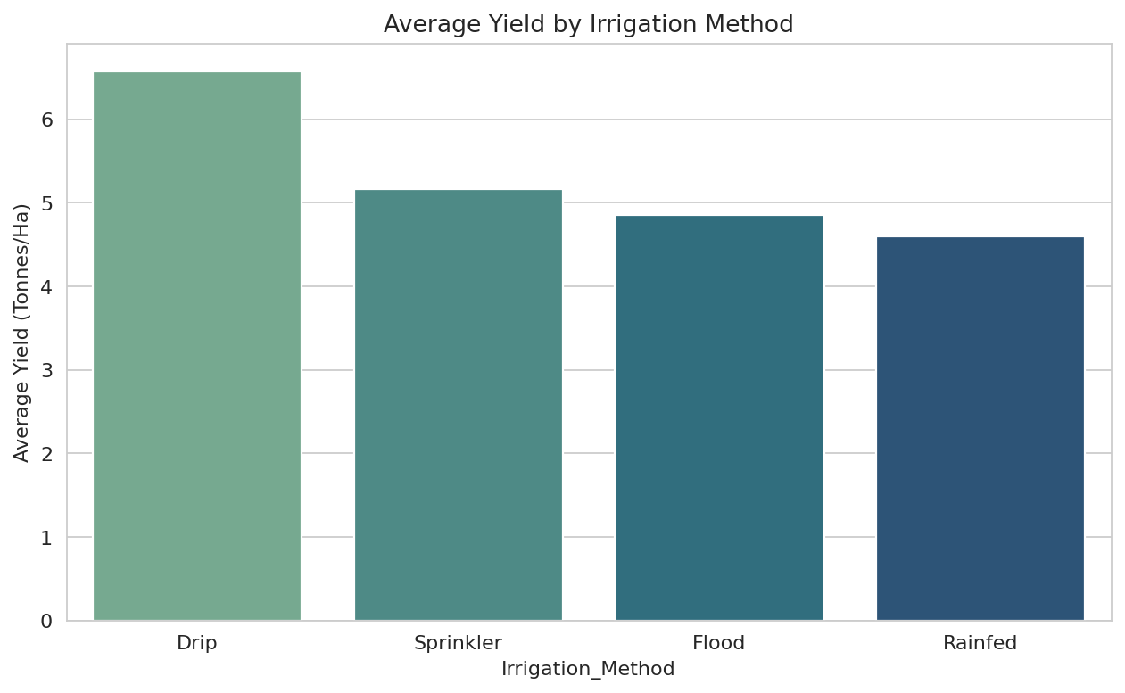
RESULTS
Irrigation Method: Average Yield
Takeaway: Drip irrigation consistently out-yields every other method, suggesting irrigation upgrades could lift output regardless of season.

Slide 10
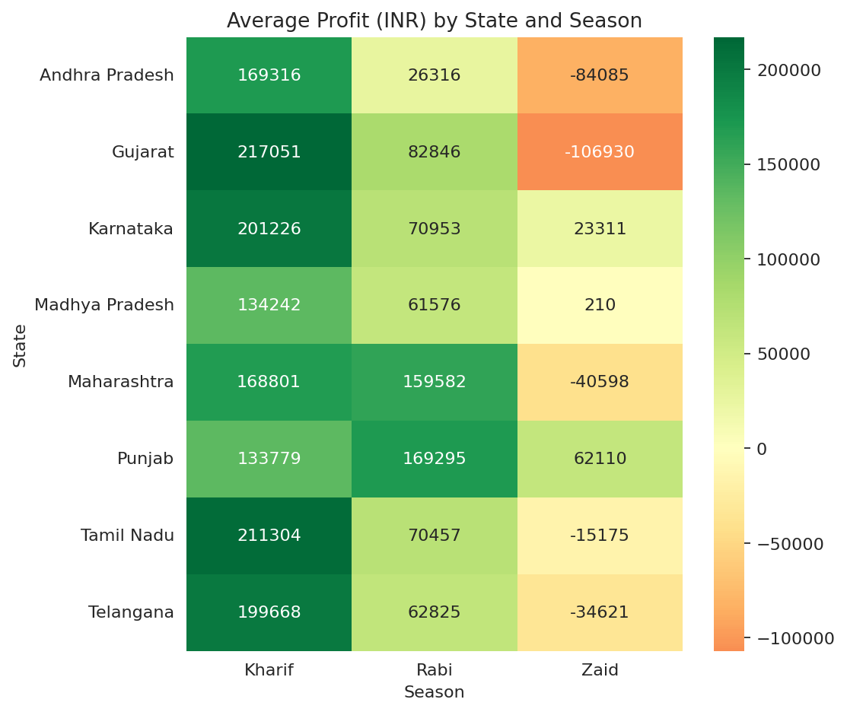
RESULTS
State-wise Profitability Across Seasons
Takeaway: Every state's weakest season is Zaid — Punjab is the only state that stays profitable across all three seasons.

Slide 11
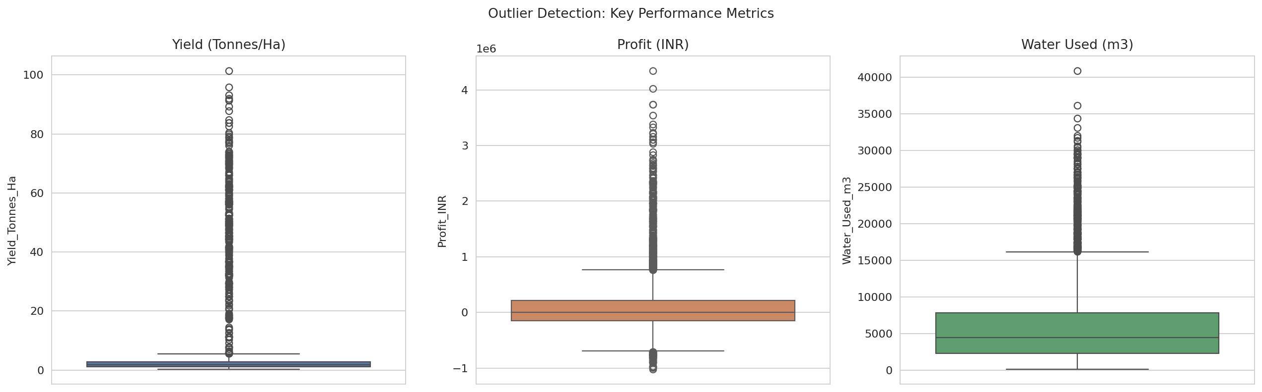
RESULTS
Outlier Detection Across Key Metrics
Takeaway: Yield and Profit are heavily right-skewed by a handful of extreme farms — this is why median (not mean) was used to fill missing values.

Slide 12
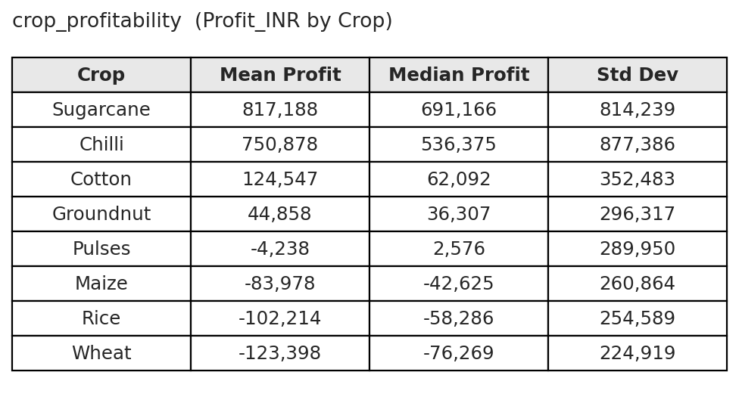
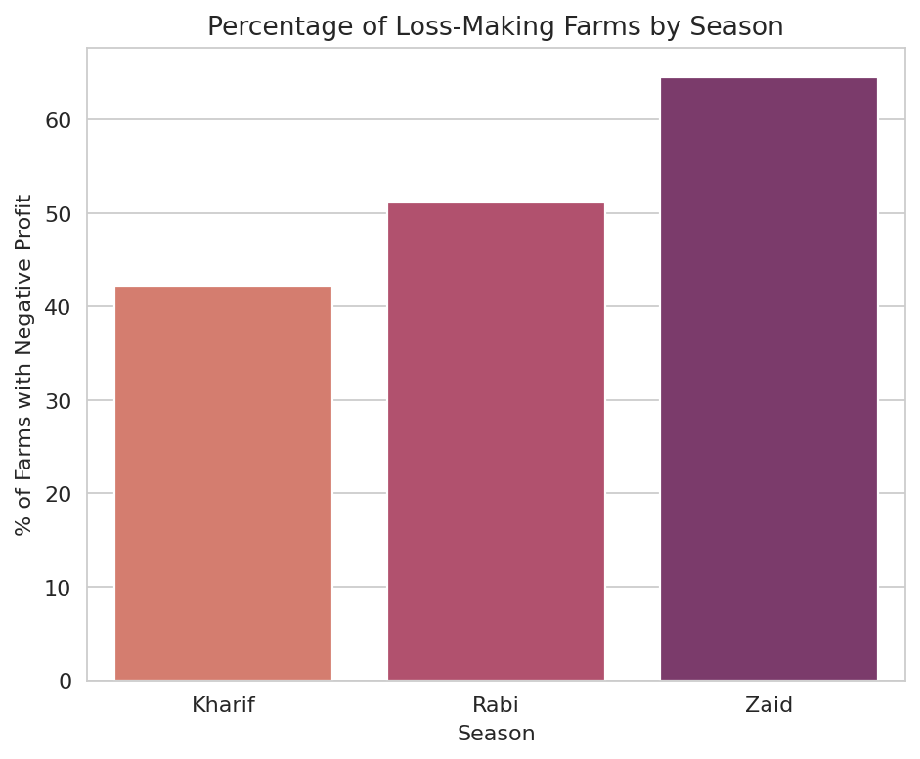
RESULTS
Crop Profitability & Seasonal Loss Trends
Takeaway: Sugarcane and Chilli stay profitable in every season while Wheat, Rice and Maize average losses — and loss-making farms nearly triple from Kharif (42.2%) to Zaid (64.5%).

Slide 13
Key Findings
Kharif is the strongest season – highest average yield (5.64 t/ha) and the only season with a positive average profit (₹1.79 lakh).
Zaid is the weakest and riskiest – negative average profit (-₹24.8k) with 64.5% of farms operating at a loss.
Water-use efficiency drives yield – far more than rainfall (r ≈ 0.92 vs. a much weaker rainfall link).
Drip irrigation performs best – it delivers the highest average yield (6.62 t/ha) of any irrigation method.
Crop choice matters – Sugarcane and Chilli stay profitable every season; Wheat, Rice and Maize show average losses.
The Zaid slump is state-wide – every state's lowest seasonal profit occurs in Zaid, except Punjab.
Disease/pest risk barely matters – it shows almost no correlation with yield (r ≈ 0.01).
Profit follows revenue, not just yield – profit tracks revenue and production volume more closely than yield alone.

Slide 14
Future scope
Extend the dataset to a multi-year time series to study year-on-year seasonal trends rather than a single-year snapshot.
Build an interactive dashboard (e.g. Power BI / Tableau) for real-time seasonal performance monitoring.
Incorporate weather forecast data to move from descriptive analysis toward predictive seasonal planning.
Expand coverage to more states, crops and irrigation methods for broader generalizability of the findings.
Investigate the disease/pest risk metric further with more granular, crop-specific data to explain its weak link with yield.

Slide 15
GitHub Link
https://github.com/Sourav180410/Seasonal_Agriculture_Performance_Analysis_Sour.git

Slide 16

VOIS Course completion certificate -
Course name- Data Visualization

Slide 17
Thank you
.
.

