Slide 1


Data Structure & Algorithms (PCC-CS301)
Lecture 3
Dr. Dipak Kumar Kole
Associate Professor, Dept. of CSE, JGEC
Email: dipak.kole@cse.jgec.ac.in

Slide 2
ASYMPTOTIC NOTATIONS
Outline of Lecture 3:
Formal Definition of Individual Asymptotic Notation
Geometrical Interpretation of each Asymptotic Notation
Examples to understand the corresponding notation
Properties of Big Oh Asymptotic Notation
Calculation of Big Oh of an Algorithm

Slide 3
Contents
What is an asymptote?
What do you mean by the run time T_{A}(n) of an algorithm?
Why we need to know asymptotic behavior for analyzing an algorithm?
What are the different types of asymptotic notations?
Big Oh: An Asymptotic Upper Bound
Definition
Geometrical Interpretation
Examples
Properties
How Big Oh help us to calculate the time complexity of an algorithm?

Slide 4
Contents (Contd…)
Small oh: An Asymptotic Loose upper bound
Definition
Geometrical Interpretation
Examples
Big -Omega: An Asymptotic Lower Bound
Definition
Geometrical Interpretation
Examples
Small -omega: An Asymptotic lose Lower Bound
Definition
Geometrical Interpretation
Examples
Theta Notation
Definition
Geometrical Interpretation
Examples

Slide 5

What is an asymptote?
Definition
Consider a curve say $y = 1 / x$
x | 1 | 2 | 3 | 4 | 5 | …… | 100 | 1000 | 10000
y | 1 | 0.5 | 0.33 | 0.25 | 0.2 | ……. | 0.01 | 0.001 | 0.0001
x=1
y=1
x=2
y=0.5
y
x=100
y=0.01
x

Slide 6
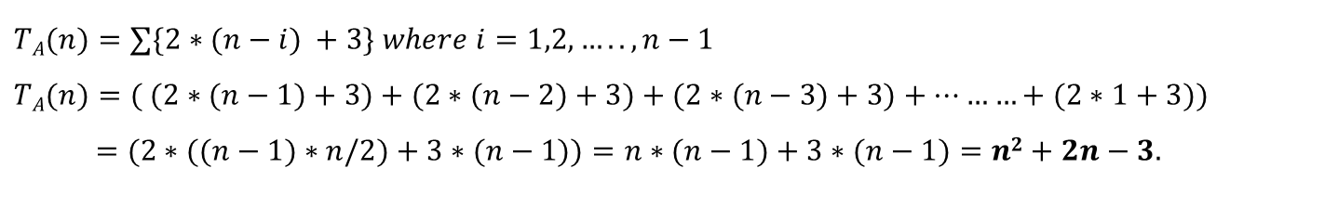
Calculation of Run time T_{A}(n) of an Algorithm
Selection SelectionSort(A)
For I = 1 to n-1 do:
Smallsub = I
For J = I + 1 to n do:
If A(J) < A(Smallsub)
Smallsub = J
End-If
End-For
Temp = A(I)
A(I) = A(Smallsub)
A(Smallsub) = Temp
End-For
(n-i) times
3
(n-1) times
$$TA(n)=∑\{2∗(n−i) +3\} where i=1,2,…..,n−1$$
$$TA(n)=( (2∗(n−1)+3)+(2∗(n−2)+3)+(2∗(n−3)+3)+………+(2∗1+3))$$
$$=(2∗((n−1)∗n/2)+3∗(n−1))=n∗(n−1)+3∗(n−1)=n2+2n−3.$$

Slide 7
Calculation of Run time T_{A}(n) of an Algorithm: Assumption involved
All operations have been considered as taking same time.
Time taken by a particular instruction depends on the architecture.
For example, multiplication operation takes longer than addition operation.

Slide 8
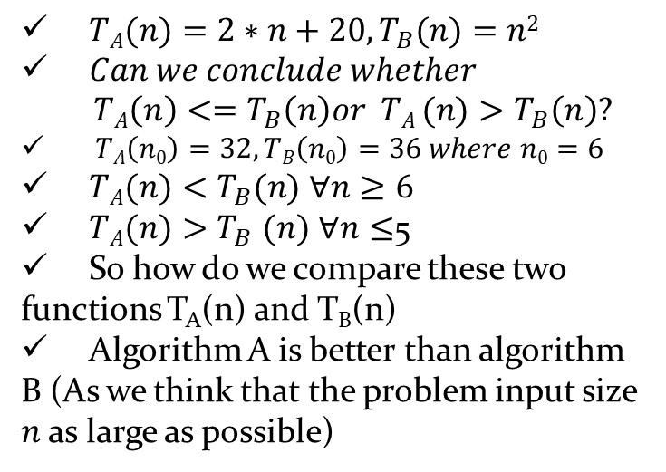
Why do we need to know asymptotic behavior for analyzing an algorithm?
A given problem
Algorithm A
Algorithm B
T_{A}(n)
T_{B}(n)
Compare the two functions and determine which algorithm is the best.
T_{A}(n₀)<T_{B}(n₀) where n₀ denotes the known problem size.
No prior knowledge of the problem size.
T_{A}(n)<=T_{B}(n), for all n>0
One of the functions is less than or equal to the other over the entire range of problem sizes.
$TA(n)=2∗n+20, T_{B}(n)=n2$
$Can we conclude whether$
$$TA\left(n\right)<=T_{B}\left(n\right)or TA (n)>T_{B}\left(n\right)?$$
$TA\left(n0\right)=32, TB\left(n0\right)=36 where n0=6$
$TA(n)<T_{B}(n)$ $∀n≥6$
$TA(n){>T}_{B}(n)$ $∀n≤$5
So how do we compare these two functions T_{A}(n) and T_{B}(n)
Algorithm A is better than algorithm B (As we think that the problem input size $n$ as large as possible)
Notes:
8

Slide 9
What are the different types of asymptotic notations?
Big Oh ( O)
Small oh (o)
Big Omega (Ω)
Small omega (ω)
Theta(Θ)

Slide 10
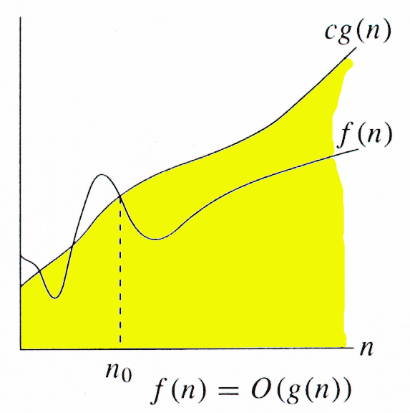

Big Oh Notation
We write f(n)=O(g(n)).
g(n) is an asymptotic upper bound for f(n).
f(n)=O(g(n)) iff
where l is finite.
O(g(n)) = {f(n) : ∃ positive constants c and positive integer n_{0,} such that ∀n ≥ n₀, we have 0 ≤ f(n) ≤ cg(n) }

Slide 11
Example of Asymptotic Upper Bound
f(n)=3n²+5
4 g(n) = 4n²
= 3n² + n²
≥ 3n² + 9 for all n ≥ 3
> 3n² + 5
= f(n)
Thus, f(n)=O(g(n)).
4g(n)=4n²
f(n)=3n²+5
g(n)=n²
3

Slide 12


Loose and Tight Upper Bounds
The upper bound given by Big Oh may be lose or tight upper bound:
f(n)=3n²+5
g(n)=n²
g(n)=n⁴
Tight Upper bound
Loose Upper bound

Slide 13
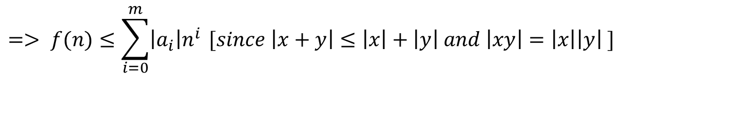

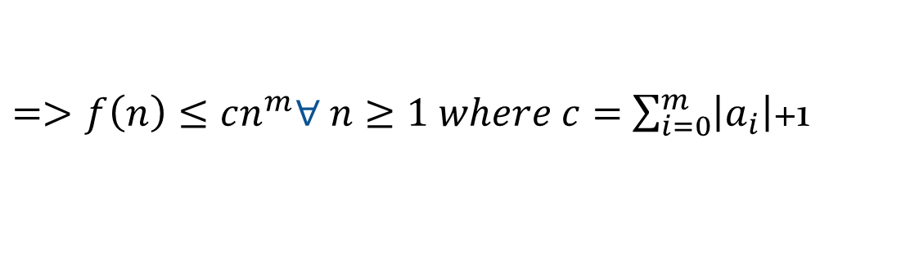
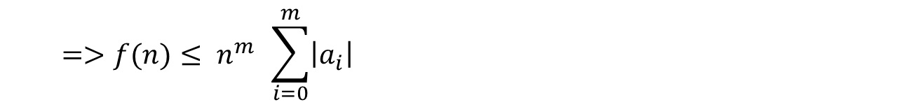
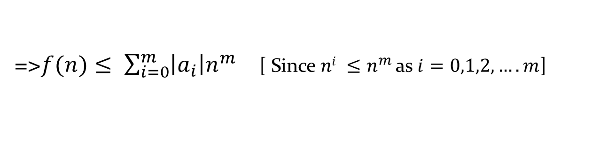
Properties of Big Oh
Property 1
If $f(n)$=$a_{m}n^{m}+a_{m−1}n^{m−1}$+ $…+a_{1}n+a_{0}$, Then $f(n)=O(n^{m})$
$f(n)$=$a_{m}n^{m}+a_{m−1}n^{m−1}$+ $…+a_{1}n+a_{0}$
Proof:
$$=> f(n)≤\sum_{i=0}^{m}{\left|a_{i}\right|n^{i }}[since \left|x+y\right|≤\left|x\right|+\left|y\right| and \left|xy\right|=\left|x\right|\left|y\right| ]$$
=>$f(n)≤ \sum_{i=0}^{m}{\left|a_{i}\right|n^{m }}$ [ Since $ni ≤n^{m }$as $i=0,1,2,….m$]
$$=>f(n)≤ n^{m } \sum_{i=0}^{m}{\left|a_{i}\right|}$$
$=>f\left(n\right)≤cn^{m}∀ n≥1 where c=$ $\sum_{i=0}^{m}{\left|a_{i}\right|}$+1
$$=>f(n)=O(n^{m})$$
So, the Big Oh of a polynomial function is the highest power of the variable in the function.

Slide 14
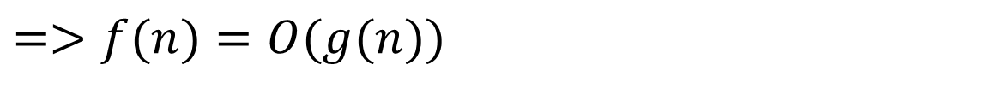
Properties of Big Oh (contd.)
Property 2
$$If f\left(n\right)=c1g\left(n\right), then f(n)=O(g(n))$$
Proof: $f(n)= c1g(n)$
$$=> |f(n)|=|c1g(n)|$$
$$=>|f(n)|≤ c |g(n)| where n≥1 and c=(|c1|+1)$$
$$=>f(n)=O(g(n))$$

Slide 15
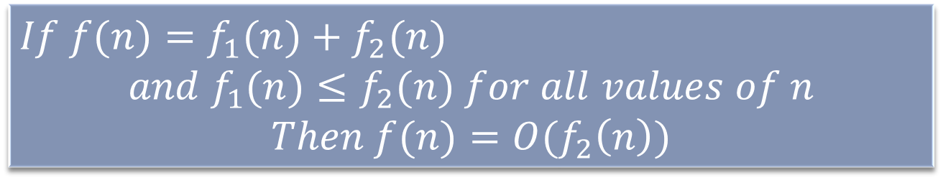
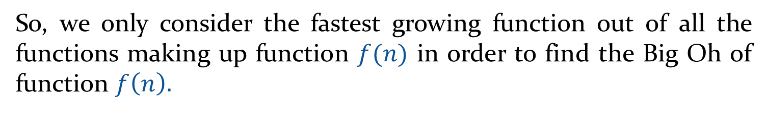
Properties of Big Oh(contd.)
Property 3
$$If f(n)=f_{1}(n)+f_{2}(n)$$
$$and f_{1}(n)≤f_{2}(n) for all values of n$$
$$Then f(n)=O(f_{2}\left(n\right))$$
Proof: $f(n)=f_{1}(n)+f_{2}(n)$
$$⇒f\left(n\right)≤f_{2}\left(n\right)+f_{2}\left(n\right) ∀n$$
$$⇒f\left(n\right)≤2f_{2}\left(n\right) ∀n$$
$$⇒f\left(n\right)=O(f_{2}\left(n\right)) ∀n$$
So, we only consider the fastest growing function out of all the functions making up function $f(n)$ in order to find the Big Oh of function $f\left(n\right).$

Slide 16
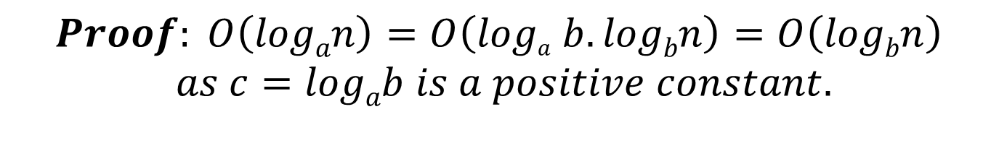

Properties of Big Oh(contd.)
Property 4
Prove that $O(logan)=O(logbn)$.
Or
Prove that all log functions grows in the same fashion in terms of Big Oh.
$$Proof: O\left(logan\right)=O\left(loga b. logbn\right)=O\left(logbn\right)$$
$$as c=logab is a positive constant.$$

Slide 17
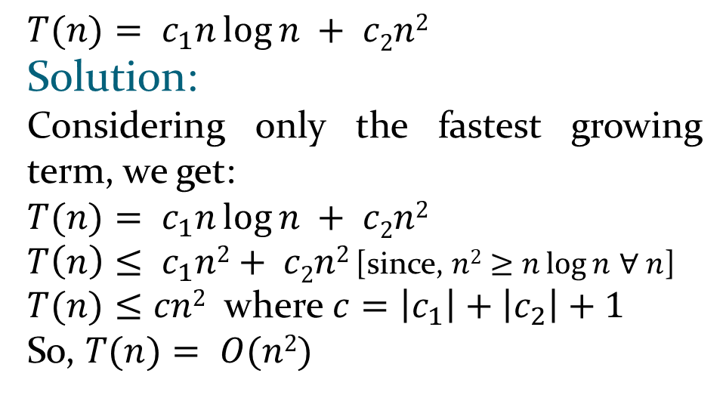

Example of Calculation of Big Oh using Properties
Sample Code:
Block 1:
{……..
$c_{1}n\log{n}$ …..
………..}
Block 2:
{……..
c₂n² …..
………..}
$$T(n)= c_{1}n\log{n} + c2n2$$
Solution:
Considering only the fastest growing term, we get:
$$T(n)= c_{1}n\log{n} + c2n2$$
$T\left(n\right)≤ c_{1}n2+ c2n2$ [since, $n2≥n\log{n}$ $∀ n$]
$T(n)≤cn2$ where $c=\left|c_{1}\right|+\left|c_{2}\right|+1$
So, $T(n)= O(n2)$

Slide 18
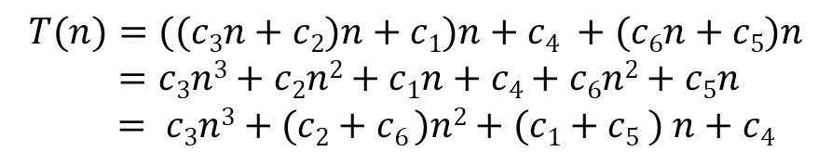

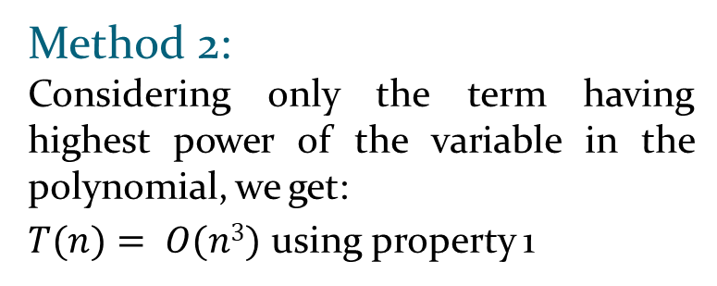

Example of Calculation of Big Oh using Properties
Sample Code:
$for( i=1; i<=n;i$++$)$
$$\{$$
$….c1 instructions$
$for(j=1; j<=n; j$++$)$
$\{$
$…..c2 instructions$
$for( k=1; k<=n; k$++$)$
$$\{$$
$…..c3 instructions$
$$\}$$
$$\}$$
$$\}$$
$$…….c4 instructions$$
$for(i=1;i<=n;i$++)
$$\{….c5 instructions$$
$for(j=1;j≤n;j$++)
$$\{…..c6 instructions$$
$\}$
$$\}$$
$$T(n)=((c3n+c2)n+c1)n+c4 +(c6n+c5)n$$
$$=c3n3+c2n2+c1n+c4+c6n2+c5n$$
$$= c3n3+(c2+c6 )n2+(c1+c5 ) n+c4$$
Method 1:
Considering only the fastest growing term, we get: $T\left(n\right)=O(c3n3)$ [ using property 3]
So, T$(n)= O(n3)$ [ using property 2]
Method 2:
Considering only the term having highest power of the variable in the polynomial, we get:
$T(n)= O(n3)$ using property 1

Slide 19

Small Oh: An Asymptotic Loose Upper Bound
o(g(n)) =
{f(n) : ∀c >0 ∃n₀ > 0 such that ∀n ≥ n₀
0 ≤ f(n) < cg(n)}
We write f(n)=o(g(n))
Small- oh notation is used to denote an upper bound that is not asymptotically tight.
f(n)=o(g(n)) iff

Slide 20
Differences between Big Oh and Small oh
Big Oh
Small oh
O(g(n)) = {f(n) : ∃ positive constants c and n_{0,} such that ∀n ≥ n₀,
0≤ f(n) ≤ cg(n) }
The bound 0≤ f(n) ≤ cg(n) holds for some value of constant c>0
o(g(n)) =
{f(n) : ∀c >0 ∃n₀ > 0 such that ∀n ≥ n₀,
0 ≤ f(n) < cg(n)}
The bound 0≤ f(n) < cg(n) some holds for all value of constants c>0

Slide 21


Example of Small-oh
Since, for all values of c>0, cn²>2n
Since, for c=1, cn²<2n

Slide 22
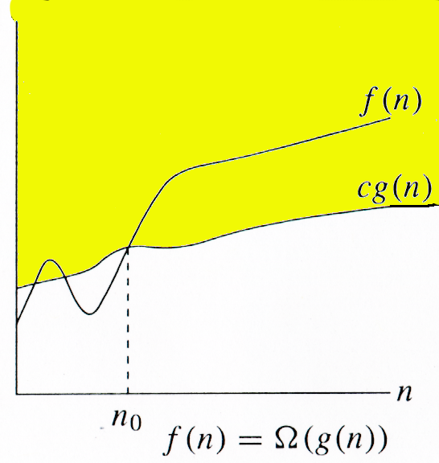
Big Omega: An Asymptotic Lower Bound
Ω(g(n)) = {f(n) : ∃ positive constants c and n_{0,} such that ∀n ≥ n₀,
we have 0 ≤ cg(n) ≤ f(n)}
g(n) is an asymptotic lower bound for f(n).
We write f(n)=Ω(g(n))

Slide 23
Example of Asymptotic Lower Bound (Big Omega)
g(n)=n²
g(n)/4 = n²/4
= n²/2 – n²/4
≤ n²/2 – 9 for all n ≥ 6
< n²/2 – 7
Thus, f(n)= Ω(g(n)).
f(n)=n²/2-7
c g(n)=n²/4
4
Notes:
There could be many pairs of c,n0 which leads to f(n)=O(g(n))

Slide 24
Loose and Tight Lower Bounds
The lower bound given by Big Oh may be lose or tight lower bound:
f(n)=n²/2
g(n)=n²
g(n)=n
Tight Lower bound
Loose Lower bound

Slide 25

Small Omega: An Asymptotic Loose Lower Bound
ω(g(n)) = { f(n): ∀ c > 0, ∃ n₀ > 0 such that ∀ n ≥ n₀, we have 0 ≤ cg(n) < f(n)}.
We write f(n)=ω (g(n))
Small- omega notation is used to denote a lower bound that is not asymptotically tight.
f(n)=ω (g(n)) iff

Slide 26
Differences between Big Omega and Small Omega
Big Omega
Small omega
Ω(g(n)) = {f(n) : ∃ positive constants c and n_{0,} such that ∀n ≥ n₀,we have 0 ≤ cg(n) ≤ f(n)}
The bound 0≤ cg(n) ≤ f(n) holds for some value of constant c>0.
ω(g(n)) = {f(n): ∀ c > 0, ∃ n₀ > 0 such that ∀ n ≥ n₀, we have 0 ≤ cg(n) < f(n)}.
The bound 0≤ cg(n) < f(n) some holds for all value of constants c>0.

Slide 27


Example of Small Omega
Since, for all values of c>0 (n²/2)>cn
Since, for c>1/2, (n²/2⁾<cn

Slide 28
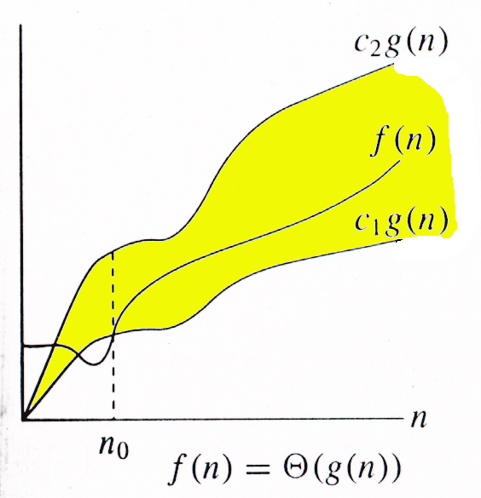
Theta Notation
Θ(g(n)) = {f(n) : ∃ positive constants c₁, c₂, and n_{0,} such that ∀n ≥ n₀,
we have 0 ≤ c₁g(n) ≤ f(n) ≤ c₂g(n)
}
g(n) is an asymptotic tight bound for f(n).
We write f(n)=Θ(g(n))

Slide 29
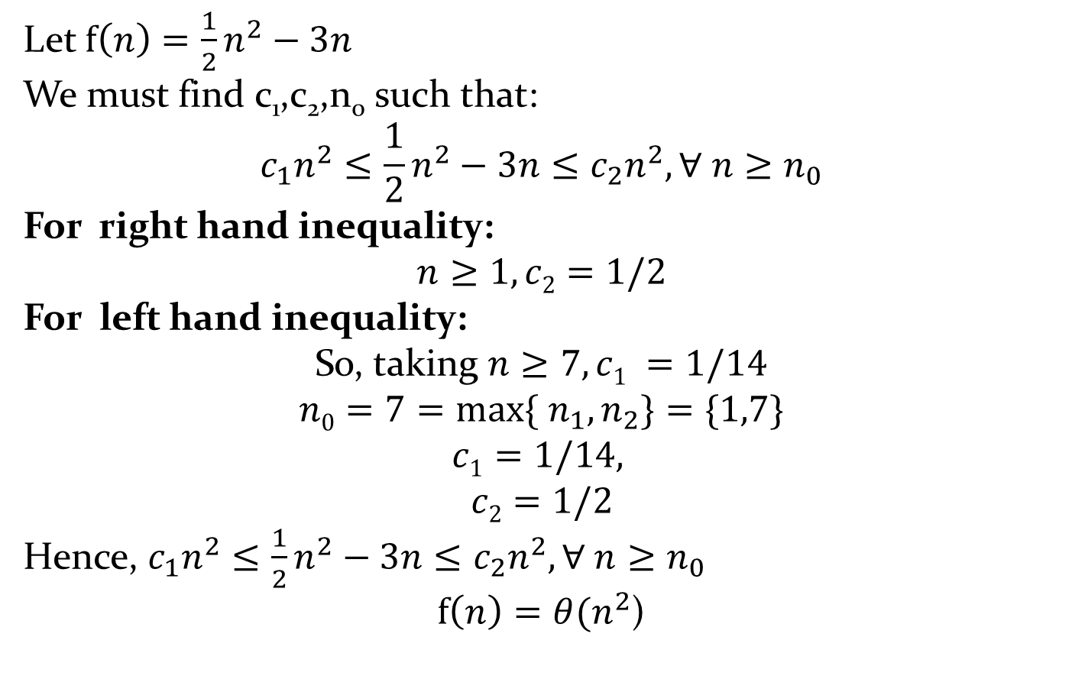
Example of Theta
Let $f\left(n\right)=\frac{1}{2}n^{2}−3n$
We must find c₁,c₂,n₀ such that:
$$c_{1}n^{2}≤\frac{1}{2}n^{2}−3n≤c_{2}n^{2}, ∀ n≥n_{0}$$
For right hand inequality:
$$n≥1, c2=1/2$$
For left hand inequality:
So, taking $n≥7, c1 =1/14$
$n0=7=max⁡\{$ $n_{1}, n_{2}\}=\{1,7\}$
$$c1=1/14,$$
$$c2=1/2$$
Hence, $c_{1}n^{2}≤\frac{1}{2}n^{2}−3n≤c_{2}n^{2}, ∀ n≥n_{0}$
$f\left(n\right)=θ(n^{2}$)

Slide 30

To be discussed in the next Lecture 4:
Classification of Data Structure
Array Data Structure
Definition
Array Representation in Memory
Linear Array
Multidimensional Array
Properties of Array Data Structure
Operations of Array Data Structure
Traversal
Insertion
Deletion
Questions??

