Slide 1

Data Structure & Algorithms (PCC-CS301)
Lecture 4
Dr. Dipak Kumar Kole
Associate Professor, Dept. of CSE, JGEC
Email: dipak.kole@cse.jgec.ac.in

Slide 2
Outline : Lecture 4
Classification of Data Structure
Array Data Structure
Representation Linear Array in Memory
Representation of Two Dimensional Array in Memory
Representation of Multidimensional Array in Memory
Operations on Array Data Structure
Traversing Linear Array
Insertion Operation
Time complexity Analysis
Best Case Analysis
Worst Case Analysis
Deletion Operation
Time complexity Analysis
Best Case Analysis
Worst Case Analysis
Binary Search Algorithm
Time complexity Analysis
Best Case Analysis
Worst Case Analysis

Slide 3
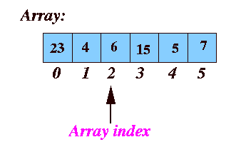
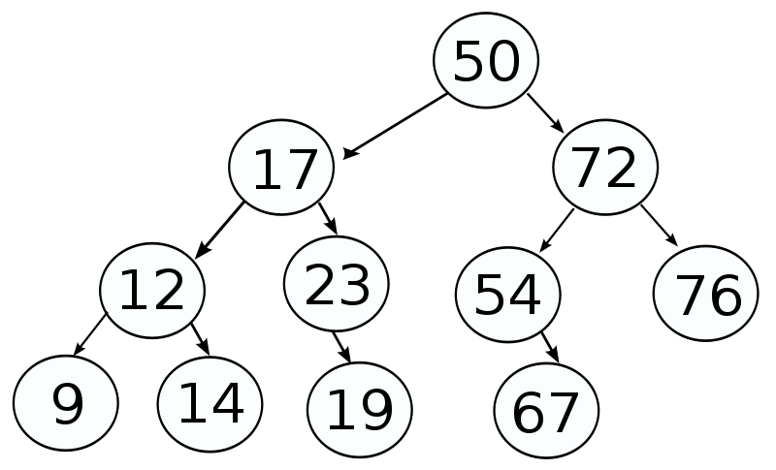
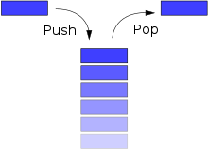
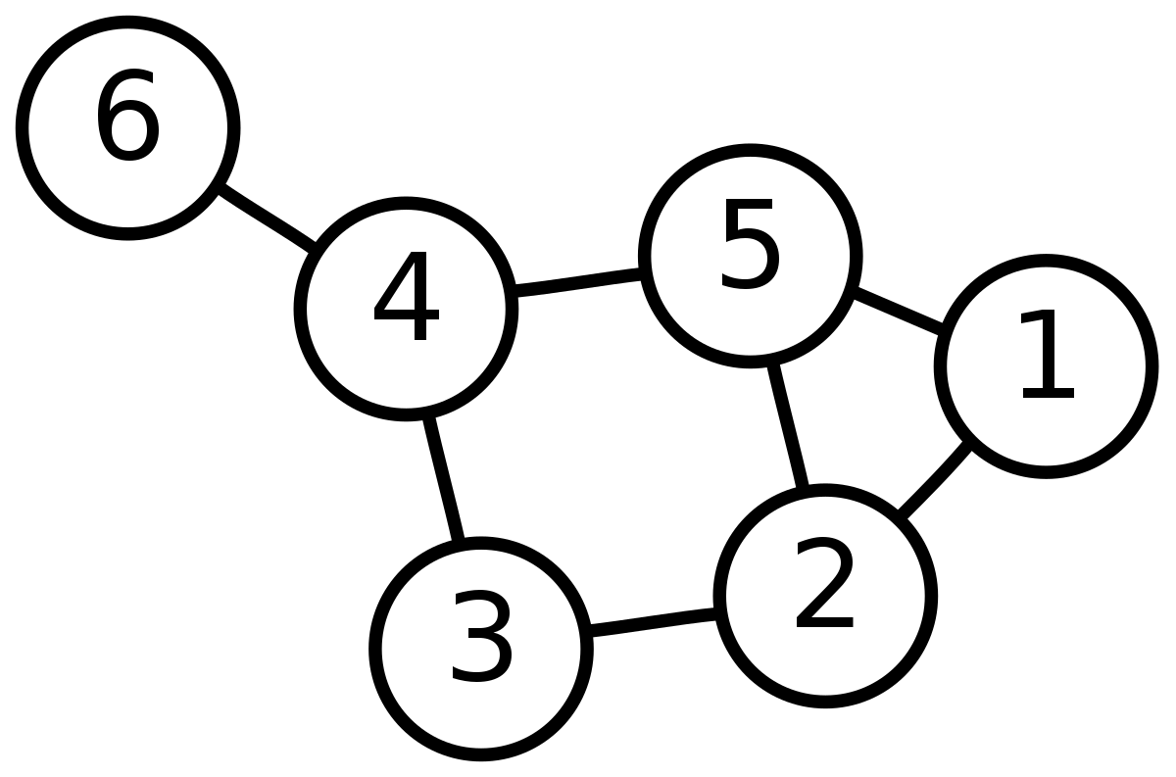
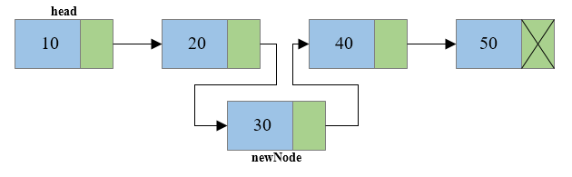
Classification of Data Structure:
Data Structure
Linear Data Structure
Non-linear Data Structure
Stack
Graph
Tree
Link List

Slide 4
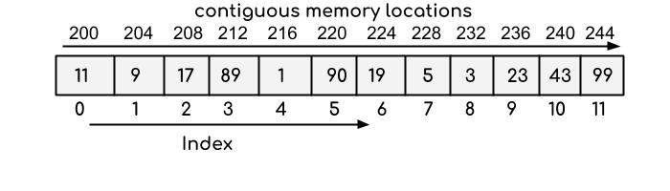
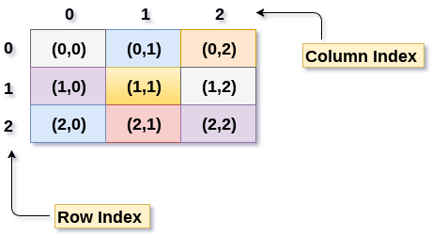
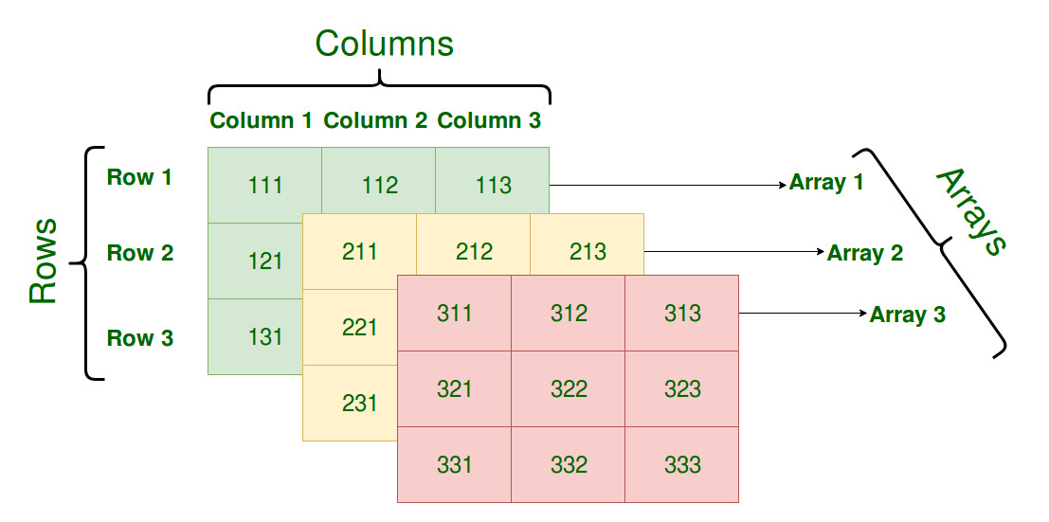
Array Data Structure:
Linear Array :
Two Dimensional Array:
Three Dimensional Array:

Slide 5
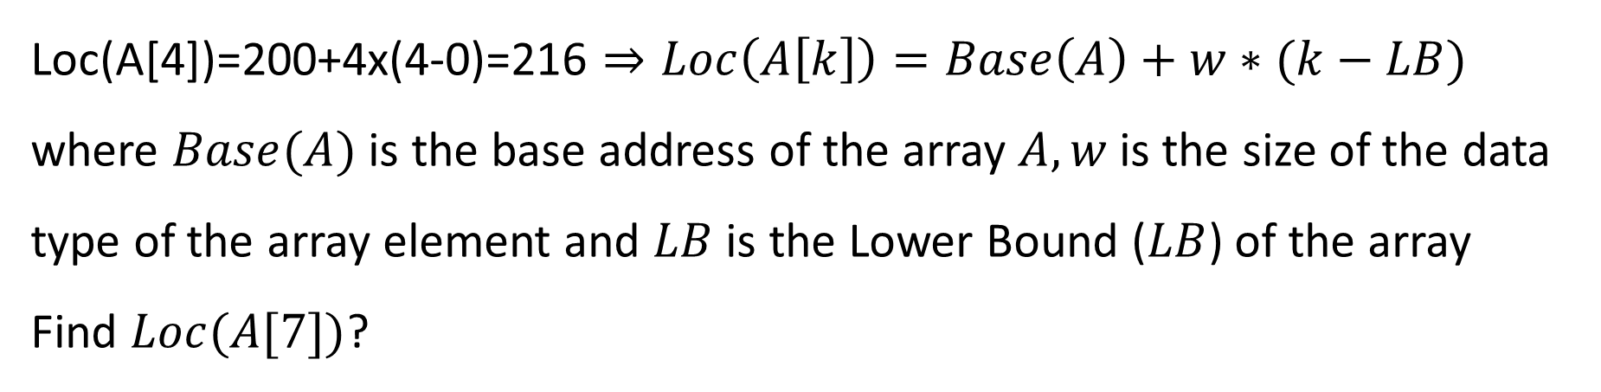
Representation of Linear Array in Memory:
Loc(A[4])=200+4x(4-0)=216 $⇒Loc\left(A\left[k\right]\right)=Base\left(A\right)+w∗(k−LB)$ where $Base(A)$ is the base address of the array $A, w$is the size of the data type of the array element and $LB$ is the Lower Bound ($LB$) of the array
Find $Loc(A[7])$?

Slide 6
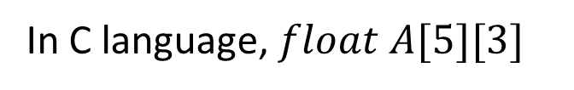
Representation of Two-Dimensional Array in Memory:
In C language, $float A[5][3]$
2000
2004
2008
2012
2016
2020
2024
2028
2032
2036
2040
2044
2048
2052
2056
A[0][0]
A[0][1]
A[0][2]
A[1][0]
A[1][1]
A[1][2]
A[2][0]
A[2][1]
A[2][2]
A[3][0]
A[3][1]
A[3][2]
A[4][0]
A[4][1]
A[4][2]
Row 0
Row 1
Row 2
Row 3
Row 4
2000
2004
2008
2012
2016
2020
2024
2028
2032
2036
2040
2044
2048
2052
2056
A[0][0]
A[1][0]
A[2][0]
A[3][0]
A[4][0]
A[0][1]
A[1][1]
A[2][1]
A[3][1]
A[4][1]
A[0][2]
A[1][2]
A[2][2]
A[3][2]
A[4][2]
Column 0
Column 1
Column 2
0 1 2
0
1
2
3
4
A[0][0] | A[0][1] | A[0][2]
A[1][0] | A[1][1] | A[1][2]
A[2][0] | A[2][1] | A[2][2]
A[3][0] | A[3][1] | A[3][2]
A[4][0] | A[4][1] | A[4][2]
Row-Major Order
Column-Major Order

Slide 7
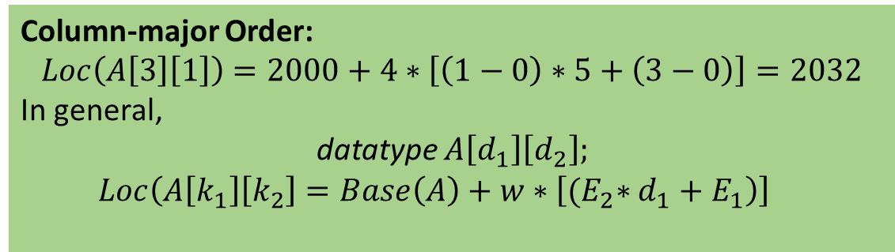
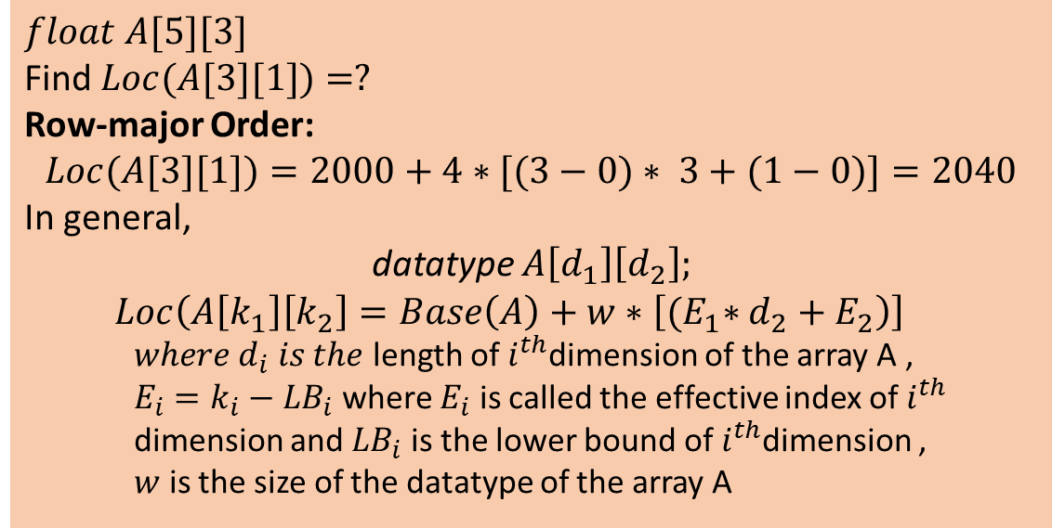
Representation of Two-Dimensional Array in Memory: (Cont..)
2000
2004
2008
2012
2016
2020
2024
2028
2032
2036
2040
2044
2048
2052
2056
A[0][0]
A[0][1]
A[0][2]
A[1][0]
A[1][1]
A[1][2]
A[2][0]
A[2][1]
A[2][2]
A[3][0]
A[3][1]
A[3][2]
A[4][0]
A[4][1]
A[4][2]
Row 0
Row 1
Row 2
Row 3
Row 4
$$float A[5][3]$$
Find $Loc(A[3][1])=?$
Row-major Order:
$$Loc(A[3][1])=2000+4∗[(3−0)∗ 3+(1−0)]=2040$$
In general,
datatype $A\left[d_{1}\right]\left[d_{2}\right];$
$$Loc\left(A\left[k_{1}\right]\left[k_{2}\right]=Base\left(A\right)+w∗\left[{(E}_{1}∗d_{2}+E_{2}\right)\right]$$
$where d_{i} is the$ length of $i^{th}$dimension of the array A ,
$E_{i}=k_{i}−{LB}_{i}$ where $E_{i}$ is called the effective index of $i^{th}$ dimension and ${LB}_{i}$ is the lower bound of $i^{th}$dimension ,
$w$ is the size of the datatype of the array A
2000
2004
2008
2012
2016
2020
2024
2028
2032
2036
2040
2044
2048
2052
2056
A[0][0]
A[1][0]
A[2][0]
A[3][0]
A[4][0]
A[0][1]
A[1][1]
A[2][1]
A[3][1]
A[4][1]
A[0][2]
A[1][2]
A[2][2]
A[3][2]
A[4][2]
Column 0
Column 1
Column 2
Column-major Order:
$$Loc\left(A\left[3\right]\left[1\right]\right)=2000+4∗\left[\left(1−0\right)∗5+\left(3−0\right)\right]=2032$$
In general,
datatype $A\left[d_{1}\right]\left[d_{2}\right];$
$$Loc\left(A\left[k_{1}\right]\left[k_{2}\right]=Base\left(A\right)+w∗\left[{(E}_{2}∗d_{1}+E_{1}\right)\right]$$
(a) Row-major Order
(b) Column-major Order

Slide 8
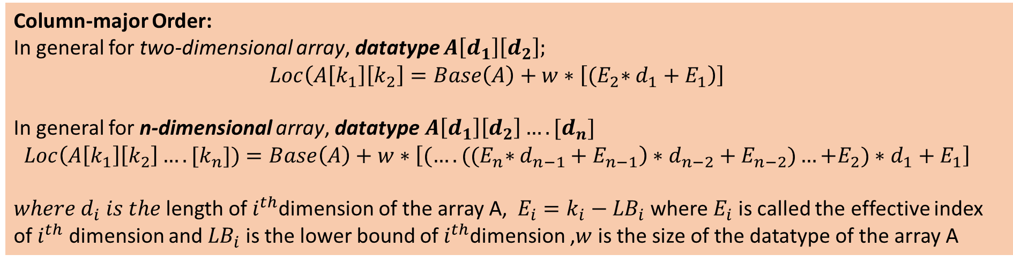
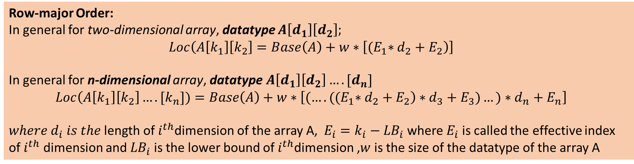
Representation of Multi-Dimensional Array in Memory:
Row-major Order:
In general for two-dimensional array, datatype $A\left[d_{1}\right]\left[d_{2}\right];$
$$Loc\left(A\left[k_{1}\right]\left[k_{2}\right]=Base\left(A\right)+w∗\left[{(E}_{1}∗d_{2}+E_{2}\right)\right]$$
In general for n-dimensional array, datatype$A\left[d_{1}\right]\left[d_{2}\right]….[d_{n}]$
$$Loc\left(A\left[k_{1}\right]\left[k_{2}\right]….[k_{n}])=Base\left(A\right)+w∗\left[{(….((E}_{1}∗d_{2}+E_{2}\right)∗d_{3}+E_{3})…)∗d_{n}+E_{n}\right]$$
$where d_{i} is the$ length of $i^{th}$dimension of the array A, $E_{i}=k_{i}−{LB}_{i}$ where $E_{i}$ is called the effective index of $i^{th}$ dimension and ${LB}_{i}$ is the lower bound of $i^{th}$dimension ,$w$ is the size of the datatype of the array A
Column-major Order:
In general for two-dimensional array, datatype $A\left[d_{1}\right]\left[d_{2}\right];$
$$Loc\left(A\left[k_{1}\right]\left[k_{2}\right]=Base\left(A\right)+w∗\left[{(E}_{2}∗d_{1}+E_{1}\right)\right]$$
In general for n-dimensional array, datatype$A\left[d_{1}\right]\left[d_{2}\right]….[d_{n}]$
$$Loc\left(A\left[k_{1}\right]\left[k_{2}\right]….[k_{n}])=Base\left(A\right)+w∗\left[{(….((E}_{n}∗d_{n−1}+E_{n−1}\right)∗d_{n−2}+E_{n−2})…{+E}_{2})∗d_{1}+E_{1}\right]$$
$where d_{i} is the$ length of $i^{th}$dimension of the array A, $E_{i}=k_{i}−{LB}_{i}$ where $E_{i}$ is called the effective index of $i^{th}$ dimension and ${LB}_{i}$ is the lower bound of $i^{th}$dimension ,$w$ is the size of the datatype of the array A

Slide 9
Operations on Array Data Structure: Traversing Linear Array
Traversing a linear array means accessing and processing each element of the array exactly once.
void display (int n)
{
int i;
for (i=0 ; i<n ; i++)
printf(“%d”, a[i]);
}
/* Assumption:: here the array a is declared globally */
0 | 1 | 2 | 3
a
10 | -45 | 13 | 95
Output:
10
-45
13
95
Time complexity : $f\left(n\right)=O(n)$

Slide 10
Insertion Operation on Array Data Structure
(pos-1)
Let int a[MAX];
MAX : the size of the array a
n : The number elements present in the array a
Suppose, we want to insert an element x=84 at a given position pos=3 of the given array a.
Here, MAX=8, n=5
0 | 1 | 2 | 3 | 4 | 5 | 6 | 7
10 | -14 | 15 | 9 | 20
0 | 1 | 2 | 3 | 4 | 5 | 6 | 7
10 | -14 | 15 | 9 | 20
//Shifting from right to left starting from (n-1) to (pos-1)
for ( i=n-1 ; i >=(pos-1) ; i-- )
a[i+1]=a[i];
// a[pos-1] is logically empty now
a[pos-1]=x; //the element x is inserted
n=n+1; // the number of element n is updated
0 | 1 | 2 | 3 | 4 | 5 | 6 | 7
10 | -14 | 15 | 9 | 20 | 20
0 | 1 | 2 | 3 | 4 | 5 | 6 | 7
10 | -14 | 15 | 9 | 9 | 20
84 inserted
0 | 1 | 2 | 3 | 4 | 5 | 6 | 7
0 | 1 | 2 | 3 | 4 | 5 | 6 | 7
10 | -14 | 15 | 15 | 9 | 20
10 | -14 | 84 | 15 | 9 | 20
Logically Empty

Slide 11


Insertion Operation on Array Data Structure: (Cont…)
In case of insertion operation, we first check the overflow condition
The position pos given by the user must be checked its validity that means whether the position is valid position or not ( valid position range: $1<= pos<=(n+1)$)
void insert (int x, int pos)
{
int i;
if (n==MAX_SIZE) // MAX_SIZE is the size of the array
printf(“\n Overflow”);
else
{
if ((pos>=1) && (pos<=(n+1))) // valid position
{
//Shifting from right to left starting from (n-1) to (pos-1)
for ( i=n-1 ; i >=(pos-1) ; i-- )
a[i+1]=a[i];
// a[pos-1] is logically empty now
a[pos-1]=x; //the element x is inserted
n=n+1; // the number of element n is updated
}
else
printf(“\n Invalid position”);
}
}
Time complexity Analysis:
Best Case Analysis:
Here n=5
Best case Situation: If we want to insert at the (n+1)th position, then a[n]=x and n=n+1
Hence, $f\left(n\right)=O(1)$ [Constant time]
Worst Case Analysis: If we inset at the first position, then
Hence, $f\left(n\right)=O(n)$
0 | 1 | 2 | 3 | 4 | 5 | 6 | 7
10 | -14 | 15 | 9 | 20
0 | 1 | 2 | 3 | 4 | 5 | 6 | 7
10 | -14 | 15 | 9 | 20
$n$ no. of shifting to be done

Slide 12
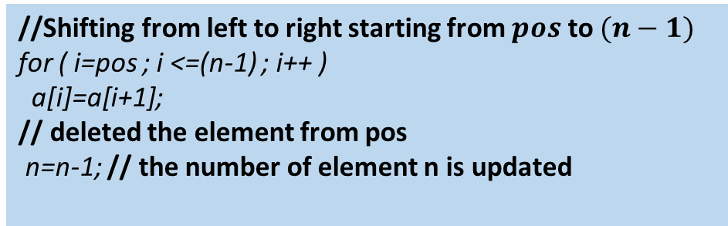
Deletion Operation on Array Data Structure:
(pos-1)
Let int a[MAX];
MAX : the size of the array a
n : The number elements present in the array a
Suppose, we want to deletion an element at a given position pos=3 of the given array a.
Here, MAX=8, n=6
0 | 1 | 2 | 3 | 4 | 5 | 6 | 7
10 | -14 | 84 | 15 | 9 | 20
0 | 1 | 2 | 3 | 4 | 5 | 6 | 7
10 | -14 | 84 | 15 | 9 | 20
//Shifting from left to right starting from $pos$ to $(n−1)$
for ( i=pos ; i <=(n-1) ; i++ )
a[i]=a[i+1];
// deleted the element from pos
n=n-1; // the number of element n is updated
0 | 1 | 2 | 3 | 4 | 5 | 6 | 7
10 | -14 | 15 | 15 | 9 | 20
0 | 1 | 2 | 3 | 4 | 5 | 6 | 7
84 Deleted
10 | -14 | 15 | 9 | 9 | 20
0 | 1 | 2 | 3 | 4 | 5 | 6 | 7
0 | 1 | 2 | 3 | 4 | 5 | 6 | 7
10 | -14 | 15 | 9 | 20 | 20
10 | -14 | 15 | 9 | 20 | 20
Logically Empty

Slide 13
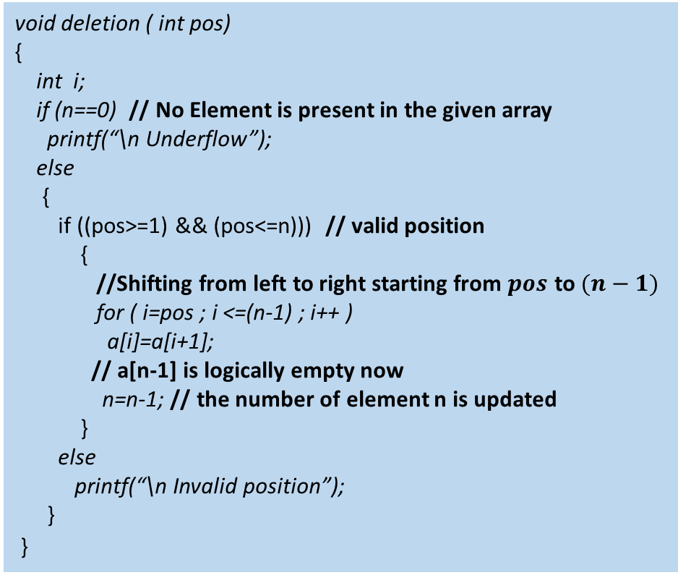
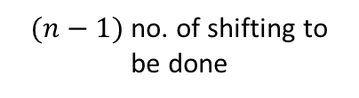
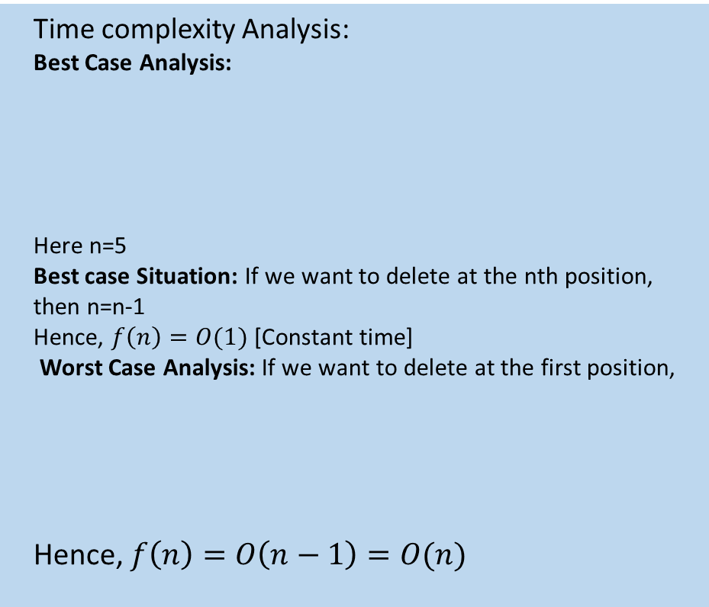
Deletion Operation on Array Data Structure: (Cont…)
In case of deletion operation, we first check the underflow condition
The position pos given by the user must be checked its validity that means whether the position is valid position or not ( valid position range: $1<= pos<=n)$)
void deletion ( int pos)
{
int i;
if (n==0) // No Element is present in the given array
printf(“\n Underflow”);
else
{
if ((pos>=1) && (pos<=n))) // valid position
{
//Shifting from left to right starting from $pos$ to $(n−1)$
for ( i=pos ; i <=(n-1) ; i++ )
a[i]=a[i+1];
// a[n-1] is logically empty now
n=n-1; // the number of element n is updated
}
else
printf(“\n Invalid position”);
}
}
Time complexity Analysis:
Best Case Analysis:
Here n=5
Best case Situation: If we want to delete at the nth position, then n=n-1
Hence, $f\left(n\right)=O(1)$ [Constant time]
Worst Case Analysis: If we want to delete at the first position,
Hence, $f\left(n\right)=O\left(n−1\right)=O(n)$
0 | 1 | 2 | 3 | 4 | 5 | 6 | 7
10 | -14 | 15 | 9 | 20
0 | 1 | 2 | 3 | 4 | 5 | 6 | 7
10 | -14 | 15 | 9 | 20
$(n−1)$ no. of shifting to be done

Slide 14
Binary Search Algorithm:
mid, x=49
Limitations:
The list must be sorted
The data structure, containing the list of sorted elements, must have direct access to any element without accessing any other elements
0 | 1 | 2 | 3 | 4 | 5 | 6 | 7
10 | 17 | 23 | 29 | 37 | 48 | 89
Left Sub list
Right Sub list
n=7, x=49, Initially, beg=0, end=(n-1)=6,
mid=(beg+end)/2;
If (x==a[mid])
printf(“\n Search is successful “);
else
If(x>a[mid])
beg=mid+1;
else
end=mid-1;
mid, x=49
0 | 1 | 2 | 3 | 4 | 5 | 6 | 7
10 | 17 | 23 | 29 | 37 | 48 | 89
Left Sub list
Right Sub list
mid, x=49
beg | end | mid
0 | 6 | 3
0 | 1 | 2 | 3 | 4 | 5 | 6 | 7
4
6
5
10 | 17 | 23 | 29 | 37 | 48 | 89
6
6
6
6
Left Sub list
Right Sub list
5
STOP

Slide 15
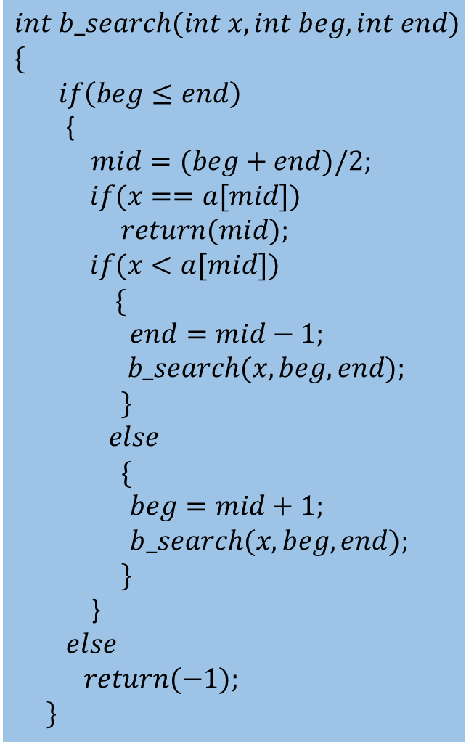
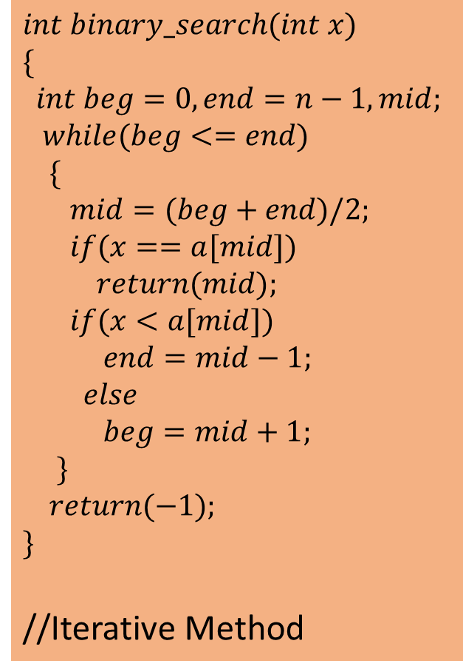
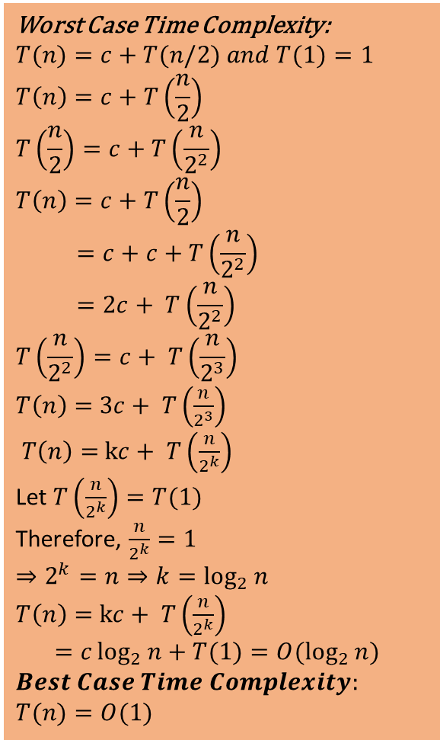
Binary Search Algorithm: (Cont..)
$$int binary_search(int x)$$
$$\{$$
$$int beg=0,end=n−1,mid;$$
$$while(beg<=end)$$
$$\{$$
$$mid=(beg+end)/2;$$
$$if(x==a[mid])$$
$$return(mid);$$
$$if(x<a[mid])$$
$$end=mid−1;$$
$$else$$
$$beg=mid+1;$$
$$\}$$
$$return(−1);$$
$$\}$$
//Iterative Method
$$int b_search(int x,int beg, int end)$$
$$\{$$
$$if\left(beg≤end\right)$$
{
$mid=(beg+end)/2;$
$$if(x==a[mid])$$
$$return(mid);$$
$$if(x<a[mid])$$
$$\{$$
$end=mid−1;$
$$b_search(x, beg, end);$$
$$\}$$
$$else$$
$$\{$$
$beg=mid+1;$
$b_search(x, beg, end);$
$$\}$$
}
$else$
$$return(−1);$$
$$\}$$
Worst Case Time Complexity:
$$T(n)=c+T(n/2) and T(1)=1$$
$$T\left(n\right)=c+T\left(\frac{n}{2}\right)$$
$$T\left(\frac{n}{2}\right)=c+T\left(\frac{n}{2^{2}}\right)$$
$$T\left(n\right)=c+T\left(\frac{n}{2}\right)$$
$$=c+c+T\left(\frac{n}{2^{2}}\right)$$
$$=2c+ T\left(\frac{n}{2^{2}}\right)$$
$$T\left(\frac{n}{2^{2}}\right)=c+ T\left(\frac{n}{2^{3}}\right)$$
$T\left(n\right)=$ $3c+ T\left(\frac{n}{2^{3}}\right)$
$T\left(n\right)=$ $kc+ T\left(\frac{n}{2^{k}}\right)$
Let $T\left(\frac{n}{2^{k}}\right)=T(1)$
Therefore, $\frac{n}{2^{k}}=1$
$$⇒2^{k}=n⇒k=\log_{2}{n}$$
$T\left(n\right)=$ $kc+ T\left(\frac{n}{2^{k}}\right)$
$$=c\log_{2}{n}+T(1)=O(\log_{2}{n})$$
$$Best Case Time Complexity:$$
$$T(n)=O(1)$$

Slide 16

To be discussed in the next Lecture 5:
Sorting Algorithms with Examples:
Insertion Sort
Selection Sort
Bubble Sort
Quick Sort
Merge Sort
Time & Space Complexity Analysis of All Sorting Algorithms
Questions??

