Slide 1

Data Structure & Algorithms (PCC-CS301)
Lecture 5
Dr. Dipak Kumar Kole
Associate Professor, Dept. of CSE, JGEC
Email: dipak.kole@cse.jgec.ac.in

Slide 2
Outline : Lecture 5
Sorting Algorithms
Insertion Sorting algorithm
Analysis of Insertion Sorting Algorithm
Selection Sorting algorithm
Analysis of Selection Sorting Algorithm
Bubble Sorting Algorithm
Analysis of Bubble Sorting Algorithm
Modified Bubble Sorting Algorithm
Advantage of Modified Bubble Sort Algorithm
Linked List
Classification of Linked List
Classification of Linked List with respect to Implementation
Static Linked List
Dynamic Linked List
Operations on Single Linked List:
Creation of Single Dynamic Linked List
Display the Linked List (Iterative and recursive Algorithms)
Searching Operation
Insertion Operation
Deletion Operation
Reverse Print the Linked List (Iterative and Recursive Method)
Reverse the Linked List

Slide 3
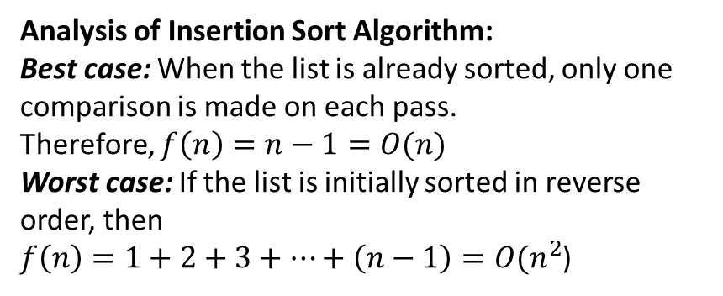
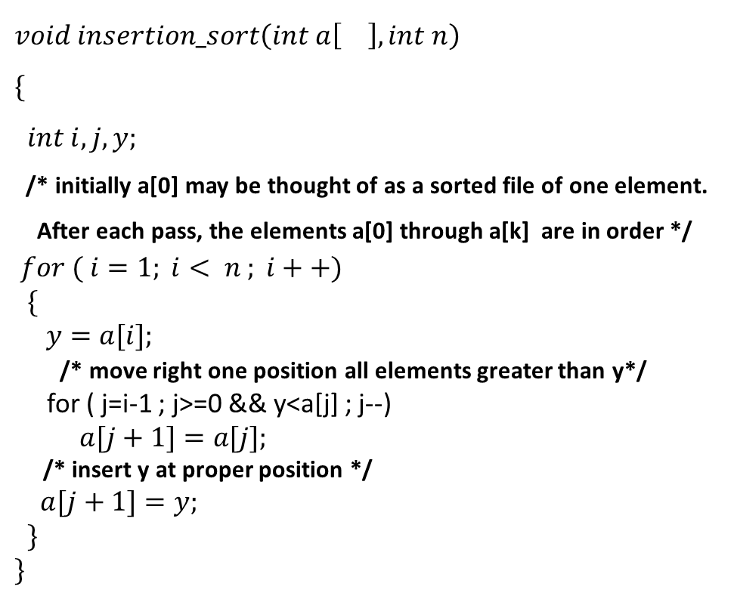
Insertion Sorting algorithm
This Sorting Algorithm is very popular with bridge players when they are first sorting their cards.
$$void insertion_sort\left(int a\left[\right], int n\right)$$
$$\{$$
$$int i, j, y;$$
/* initially a[0] may be thought of as a sorted file of one element.
After each pass, the elements a[0] through a[k] are in order */
$$for ( i=1; i< n ; i++)$$
$$\{$$
$$y=a[i];$$
/* move right one position all elements greater than y*/
for ( j=i-1 ; j>=0 && y<a[j] ; j--)
$a[j+1]=a[j];$
/* insert y at proper position */
$a[j+1]=y;$
$$\}$$
$$\}$$
Pass | A[0] | A[1] | A[2] | A[3] | A[4]
Initially | 77 | 33 | 44 | 11 | 55
i=1 | 77 | 33
i=2 | 33 | 77 | 44
i=3 | 33 | 44 | 77 | 11
i=4 | 11 | 33 | 44 | 77 | 55
Sorted | 11 | 33 | 44 | 55 | 77
Analysis of Insertion Sort Algorithm:
Best case: When the list is already sorted, only one comparison is made on each pass.
Therefore, $f\left(n\right)=n−1=O(n)$
Worst case: If the list is initially sorted in reverse order, then
$f\left(n\right)=1+2+3+…+\left(n−1\right)=O(n^{2}$)

Slide 4
Selection Sorting algorithm: Example
Pass | position | Smallest
1 | 0 | 55
1 | 1 | 33
1 | 1 | 33
1 | 1 | 33
1 | 4 | 22
 | 5 | 11
Steps | 5
2 | 1 | 33
2 | 1 | 33
2 | 1 | 33
2 | 4 | 22
 | 4 | 22
Steps | 4
0 | 1 | 2 | 3 | 4 | 5
55 | 33 | 88 | 44 | 22 | 11
55 | 33 | 88 | 44 | 22 | 11
55 | 33 | 88 | 44 | 22 | 11
55 | 33 | 88 | 44 | 22 | 11
55 | 33 | 88 | 44 | 22 | 11
55 | 33 | 88 | 44 | 22 | 11
11 | 33 | 88 | 44 | 22 | 55
11 | 33 | 88 | 44 | 22 | 55
11 | 33 | 88 | 44 | 22 | 55
11 | 33 | 88 | 44 | 22 | 55
11 | 33 | 88 | 44 | 22 | 55
11 | 33 | 88 | 44 | 22 | 55
11 | 22 | 88 | 44 | 33 | 55
Pass | position | Smallest
3 | 2 | 88
3 | 3 | 44
3 | 4 | 33
 | 4 | 33
Steps | 3
4 | 3 | 44
4 | 3 | 44
 | 3 | 44
Steps | 2
5 | 4 | 88
 | 5 | 55
Steps | 1
Sorted
0 | 1 | 2 | 3 | 4 | 5
11 | 22 | 88 | 44 | 33 | 55
11 | 22 | 88 | 44 | 33 | 55
11 | 22 | 88 | 44 | 33 | 55
11 | 22 | 88 | 44 | 33 | 55
11 | 22 | 33 | 44 | 88 | 55
11 | 22 | 33 | 44 | 88 | 55
11 | 22 | 33 | 44 | 88 | 55
11 | 22 | 33 | 44 | 88 | 55
11 | 22 | 33 | 44 | 88 | 55
11 | 22 | 33 | 44 | 88 | 55
11 | 22 | 33 | 44 | 88 | 55
11 | 22 | 33 | 44 | 55 | 88
11 | 22 | 33 | 44 | 55 | 88

Slide 5
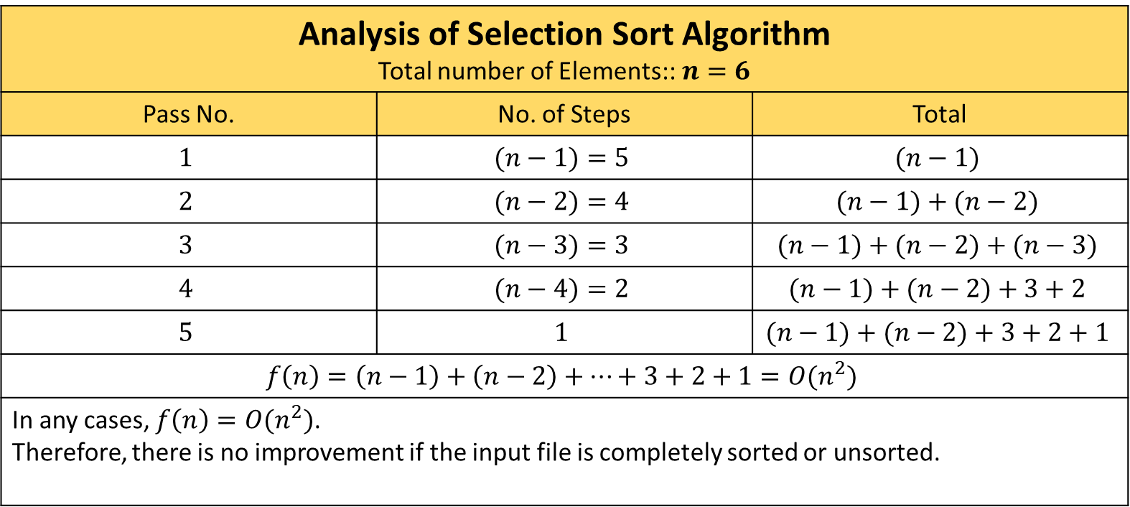
Selection Sorting algorithm (Cont..)
Analysis of Selection Sort Algorithm Total number of Elements::$n=6$
Pass No. | No. of Steps | Total
$$1$$ | $$(n−1)=5$$ | $$(n−1)$$
$$2$$ | $$(n−2)=4$$ | $$(n−1)+(n−2)$$
$$3$$ | $$(n−3)=3$$ | $$(n−1)+(n−2)+(n−3)$$
$$4$$ | $$(n−4)=2$$ | $$(n−1)+(n−2)+3+2$$
$$5$$ | $$1$$ | $$(n−1)+(n−2)+3+2+1$$
$$f\left(n\right)=\left(n−1\right)+\left(n−2\right)+…+3+2+1=O(n^{2})$$
In any cases, $f\left(n\right)=O(n^{2})$. Therefore, there is no improvement if the input file is completely sorted or unsorted.

Slide 6
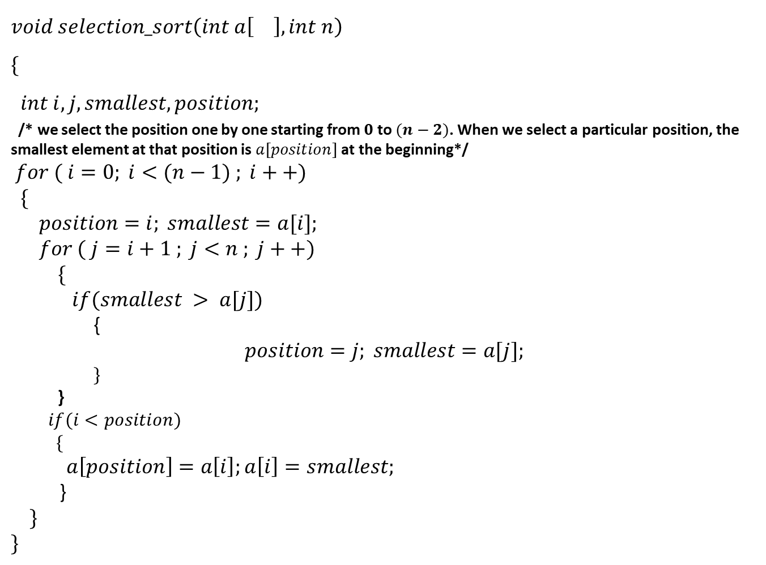
Selection Sorting algorithm (Cont..)
$$void selection_sort\left(int a\left[\right], int n\right)$$
$$\{$$
$$int i, j, smallest, position;$$
/* we select the position one by one starting from $0$ to $(n−2)$. When we select a particular position, the smallest element at that position is $a[position]$at the beginning*/
$$for ( i=0; i<(n−1) ; i++)$$
$$\{$$
$$position=i; smallest=a[i];$$
$$for ( j=i+1 ; j<n ; j++)$$
$$\{$$
$$if(smallest > a[j])$$
{
$$position=j; smallest=a[j];$$
$$\}$$
}
$$if(i<position)$$
$$\{$$
$a\left[position\right]=a\left[i\right];a\left[i\right]=smallest;$
}
$$\}$$
$$\}$$

Slide 7
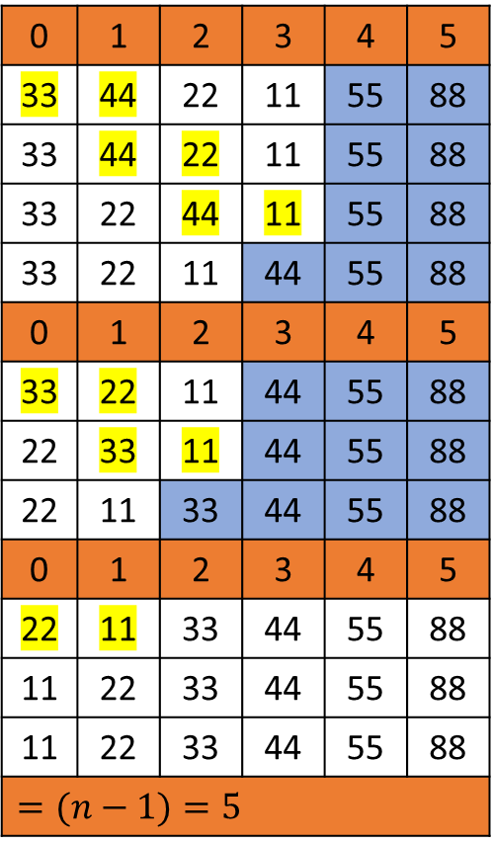
Bubble Sorting algorithm :: Example
Pass | Swapping Status (1/0)
1 | 1
1 | 0
1 | 1
1 | 1
1 | 1
Steps | 5
Pass | Swapping Status (1/0)
2 | 0
2 | 1
2 | 1
2 | 1
Steps | 4
0 | 1 | 2 | 3 | 4 | 5
55 | 33 | 88 | 44 | 22 | 11
33 | 55 | 88 | 44 | 22 | 11
33 | 55 | 88 | 44 | 22 | 11
33 | 55 | 44 | 88 | 22 | 11
33 | 55 | 44 | 22 | 88 | 11
33 | 55 | 44 | 22 | 11 | 88
0 | 1 | 2 | 3 | 4 | 5
33 | 55 | 44 | 22 | 11 | 88
33 | 55 | 44 | 22 | 11 | 88
33 | 44 | 55 | 22 | 11 | 88
33 | 44 | 22 | 55 | 11 | 88
33 | 44 | 22 | 11 | 55 | 88
Pass | Swapping Status (1/0)
3 | 0
3 | 1
3 | 1
Steps | 3
Pass | Swapping Status (1/0)
4 | 1
4 | 1
Steps | 2
Pass | Swapping Status (1/0)
5 | 1
Steps | 1
Sorted
Total No. of Passes
0 | 1 | 2 | 3 | 4 | 5
33 | 44 | 22 | 11 | 55 | 88
33 | 44 | 22 | 11 | 55 | 88
33 | 22 | 44 | 11 | 55 | 88
33 | 22 | 11 | 44 | 55 | 88
0 | 1 | 2 | 3 | 4 | 5
33 | 22 | 11 | 44 | 55 | 88
22 | 33 | 11 | 44 | 55 | 88
22 | 11 | 33 | 44 | 55 | 88
0 | 1 | 2 | 3 | 4 | 5
22 | 11 | 33 | 44 | 55 | 88
11 | 22 | 33 | 44 | 55 | 88
11 | 22 | 33 | 44 | 55 | 88
$$=(n−1)=5$$

Slide 8
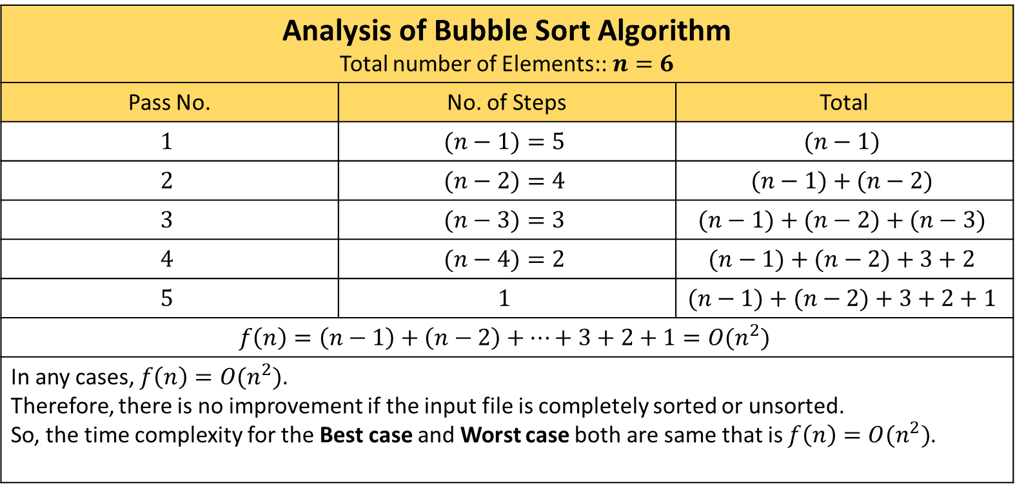
Bubble Sorting algorithm (Cont..)
Analysis of Bubble Sort Algorithm Total number of Elements::$n=6$
Pass No. | No. of Steps | Total
$$1$$ | $$(n−1)=5$$ | $$(n−1)$$
$$2$$ | $$(n−2)=4$$ | $$(n−1)+(n−2)$$
$$3$$ | $$(n−3)=3$$ | $$(n−1)+(n−2)+(n−3)$$
$$4$$ | $$(n−4)=2$$ | $$(n−1)+(n−2)+3+2$$
$$5$$ | $$1$$ | $$(n−1)+(n−2)+3+2+1$$
$$f\left(n\right)=\left(n−1\right)+\left(n−2\right)+…+3+2+1=O(n^{2})$$
In any cases, $f\left(n\right)=O(n^{2})$. Therefore, there is no improvement if the input file is completely sorted or unsorted. So, the time complexity for the Best case and Worst case both are same that is $f\left(n\right)=O(n^{2})$.

Slide 9

Bubble Sorting algorithm (Cont..)
$$void bubble_sort\left(int a\left[\right], int n\right)$$
$$\{$$
$$int i, j, hold;$$
$for ( i=1; i<n ; i++)$ // outer loop control the number of passes
$$\{$$
$$for ( j=0 ; j<n−i ; j++)$$
$$\{$$
$$if(a\left[j\right]>a[j+1])$$
$$\{$$
$$hold=a\left[j\right];$$
$a\left[j\right]=a\left[j+1\right];$
$a\left[j+1\right]=hold;$
$$\}$$
$$\}$$
}
}

Slide 10
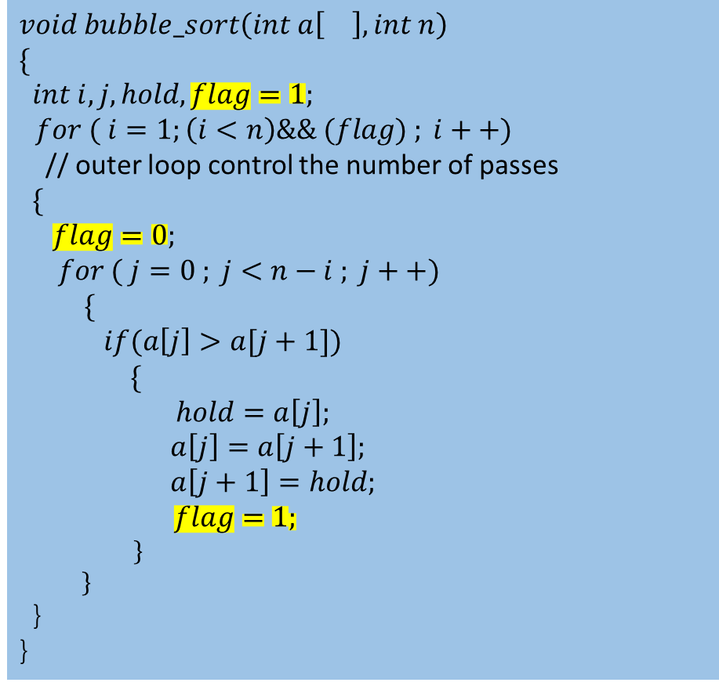
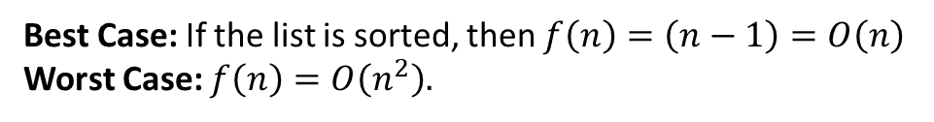
Modified Bubble Sorting algorithm :: Example
Pass | Swapping Status (1/0)
1 | 0
1 | 0
1 | 0
1 | 0
1 | 0
Steps | 5
No swapping is done in pass 1. So, the question is whether we will continue the nest pass or not?
0 | 1 | 2 | 3 | 4 | 5
11 | 22 | 33 | 44 | 55 | 66
11 | 22 | 33 | 44 | 55 | 66
11 | 22 | 33 | 44 | 55 | 66
11 | 22 | 33 | 44 | 55 | 66
11 | 22 | 33 | 44 | 55 | 66
11 | 22 | 33 | 44 | 55 | 66
So, we don’t need to continue the next pass as because the current pass indicates the list is sorted.
$$void bubble_sort\left(int a\left[\right], int n\right)$$
$$\{$$
$$int i, j, hold, flag=1;$$
$for ( i=1;\left(i<n\right)\&\& (flag) ; i++)$
// outer loop control the number of passes
$$\{$$
$flag=0;$
$$for ( j=0 ; j<n−i ; j++)$$
$$\{$$
$$if(a\left[j\right]>a[j+1])$$
$$\{$$
$$hold=a\left[j\right];$$
$a\left[j\right]=a\left[j+1\right];$
$a\left[j+1\right]=hold;$
$flag=1;$
$$\}$$
$$\}$$
}
}
Best Case: If the list is sorted, then $f\left(n\right)=\left(n−1\right)=O\left(n\right)$
Worst Case: $f\left(n\right)=O\left(n^{2}\right).$

Slide 11
Linked List
Start
15
5
25
55
60
A linked list is a linear data structure where the linearity is maintained by means of pointers.
The linked list is a collection of nodes, where each node has at least two parts: first part contains the information / data and the second part, called the link part, contains the address of the next node if exist, otherwise contains null pointer.
Linked List
Single Linked List
(One way Linked List)
Double Linked List
(Two way Linked List)
Circular Linked List

Slide 12
Linked List Classification
Start
Single Linked List
(One way Linked List)
15
5
25
55
60
Start
Circular Linked List
15
5
25
55
60
Start
Double Linked List
(Two way Linked List)
15
5
25
55

Slide 13
Linked List Classification with respect to Implementation
Linked List
Static Linked List
Dynamic Linked List
Static Linked List: A linked list, which is implemented using array data structure, is called static linked list.
Dynamic Linked List: A linked list, which is implemented using dynamic memory allocation concept (memory space will be allocated / deallocated during run time of the program)

Slide 14
Representation of Linked List in Memory:
Start
15
5
25
55
60
INFO
LINK
Start
0
1
2
3
4
5
6
7
8
5
55
15
60
25
0
1
2
3
4
5
6
7
8
7
5
0
-1
1
3

Slide 15
Implementation of Dynamic Linked List:
typedef struct node
{
int data ;
struct node * link;
} nd;
data
link
Start
Node
Step 1: nd * start=NULL;
15
5
60
Step 2: ptr=(nd*) malloc(sizeof(nd));
ptr
Step 3: ptr->data=15;
start=ptr;
Step 4: Do you want to continue?(y/n)
If no, then go to Step 5;
Step 4.1: ptr->link=(nd*) malloc(sizeof(nd));
Step 4.2: ptr=ptr->link;
printf(“\nEnter the data:”);
scanf(“%d”,&ptr->data);
Step 5: ptr->link=NULL;

Slide 16
Creation of Dynamic Linked List:
nd * start=NULL;
void create_linkedlist()
{
nd *ptr;
char ch;
ptr=(nd*)malloc(sizeof(nd));
printf(“\nEnter the data:”);
scanf(“%d”,&ptr->data);
start=ptr;
printf(“\n Do you want to continue?(y/n)”);
fflush(stdin);
ch=getchar();
while(ch==‘y’)
{
ptr->link=(nd*)malloc(sizeof(nd));
ptr=ptr->link;
printf(“\nEnter the data:”);
scanf(“%d”,&ptr->data);
printf(“\n Do you want to continue?(y/n)”);
fflush(stdin);
ch=getchar();
}
ptr->link=NULL;
} // end of function

Slide 17
How to display the linked list?
ptr
Start
15
5
25
55
60
void display()
{
nd *ptr;
ptr=start;
printf(“\nStart”);
while(ptr)
{
printf(“->%d”,ptr->data);
ptr=ptr->link;
}
} // end of display function
Output::
Start
->15
->5
->25
->55
->60
void main()
{
display(start);
}
void display(nd * ptr)
{
if (ptr)
{
printf(“->%d”,ptr->data);
ptr=ptr->link;
display(ptr);
}
} //end of function

Slide 18
Linked List:: Searching Operation
Linear searching and Binary Searching
Limitations of Binary Searching Algorithms:
The list must be sorted.
The data structure, where the list is stored, should have the facility to direct access the element without accessing the other elements.
The second limitation fails in case of linked list.
So, we can not apply binary search algorithm even if the list is sorted in the linked list.
Therefore, we can implement the only linear searching algorithm on the linked list.

Slide 19
Linked List:: Searching Operation (Cont..)
ptr
Start
15
5
25
55
60
void main()
{
nd *temp;
int x;
printf(“\n Enter the searching element:”);
scanf(“%d”,&x);
temp=search(x)
if (temp)
printf(“\n Search is successful”);
else
printf(“\n Search is unsuccessful”);
}
nd *search(int x)
{
nd *ptr;
ptr=start;
while ((ptr)&&(ptr->data!=x))
ptr=ptr->link;
return(ptr)
} // end of search function
Input/Output::
Enter the searching element:
x=25
Search is successful
Enter the searching element:
x=85
Search is unsuccessful

Slide 20
Linked List:: Insertion Operation
Different cases of Insertion operations:
After a specified element
Before a specified element
At a particular given position
Start
15
5
25
55
60

Slide 21
Linked List:: Insertion Operation (Cont..)
Case 1: After a specified element
Start
temp
15
5
25
55
60
ptr
35
case 1: temp=search(x);
if(temp)
{
ptr=(nd*)malloc(sizeof(nd));
printf(“\nEnter the data”);
scanf(“%d”,&ptr->data);
ptr->link=temp->link;
temp->link=ptr;
}
else
printf(“\n Specified element is not present in the list”);
break
Insert 35 after the specified element x=5
temp=search(5);
ptr->link=temp->link;
temp->link=ptr;

Slide 22
Linked List:: Insertion Operation (Cont..)
Case 2: Before a specified element
Start
temp
15
5
25
55
60
Insert 35 before the specified element x=25
else
{
temp=start;
while(temp->link->data!=x)
temp=temp->link;
if(temp)
{
ptr->link=temp->link;
temp->link=ptr;
}
else
printf(“\n Specified element is not present in the list”);
}
break;
ptr
35
case 2: ptr=(nd*)malloc(sizeof(nd));
printf(“\nEnter the data”);
scanf(“%d”,&ptr->data);
if(start->data==x )
{
ptr->link=start;
start=ptr;
}

Slide 23

Linked List:: Insertion Operation (Cont..)
Case 3: At a particular given position
Start
temp
15
5
25
55
60
Insert 35 at position $pos=3$
ptr
35
If(temp)
{
ptr->link=temp->link;
temp->link=ptr;
}
else
printf(“\n Invalid Position supplied”);
break;
case 3: ptr=(nd*)malloc(sizeof(nd));
printf(“\nEnter the data”);
scanf(“%d”,&ptr->data);
temp=start; count=1;
while((count!=(pos-1))&&(temp))
{
temp=temp->link;
count++; }

Slide 24
Linked List:: Deletion Operation
Different cases of Deletion operations:
Delete a specified element
Delete an element whose position is given
Start
15
5
25
55
60

Slide 25
Linked List:: Deletion Operation (Cont..)
Case 1: Delete a specified element
Start
temp
15
5
25
55
60
ptr
case 1: temp=start;
while(temp->link->data!=x)
temp=temp->link;
if(temp)
{
ptr=temp->link;
temp->link=ptr->link;
free(ptr);
}
else
printf(“\n Specified element is
not present in the list”);
break;
Delete the specified element 25
temp->link=temp->link->link;
ptr=temp->link;
free(ptr); // for deallocating the node (25)

Slide 26

Linked List:: Deletion Operation (Cont..)
Case 2: Delete an element at a particular given position, $pos$
Start
temp
15
5
25
55
60
ptr
Delete the node at given position $pos=3$
If(temp)
{
ptr=temp->link;
temp->link=ptr->link;
free(ptr);
}
else
printf(“\n Invalid Position supplied”);
break;
case 3: printf(“\n Enter the position”);
scanf(“%d”,&pos);
temp=start; count=1;
while((count!=(pos-1))&&(temp))
{
temp=temp->link;
count++; }

Slide 27

Linked List:: Reverse Print (Recursive Method)
Start
nd1
nd2
nd3
nd4
15
5
25
60
void display(nd *ptr)
{
if(ptr)
{
printf(“%d”,ptr->data);
display(ptr->link);
}
} // end of display function
display(nd1)
P(nd1)
display(nd2)
15
P(nd2)
display(nd3)
5
P(nd3)
display(nd4)
25
P(nd4)
display(NULL)
60

Slide 28
Linked List:: Reverse Print (Recursive Method)
Start
nd1
nd2
nd3
nd4
15
5
25
60
void rdisplay(nd *ptr)
{
if(ptr)
{
rdisplay(ptr->link);
printf(“%d”,ptr->data);
}
} // end of rdisplay function
rdisplay(nd1)
rdisplay(nd2)
P(nd1)
rdisplay(nd3)
P(nd2)
15
rdisplay(nd4)
P(nd3)
5
rdisplay(NULL)
P(nd4)
25
60

Slide 29
Linked List:: Reverse Print (Iterative Method)
Start
ptr
ptr
ptr
ptr
15
5
25
60
void rdisplay()
{
nd *ptr, *temp;
temp=NULL;
while(temp!=start)
{
ptr=start;
while(ptr->link!=temp)
ptr=ptr->link;
printf(“%d”,ptr->data);
temp=ptr;
}
} // end of function
temp
Output:
60
25
5
15

Slide 30
Linked List:: Reverse Linked List
How?
Start
15
5
25
55
60
Start
15
5
25
55
60

Slide 31
Linked List:: Reverse Linked List (Cont..)
Start
15
5
25
55
60
Pre
Cur
Next
5
25
55
60
Cur->link=Pre;
Pre=Cur;
Cur=Next;
Next=Next->link;
We will continue to update the link part of the node pointed by Cur.
What will be the stopping criteria?
while (Cur!=NULL)

Slide 32
Circular Linked List & Double Linked List
Circular Linked List
Start
15
5
25
55
60
Double Linked List
(Two way Linked List)
Start
15
5
25
55

Slide 33
Circular Linked List
Start
15
5
25
55
60
void display()
{
nd *ptr;
ptr=start;
printf(“\nStart”);
do{
printf(“->%d”,ptr->data);
ptr=ptr->link;
}while(ptr!=start);
} // end of display function
Advantage and Disadvantage of Circular Linked List:

Slide 34
Double Linked List
Start
15
5
25
55
typedef dnode
{
int data;
struct dnode * left;
struct dnode * right;
} dnd;
Advantage and Disadvantage of Double Linked List:

