Slide 1

Data Structure & Algorithms (PCC-CS301)
Lecture 6
Dr. Dipak Kumar Kole
Associate Professor, Dept. of CSE, JGEC
Email: dipak.kole@cse.jgec.ac.in

Slide 2
Outline : Lecture 6
Stack (LIFO)
Static Stack & Dynamic Stack
Implementation of Static Stack
Push
Pop
Display
Implementation of Dynamic Stack
Push
Pop
Display
Application of stack
Transformation of Infix Arithmetic Expression into Equivalent Postfix Expression
Evaluation of Postfix Expression
Recursion
Tower of Hanoi Problem

Slide 3

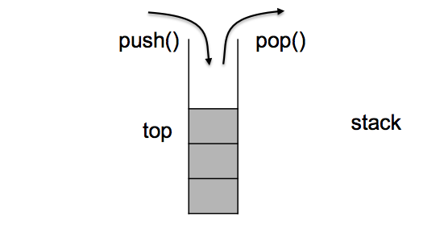


Stack (LIFO):
Push
Pop
Push
Pop
Push
Pop

Slide 4
Static Stack & Dynamic Stack
Top
Static Stack
#define MAX 8;
typedef struct stack
{
int top;
int s[MAX];
}stk;
0 | 1 | 2 | 3 | 4 | 5 | 6 | 7
S
25 | 67 | 89 | 15 | 49
Top
typedef struct stack_node
{
int data;
struct stack_node *link;
}stk;
stk *top=NULL;
49
15
89
67
25
Dynamic Stack
top
49
15
89
67
25

Slide 5
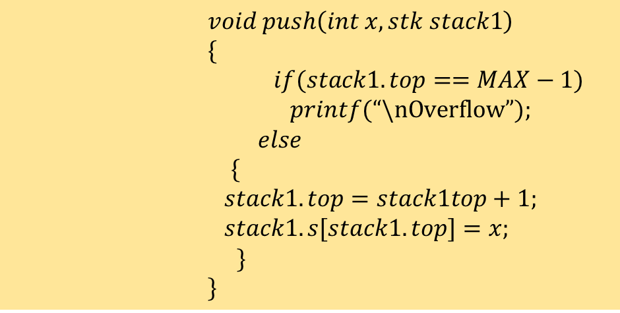
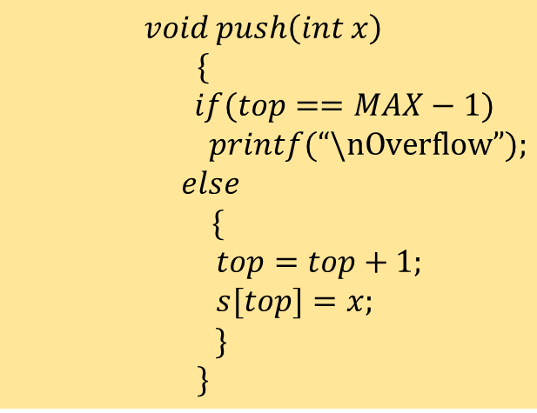
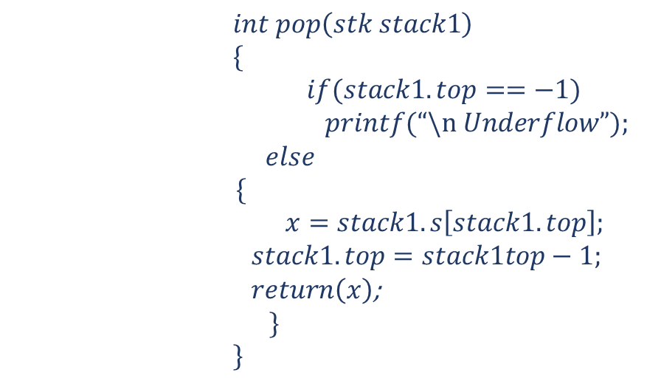
Implementation of Static Stack (using Array):
$$int pop\left(stk stack1\right)$$
$$\{$$
$$if(stack1.top==−1)$$
$$printf(“\backslash n Underflow”);$$
$$else$$
$$\{$$
$x=stack1.s\left[stack1.top\right];$
$$stack1.top=stack1top−1;$$
$return\left(x\right)$;
$$\}$$
$$\}$$
#define MAX 5;
typedef struct stack
{
int top;
int s[MAX];
}stk;
Top
0 | 1 | 2 | 3 | 4
S
25
67
89
15
49
$$void push\left(int x\right)$$
$$\{$$
$$if(top==MAX−1)$$
$$printf(“\backslash nOverflow”);$$
$$else$$
$$\{$$
$$top=top+1;$$
$$s[top]=x;$$
$$\}$$
$$\}$$
49
$$void push\left(int x, stk stack1\right)$$
$$\{$$
$$if(stack1.top==MAX−1)$$
$$printf(“\backslash nOverflow”);$$
$$else$$
$$\{$$
$$stack1.top=stack1top+1;$$
$$stack1.s[stack1.top]=x;$$
$$\}$$
$$\}$$
15
Top
89
67
25

Slide 6
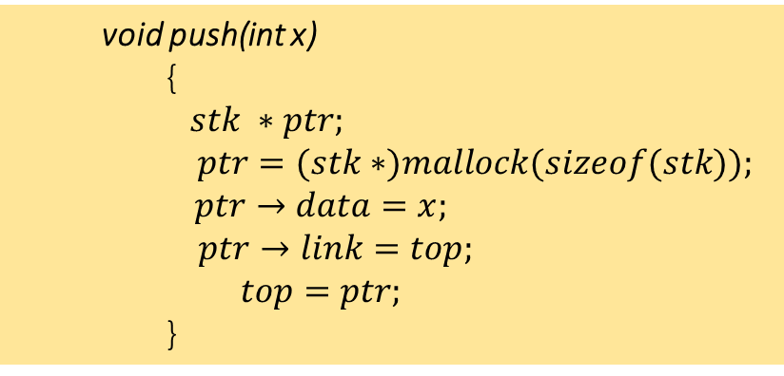
Dynamic Stack
typedef struct stack_node
{
int data;
struct stack_node *link;
}stk;
stk *top=NULL;
top
49
15
89
67
25
void push(int x)
{
$stk ∗ptr;$
$$ptr=(stk∗)mallock(sizeof(stk));$$
$$ptr→data=x;$$
$ptr→link=top;$
$$top=ptr;$$
}
int pop()
{
stk ∗ptr;
if(top)
{
ptr=top;
top=top→link;
free(ptr); // deallocating memory
}
else
printf(“/n Underflow”);
}

Slide 7
Application of stack: Transformation of Infix Arithmetic Expression into Equivalent Postfix Expression
Infix Expression | Postfix Expression | Prefix Expression
A+B
A B +
+ A B
(A+B)*C
A B + C *
* + A B C
A+(B*C)
A B C * +
+ A * B C
(A+B) / (C-D)
A B + C D - /
/ + A B - C D
D / E ^ F
D E F ^ /
/ D ^ E F
(D / E ^ F) *G
D E F ^ / G *
* / D ^ E F G
A + ( B * C – ( D / E ^ F ) * G) * H
A B C * D E F ^ / G * - H * +
?
(A+B)*C
(A B +)*C
A B + C *
(A+B) / (C-D)
(A B +) / (C-D)
(A B +) / (C D -)
A B + C D - /
(D / E ^ F) * G
(D / E F ^) * G
(D E F ^ / ) * G
D E F ^ / G *
A + ( B * C – ( D / E ^ F ) * G) * H
A + ( B C * – D E F ^ / G *) * H
A + ( B C * D E F ^ / G * -) * H
A + B C * D E F ^ / G * - H *
A B C * D E F ^ / G * - H * +

Slide 8
Infix to Postfix Conversion: Example:
( A + ( B * C – ( D / E ^ F ) * G) * H )
Symbol Scanned | STACK | Postfix Expression
1) A
(
A
2) +
( +
A
3) (
( + (
A
4) B
( + (
A B
5) *
( + ( *
A B
6) C
( + ( *
A B C
7) -
( + ( -
A B C *
8) (
( + ( - (
A B C *
9) D
( + ( - (
A B C * D
10) /
( + ( - ( /
A B C * D
11) E
( + ( - ( /
A B C * D E
12) ^
( + ( - ( / ^
A B C * D E
13) F
( + ( - ( / ^
A B C * D E F
14) )
( + ( -
A B C * D E F ^ /
15) *
( + ( - *
A B C * D E F ^ /
16) G
( + ( - *
A B C * D E F ^ / G
17) )
( +
A B C * D E F ^ / G * -
18) *
( + *
A B C * D E F ^ / G * -
19) H
( + *
A B C * D E F ^ / G * - H
20) )
A B C * D E F ^ / G * - H * +

Slide 9
Algorithm::Transformation of Infix Arithmetic Expression into Equivalent Postfix Expression
char infix[MAX]; char postfix[MAX]; // Assuming globally declared
void infix2postfix( )
{
int i=0,j=0; char ch;
//Input the infix arithmetic expression
printf(“\n Give the Infix Arithmetic Expression::”);
gets(infix); //Assumption infix starts with “(“ and ends with “)”
//read (scan) each character from infix expression
while(infix[i])
{
ch=infix[i];
switch(ch)
{
//categorize the scanned data (ch), whether it is an operand
// or operator or parenthesis (left or right)
……
}
i++;
} // end of while
postfix[j]=‘/0’; //Insert NULL character at the end of postfix exp.
puts(postfix); //Display the postfix expression
}
switch(ch)
{
case ‘(‘: push(ch); break;
case ‘)’: do
{
postfix[j++]=pop();
} while(top->data != ‘(‘);
pop(); break;
case ‘+’:
case ‘-’ :
case ‘*’:
case ‘/’ :
case ‘^’: while (priority(ch) <= priority(top->data))
{
postfix[j++]=pop();
}
push(ch); break;
default: postfix[j++]=ch;
} // end of switch

Slide 10
Algorithm::Transformation of Infix Arithmetic Expression into Equivalent Postfix Expression
Limitations of the above Algorithm:
Assumption:: Single character operand:: (5+7*3)
Multicharacter operand ???
2) Left associativity property is maintain only :: A + B + C
Right Associativity property is not maintained here:: A ^ B ^ C
How to incorporate the right associativity property in this algorithm?
Int priority (char op)
{
switch(ch)
{
case ‘^’ : return(5);
case ‘*’:
case ‘/’ : return(3);
case ‘+’:
case ‘-’ : return(2);
default: return(1); // for ‘(‘
}
}
case ‘+’:
case ‘-’ :
case ‘*’:
case ‘/’ :while (priority(ch) <= priority(top->data))
{
postfix[j++]=pop();
}
push(ch); break;
case ‘^’ : push(ch);
break;

Slide 11
Application of stack: Postfix Evaluation
Infix Expression : 5 * ( 6 + 2 ) - 8 / 4
Postfix Expression: 5 6 2 + * 8 4 / -
Postfix Expression: 5 6 2 + * 8 4 / -
Symbol Scanned | STACK
void postfix_evaluation( char postfix[])
{
int i=0;
char ch;
while(postfix[i])
{
ch=postfix[i];
switch(ch)
{
//categorize the scanned data (ch),
//whether it is an operand or operator
……..
} // end of switch
i++;
} // end of while
} // end of function
1) 5
5
2) 6
5, 6
Top
3) 2
5, 6, 2
2
4
4) +
5, 8
6
8
2
5) *
40
5
40
38
6) 8
40, 8
STACK
7) 4
40, 8, 4
8) /
40, 2
9) -
38
10) /0

Slide 12
Algorithm: Postfix Evaluation
void postfix_evaluation( char postfix[])
{
int i=0, x, y, r;
char ch;
while(postfix[i])
{
ch=postfix[i];
switch(ch)
{
//categorize the scanned data (ch),
//whether it is an operand or operator
……..
} // end of switch
i++;
} // end of while
} // end of function
switch()
{
case ‘+’: y=pop(); x=pop(); push(x+y);break;
case ‘-’: y=pop(); x=pop(); push(x-y);break;
case ‘*’: y=pop(); x=pop(); push(x*y);break;
case ‘/’: y=pop(); x=pop(); push(x/y);break;
case’^’: y=pop(); x=pop(); push(x^y);break;
default: r=ch-’0’; push(r); // operand r
}

Slide 13
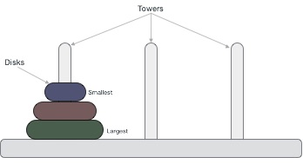
What is the Tower of Hanoi problem?
The Tower of Hanoi (also called the Tower of Brahma or Lucas' Tower) is a mathematical game or puzzle. It consists of three rods and a number of disks of different sizes, which can slide onto any rod. The puzzle starts with the disks in a neat stack in ascending order of size on one rod, the smallest at the top, thus making a conical shape.
Rules
The mission is to move all the disks to some another tower without violating the sequence of arrangement. A few rules to be followed for Tower of Hanoi are −
Only one disk can be moved among the towers at any given time.
Only the "top" disk can be removed.
No large disk can sit over a small disk.
https://www.tutorialspoint.com/data_structures_algorithms/images/tower_of_hanoi_two_disks.gif

Slide 14


Algorithm:: Tower of Hanoi problem
To write an algorithm for Tower of Hanoi, first we need to learn how to solve this problem with lesser amount of disks, say → 1 or 2. We mark three towers with name, source, destination and aux (only to help moving the disks). If we have only one disk, then it can easily be moved from source to destination peg.
If we have 2 disks −
First, we move the smaller (top) disk to aux peg.
Then, we move the larger (bottom) disk to destination peg.
And finally, we move the smaller disk from aux to destination peg.
n=2
n=3
A
Source
C
Destination
B
Auxiliary
A
Source
C
Destination
B
Auxiliary
Total no. of moves = 3= $2^{2}−1$
Total no. of moves = 7= $2^{3}−1$

Slide 15

Algorithm:: Tower of Hanoi problem (Cont…)
void tower_hanoi (char A, char C, char B, int n)
{
if(n=1)
{
printf(“\n Move %c to %c “, A, C);
}
else
{
tower_hanoi ( A, B, C, n-1);
printf(“\n Move %c to %c “, A, C);
tower_hanoi ( B, C, A, n-1);
}
}
n=3
A
Source
C
Destination
B
Auxiliary
Total no. of moves = 7= $2^{3}−1$

