Slide 1

Data Structure & Algorithms (PCC-CS301)
Lecture 7
Dr. Dipak Kumar Kole
Professor, Dept. of CSE, JGEC
Email: dipak.kole@cse.jgec.ac.in

Slide 2
Outline : Lecture 7
Queue (FIFO)
Static Queue & Dynamic Queue
Representation & Implementation of Static Linear Queue
Insertion
Deletion
Display
Representation & Implementation of Dynamic Linear Queue
Insertion
Deletion
Display
Linear Queue, Double ended Queue, Priority Queue and Circular Queue
Circular Queue
Advantage of Circular Queue over Linear Queue
Implementation (Insertion, Deletion & Display)

Slide 3

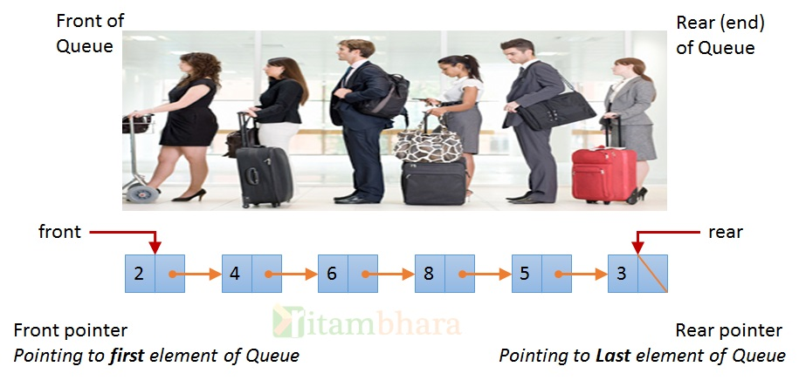
Queue (FIFO):
Rear
Front
Front
Rear
0 | 1 | 2 | 3 | 4
2 | 4 | 6

Slide 4
Static Queue & Dynamic Queue
front
rear
Static Queue
#define MAX 8;
typedef struct queue
{
int front;
int rear;
int Q[MAX];
}queue;
typedef struct queue_node
{
int data;
struct queue_node *link;
}qnode;
qnode *rear=NULL, *front=NULL;
0 | 1 | 2 | 3 | 4 | 5 | 6 | 7
Q
25 | 67 | 89 | 15 | 49
Dynamic Queue
rear
front
25
67
89
15
49

Slide 5
Implementation of Static Queue (using Array):
Operation | Front | Rear
Initial
0
-1
Insert(25)
0
0
#define MAX 5;
typedef struct queue
{
int front;
int rear;
int Q[MAX];
}queue;
Insert(67)
0
1
Insert(89)
0
2
0 | 1 | 2 | 3 | 4
3
Insert(15)
0
Q
25
67
89
15
49
Insert(49)
0
4
Delete
1
4
int delete (queue qu1)
{
if(qu1.front> qu1.rear)
printf(“\n Underflow”);
else
{
x=qu1.Q[qu1.front];
qu1.front=qu1.front+1;
return(x);
}
}
Delete
2
4
void insert(int x, queue qu1)
{
if(qu1.rear==MAX-1)
printf(“\nInsertion is not possible);
else
{
qu1.rear=qu1.rear+1;
qu1.Q[qu1.rear]=x;
}
}
Delete
3
4
Delete
4
4
Delete
5
4
void display()
{
printf(“\nFront->”);
for(int i=front; i<=rear; i++)
printf(“%d”,qu1.Q[i]);
printf(“<-Rear/n”);
}

Slide 6
Dynamic Queue
rear
front
typedef struct queue_node
{
int data;
struct queue_node *link;
}qnode;
qnode *rear=NULL, *front=NULL;
25
67
89
15
49
int delete()
{
qnode ∗ptr;
if(front)
{
ptr=front;
front=front→link;
free(ptr); // deallocating memory
}
else
printf(“/n Underflow”);
}
void display()
{
qnode ∗ptr=front;
printf(“\nFront->”);
while(ptr)
{
printf(“ %d”,ptr->data);
ptr=ptr→link;
}
printf(“<-Rear\n”);
}
void insert (int x)
{
qnode∗ptr;
ptr=(qnode∗)mallock(sizeof(qnode));
ptr→data=x;
ptr→link=NULL;
rear=ptr;
}

Slide 7
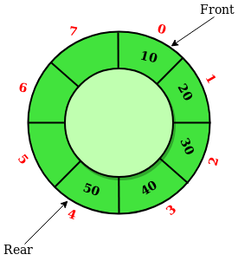
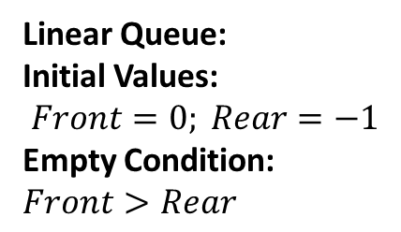
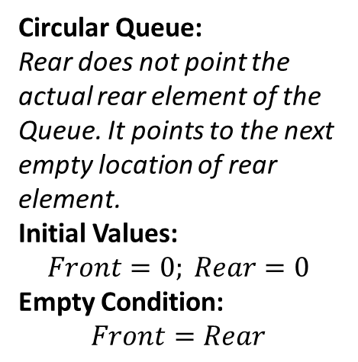
Problem of Linear Queue:
Operation | Front | Rear
Initial | 0 | -1
Insert(25) | 0 | 0
Insert(67) | 0 | 1
Insert(89) | 0 | 2
Insert(15) | 0 | 3
Insert(49) | 0 | 4
delete | 1 | 4
delete | 2 | 4
Insert?
0 | 1 | 2 | 3 | 4
Q
25
67
89
15
49
Linear Queue:
Initial Values:
$$Front=0; Rear=−1$$
Empty Condition: $Front>Rear$
Circular Queue:
Rear does not point the actual rear element of the Queue. It points to the next empty location of rear element.
Initial Values:
$$Front=0; Rear=0$$
Empty Condition:
$$Front=Rear$$
Circular Queue

Slide 8
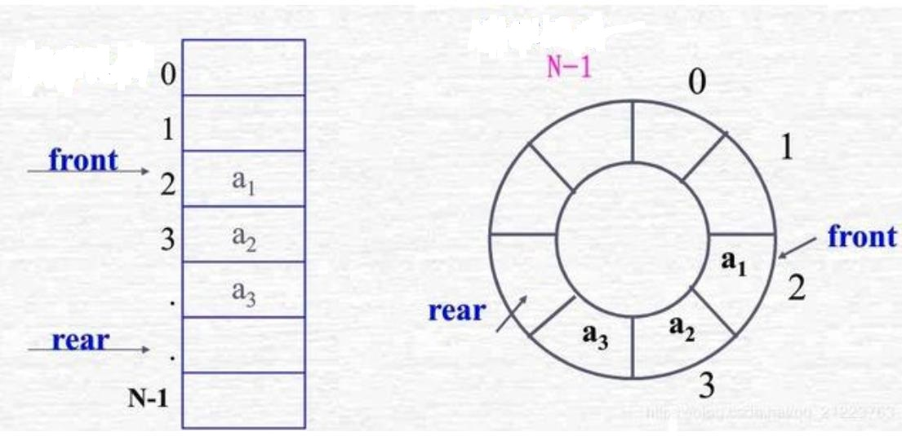
Implementation of Circular Queue:
void insert(int x, cqueue cqu1)
{
if( (cqu1.rear+1)%MAX== cqu1.front )
printf(“\nInsertion is not possible);
else
{
cqu1.Q[cqu1.rear]=x;
cqu1.rear=(cqu1.rear+1)%MAX;
}
}
#define MAX 5;
typedef struct queue
{
int front;
int rear;
int Q[MAX];
}cqueue;
cqueue cqu1;
//cqu1.front=0;
//cqu1.rear=0;
int delete (cqueue cqu1)
{
if(cqu1.front== cqu1.rear)
printf(“\n Underflow”);
else
{
x=cqu1.Q[cqu1.front];
cqu1.front=(cqu1.front+1)%MAX;
return(x);
}
}
void display()
{
printf(“\nFront->”);
for(int i=front; i!=rear; )
{
printf(“%d”,qu1.Q[i]);
i=(i+1)%MAX;
}
printf(“<-Rear/n”);
}

Slide 9
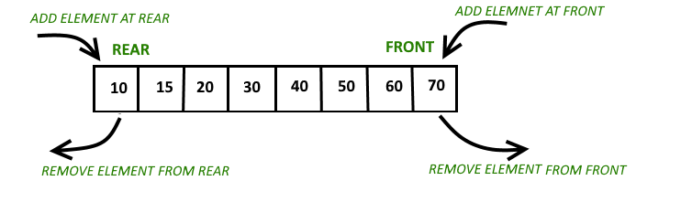
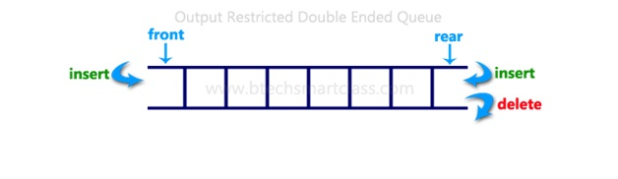
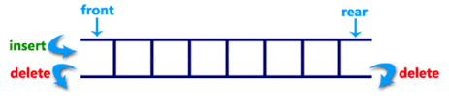
Dequeue:
Input Restricted Dequeue
Output Restricted Dequeue

Slide 10
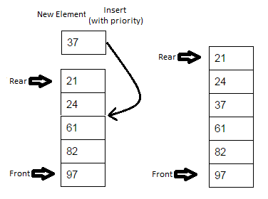
Priority Queue:
A priority queue is a special type of queue in which each element is associated with a priority and is served according to its priority. If elements with the same priority occur, they are served according to their order in the queue.
Application of Priority Queue:
Priority queues are used in operating system for load balancing and interrupt handling.
Priority queues are used in huffman codes for data compression.
In traffic light, depending upon the traffic, the colors will be given priority.

