Slide 1

Data Structure & Algorithms (PCC-CS301)
Lecture 8
Dr. Dipak Kumar Kole
Associate Professor, Dept. of CSE, JGEC
Email: dipak.kole@cse.jgec.ac.in

Slide 2
Outline : Lecture 8
Binary Search Trees (BST)
Searching in BST
Inserting in BST
Complexity of the Searching Algorithm in BST
Deleting in a BST
Problems of BST
AVL Search Trees
Insertion in an AVL Search Trees
m- Way Search Trees
B Trees
B+ -Trees
Heap Trees (Max / Min Heap)
Inserting into a Heap
Deleting the Root of a Heap
Heap Sort
Trees
Binary Trees
Complete Binary Trees
Extended Binary Trees: 2-Trees
Representation Binary Trees in Memory
Linked Representation of Binary Trees
Sequential Representation of Binary Trees
Traversing Binary Trees
Preorder Traversal
Inorder Traversal
Postorder Traversal
Threaded Binary Trees
Inorder Threading (One Way / Two Way)
Preorder Threading (One Way / Two Way)

Slide 3

Tree

Slide 4

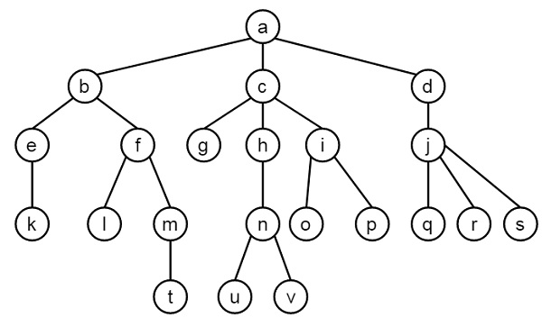
Trees:
Root Node
Leaf Nodes

Slide 5
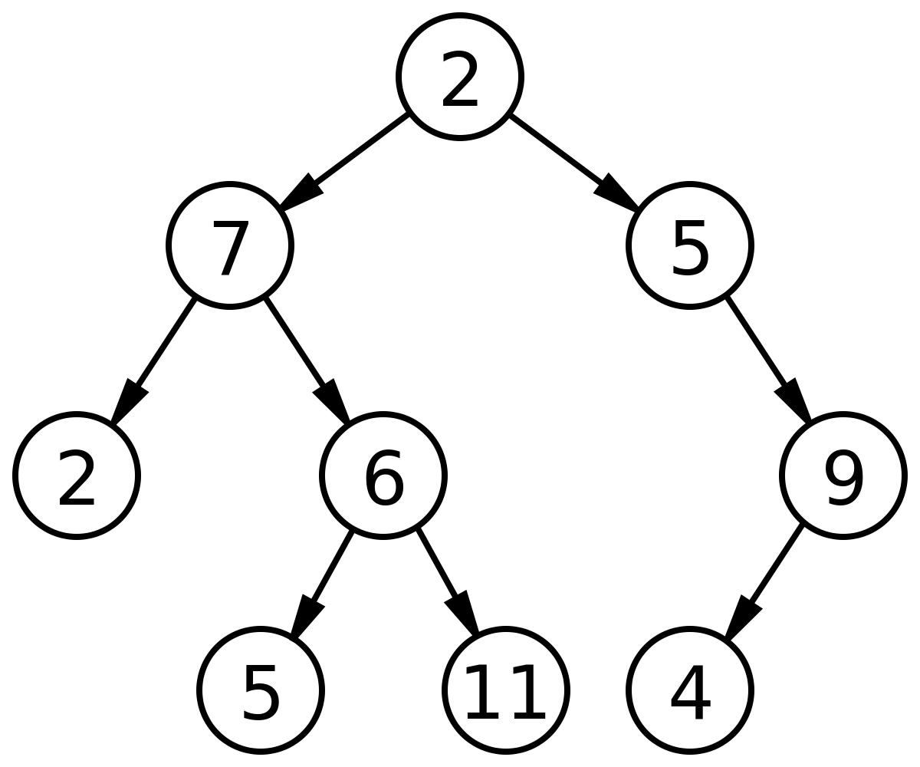
Binary Tree:
Complete Binary Tree
Full Binary Tree

Slide 6
Extended Binary Tree: 2-Tree
A Binary tree with special nodes replacing every null subtree. Every regular node has two children and every special node has no children.
Application: Huffman’s Algorithm (Huffman coding is a lossless data compression algorithm. In this algorithm, a variable-length code is assigned to input different characters. The code length is related to how frequently characters are used. Most frequent characters have the smallest codes and longer codes for least frequent characters.)

Slide 7
Representation Binary Trees in Memory:
T
R
0
1
2
3
4
5
6
7
8
9
10
11
12
13
2
7
5
2
6
9
5
11
4
R
2
25
67
89
15
49
7
5
2
6
9
5
11
4
Linked Representation of Binary Trees
Sequential Representation of Binary Trees

Slide 8
Traversing Binary Trees
Preorder: 2 7 2 6 5 11 5 9 4
Preorder
Process the root R
Traverse the left subtree of R in preorder
Traverse the right subtree of R in preorder
R
2
Inorder: 2 7 5 6 11 2 5 4 9
25
67
89
15
49
7
5
Inorder
Traverse the left subtree of R in inorder
Process the root R
Traverse the right subtree of R in inorder
2
6
9
5
11
4
Postorder: 2 5 11 6 7 4 9 5 2
Postorder
Traverse the left subtree of R in postorder
Traverse the right subtree of R in postorder
Process the root R

Slide 9
Traversing Algorithms of Binary Trees: Preorder
Preorder: 2 7 2 6 5 11 5 9 4
typedef struct tree_node
{
int data;
struct tree_node *left;
struct tree_node *right;
} tnd;
Preorder
Process the root R
Traverse the left subtree of R in preorder
Traverse the right subtree of R in preorder
R
2
void preorder ( tnd *root)
{
if(root!=NULL)
{
printf(“ %d”, root->data);
preorder(root->left);
preorder(root->right);
}
}
25
67
89
15
49
7
5
2
6
9
5
11
4

Slide 10
Traversing Algorithms of Binary Trees: Inorder
Inorder: 2 7 5 6 11 2 5 4 9
typedef struct tree_node
{
int data;
struct tree_node *left;
struct tree_node *left;
} tnd;
Inorder
Traverse the left subtree of R in inorder
Process the root R
Traverse the right subtree of R in inorder
R
2
void inorder ( tnd *root)
{
if(root!=NULL)
{
inorder(root->left);
printf(“ %d”, root->data);
inorder(root->right);
}
}
25
67
89
15
49
7
5
2
6
9
5
11
4

Slide 11
Traversing Algorithms of Binary Trees: Postorder
Postorder: 2 5 11 6 7 4 9 5 2
typedef struct tree_node
{
int data;
struct tree_node *left;
struct tree_node *left;
} tnd;
Postorder
Traverse the left subtree of R in postorder
Traverse the right subtree of R in postorder
Process the root R
R
2
void postorder ( tnd *root)
{
if(root!=NULL)
{
postorder(root->left);
postorder(root->right);
printf(“ %d”, root->data);
}
}
25
67
89
15
49
7
5
2
6
9
5
11
4

Slide 12
Threaded Binary Trees
Consider the linked representation of binary tree T. Approximately half of the entries in the pointer fields LEFT and RIGHT will contain null elements.
R
2
This space may be more efficiently used by replacing the null entries by some other type of information. Specifically, we will replace certain null entries by special pointers which point to nodes higher in the tree. These special pointers are called threads and binary trees with such pointers are called threaded binary tress.
25
67
89
15
49
7
5
2
6
9
There are many ways to thread a binary tree T, but each threading will corresponding to a particular traversal of T (Inorder and Preorder only)
One-way Threading
Two-way threading
5
11
4

Slide 13
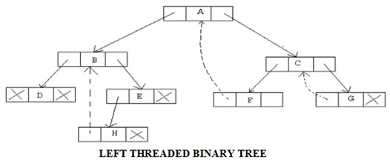
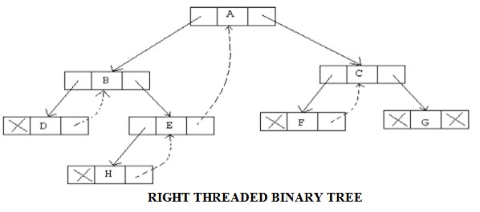
Inorder Threaded Binary Trees
Inorder: D B H E A F C G

Slide 14
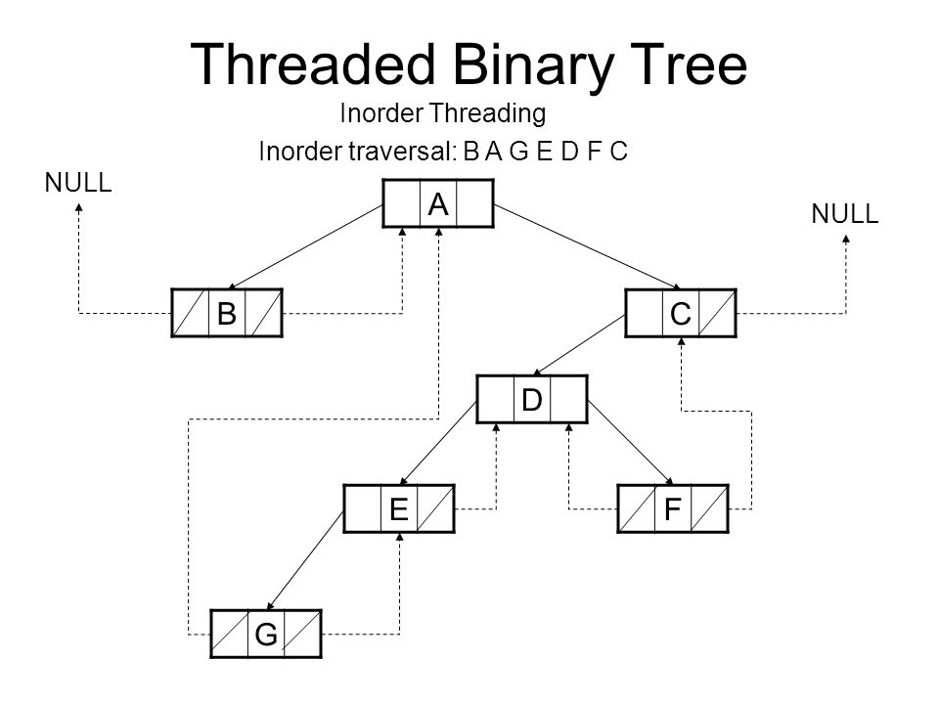

Slide 15
Binary Search Trees (BST):
A binary tree T is called a binary search tree (BST) if each node N of T has the following property: The value at N is greater than every value in the left subtree of N and is less than every value in the right subtree of N.
R
19
25
67
89
15
49
7
25
Inorder Traversal: ?
2
9
29
Inorder traversal of T will yield a sorted listing of the elments of T.
Inorder: 2 7 8 9 11 19 25 26 29
Modified Binary search Trees
8
11
26

Slide 16
Binary Search Trees (BST): Insertion & Searching
Inserting in Binary Search Tree
R
40, 60, 50, 33, 55, 11
40
25
67
89
15
49
tnd *search (tnd *root, int x)
{
tnd *t;
t=root;
while((t!=NULL) && (t->data!=x))
{
if (x<t->data)
t=t->left;
else
t=t->right;
}
return(t);
}
33
60
11
50
55
Note:
If (t==NULL), then search is unsuccessful
If (t!=NULL), then search is successful

Slide 17



Binary Search Trees (BST): Complexity of Searching
Inserting in Binary Search Tree
R
40, 60, 70, 80, 90, 95
R
40
f(n)=n=O(n)
25
89
67
15
49
60
19, 7, 25, 2, 9, 22, 29
19
25
67
89
15
49
70
$$f(n)=\log_{2}{n}=O(\log{n})$$
7
25
80
2
9
22
29
90
$$O\left(\log{n}\right)≤f\left(n\right)≤O(n)$$
Complete Binary Tree Structure
95
$$f\left(n\right)=O(h)$$
Right Skew Binary Tree Structure

Slide 18
Binary Search Trees (BST): Deletion
The deletion algorithm first uses a Algorithm to find the location of the node N which contains ITEM and also the location of the parent node P(N).
The way N is deleted from the tree depends primarily on the number of children of node N. There are three cases:
Case 1: N has no children. Then N is deleted from T simply replacing the location of N in the parent node P(N) by the null pointer.
Case 2: N has exactly one child. Then N is deleted from T by simply replacing the location of N in P(N) by the location of the only child of N.
Case 3: N has two children. Let S(N) denote the inorder successor of N. Then N is deleted from T by first deleting S(N) from T (by using Case 1 or Case 2) and replacing node N in T by the node S(N).
R
25
89
19
25
67
89
15
49
7
25
2
9
22
29
Complete Binary Tree Structure
Inoder: 2, 7, 9, 19, 22, 25, 29

Slide 19
Binary Search Trees (BST): Deletion
Case 1: N has no children. Then N is deleted from T simply replacing the location of N in the parent node P(N) by the null pointer.
R
25
89
19
Delete 9
25
67
89
15
49
7
25
2
9
22
29

Slide 20
Binary Search Trees (BST): Deletion
Case 2: N has exactly one child. Then N is deleted from T by simply replacing the location of N in P(N) by the location of the only child of N.
R
25
89
19
P(N)
Delete 22
25
67
89
15
49
7
25
2
9
22
29
N
23

Slide 21
Binary Search Trees (BST): Deletion
Case 3: N has two children. Let S(N) denote the inorder successor of N. Then N is deleted from T by first deleting S(N) from T (by using Case 1 or Case 2) and replacing node N in T by the node S(N).
R
25
89
19
N
25
67
89
15
49
Delete 25
7
29
25
S(N)
S(N)
Inoder: 2, 7, 9, 19, 22, 23, 25, 29
2
9
22
29
N
23

Slide 22

Problems of BST: Searching
R
R
R
40
90
40
49
25
90
67
25
89
67
15
89
15
49
80
60
50
70
70
80
60
60
80
50
90
75
20
95
Left Skew Binary Search Tree
Zig Zag Binary Search Tree
Right Skew Binary Search Tree
Worst Case time Complexity, $f\left(n\right)=O(n)$

Slide 23

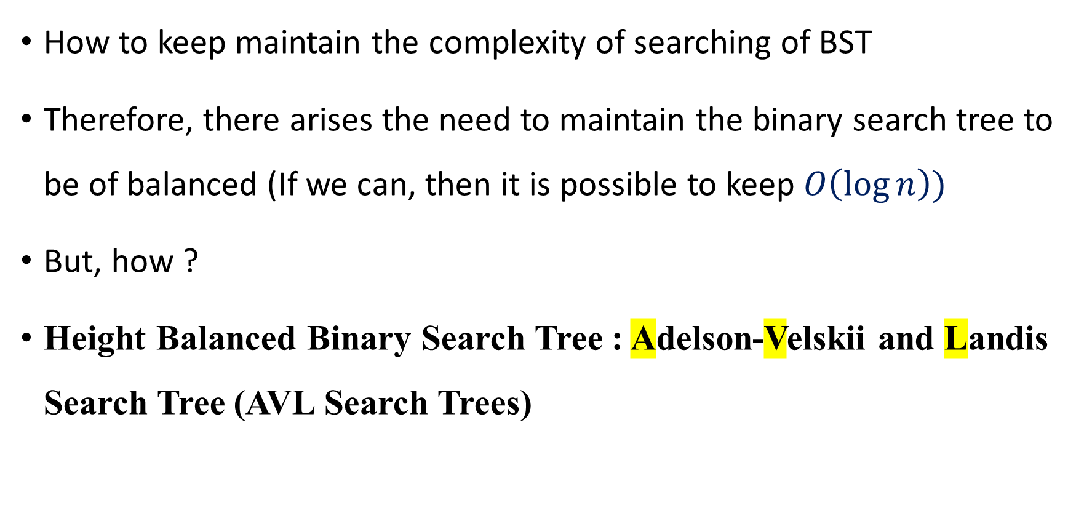
Problems of BST: Searching
How to keep maintain the complexity of searching of BST
Therefore, there arises the need to maintain the binary search tree to be of balanced (If we can, then it is possible to keep $O\left(\log{n}\right))$
But, how ?
Height Balanced Binary Search Tree : Adelson-Velskii and Landis Search Tree (AVL Search Trees)
$$f(n)=O(\log{n})$$

Slide 24
AVL Trees

Slide 25
Balanced and unbalanced BST
1
4
2
2
5
3
1
3
4
4
Is this “balanced”?
5
2
6
6
1
3
5
7
7

Slide 26
Approaches to balancing trees
Don't balance
May end up with some nodes very deep
Strict balance
The tree must always be balanced perfectly
Pretty good balance
Only allow a little out of balance

Slide 27
Balancing Binary Search Trees
Many algorithms exist for keeping binary search trees balanced
Adelson-Velskii and Landis (AVL) trees (height-balanced trees)
Splay trees and other self-adjusting trees
B-trees and other multiway search trees

Slide 28
Perfect Balance
Want a complete tree after every operation
tree is full except possibly in the lower right
This is expensive
For example, insert 2 in the tree on the left and then rebuild as a complete tree
6
5
Insert 2 &
complete tree
4
9
2
8
1
5
8
1
4
6
9

Slide 29
AVL - Good but not Perfect Balance
AVL trees are height-balanced binary search trees
Balance factor of a node
height(left subtree) - height(right subtree)
An AVL tree has balance factor calculated at every node
For every node, heights of left and right subtree can differ by no more than 1
Store current heights in each node

Slide 30
Node Heights
Tree A (AVL)
Tree B (AVL)
BF=2-1=1
0
6
6
0
0
0
1
4
9
4
9
0
0
0
0
0
1
5
1
5
8
height of node = h
balance factor = h_{left}-h_{right}
empty height = -1

Slide 31
Node Heights after Insert 7
Tree A (AVL)
Tree B (not AVL)
0
2-3=-1
balance factor
2-0 = 2
6
6
0
1
0
2
4
9
4
9
0
0
0
0
0
1
1
5
7
1
5
8
0
7
height of node = h
balance factor = h_{left}-h_{right}
empty height = -1

Slide 32
Insert and Rotation in AVL Trees
Insert operation may cause balance factor to become 2 or –2 for some node
only nodes on the path from insertion point to root node have possibly changed in height
So after the Insert, go back up to the root node by node, updating heights
If a new balance factor (the difference h_{left}-h_{right}) is 2 or –2, adjust tree by rotation around the node

Slide 33
Single Rotation in an AVL Tree
-1
2
6
6
0
2
1
1
4
9
4
8
0
0
1
0
0
0
0
1
5
8
1
5
7
9
0
7

Slide 34
AVL Insertion:
j
Consider a valid
AVL subtree
k
h
Z
h
h
X
Y

Slide 35
AVL Insertion: Outside Case
j
Inserting into X
destroys the AVL
property at node j
k
h
Z
h+1
h
Y
X

Slide 36
AVL Insertion: Outside Case
j
Do a “right rotation”
k
h
Z
h+1
h
Y
X

Slide 37
Single right rotation
j
Do a “right rotation”
k
h
Z
h+1
h
Y
X

Slide 38
Outside Case Completed
k
“Right rotation” done!
(“Left rotation” is mirror
symmetric)
j
h+1
h
h
X
Y
Z
AVL property has been restored!

Slide 39
AVL Insertion: Inside Case
j
Y = node i and
subtrees V and W
k
h
Z
i
h
h+1
X
h or h-1
V
W

Slide 40
AVL Insertion: Inside Case
j
We will do a left-right
“double rotation” . . .
k
Z
i
X
V
W

Slide 41
Double rotation : first rotation
j
left rotation complete
i
Z
k
W
V
X

Slide 42
Double rotation : second rotation
j
Now do a right rotation
i
Z
k
W
V
X

Slide 43
Double rotation : second rotation
right rotation complete
Balance has been
restored
i
k
j
h
h
h or h-1
V
X
W
Z

Slide 44
Implementation
balance (1,0,-1)
key
left
right
No need to keep the height; just the difference in height, i.e. the balance factor; this has to be modified on the path of insertion even if you don’t perform rotations
Once you have performed a rotation (single or double) you won’t need to go back up the tree

Slide 45
Insertion in AVL Trees
Insert at the leaf (as for all BST)
only nodes on the path from insertion point to root node have possibly changed in height
So after the Insert, go back up to the root node by node, updating heights
If a new balance factor (the difference h_{left}-h_{right}) is 2 or –2, adjust tree by rotation around the node

Slide 46
Example of Insertions in an AVL Tree
-1
20
Insert 5, 40
0
0
10
30
0
0
25
35

Slide 47
Example of Insertions in an AVL Tree
-2
20
1
-1
10
30
0
1
20
0
0
5
25
35
1
0
10
30
0
0
0
0
40
1
5
25
35
30
1
-1
20
35
0
0
0
Insert 5, 40
10
25
40
5
0

Slide 48
Double rotation
-2
-2
-1
20
20
20
1
-2
1
-2
1
0
10
30
10
30
10
35
0
0
1
0
0
1
0
0
0
5
Imbalance
25
40
5
25
35
5
30
40
1
1
0
25
0
0
35
45
0
34
40
0
34
45
Insertion of 34
0
0
34
45

