Slide 1
ANZ Data Analytics
Explotary Data Analysis
Sourav Mandal

Slide 2
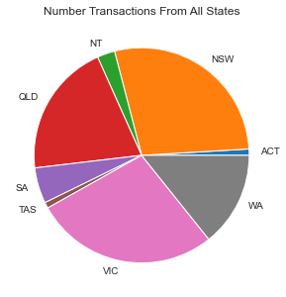
Data Insights
Contribution Of Transactions From All States
It has been found that most of the transaction has been done from/to the states QLD, NSW and VIC.
Average Transaction Amount is
$ 187.93358797641767.

Slide 3
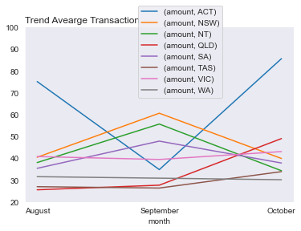
Trend in transaction amount of each state in three months
There is an irregularity in transaction amounts in 3 months.
There is an increase in transaction amount inthe state QLD while there is a slight decrease in WA.
There is a dramatic fall in September in ACT and then it rises again.
Although the amount in NSW, NT and SA rises in September but it falls again.

Slide 4
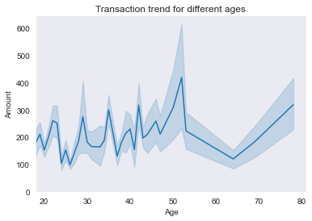
Data Insights
Trend in transaction with age of the customers
There is an irregularity in transaction amounts for the age of 45 years.
The people with the age around 50 years have done the most expensive transactions.
There is a drastic decrease in amounts of transactions from the people of age 50 to 65(Approx).
There is an increase in transaction amount for the people from age 65 to 78.

Slide 5
Thank You.

