Slide 1

Note: The data and information in this document is reflective of a hypothetical situation and client. This document is to be used for KPMG Virtual Internship purposes only.
Sprocket Central Pty Ltd
Data analytics approach
Sourav Mandal

Slide 2
Note: The data and information in this document is reflective of a hypothetical situation and client. This document is to be used for KPMG Virtual Internship purposes only.
Agenda
Introduction
Data Exploration
Model Development
Interpretation

Slide 3
Note: The data and information in this document is reflective of a hypothetical situation and client. This document is to be used for KPMG Virtual Internship purposes only.
Introduction
Identifying and recommending High Value Customers
Outline Of Problem
Sprocket Central is a company that specializes in high quality bike accessories.
The Marketing teams is looking to boost sales.
To target 1000 new customers that will bring highest value to the bussiness.
Approach For Data Analysis
Profit of Wealth Segment by Age Category.
Numbers of cars owned in each state.
Top Industries contributing the maximum profit and bike related sales.
Bike Related Purchase Over Last Three Years On Gender.

Slide 4
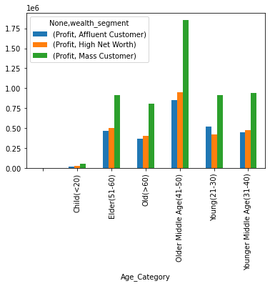
Note: The data and information in this document is reflective of a hypothetical situation and client. This document is to be used for KPMG Virtual Internship purposes only.
Data Exploration
Profit of Wealth Segment by Age Category
Overall, among the different Age Category, Mass Customer segment of the Wealth Category makes the highest profit.
Mass Customer Aged between 41-50 are likely to bring more profit for the company compared to other groups.
This also shows a trend in increase in buying power of customers till the age of 50 then it gradually decrease, thus leading to a lower profit.
Place any supporting images, graphs, data or extra text here.

Slide 5
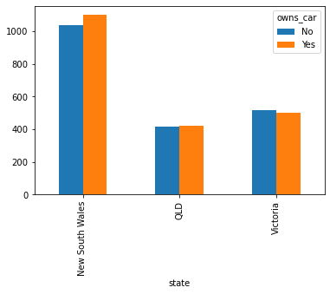
Note: The data and information in this document is reflective of a hypothetical situation and client. This document is to be used for KPMG Virtual Internship purposes only.
Data Exploration
Numbers of cars owned in each state.
New South Wales could be potential market opportunities for the company
New South Wales, has the highest potential as the number of people that own car is almost equal to the people who don’t own cars which shows that there is opportunity to find value customers there.

Slide 6
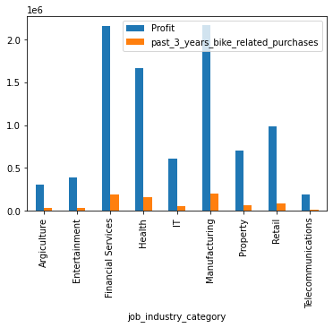
Note: The data and information in this document is reflective of a hypothetical situation and client. This document is to be used for KPMG Virtual Internship purposes only.
Data Exploration
Top Industries contributing the maximum profit and bike related sales.
Manufacturing and Financial Services followed by Health industries brings the highest profit to the company.
This can be obvious as most of these industry sectors are based within the city or on the outside of the city therefore consumers prefer bikes for commuting.
Most of the industry sectors have returned less than $1 million in profits.
In millions

Slide 7
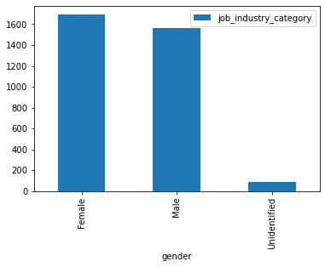
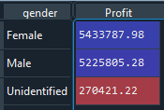
Note: The data and information in this document is reflective of a hypothetical situation and client. This document is to be used for KPMG Virtual Internship purposes only.
Data Exploration
Bike Related Purchase Over Last Three Years On Gender.
In Past 3 years, Females Have Purchased more Bikes than Males.
On an Average Females have 1% higher bike related purchase compared to men in the last 3 years.
Even Female Contributes more profit than that of Male.

Slide 8
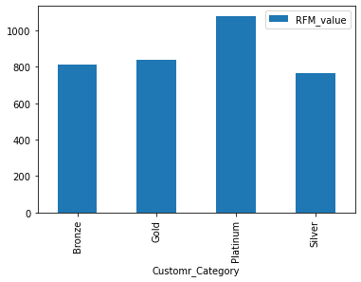
Note: The data and information in this document is reflective of a hypothetical situation and client. This document is to be used for KPMG Virtual Internship purposes only.
Model Development
Customer Classification – Targeting High Value Customers.
We Performed RFM Technique Of Classification to group the Customers in Platinum, Gold, Silver and Bronze Customers According to their RFM values And to find the high value customers that should be targeted from the new list:
Most of the high value customers will be female as compared to male.
Working in the financial services, health and manufacturing industry sector.
Aged between 41-50.
Who are currently living in New South Whales.

Slide 9
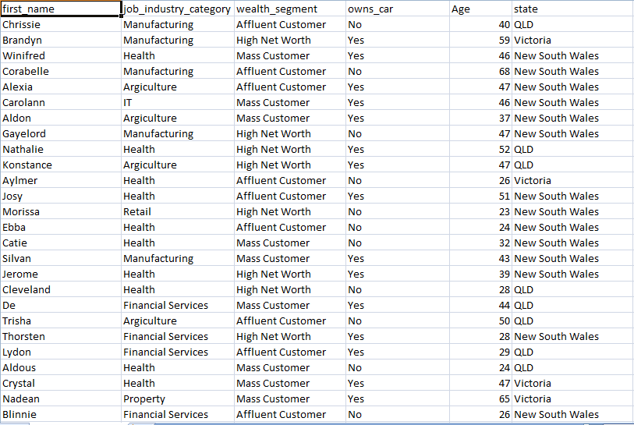
Note: The data and information in this document is reflective of a hypothetical situation and client. This document is to be used for KPMG Virtual Internship purposes only.
Interpretation
Summary Table for High Value Customers
Here is a snapshot of a few customer that will come under high value customer classification.

Slide 10
These were the customer id of the top 1000 customers
419, 3290, 1438, 1905, 768, 1182, 165, 2492, 167, 2659, 2653, 753, 1428, 173, 174, 2651, 1885, 3118, 322, 180, 3375, 182, 320, 2992, 577, 2993, 739, 1232, 1233, 1446, 548, 1404, 3286, 357, 1137, 2705, 1942, 2929, 1140, 2183, 3402, 2308, 1470, 2698, 534, 799, 2695, 538, 2476, 144, 1158, 2374, 793, 790, 346, 151, 344, 1460, 3283, 2369, 195, 310, 124, 235, 668, 3315, 239, 1313, 3074, 3344, 3044, 1792, 1317, 2548, 3048, 621, 3337, 1328, 1773, 1770, 1329, 1331, 2301, 2304, 1358, 640, 637, 1357, 1748, 1346, 2310, 669, 234, 729, 1802, 2999, 200, 725, 1396, 721, 2523, 1252, 719, 1830, 1706, 3007, 2341, 704, 2340, 2339, 298, 3086, 605, 695, 1722, 2606, 2603, 1726, 1291, 3080, 1299, 2335, 2379, 2937, 270, 2013, 52, 2851, 2109, 2023, 1558, 2434, 2111, 906, 3199, 820, 902, 2856, 3202, 2859, 1000, 3217, 2083, 2860, 3251, 995, 973, 1068, 2747, 3451, 2816, 2060, 2120, 23, 407, 953, 3232, 2836, 946, 25, 2055, 2841, 3470, 1028, 37, 934, 2029, 1033, 2791, 925, 2103, 2822, 2428, 2762, 2761, 2033, 2850, 2794, 1074, 2865, 886, 3262, 2386, 2418, 2728, 2458, 1506, 2149, 983, 2464, 2152, 1115, 109, 2914, 3433, 3169, 3420, 3225, 498, 3223, 1492, 117, 2465, 3157, 2165, 515, 99, 377, 1625, 2391, 975, 3191, 1076, 2737, 1530, 1084, 2879, 1086, 2070, 2072, 2130, 1091, 2826, 1578, 89, 1991, 91, 3256, 2884, 381, 1629, 1740, 1745, 1577, 1367, 433, 1353, 3231, 2318, 359, 611, 1600, 3151, 1478, 368, 2372, 1511, 2358, 478, 1519, 2498, 1691, 318, 3300, 3112, 2505, 1407, 1545, 307, 1390, 2530, 2531, 1713, 3241, 1721, 443, 442, 3077, 2425, 1549, 1, 789, 187, 110, 835, 115, 1953, 1950, 2923, 2942, 142, 796, 1925, 3395, 786, 1165, 2680, 1893, 2647, 1217, 2990, 185, 3427, 1970, 856, 1054, 3495, 993, 2082, 2088, 2796, 1014, 945, 928, 2027, 1098, 908, 903, 2751, 76, 1993, 2732, 1990, 1985, 1867, 1824, 2641, 723, 3013, 215, 2611, 2618, 1274, 2621, 2622, 2585, 1318, 656, 1798, 260, 1760, 730, 2633, 633, 3335, 1763, 652, 2730, 116, 1221, 3088, 990, 1104, 2607, 3183, 410, 1515, 440, 962, 1301, 86, 1996, 1999, 3154, 470, 2009, 1315, 955, 3468, 1480, 2559, 338, 1702, 825, 2479, 1914, 2958, 2251, 1758, 2672, 172, 1690, 328, 1134, 2935, 217, 776, 1467, 56, 398, 1207, 576, 772, 3105, 556, 2831, 736, 2808, 2427, 918, 1586, 1449, 1184, 2555, 513, 1308, 1062, 829, 1123, 703, 1471, 3016, 2536, 533, 3181, 2947, 2892, 3012, 2729, 1589, 2597, 2623, 1303, 2961, 1378, 2683, 545, 1306, 2712, 2805, 2195, 2057, 2053, 3255, 374, 2044, 371, 40, 3467, 363, 360, 1926, 2022, 2377, 2017, 220, 62, 3307, 2005, 2345, 3298, 21, 312, 1860, 1594, 189, 1787, 2213, 1602, 1663, 1668, 2114, 285, 290, 2012, 3356, 3227, 2676, 2969, 2282, 2092, 1143, 1872, 53, 2378, 2995, 517, 2550, 974, 2325, 134, 511, 1052, 70, 1453, 3084, 1972, 1994, 1413, 1088, 3445, 1918, 3114, 858, 188, 572, 224, 693, 1081, 327, 505, 593, 884, 1289, 3448, 979, 1445, 3293, 3129, 2191, 3130, 1452, 2535, 364, 3031, 2786, 2779, 2780, 2693, 1342, 716, 1522, 140, 1532, 1623, 2396, 1795, 2833, 1540, 465, 2443, 3197, 1617, 122, 1767, 2426, 3054, 2661, 2922, 1610, 2404, 1327, 1326, 447, 3472, 1355, 1906, 937, 132, 933, 3386, 3332, 156, 3008, 405, 2778, 485, 1500, 831, 1120, 256, 817, 3042, 1965, 2908, 2689, 2954, 625, 3065, 2520, 1944, 1166, 2709, 1794, 683, 2329, 843, 1934, 293, 3082, 279, 1304, 2575, 262, 631, 612, 681, 639, 613, 673, 1709, 1297, 1319, 3355, 245, 1701, 2775, 1650, 3152, 1479, 17, 362, 3158, 1607, 1484, 3163, 964, 926, 3363, 932, 2980, 1190, 766, 1833, 1624, 2448, 717, 3193, 2977, 464, 951, 2254, 203, 3239, 216, 2063, 218, 5, 1815, 321, 2502, 1077, 2125, 1684, 564, 694, 2485, 3393, 2365, 550, 891, 1454, 3133, 543, 2862, 3455, 2081, 2471, 529, 3210, 2098, 2421, 649, 1895, 1504, 276, 1822, 742, 705, 520, 2714, 3147, 350, 64, 687, 1903, 2632, 697, 1179, 3374, 2319, 2561, 1638, 1116, 1095, 3253, 824, 1571, 2470, 2752, 1507, 2848, 2106, 2038, 2079, 1264, 1070, 660, 30, 2976, 81, 1012, 2054, 1240, 199, 3486, 2814, 1873, 3494, 1425, 2112, 1408, 297, 680, 3312, 3096, 851, 101, 1983, 3419, 2136, 1941, 1167, 1161, 1923, 2823, 2817, 108, 826, 1886, 1197, 143, 2168, 1216, 2708, 3487, 745, 1219, 2075, 985, 3480, 1087, 2050, 2108, 2122, 1174, 2746, 2748, 2967, 2731, 1148, 854, 1159, 106, 1038, 2773, 2042, 2838, 3473, 3475, 1108, 2414, 3282, 309, 1687, 2436, 3119, 316, 2376, 476, 2276, 675, 1399, 3257, 3043, 589, 3125, 3275, 3338, 2573, 1781, 1333, 2306, 1705, 1751, 281, 296, 1648, 3203, 236, 1655, 559, 3139, 1829, 3209, 1854, 409, 2236, 1253, 1265, 126, 1978, 1703, 3216, 2758, 2389, 1393, 900, 1764, 1035, 2710, 1456, 2846, 2713, 3322, 2994, 2719, 2330, 1341, 3156, 2878, 1185, 876, 689, 1564, 2949, 1538, 966, 3142, 155, 2905, 2452, 1608, 885, 2840, 3123, 1105, 2128, 1963, 1359, 481, 351, 1584, 3452, 3446, 1121, 3222, 2556, 1485, 2032, 1203, 1565, 1810, 1495, 100, 1145, 2468, 1473, 2375, 1056, 2750, 2469, 1477, 2474, 2020, 2755, 1870, 2036, 1483, 1616, 1551, 2400, 1554, 1611, 1006, 2433, 2401, 2793, 2095, 1561, 2799, 1567, 1570, 1599, 1576, 1597, 1579, 987, 1547, 1537, 1517, 1030, 1049, 2770, 2380, 1646, 1493, 1494, 1644, 1461, 1502, 1627, 1503, 2101, 2383, 1024, 2385, 2454, 1021, 2046, 1643, 2138, 2367, 1451, 2268, 1818, 1817, 1812, 2684, 2194, 2601, 1811, 1917, 1282, 2686, 2592, 2190, 1806, 1302, 2279, 1152, 2189, 2281, 1272, 1591, 2201, 1194, 1858, 1210, 1881, 1853, 1205, 1887, 2240, 2247, 1237, 1820, 1845, 1844, 1250, 1837, 2210, 2266, 2620, 1821, 1933, 2697, 2283, 2132, 1106, 2528, 1103, 2527, 1102, 2726, 1866, 1398, 1698, 2537, 2733, 1696, 1694, 2740, 1435, 2489, 2361, 1672, 2723, 2538, 1144, 1947, 2184, 1937, 2284, 2702, 1788, 2182, 2574, 1332, 1133, 2717, 1129, 2565, 1762, 1957, 2155, 2542, 1374, 1113, 2616, 2076, 461, 171, 2886, 2887, 177, 3201, 2901, 47, 844, 2880, 50, 3382, 833, 832, 500, 507, 44, 41, 3249

Slide 11
Note: The data and information in this document is reflective of a hypothetical situation and client. This document is to be used for KPMG Virtual Internship purposes only.
Thank You

